Slide 1
Go-To-Market (G2M) Research in Cab Industry
XYZ is a private firm in the US. Due to the remarkable growth in the Cab Industry over the last few years and the presence of multiple key players in the market, the company is planning to invest in the Cab industry. As part of their Go-to-Market (G2M) strategy, they aim to understand the market before making a final decision.
We have been provided with multiple datasets containing information on two cab companies. Each file (dataset) provided represents different aspects of the customer profile. XYZ is interested in leveraging your actionable insights to help them identify the right company for their investment.

Slide 2
Total Profit and counts of trips
The profit of the Yellow Cab company is higher, but the data on the Yellow Cab company is disproportionately larger. It is clear that the Yellow Cab company is currently larger and generates more profit.
Profit:
Pink Cab 5 298 865
Yellow Cab 43 983 010
Counts of trips:
Pink Cab 84 597
Yellow Cab 274 282

Slide 3
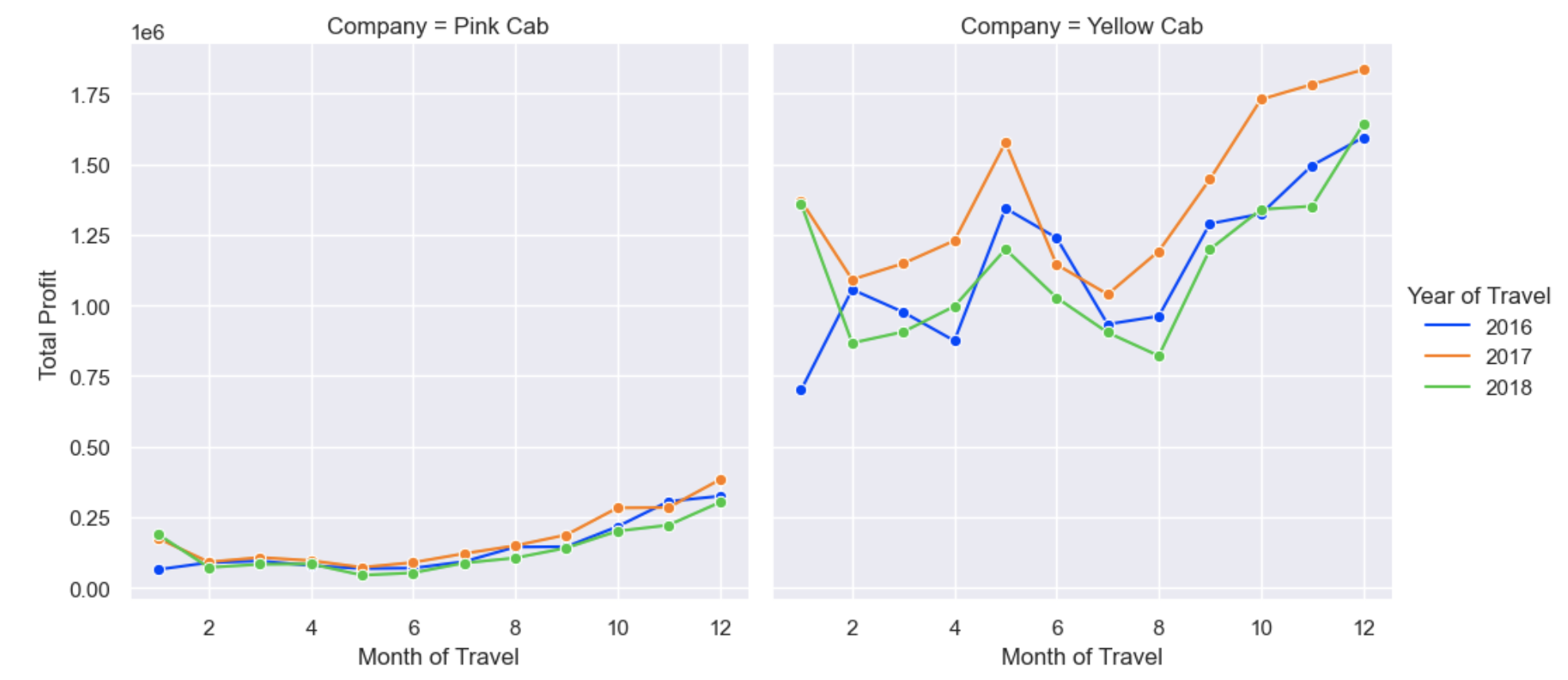

There is a distinct seasonality in the data. In the Yellow Cab company, the seasonality is more pronounced. There is a significant increase in profit from September to January and in May. Conversely, there is a decrease in profit from February to April and in June - July. In the Pink Cab company, there is also a noticeable increase in profit, but from July to January.
Additionally, it can be observed that the profit of both companies increased in 2017 compared to 2016, but experienced a sharp decline in 2018.

Slide 4
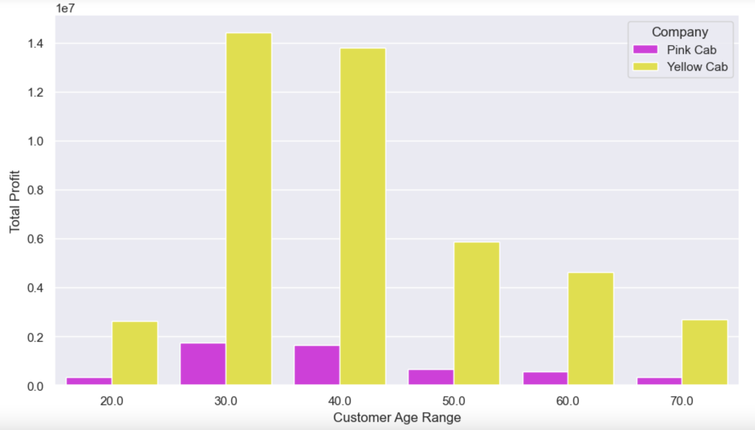
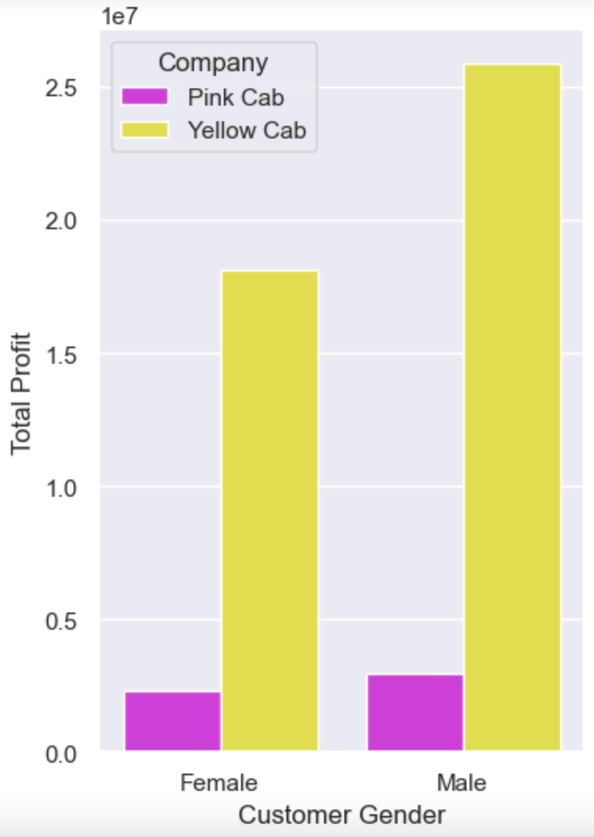
We see that the main customer group consists of people aged 20 to 40. The second, less numerous group is from 40 to 60 years old.
It can also be noticed that men rent cars more frequently.

Slide 5
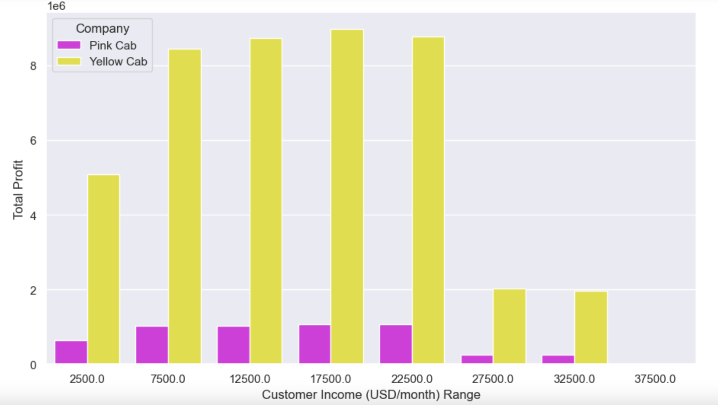
Furthermore, it can be seen that the majority of people renting cars have a monthly income of up to 25,000 USD. There is a sharp decline in profit generated by customers with a monthly income exceeding 25,000 USD.

Slide 6
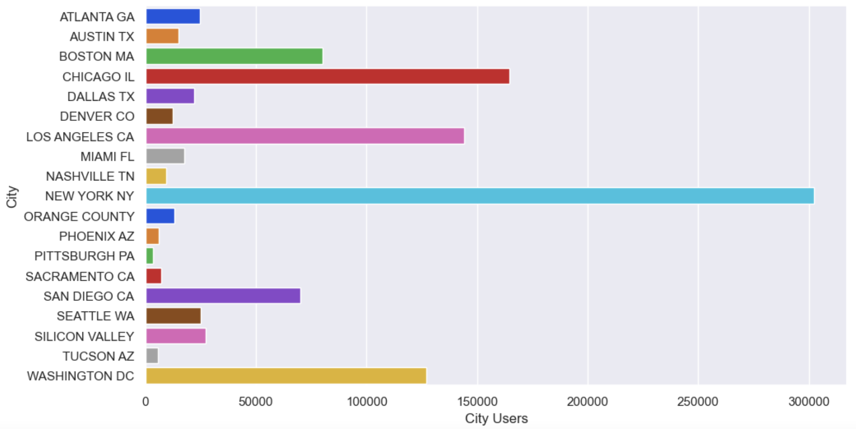
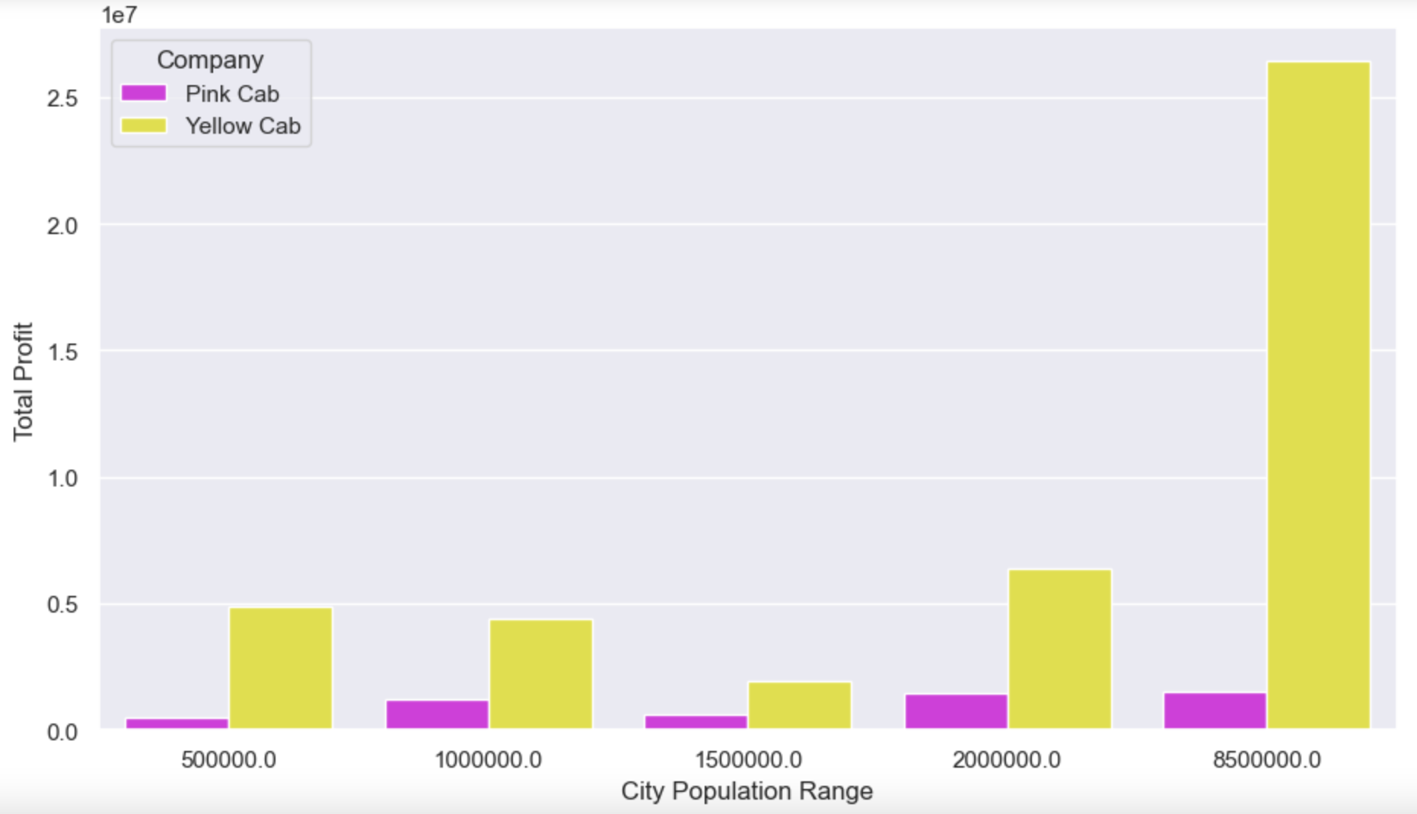
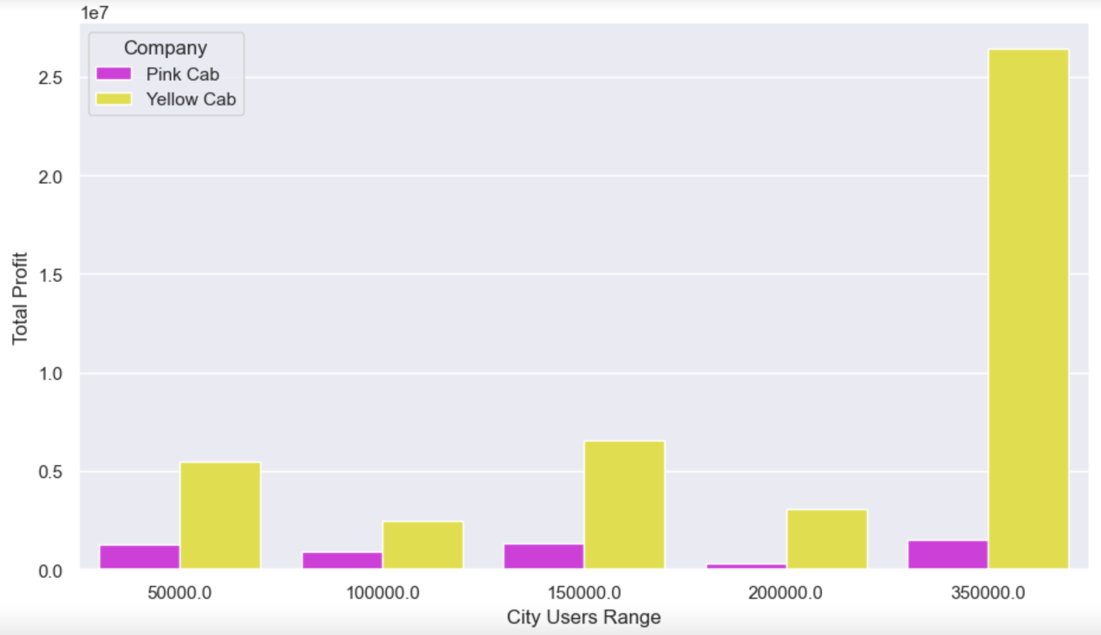
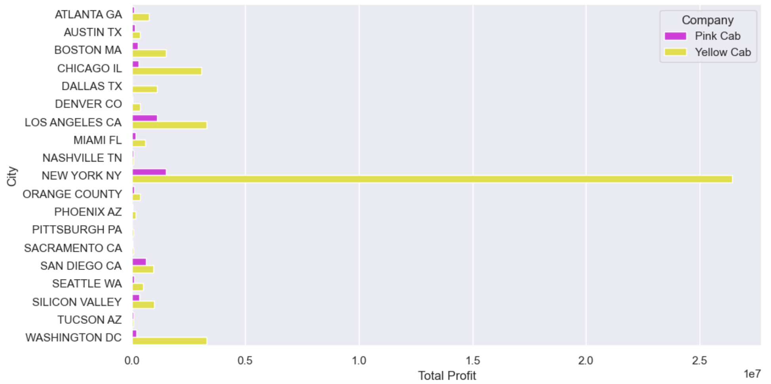
The cities with the highest usage of car rental services are New York, Chicago, Los Angeles, Washington, Boston, and San Diego.
The Yellow Cab company has the highest profit in cities like New York (especially), Los Angeles, Chicago, Washington, and Boston. The Pink Cab company shows the highest profit in New York, Los Angeles, San Diego, Silicon Valley, Chicago, and Boston.
It can be noted that in California, the Pink Cab company is catching up with the profitability of the Yellow Cab company.

Slide 7
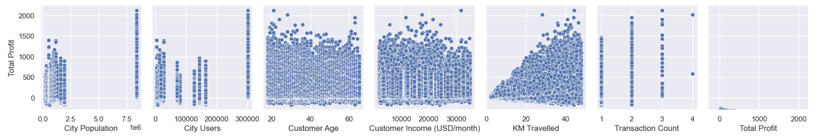
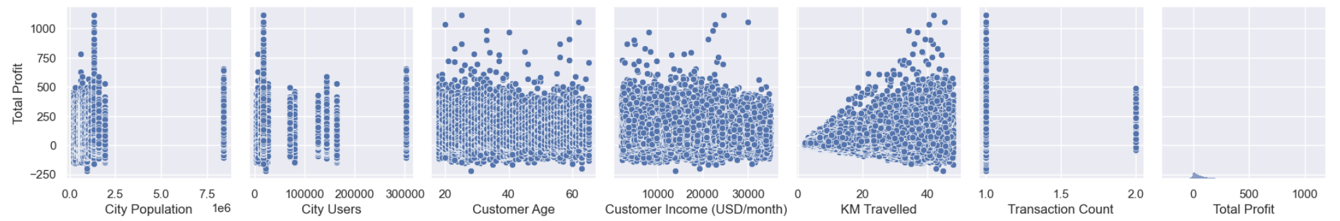
Total Profit correlations (Yellow Cab)
Total Profit correlations (Pink Cab)
It can be observed that there is a clear correlation between profit and the number of kilometers driven.
Additionally, New York City stands out in terms of profit.

