Slide 1







IBM Data Analyst Capstone Project The 2019 Stack Overflow Developer Survey Results
Anastasiia Trofymova
1/11/2025

Slide 2



OUTLINE
Executive Summary
Introduction
Methodology
Results
Visualization – Charts
Dashboard
Discussion
Findings & Implications
Conclusion
Appendix

Slide 3

EXECUTIVE SUMMARY
Languages Trends
Current: JavaScript, HTML/CSS, SQL, Bash/Shell/PowerShell.
Future: JavaScript, Python, SQL, TypeScript.
Database Trends
Current: MySQL, Microsoft SQL Server, PostgreSQL, SQLite.
Future: PostgreSQL, MongoDB, Redis, Elasticsearch.
Platforms & Frameworks
Platforms: Linux, Windows, Docker, Kubernetes.
Frameworks: jQuery, Angular, React.js (React.js most desired next year).
Demographics
Gender: 93.5% male.
Age: Mostly 20-30 years.
Education: Bachelor’s degree or higher.
Geography: High respondent concentration in North America and Europe.

Slide 4

INTRODUCTION
The Developer Survey is conducted annually by Stack Overflow to understand trends, technologies, and the developer community’s preferences.
Nearly 90,000 developers participated in the 2019 survey, making it the most comprehensive survey of people who code globally.
The survey focuses on topics such as popular languages, databases, platforms, web frameworks, and developer demographics.
The results aim to guide learning paths, hiring strategies, and technology adoption decisions across the industry.
This presentation highlights key trends in languages, databases, platforms, and frameworks.
Demographic insights, including gender, age, education, and geographical distribution, are also analyzed.

Slide 5

METHODOLOGY
Data collected from nearly 90,000 developers worldwide through a structured survey.
Survey questions focused on various topics, including languages, databases, platforms, and frameworks used by developers.
Demographic data such as gender, age, education level, and geographical distribution were also captured.
The responses were analyzed to identify current trends and future preferences in the developer community.
Quantitative analysis was conducted to determine the most popular and desired technologies.
Data visualization techniques were used to represent key findings clearly and effectively.

Slide 6
RESULTS
Languages:
JavaScript, HTML/CSS, and SQL are the most widely used languages.
JavaScript and Python are the most desired languages for next year.
Databases:
MySQL and PostgreSQL are the most popular databases.
PostgreSQL is the most desired database for the future, followed by MongoDB and Redis.
Platforms:
Linux, Windows, and Docker are the most commonly used platforms.
Docker and Kubernetes are highly desired for future use.
Frameworks:
jQuery, Angular, and React.js dominate the current landscape.
React.js is the most desired framework for next year.
Demographics:
Majority of respondents are male (93.5%).
Most respondents are between 20-30 years old.
Geography:
The highest concentration of respondents is in North America and Europe.

Slide 7
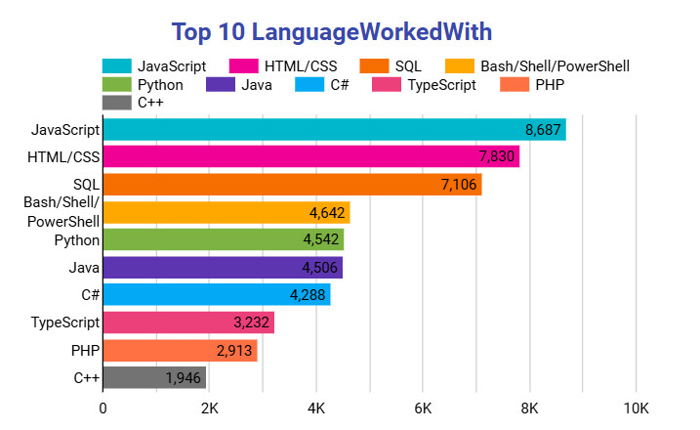
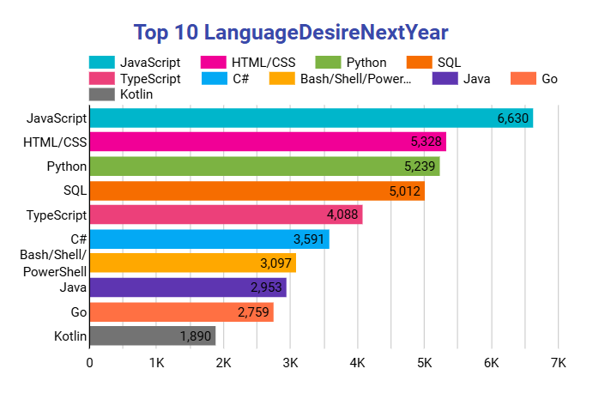
PROGRAMMING LANGUAGE TRENDS
Current Year
Next Year

Slide 8
PROGRAMMING LANGUAGE TRENDS - FINDINGS & IMPLICATIONS
JavaScript remains the most widely used programming language.
Python shows strong growth and demand, surpassing Java in popularity.
SQL maintains its importance for database interaction across industries.
Developers should prioritize learning JavaScript and its frameworks for web development roles.
Python’s popularity highlights the growing need for skills in data science, AI, and automation.
SQL’s continued relevance emphasizes the importance of database management and querying skills in software development.

Slide 9
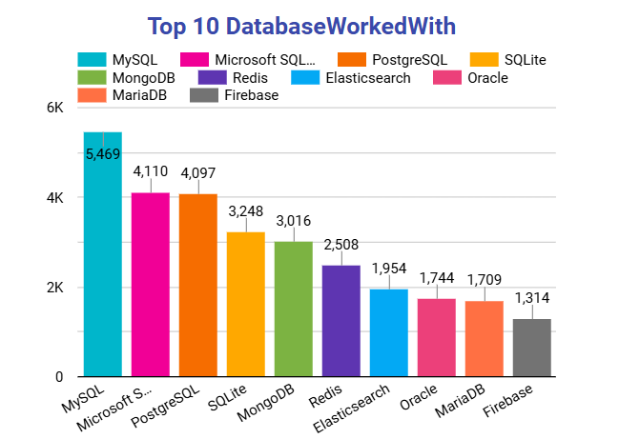
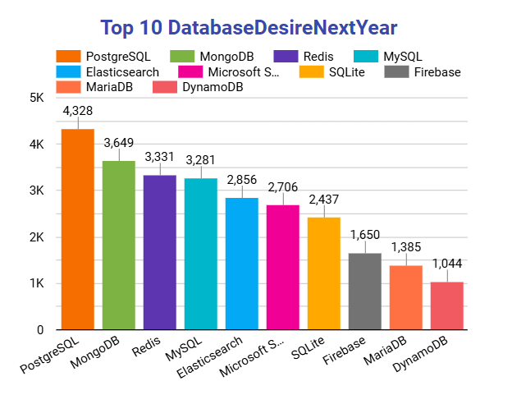
DATABASE TRENDS
Current Year
Next Year

Slide 10
DATABASE TRENDS - FINDINGS & IMPLICATIONS
MySQL, PostgreSQL, and Microsoft SQL Server are the most widely used databases.
PostgreSQL is the most desired database for future use.
NoSQL databases like MongoDB and Redis show significant growth in popularity.
Knowledge of relational databases, especially MySQL and PostgreSQL, remains essential for backend development.
The increasing demand for PostgreSQL highlights the importance of learning advanced features of this database.
The rise of NoSQL databases emphasizes the need for developers to gain expertise in flexible, schema-less database systems.

Slide 11

DASHBOARD
https://github.com/Arsiry/ibm-professional-certificates/blob/main/data_analyst_capstone_project/IBM_Data_Analyst_Capstone_Project.pdf

Slide 12
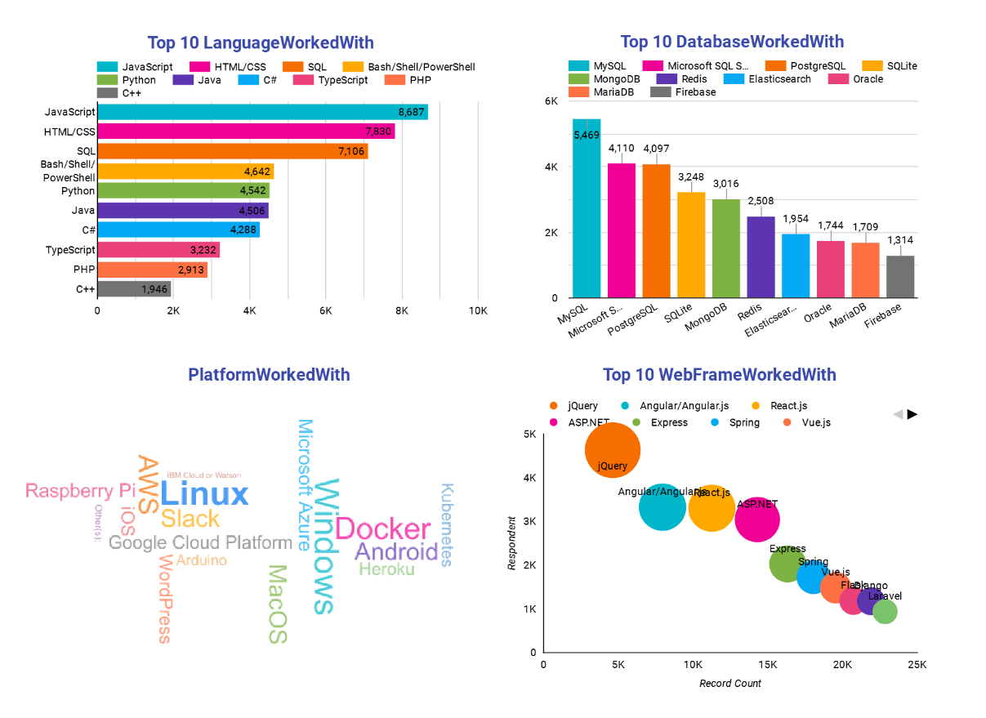
DASHBOARD TAB 1

Slide 13
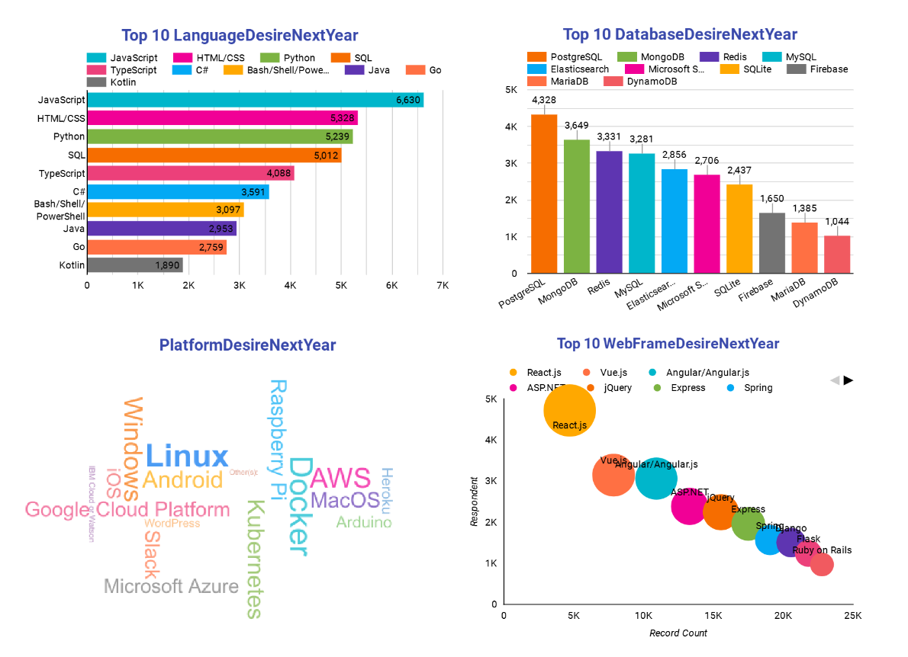
DASHBOARD TAB 2

Slide 14
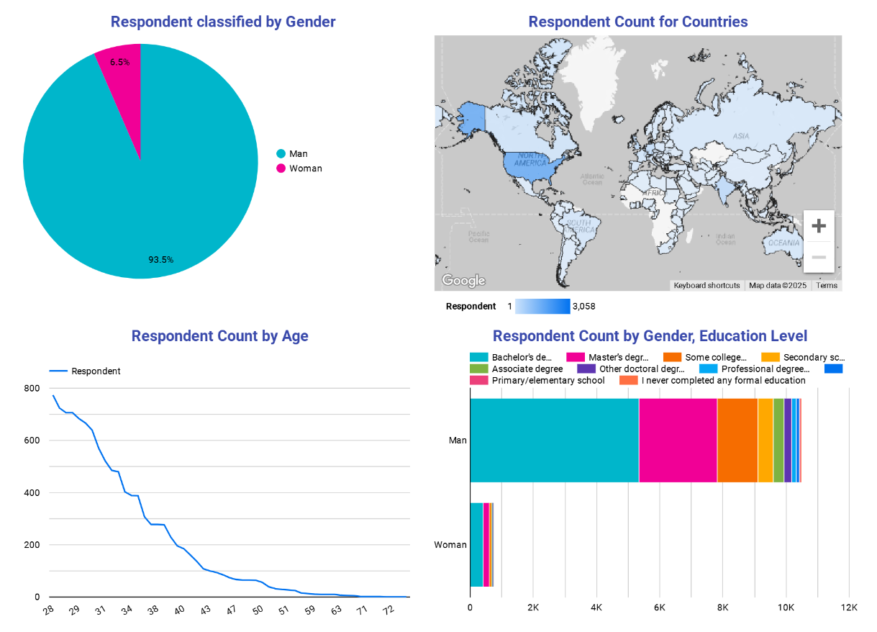
DASHBOARD TAB 3

Slide 15
DISCUSSION

Slide 16
OVERALL FINDINGS & IMPLICATIONS
Developers should focus on mastering JavaScript, Python, and SQL to stay competitive in the job market.
With the growing adoption of PostgreSQL and NoSQL databases, backend developers should gain expertise in both relational and non-relational databases.
Familiarity with cloud platforms, containerization, and orchestration tools such as Docker and Kubernetes is crucial for modern development.
Learning React.js and keeping up with modern web frameworks can enhance employability in front-end roles.
There’s a need to address gender disparity and increase diversity in the developer community.
JavaScript remains the dominant language, with Python and SQL showing high demand and usage.
PostgreSQL, MySQL, and MongoDB are leading databases, with PostgreSQL being the most desired.
Linux, Docker, and Kubernetes are key platforms for developers, reflecting a shift towards cloud-native technologies.
React.js, Angular, and jQuery are the most commonly used web frameworks, with React.js being the most desired for future use.
The majority of developers are aged 20-30, hold a bachelor’s degree or higher, and are predominantly male.

Slide 17

CONCLUSION
The survey results reveal key trends in programming languages, databases, platforms, and frameworks that are shaping the future of software development.
JavaScript, Python, and React.js continue to dominate the development landscape, while PostgreSQL and Docker see increasing demand.
Developers need to stay adaptable by learning emerging technologies, especially in cloud-native and NoSQL solutions.
The analysis also highlights demographic trends, emphasizing the need for more inclusivity and diversity in the developer community.
Continuous learning, along with a focus on both technical and soft skills, is critical for developers to remain competitive in an ever-evolving tech industry.

Slide 18
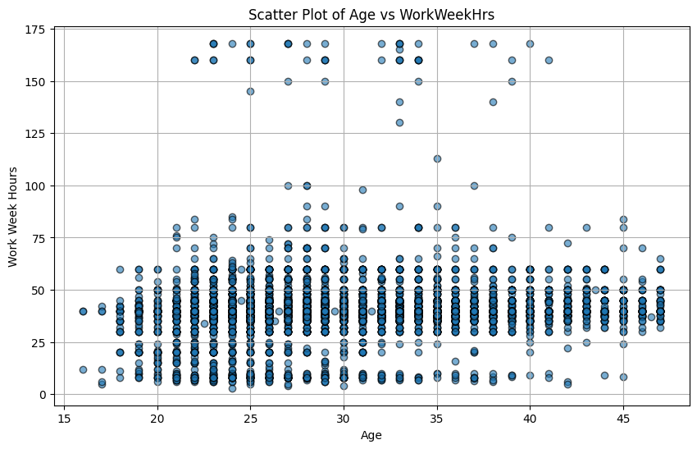

APPENDIX

Slide 19
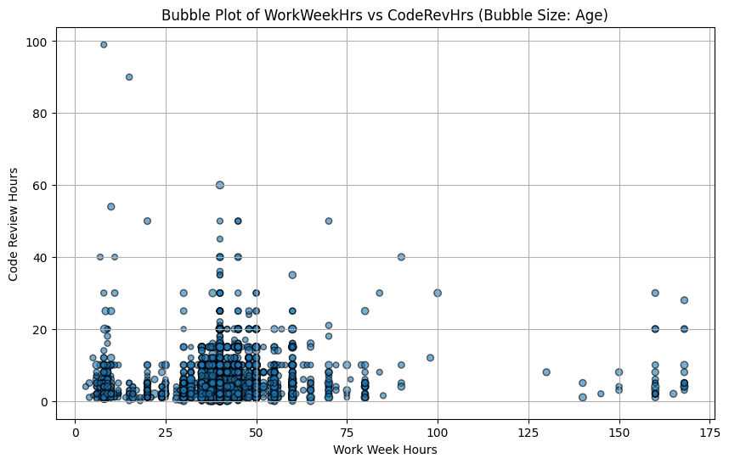
APPENDIX

Slide 20
JOB POSTINGS

Slide 21
POPULAR LANGUAGES

