Slide 1
Foodie
Campaign Report
📅 Generated: 12/25/2025 👤 Client: m.afaqpak@gmail.com ⏱️ Duration: 12/1/2025 - 12/26/2025 🎯 Number of Boards: 2

Slide 2
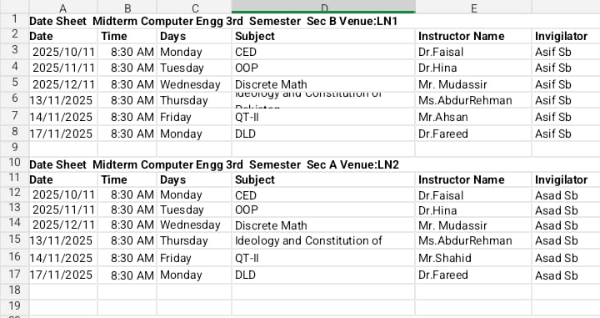
Image Details
Board:
A2 - Taj Bagh
Location:
Multan
Date:
Dec 25, 2025, 10:53 AM
Role:
admin
Image 1 of 2

Slide 3

Image Details
Board:
A1 - Taj Bagh
Qty: 230
Location:
Lahore
Date:
Dec 25, 2025, 10:53 AM
Role:
admin
Image 2 of 2

