Slide 1
CRICKEX
Vi1·at Kohli's shock i·esignatio11 fi·om Test captaincy leaves Indian c1·icket a11d him at c1·oss1·oads
Chelan \arula Janua ry 11th. 2022 9:)1:44 I T
Kohli made the huge announcement on Twitter saying, "I have ahvays believed in giving my 120 percent in everything I do, and if I can't do that, I know it's not the right thing to do. I have absolute clarity in my heart and I cannot be dishonest to my team."

Slide 2
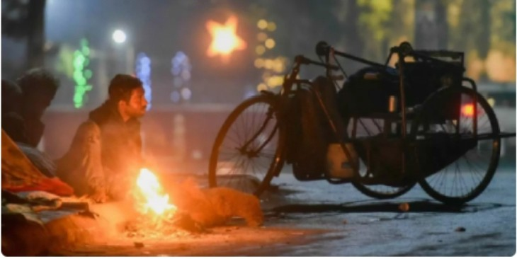
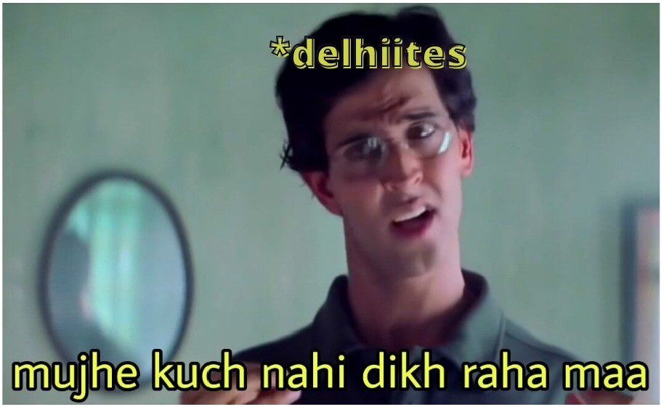
Delhi's air quality 'very poor' w ith AQ Iof 331;
cold day condit ions to continue

Slide 3
ANY BREAKING N EWS EXIST
•••
da\\\}bunt

Slide 4


Slide 5
••••

Slide 6
