Slide 1

Make Intersections Safer
Arslan Sajid

Slide 2
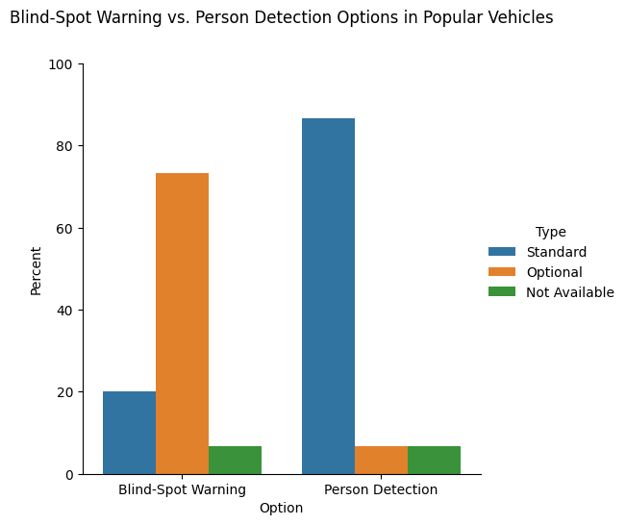
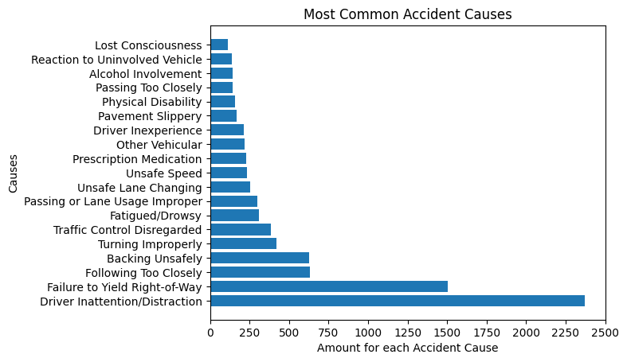
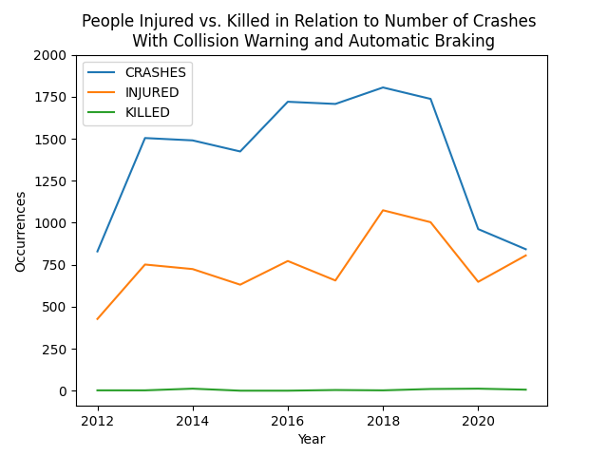
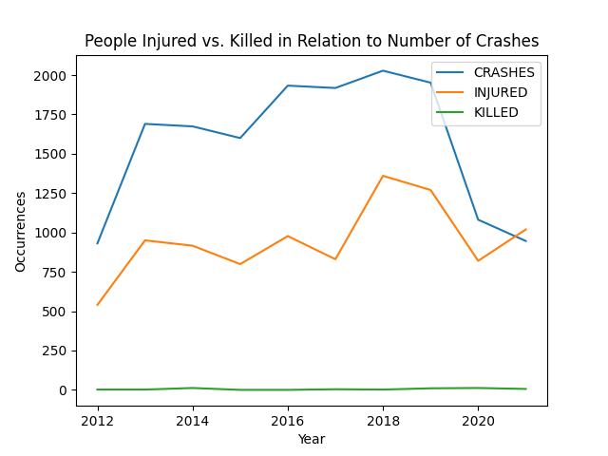
The conclusion that can be drawn here is that there exists cars that do not have very important safety features as a standard. While we don’t know if the cars involved had safety features, many of the primary causes show that there needs to be an improvement in that area where these features can help. The data does show that having some features installed can make a difference in the amount of collisions and those who come away injured.
*to look at the images more closely, click here: https://arslansajid527.wixsite.com/proj39542
]

