Slide 1

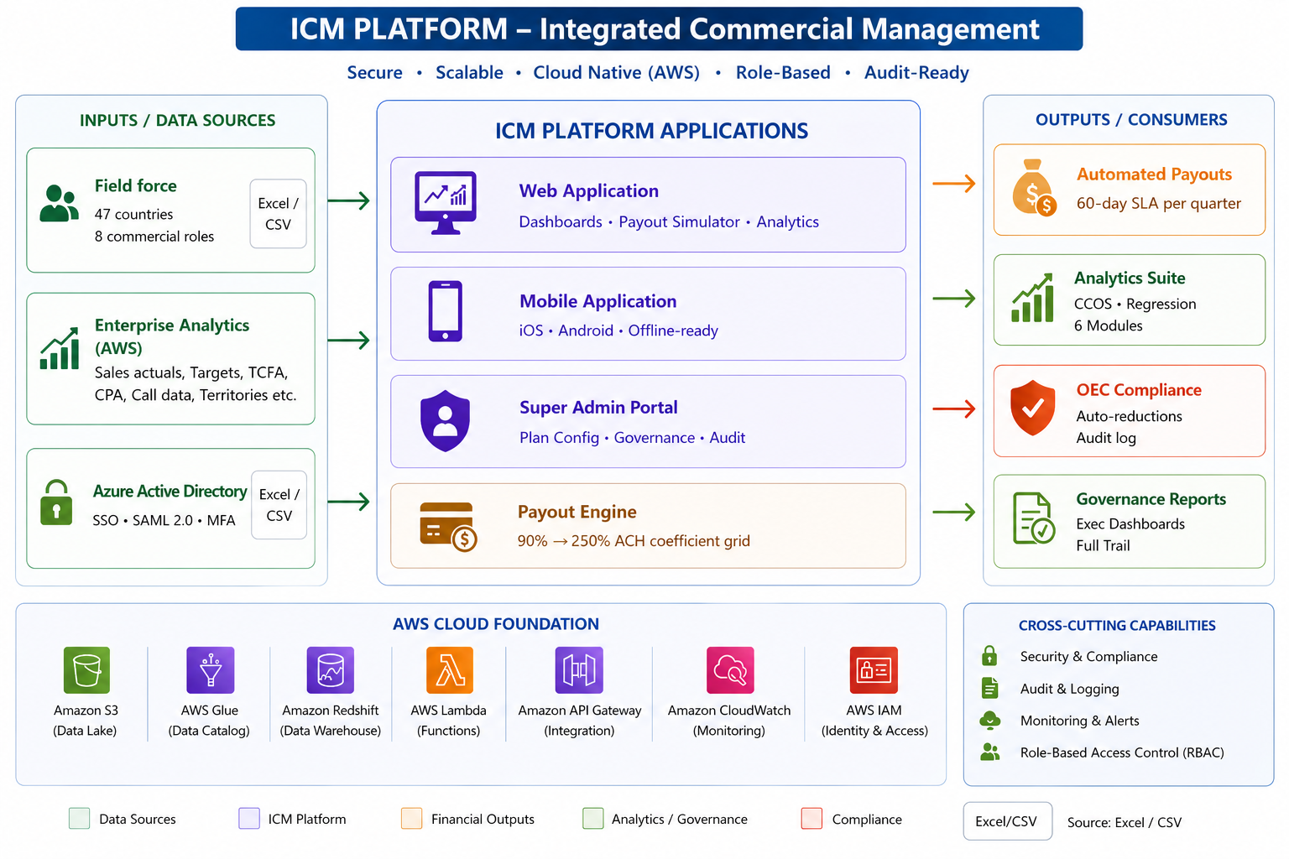
High level Architecture
© 2026 BSS. All Rights Reserved. Proprietary and Confidential.

Slide 2
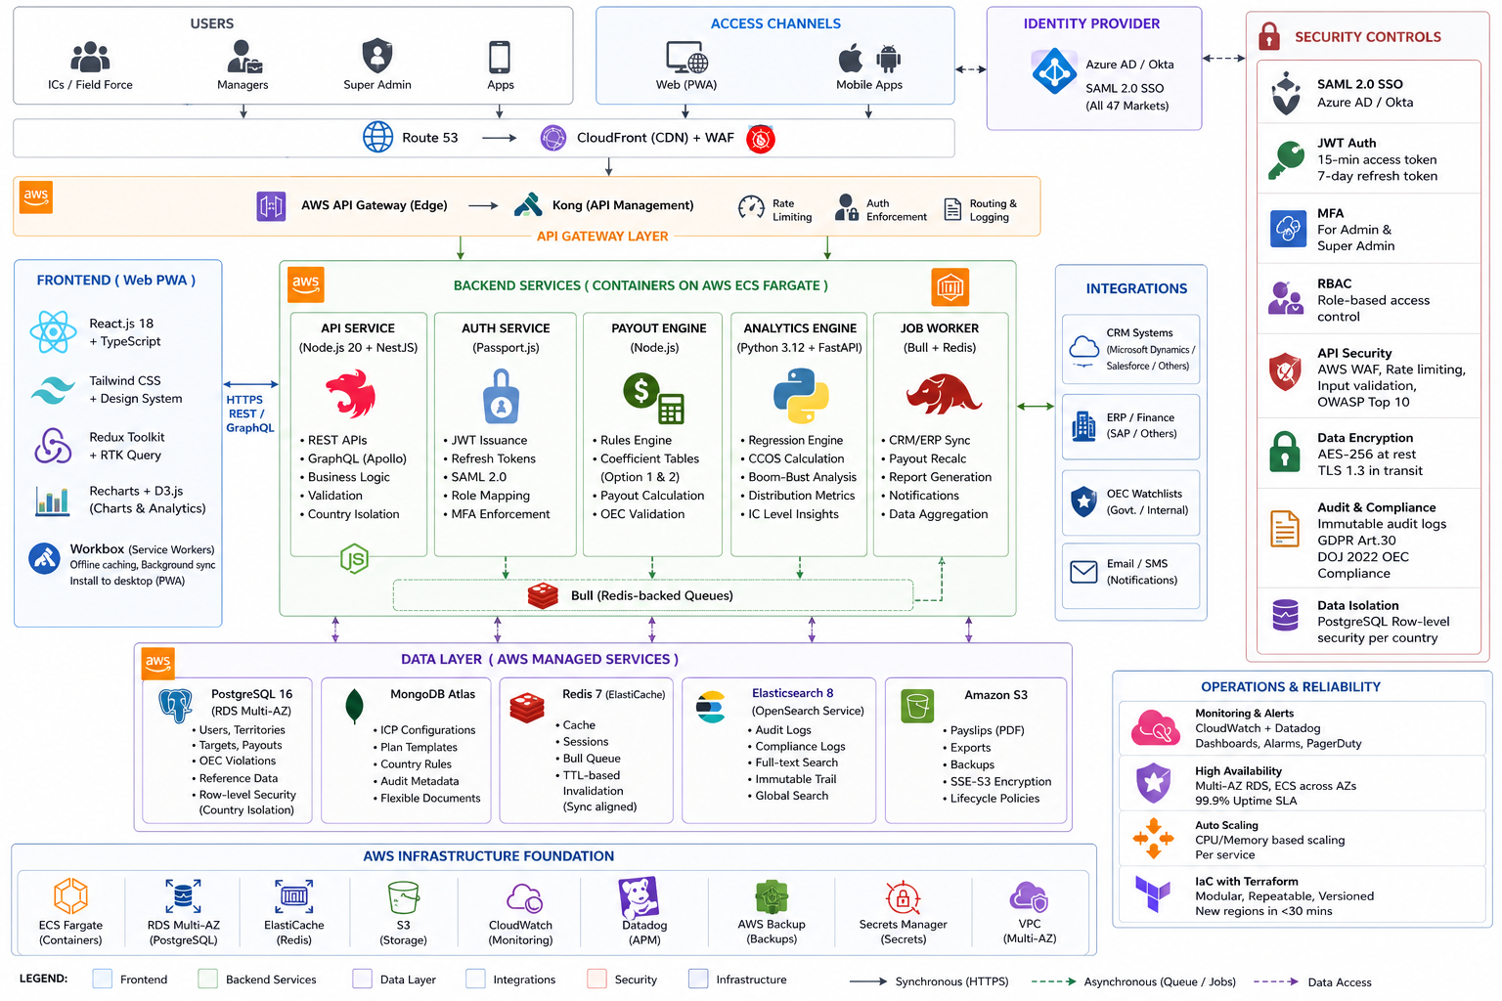
© 2026 BSS. All Rights Reserved. Proprietary and Confidential.

