Slide 1
IC process timelines
 | Jan | Feb | Mar | Apr | May | Jun | Jul | Aug | Sep | Oct | Nov | Dec
Sales quotas and SFE KPIs targets setting & communication (by the beginning of each QRT)
✓
✓
✓
✓
Sales & SFE KPIs performance IC evaluation (by the end of the month following previous QRT)
✓
✓
✓
✓
Incentives payout (within 60 days after previous QRT end or not later than after 30 days from In-Market data for previous QRT became available)
✓
✓
✓
✓
IC analysis communication, Q&A and feedback collection from Sales Force (within last month of each QRT)
✓
✓
✓
✓

Slide 2
Composition analysis – Overview & best practice
What this tells us
Composition analyses will tell you how your sales force is earning their incentive dollars
Pay Composition by Quartile
Measure 3
Measure 2
Measure 1
Average Variable Pay ($)
How to conduct the analysis
Separate incumbents into four quartiles based upon total incentive earnings
Chart the average variable pay by performance measure (by quartile) on y-axis and quartiles on x-axis
Use only incumbents in position for full year within the same position
Analysis can be done (depending on number of incumbents) by various business units and channels
50,000
47,062
40,000
36,703
12,072
35,388
32,221
8,604
30,000
7,986
25,596
6,888
12,305
4,394
6,106
7,770
7,452
20,000
3,633
10,000
19,227
20,329
22,685
19,950
17,569
0
4th
Quartile
3rd
Quartile
2nd
Quartile
1st
Quartile
Target incentive

Slide 3
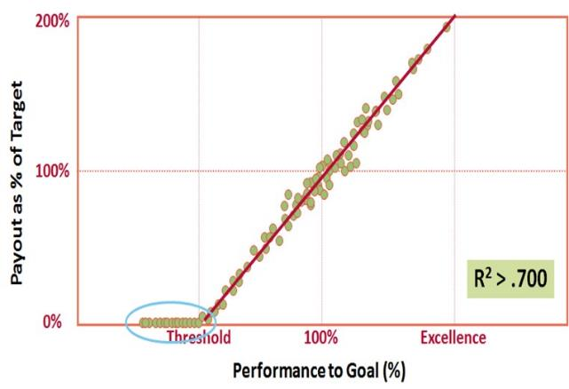
Regression analysis – Overview & best practice
What this tells us
Regression analysis provides an indication of how tightly correlated incentive pay is to performance
It also illustrates if individuals are being paid “outside of the plan parameters”
How to conduct the analysis
Chart results (performance to target for bonus plans; revenues for commission plans) against incentive payments.
This should be completed by position and for every performance measure
Points should be cluster in a linear fashion (like above); any data points that are “off the line” should be investigated

Slide 4
Performance distribution
What this tells us
Performance Distribution provides you with insight into your target setting accuracy
Is the performance distribution bell shaped?
How wide is the performance distribution?
Cumulative (%)
Frequency
Number of Salespeople
Percent of Sales force
How to conduct the analysis
Chart number of individuals within performance to target ranges
Analysis should initially be done by position
Note where the 90th percentile ranks and note the % of people at or above 100% of target
95%
100%
105%
110%
115%
120%
125%
130%
More
Quota Performance
90th percentile 140%
65% meet or exceed quota
N=140

Slide 5
Performance distribution – Best practice
30-40% of sales force
60-70% of sales force
Number of incumbents
Bottom10% of sellers
Top 10% of sellers
Threshold
Target
Max/excellence
Minimum acceptable level of achievement
Expected performance
Stretch to achieve, not a walk-over
Peak performance; may continue or cap

Slide 6
Performance distribution – Common issues
Skewed Below
Quota
Quotas may be too high so individuals may not be earning competitive pay levels
May look like sales compensation plan is not competitive
Need to reassess if business plans are realistic
75%
100%
125%
Skewed Above Quota
Quotas may be too low
Quotas may be too low or double crediting of sales-may need to examine quota or crediting practices
May look like sales compensation plan is too rich
75%
100%
125%
Bi-Modal
May have employees performing 2 different jobs
Need to reexamine quota allocation process
Most common in new organizations where quota setting is still be refined
Boom Bust or Performance Penalty
75%
100%
125%

Slide 7
IC execution and analysis Performance Distribution – Example 1
(ACH Frequency)
Majority of team falls in category of earning that indicates proper IC placement & target setting.
120
2018
2019
100
80
However, graph is preferred to be a bit skewed right indicating more of excellent achievement driving higher overall affiliate achievement
60
40
20
No key changes are recommended
0
-20
<70
70-80
80-90
90-100
100-110
110-120
>120

Slide 8
IC execution and analysis Performance Distribution – Example 2
(ACH Frequency)
Both 2018 & 2019 graphs indicates major issues in quota distribution with team members either missing plan (2018) or overachieving it (2019)
12
2018
2019
10
8
6
Employee may be performing to different jobs and there is a need to reexamine quota allocation process
4
2
0
-2
<70
70-80
80-90
90-100
100-110
110-120
>120

Slide 9
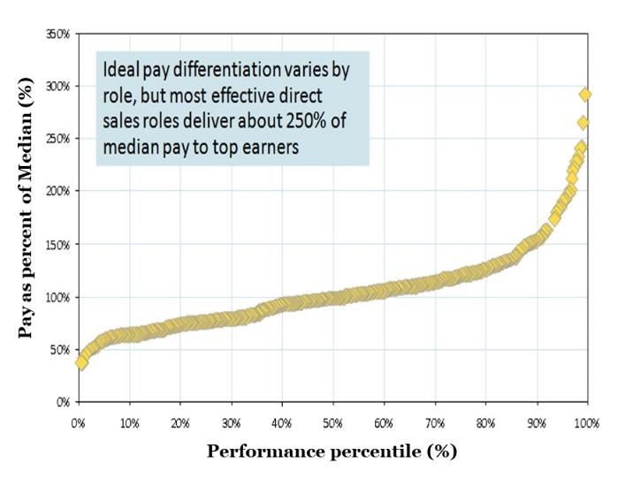
Pay differentiation analysis – Overview & best practice
What this tells us
Pay Differential analysis illustrates the pay differential between the 50th percentile earner (median) and all other percentile earners.
Best practice is for 90th percentile earners to earn 2-3x the median earner
How to conduct the analysis
Chart each incumbent’s incentive earnings as a percent of the median earners
This should be completed by position and on total incentive earned

Slide 10
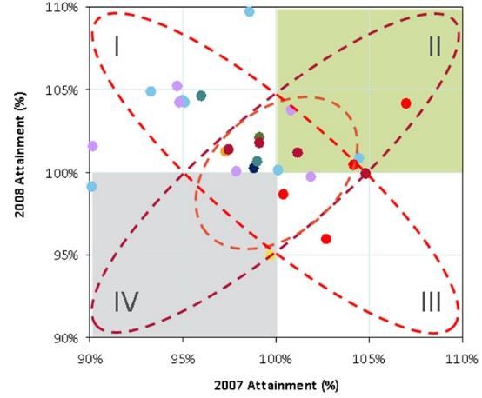
Boom bust analysis – Overview & best practice
What this tells us:
Boom Bust/Consistency analysis illustrates if your incentive plan rewards consistent results year over year (period over period)
Consistent year over year performance will have points in Quadrants II and IV
Year 2 % of Target
How to conduct the analysis
Chart each incumbent's performance (% of goal) in Year 1 versus Year 2
This should be completed by position and each performance measure
Year 1 % of Target
Quadrant
I
Performed below goal in Year 1 and above goal in Year 2
II
Consistently performed above goal in Year 1 and
III
Underperformed in Year 2 compared to Year 1 performance
IV
Consistently underperformed in Year 1 and Year 2

Slide 11
Internal/external equity – Best practice
75th
Client
Market
Med
25th
220,000
200,000
180,000
160,000
Total Cash Compensation ($)
140,000
120,000
100,000
80,000
60,000
40,000
Field Sales Rep
Market - Field Sales Rep
Senior Sales Rep
Market -Senior Slaes Rep
Sales Manager
Market - Sales Manager
As roles go from junior to senior there should be a natural progression in pay

