Slide 1
Logi Tech
Supervisor : Miss Amna Irum
Arslan Ahmed i202444
Muhammad Abdullah i201779
Abdul Wahid Awan i202367

Slide 2
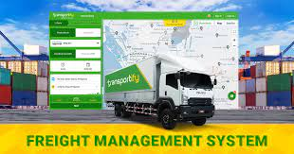
OVERVIEW
A project to help out the transporters and industrialists with their logistic operations.
A web app to make the whole process efficient, improve the coordination between the transporter and the industrialist.

Slide 3
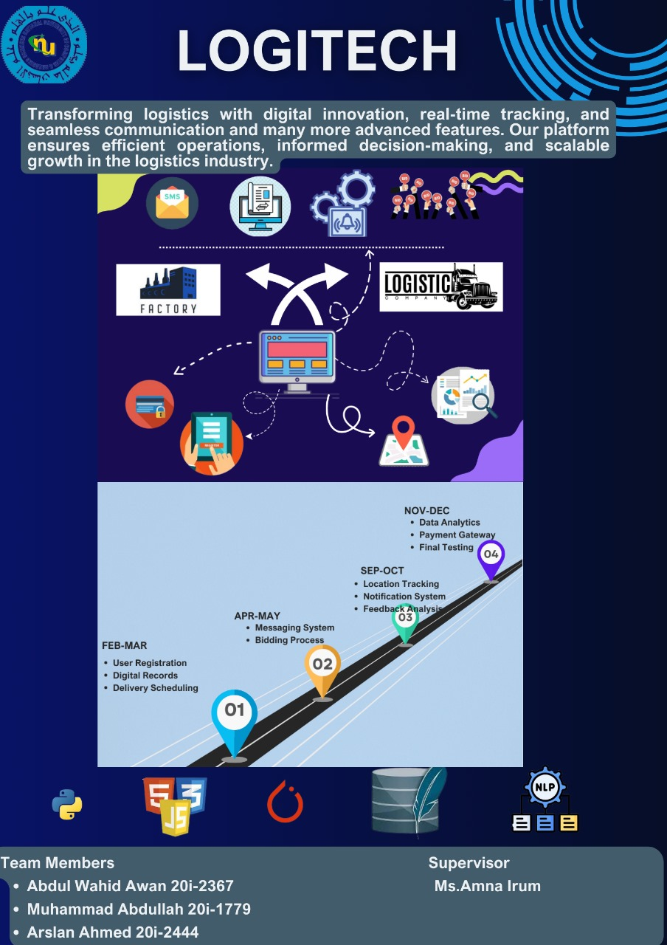
POSTER

Slide 4
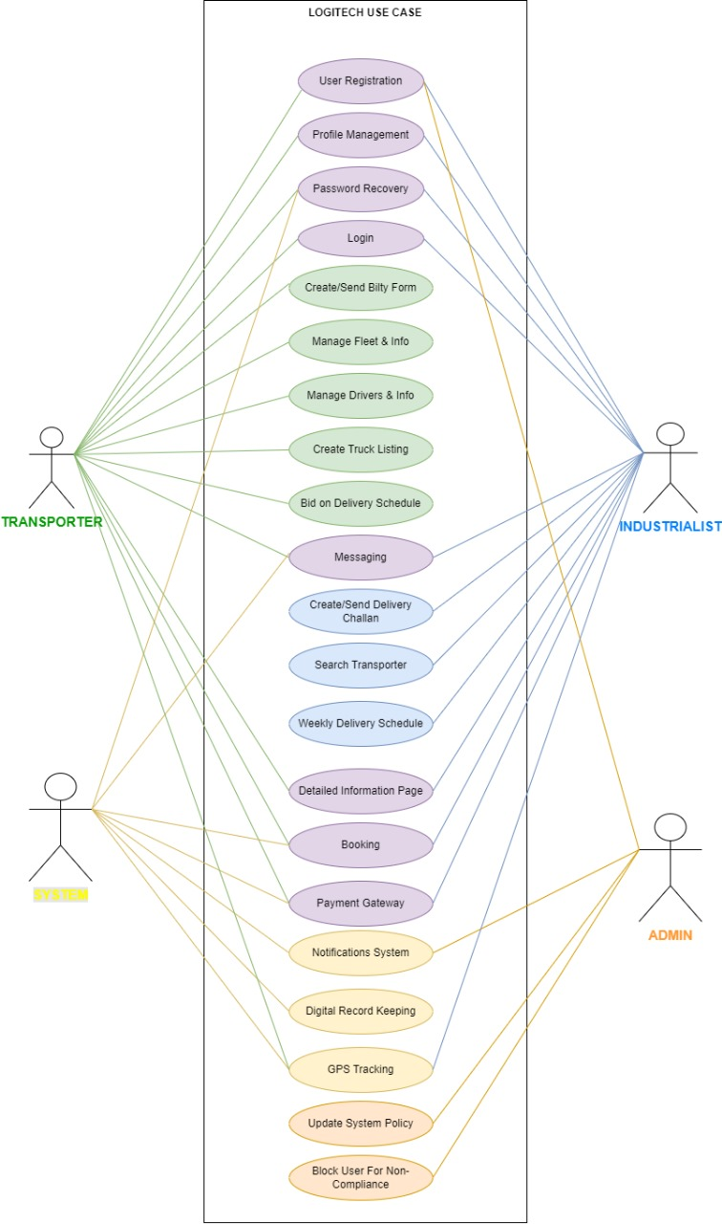
USE CASE DIAGRAM

Slide 5
TIMELINE
01
02
03
04
Iteration 1
Iteration 2
Iteration 3
Iteration 4
Login/Sign Up
+
Digital Record Maintenance
+
Delivery Scheduling
Bidding Algorithm
+
Integrated Messaging System
+
Notifications
Truck Tracking
+
NLP Driven Feedback Analysis
Data Analytics for Business Growth Monitoring
+
Payment Gateway
+
UI/Backend Testing

Slide 6
Iteration 1
Home Page.
Login / Sign Up Pages.
Delivery Scheduling for the Industrialist.
Viewing all scheduled deliveries on the Transporter's end.
Builty form for the Transporter.
Delivery Challan.

Slide 7
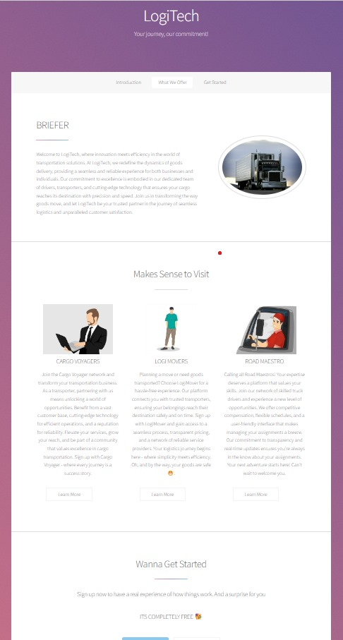
Home Page

Slide 8
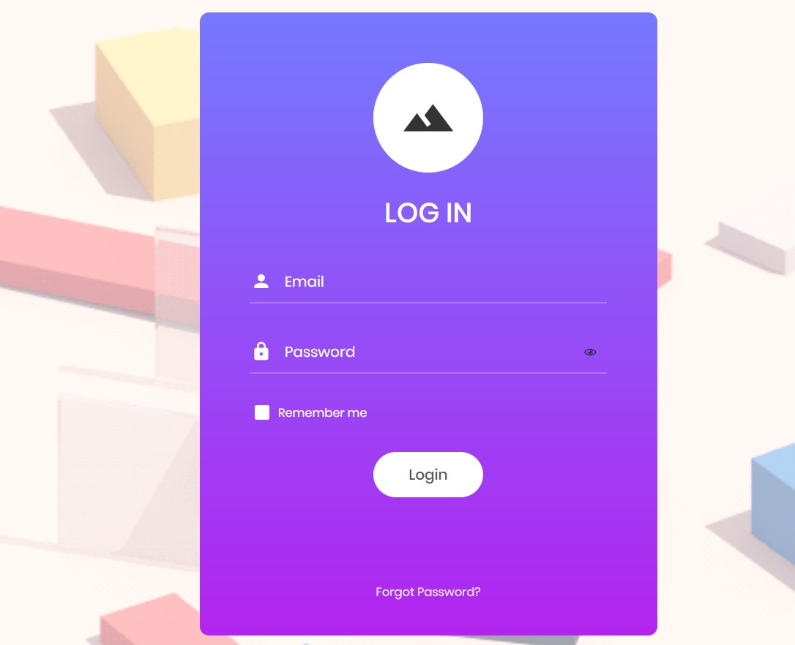
Login Page

Slide 9
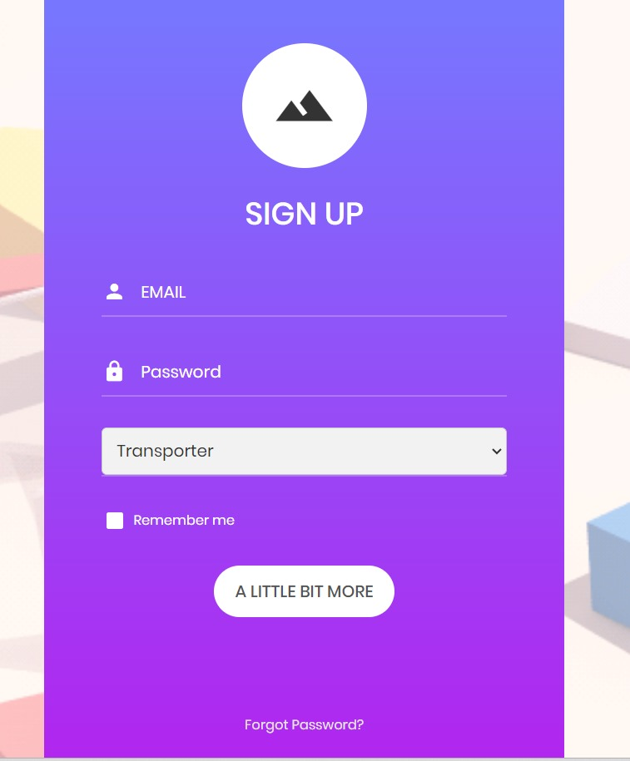
Sign Up Page

Slide 10
Industrialist Page

Slide 11
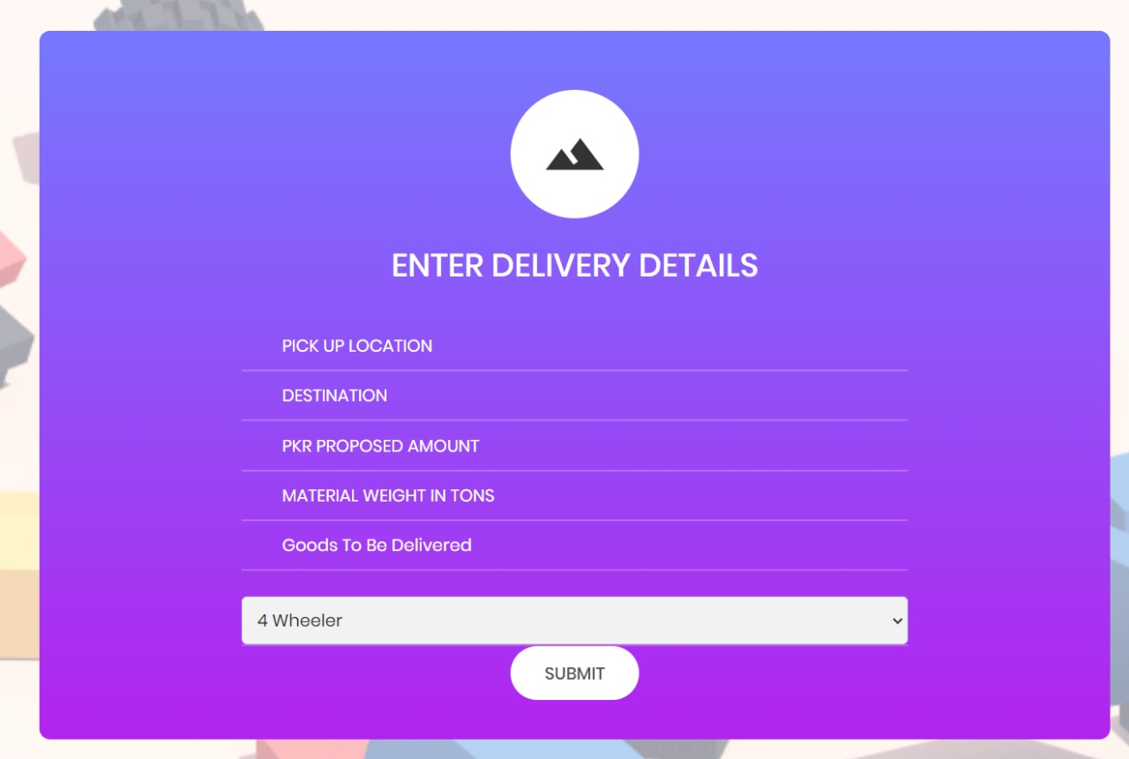
Delivery Scheduling

Slide 12
Transporter Page

Slide 13
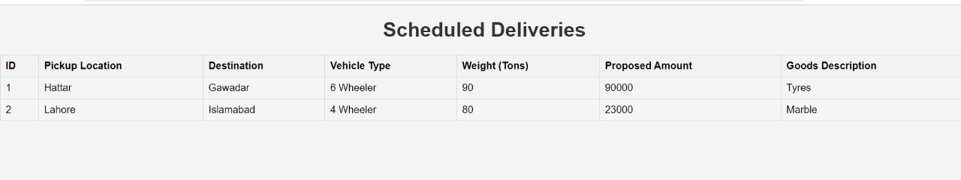
Viewing Scheduled Deliveries

Slide 14
Delivery Challan

Slide 15
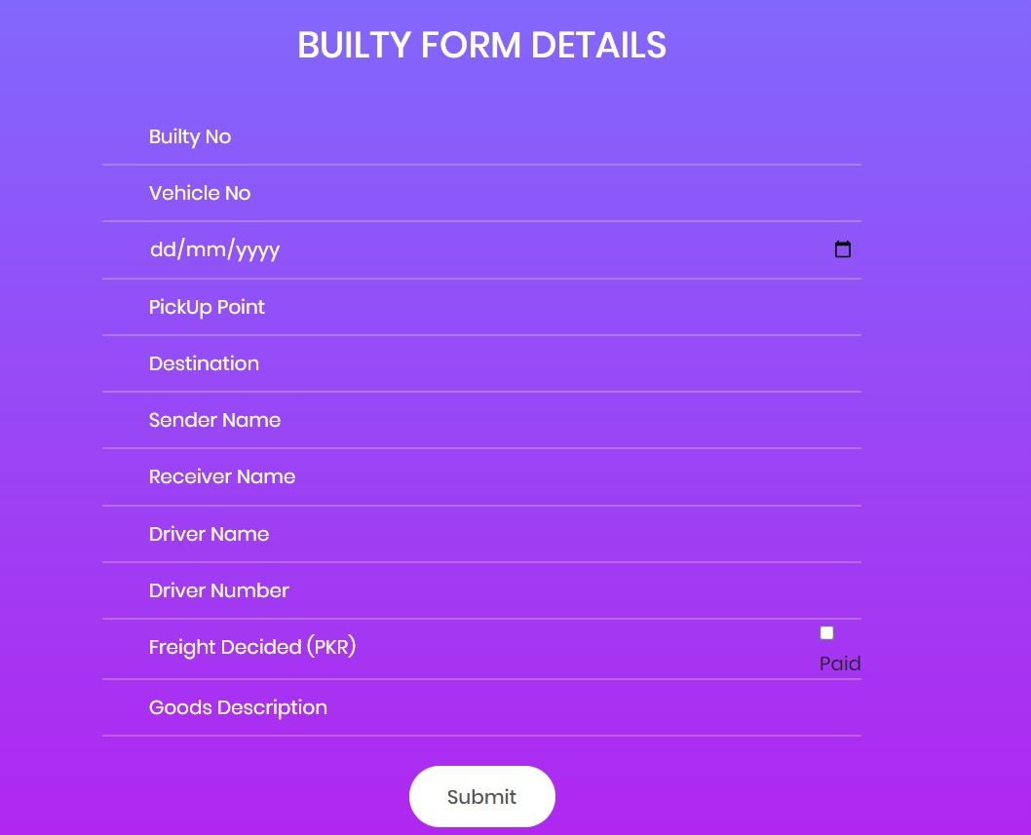
Builty Form

Slide 16
Arslan Ahmed | Abdul Wahid Awan | Muhammad Abdullah
Record Maintenance
Weekly Delivery Scheduling
Bidding System
Location Access Integration
Notification
Messaging System
NLP Feedback Analysis
Business Analytics
Interface Design

Slide 17
Thank You

