Slide 1
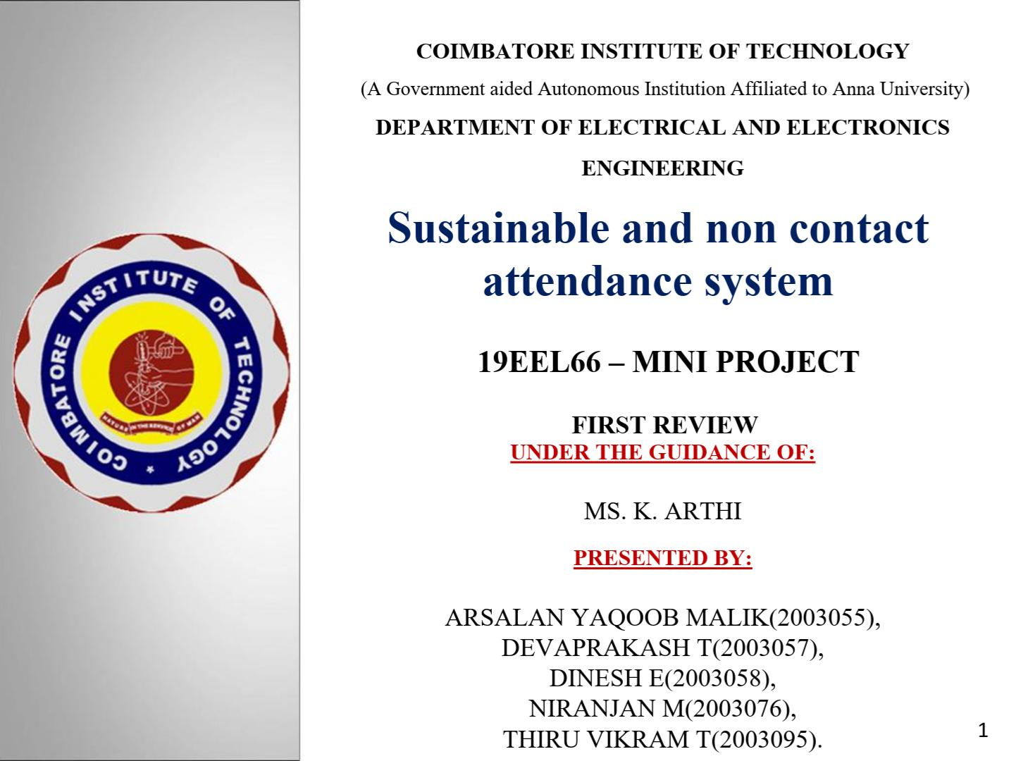

Slide 2
OBJECTIVE
Sustainable and No Contact Attendance system
To design a contactless attendance system which automatically records the entry of the students along with the time of entry using facial recognition.
To design a secure and reliable attendance system that helps to eliminate proxies and malpractices.
To design a sustainable, secure and power efficient smart system for recording student’s and teacher’s attendance.
3

Slide 3
NEED FOR THE PROJECT
Due to the COVID-19 pandemic, it is a safety precaution not to touch anything, necessitating the use of a contactless device.
To avoid time consumption and work load in the existing attendance system , we need a contactless device.
Therefore in order to be sustainable, a secure system can be
used to mark the attendance of students and teachers in a
touchless and paperless manner.

Slide 4
LITERATURE SURVEY
S.NO | TITLE | MODEL / TECHNIQUES USED | MERITS/ DEMERITS | OUTCOMES
1 | Saibal Manna,Sushil Ghildiya,kishnakumar Bhimani “Face recognition system using deep learning”IEEE ACCESS | Deep Architecture Embedding and triplet loss | Merit It performances better in character recognition when compared to each other Demerit The system shows lesser efficiency | The facial recognition part has been tested and it has acquired steady outcomes with 90% accuracy

Slide 5
LITERATURE SURVEY
S.NO | TITLE | MODEL / TECHNIQUES USED | MERITS/ DEMERITS | OUTCOMES
2. | Busra Kocaciar,Bilal Tas,Fatma Patlar Akbulut,Cagatay Catal,deepti Mishra“A real time CNN based lightweight mobile masked face recognition system” IEEE ACCESS,2022. | Image Segmentation Image Pre-processing Feature Extraction Classification | Merit The system shows good accuracy. This system assures a new direction towards a precise masked face recognition approach without human intervention | The accuracy of the system is 90.4%

Slide 6
INFERENCE FROM LITERATURE SURVEY
This application based on face detection, feature extraction and recognition algorithms, which automatically detects the human face when the person in front of the camera recognizing him.
This system consists of four phases- database creation, face detection, face recognition, attendance updation.
Database is created by the images of the students in class.
The webcam captures the image frames which are then processed using dlib face recognition package and the person is identified.

Slide 7
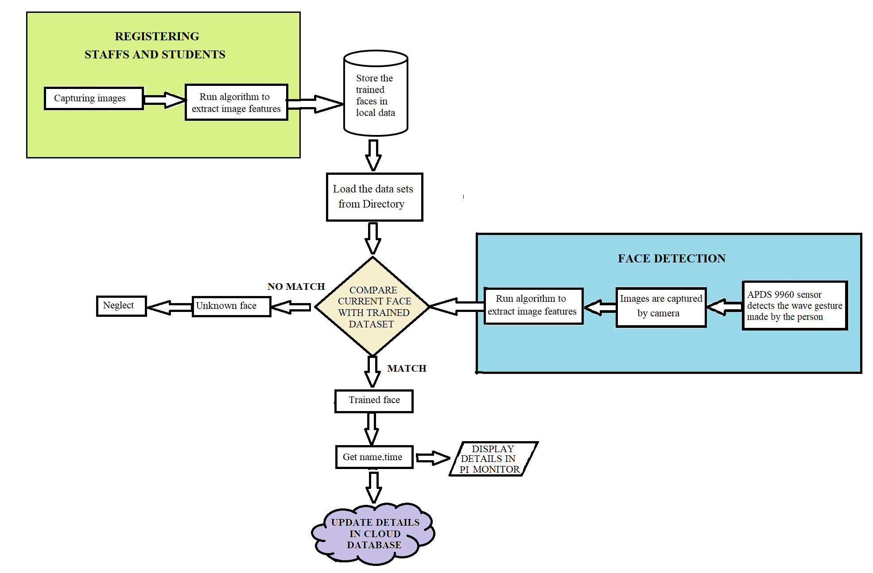
PROPOSED SYSTEM MODEL

Slide 8
HARDWARE/ SOFTWARE TOOL USED
HARDWARE
Raspberry pi 4
APDS 9960
16 X 2 LCD
Raspberry Pi 5mp camera board module
SOFTWARE
Open CV
Thinkspeak
Python 3

Slide 9
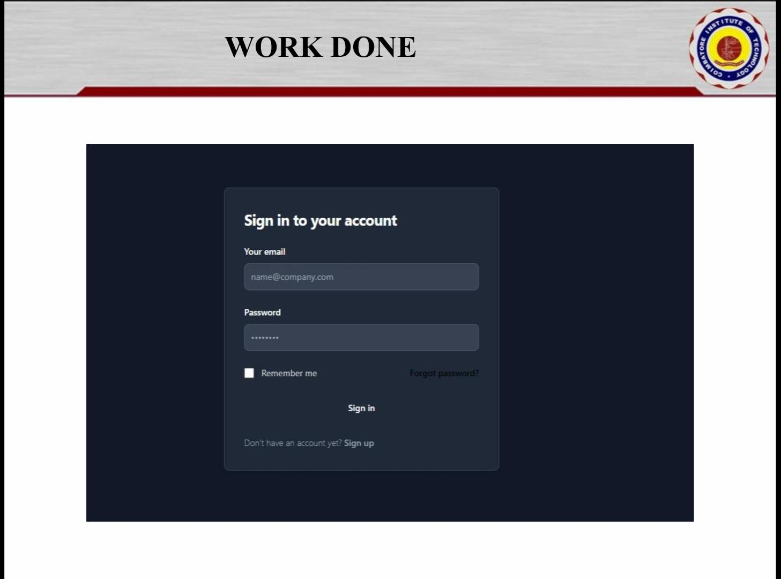

Slide 10
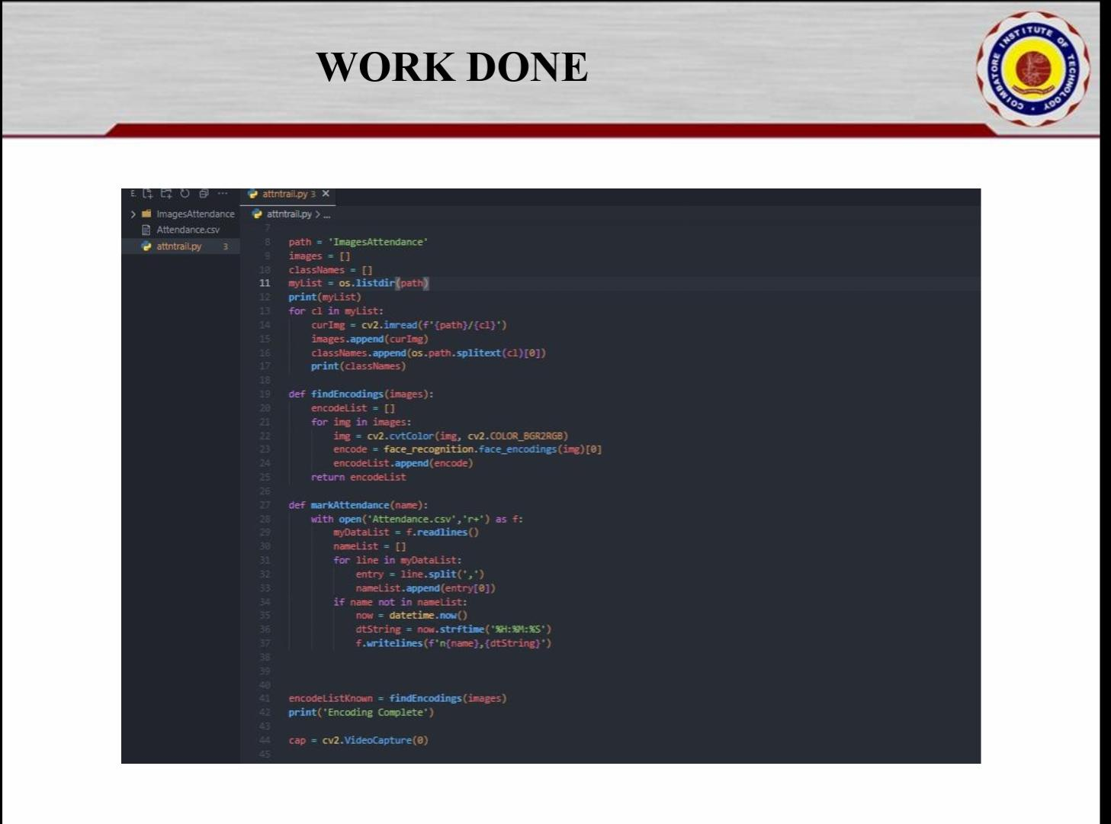

Slide 11
APPLICATIONS
This sustainable and no contact attendance system can be implemented in schools, colleges, work places, etc., by replacing the conventional attendance system.
This system can also replace the already existing advanced attendance systems such as biometrics and implemented in such a way that power consumption is low.
This low power consumption attendance system can be implemented in remote military bases where the energy factor is crucial for surveillance of the camp.
This system can also be applied in work places like Thermal Power Plants, Power Stations, etc

Slide 12
REFERENCES
Deshpande, N. T., & Ravishankar, S. (2017). Face Detection and Recognition using Viola-Jones algorithm and Fusion of PCA and ANN. Advances in Computational Sciences and Technology, 10(5), 1173- 1189
Kavia, M. Manjeet Kaur, (2016). “A Survey paper for Face Recognition Technologies”. International Journal of Scientific and Research Publications, 6(7)
Kasar, M. M., Bhattacharyya, D., & Kim, T. H. (2016). Face recognition using neural network: a review. International Journal of Security and Its Applications, 10(3), 81-100. Mikhaylov, D., Samoylov, A., Minin, P., & Egorov, A. (2014,
November). Face Detection and Tracking from Image and Statistics Gathering. In Signal-Image Technology and Internet-Based Systems (SITIS), 2014 Tenth International Conference and (pp. 37-42).
Liu, Z., & Wang, Y. (2000). Face detection and tracking in video using dynamic programming. In Image Processing, 2000. Proceedings. 2000 International Conference on (Vol. 1, pp.53-56). IEEE.

Slide 13
THANK YOU

