Slide 1
Ball and Beam Fuzzy Controller System
KON426 – Intelligent Control Systems
Prepared by:
Mehmet Ali Arslan – 040170402
Eymen Koşar – 040170452
Oktay Mutlu – 040170439
Eray Aybek – 040170413
Lecturer:
Assoc. Prof. Dr. Gülay Öke Günel
RA : Gökçen Devlet Şen
Spring – 2022

Slide 2
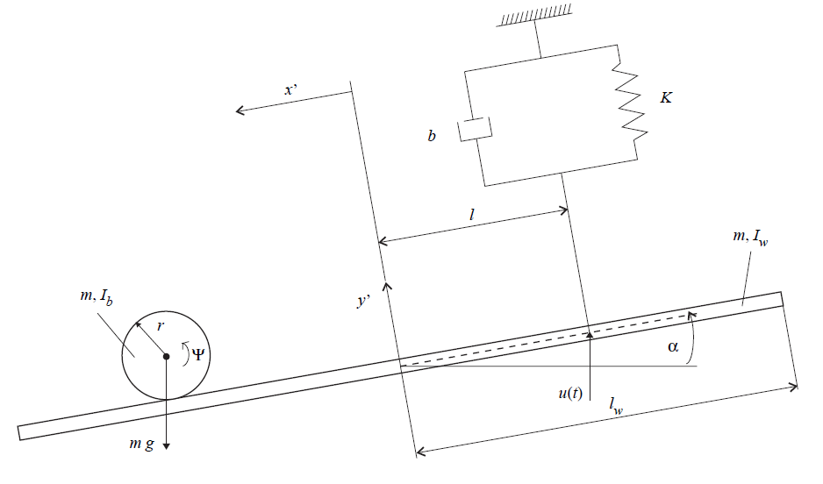
First of all, we need to determine the nonlinear mathematical model of the Ball and Beam System.

Slide 3
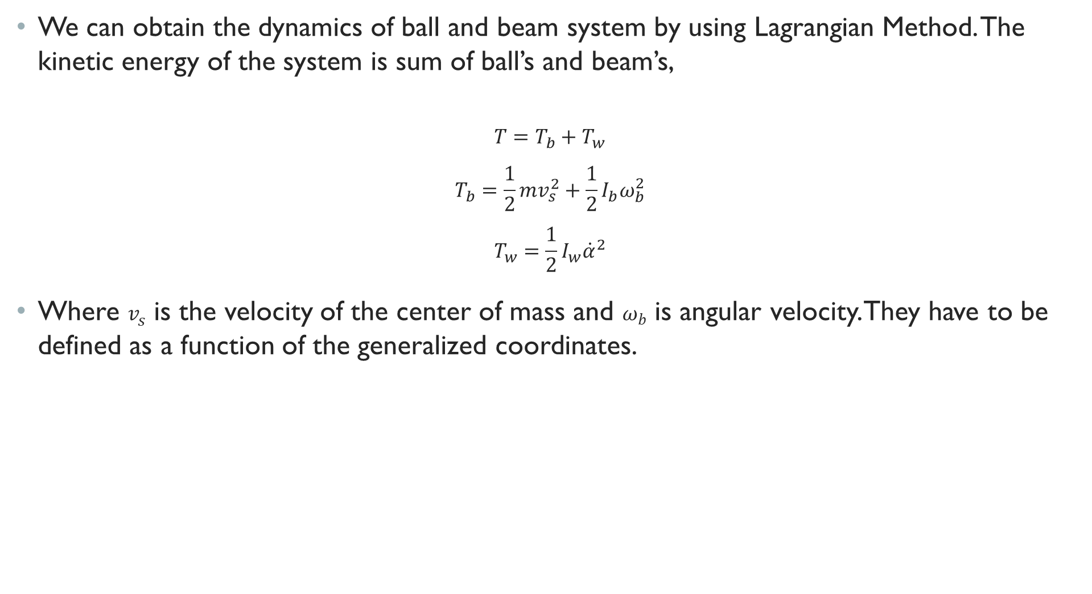
We can obtain the dynamics of ball and beam system by using Lagrangian Method. The kinetic energy of the system is sum of ball’s and beam’s,
$$T=T_{b}+T_{w}$$
$$T_{b}=\frac{1}{2}mv_{s}^{2}+\frac{1}{2}I_{b}ω_{b}^{2}$$
$$T_{w}=\frac{1}{2}I_{w}{\dot{α}}^{2}$$
Where $v_{s}$ is the velocity of the center of mass and $ω_{b}$ is angular velocity. They have to be defined as a function of the generalized coordinates.

Slide 4
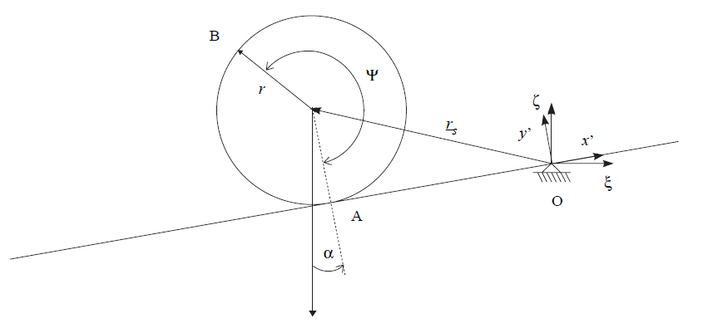
The definition of the position vector of the ball

Slide 5
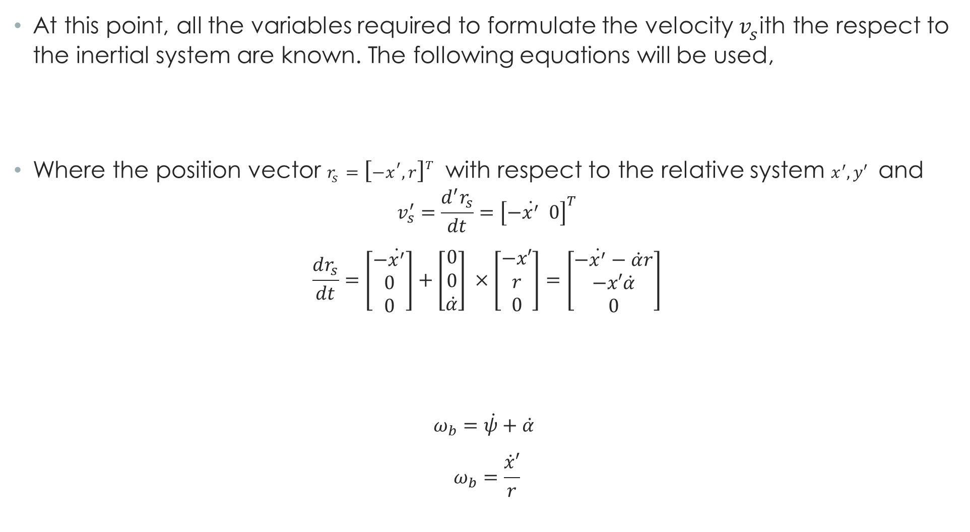

At this point, all the variables required to formulate the velocity $v_{s}$ith the respect to the inertial system are known. The following equations will be used,
Where the position vector $r_{s}={\left[−x^{′}, r\right]}^{T}$ with respect to the relative system $x^{′}, y′$ and
$$v_{s}^{′}=\frac{d^{′}r_{s}}{dt}={\left[−\dot{x^{′}} 0\right]}^{T}$$
$$\frac{dr_{s}}{dt}=\left[\begin{matrix}−\dot{x^{′}} \\ 0 \\ 0\end{matrix}\right]+\left[\begin{matrix}0 \\ 0 \\ \dot{α}\end{matrix}\right] ×\left[\begin{matrix}−x′ \\ r \\ 0\end{matrix}\right]=\left[\begin{matrix}−\dot{x^{′}}−\dot{α}r \\ −x′\dot{α} \\ 0\end{matrix}\right]$$
$ω_{b}=\dot{ψ}+\dot{α}$
$$ω_{b}=\frac{\dot{x}′}{r}$$
$$v_{s}=v_{s}^{′}+ω × r_{s}$$
$$v_{s}^{2}={\dot{x^{′}}}^{2}+2\dot{x′}\dot{α}r+{\left(\dot{α}r\right)}^{2}+{\left(x′\dot{α}\right)}^{2}$$

Slide 6
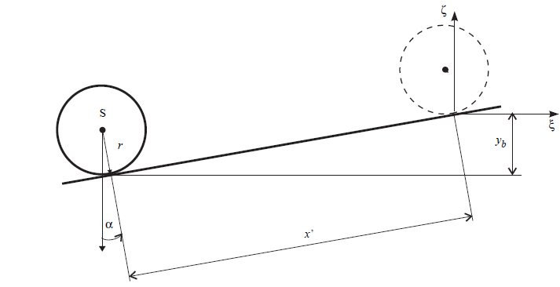

Substituting this on the kinetic energy equation, we get:
$$T=\frac{1}{2}m({\dot{x^{′}}}^{2}+2\dot{x^{′}}\dot{α}r+{\left(\dot{α}r\right)}^{2}+{\left(x^{′\dot{α}}\right)}^{2})+\frac{1}{2}I_{b}{\left(\frac{\dot{x}′}{r}\right)}^{2}+\frac{1}{2}I_{w}{\dot{α}}^{2}$$
At that point, we have to calculate the potential energy of the system.

Slide 7
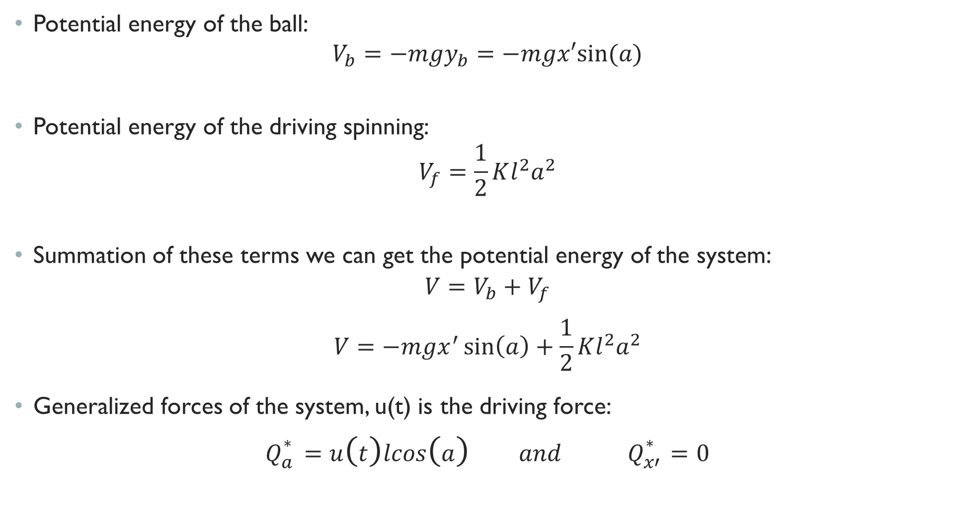
Potential energy of the ball:
$$V_{b}=−mgy_{b}=−mgx′sin⁡(a)$$
Potential energy of the driving spinning:
$$V_{f}=\frac{1}{2}Kl^{2}a^{2}$$
Summation of these terms we can get the potential energy of the system:
$$V=V_{b}+V_{f}$$
$$V=−mgx^{′}\sin\left(a\right)+\frac{1}{2}Kl^{2}a^{2}$$
Generalized forces of the system, u(t) is the driving force:
$$Q_{a}^{∗}=u\left(t\right)lcos\left(a\right) and Q_{x′}^{∗}=0$$

Slide 8

Lagrange is becomes like this:
$$L=T−V$$
$$L=\frac{1}{2}m\left({\dot{x^{′}}}^{2}+2\dot{x^{′}}\dot{α}r+{\left(\dot{α}r\right)}^{2}+{\left(x^{′\dot{α}}\right)}^{2}\right)+\frac{1}{2}I_{b}{\left(\frac{\dot{x}′}{r}\right)}^{2}+\frac{1}{2}I_{w}{\dot{α}}^{2}−(−mgx^{′}\sin\left(a\right)+\frac{1}{2}Kl^{2}a^{2})$$
Lets write the Lagrange rules:
$$\frac{d}{dt}\left[\frac{∂L}{∂\dot{α}}\right]−\frac{∂L}{∂α}=u\left(t\right)lcos\left(a\right)$$
$$\frac{d}{dt}\left[\frac{∂L}{∂\dot{x′}}\right]−\frac{∂L}{∂x′}=0$$

Slide 9

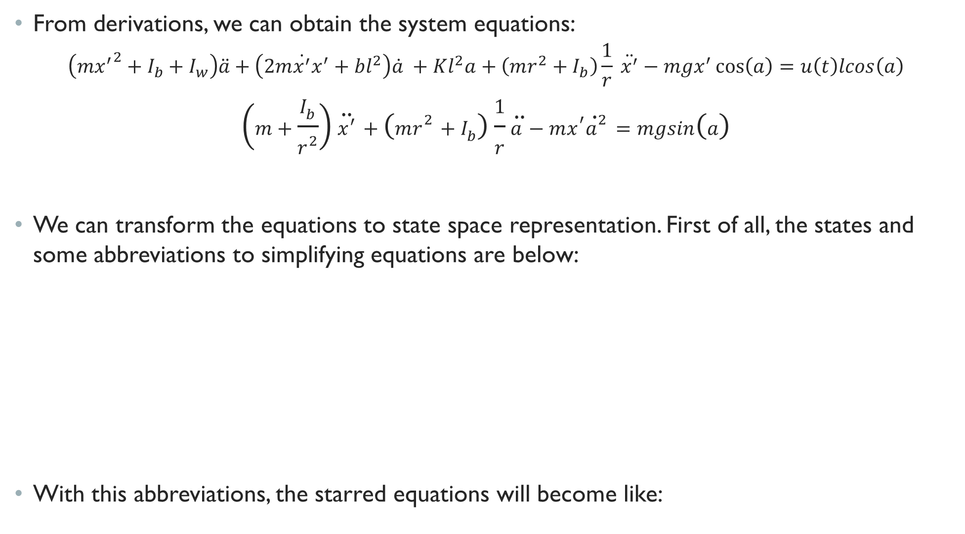

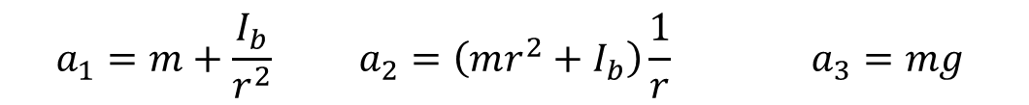
From derivations, we can obtain the system equations:
$$\left(m{x^{′}}^{2}+I_{b}+I_{w}\right)\ddot{a}+\left(2m\dot{x^{′}}x^{′}+bl^{2}\right)\dot{a} +Kl^{2}a+\left(mr^{2}+I_{b}\right)\frac{1}{r} \ddot{x^{′}}−mgx^{′}\cos\left(a\right)=u\left(t\right)lcos\left(a\right)$$
$$\left(m+\frac{I_{b}}{r^{2}}\right)\ddot{x^{′}}+\left(mr^{2}+I_{b}\right)\frac{1}{r}\ddot{a}−mx^{′}{\dot{a}}^{2}=mgsin\left(a\right)$$
We can transform the equations to state space representation. First of all, the states and some abbreviations to simplifying equations are below:
With this abbreviations, the starred equations will become like:
$$x_{1}=x^{′} (Position of the ball)$$
$$x_{2}={\dot{x}}^{′} (Velocity of the ball)$$
$$x_{3}=a (Angle of the beam)$$
$$x_{4}=\dot{a} (Angular velocity of the beam)$$
$$a_{1}=m+\frac{I_{b}}{r^{2}} a_{2}=\left(mr^{2}+I_{b}\right)\frac{1}{r} a_{3}=mg$$
$$b_{1}=I_{b}+I_{w} b_{2}=2m b_{3}=bl^{2}$$
$$b_{4}=Kl^{2} b_{5}=\left(mr^{2}+I_{b}\right)\frac{1}{r} b_{6}=mg$$

Slide 10
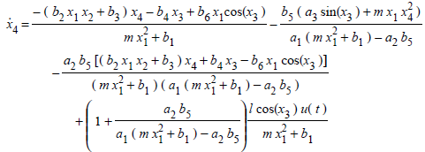

$$\left(m{x^{′}}^{2}+b_{1}\right)\ddot{a}+\left(b_{2}\dot{x^{′}}x^{′}+b_{3}\right)\dot{a} +b_{4}a+b_{5} \ddot{x^{′}}−b_{6}x^{′}\cos\left(a\right)=u\left(t\right)lcos\left(a\right)$$
$$a_{1}\ddot{x^{′}}+a_{2}\ddot{a}−mx^{′{\dot{a}}^{2}}=a_{3}sin⁡(a)$$
Finally, if we solve these equations for our states, we get our states’ derivatives as this:
$$\dot{x_{1}}=x_{2}$$
$$\dot{x_{3}}=x_{4}$$

Slide 11
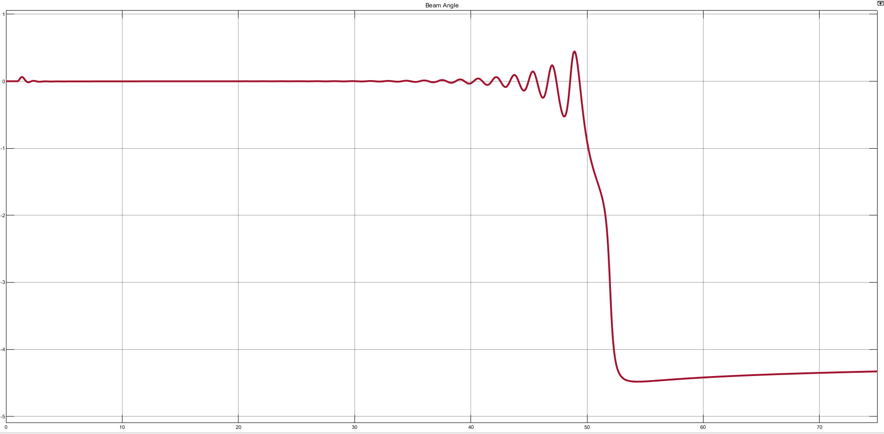
Control Method
Since our objective is controlling the system with fuzzy inference system, firstly we decided to control the system with conventional ways to see its behaviour. When we search ball and beam literature widely its seen that there are excessively state feedback controller used. So for the first step we decided to design state feedback controller for our four stated nonlinear system. We will not give the theory of state feedback controller design technique we used since it is not the aim of this document.
After designing state feedback controller its observed that ball and beam system can handle the input first 40 seconds than it goes unstable.
Beam angle plot for step input

Slide 12
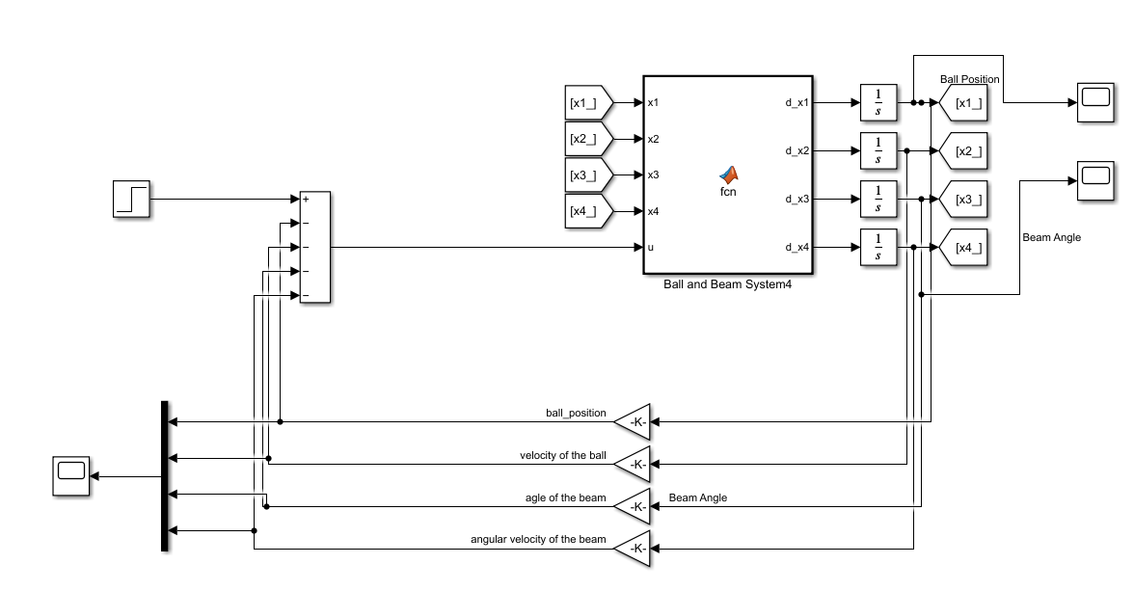
Block diagram for state feedback controller

Slide 13
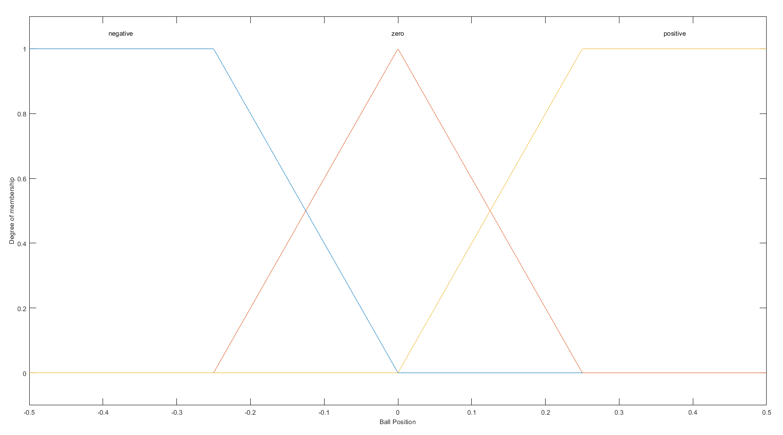
This design gained us a experience that how system behaves while it is stable and how it behaves when it is unstable. It is important to experience that how system is behaving in corresponding circumstaces. Because we will use this gained experience in fuzzy designing.
For fuzzy design we decided design it with two inputs which are ball position and ball velocity. You can see below the membership functions for each input.
Membership function for ball position

Slide 14
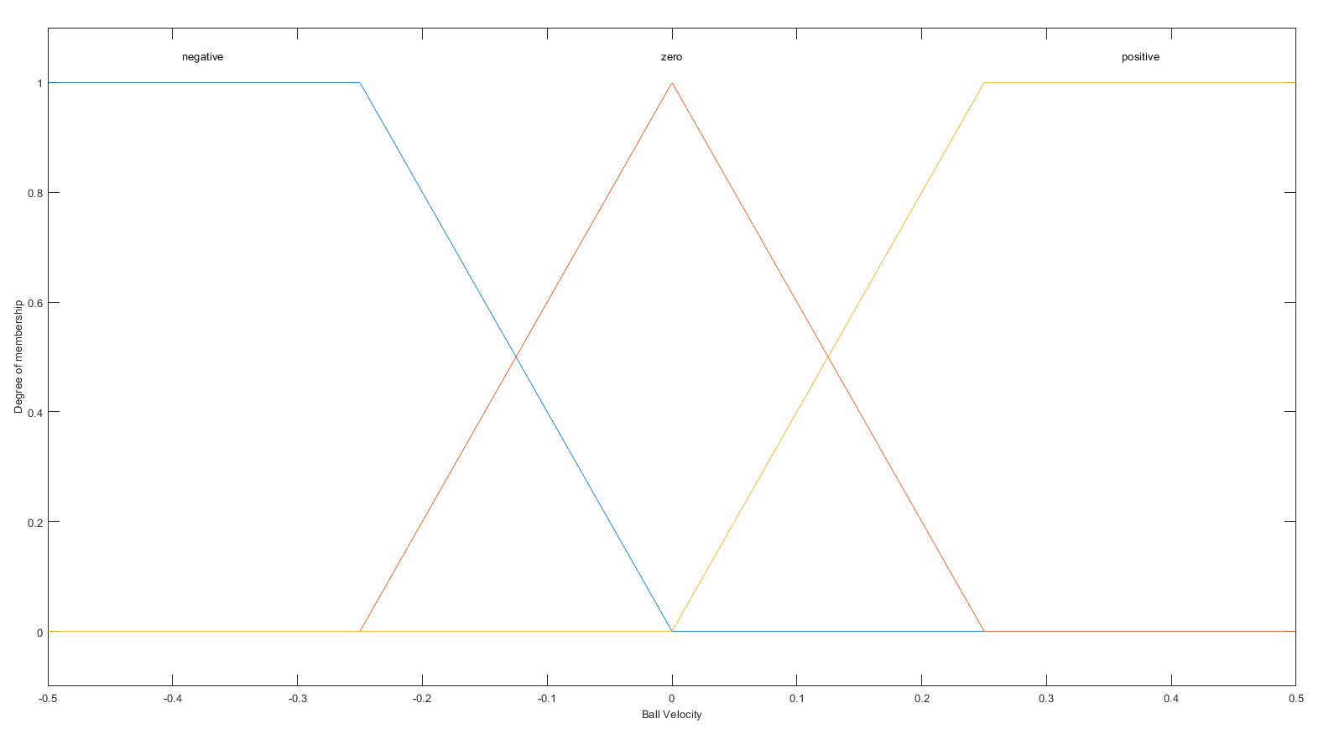
Membership function for ball velocity

Slide 15
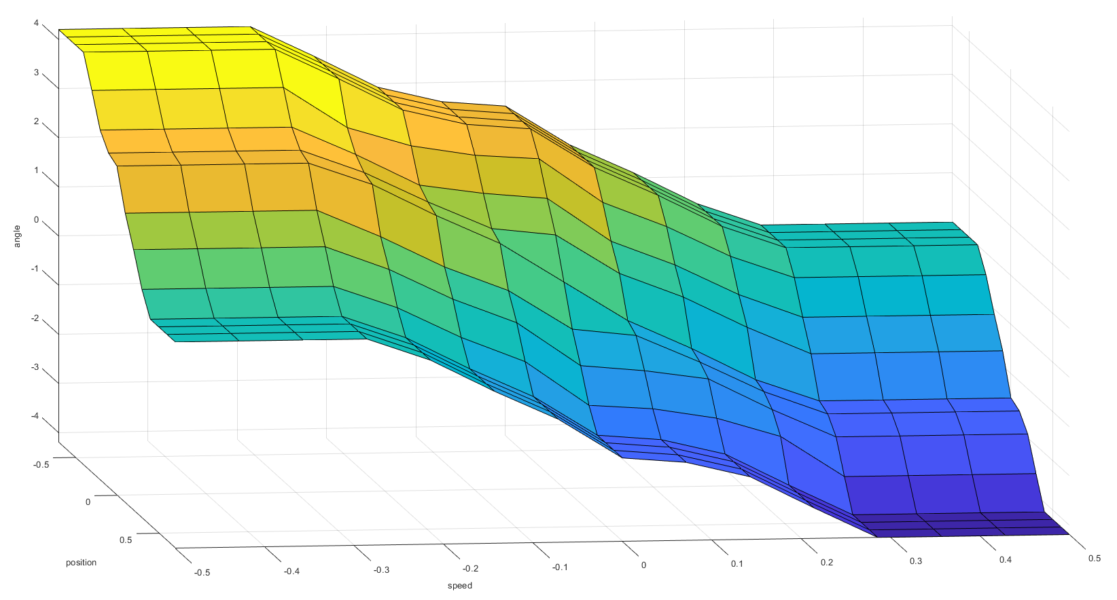
At this point, there are 9 rules as expected:
If ball position is zero and ball velocity is zero; then torque is zero,
If ball position is zero and ball velocity is negative; then torque is positive,
If ball position is zero and ball velocity is positive; then torque is negative,
If ball position is negative and ball velocity is zero; then torque is positive,
If ball position is negative and ball velocity is negative; then torque is big positive,
If ball position is negative and ball velocity is positive; then torque is zero,
If ball position is positive and ball velocity is zero; then torque is negative,
If ball position is positive and ball velocity is negative; then torque is zero,
If ball position is positive and ball velocity is positive; then torque is big negative.

Slide 16
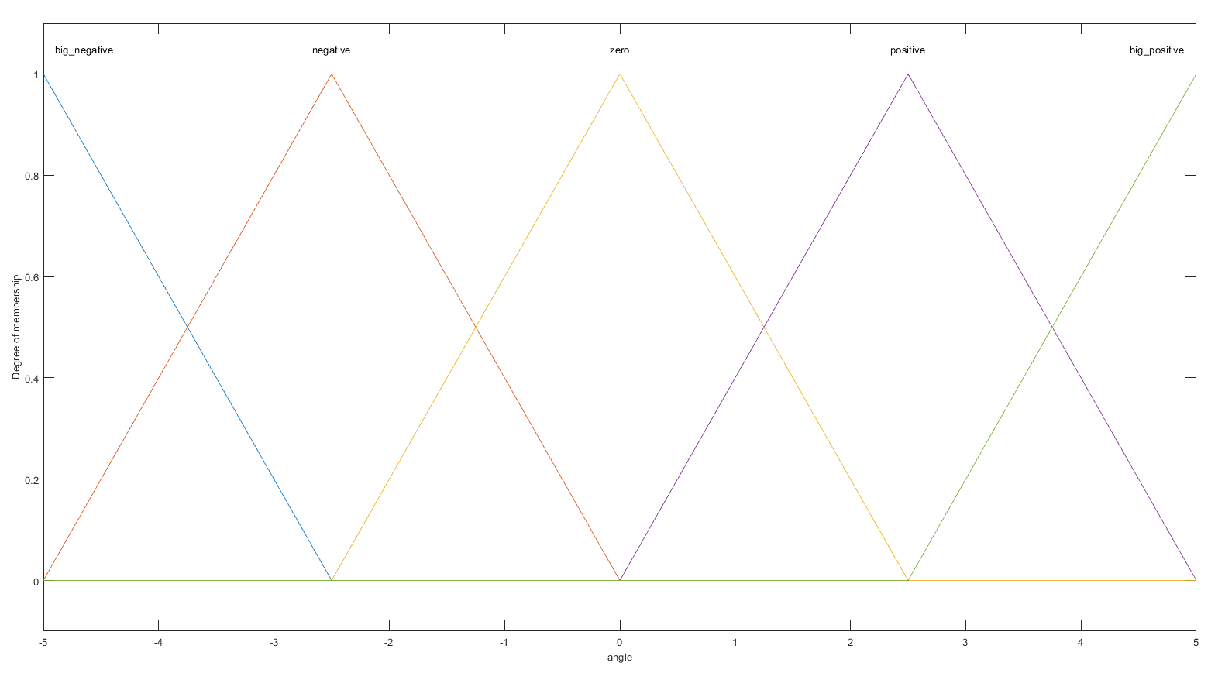
Membership functions for output

Slide 17
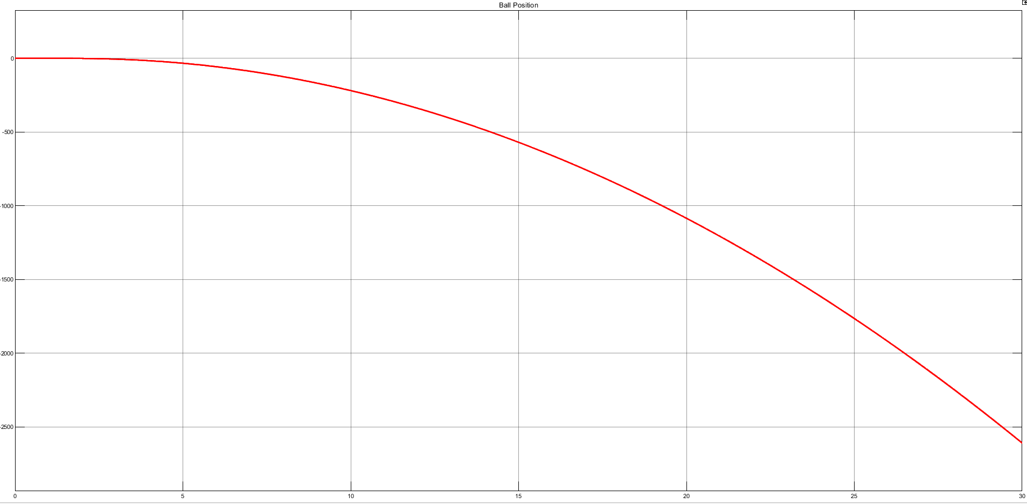
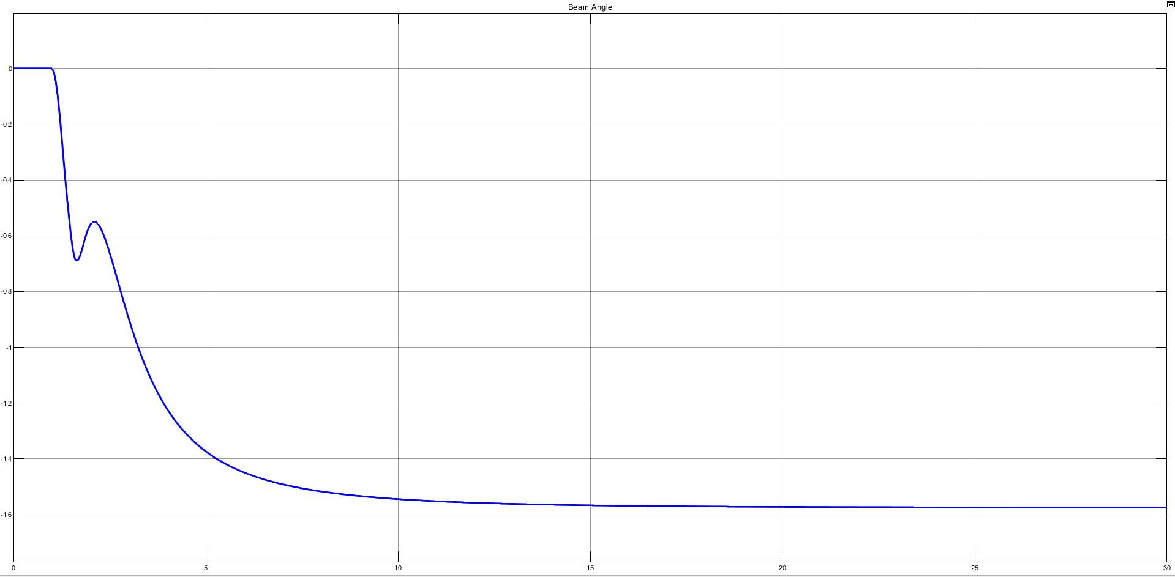
After designing, we obtained that we can not control the ball and beam system with only fuzzy. You can see beam angle plot in Figure 3-7 and ball position in Figure 3.8.
Ball position graph with fuzzy controller
Beam angle plot with fuzzy

Slide 18
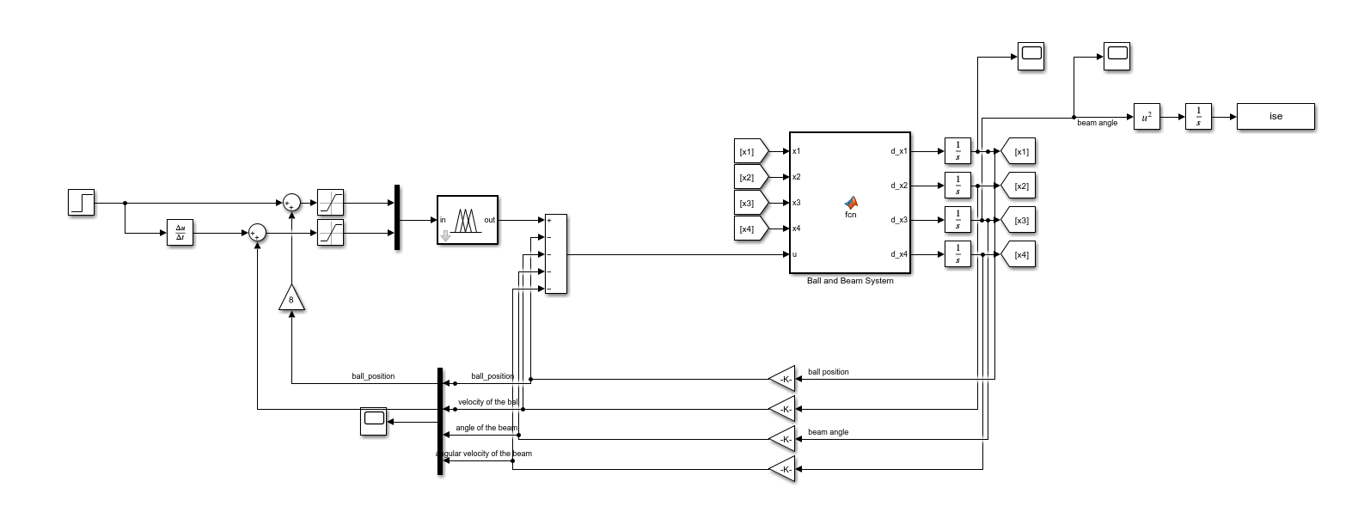
After seeing this results we decided the combine the state feedback controller and fuzzy inference controller to control ball and beam system. After implementing and changing membership boundaries we can control the system succesfully. We did not use the state feedback gains we obtained at the first for this structure. We used genetic algorithm to find state feedback gains for the sytem.
The system with fuzzy and state feedback controller combined

Slide 19
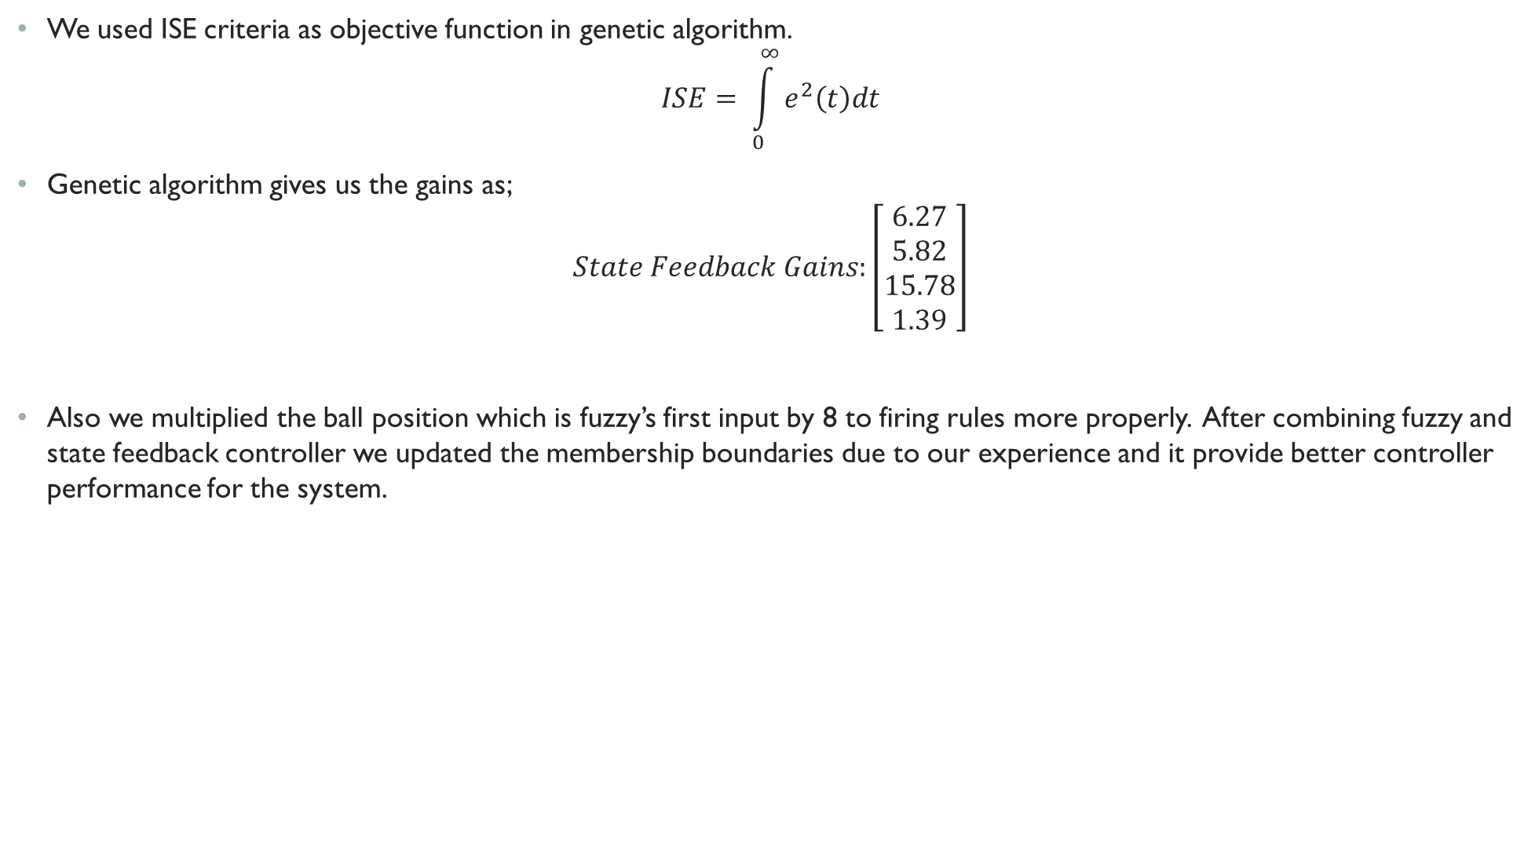
We used ISE criteria as objective function in genetic algorithm.
$$ISE= \int_{0}^{∞}{e^{2}\left(t\right)dt}$$
Genetic algorithm gives us the gains as;
$$State Feedback Gains:\left[\begin{matrix}6.27 \\ 5.82 \\ 15.78 \\ 1.39\end{matrix}\right]$$
Also we multiplied the ball position which is fuzzy’s first input by 8 to firing rules more properly. After combining fuzzy and state feedback controller we updated the membership boundaries due to our experience and it provide better controller performance for the system.

Slide 20
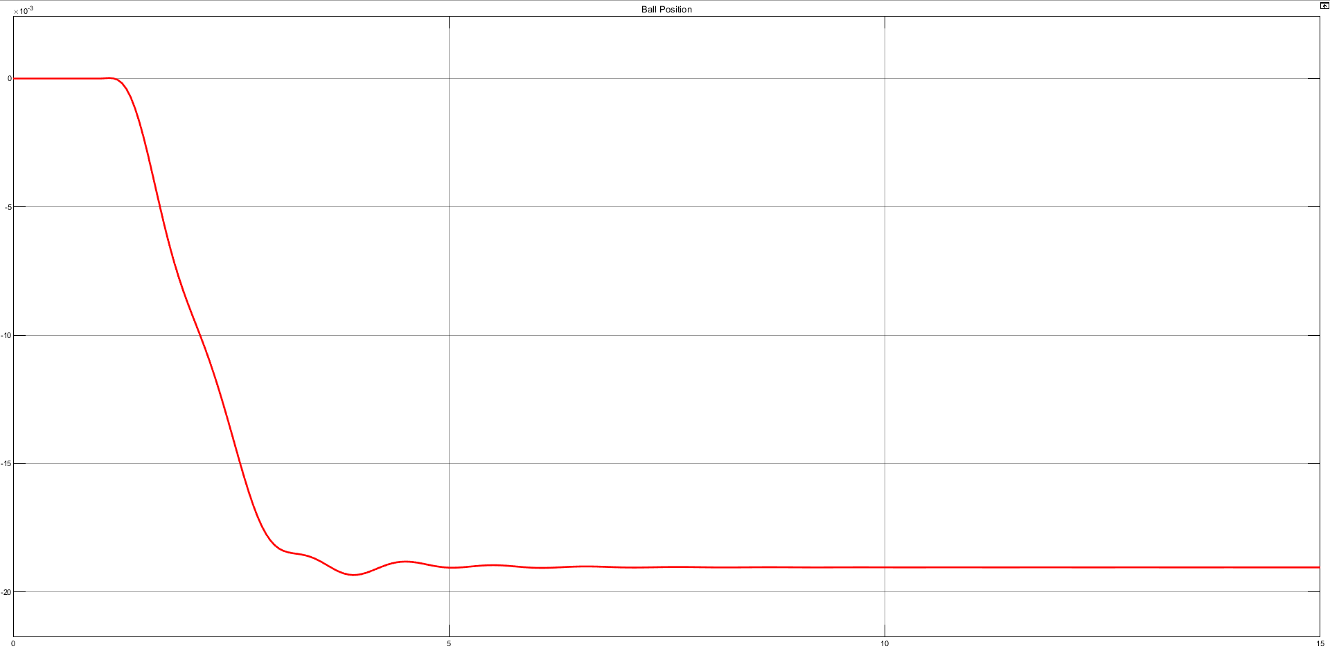
Simulation Results
Ball position for step input

Slide 21
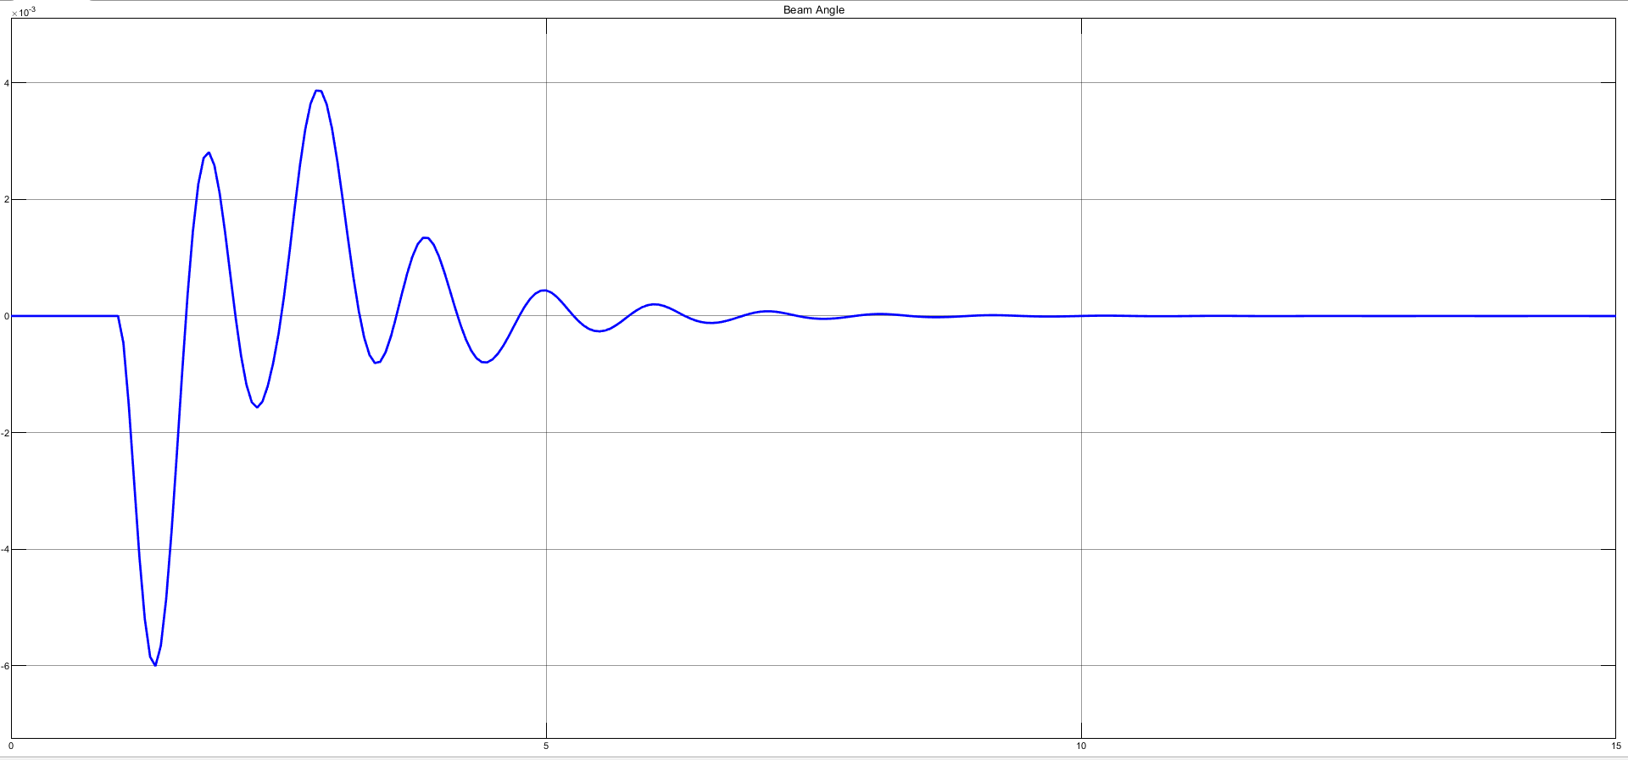
Beam angle for step input

Slide 22
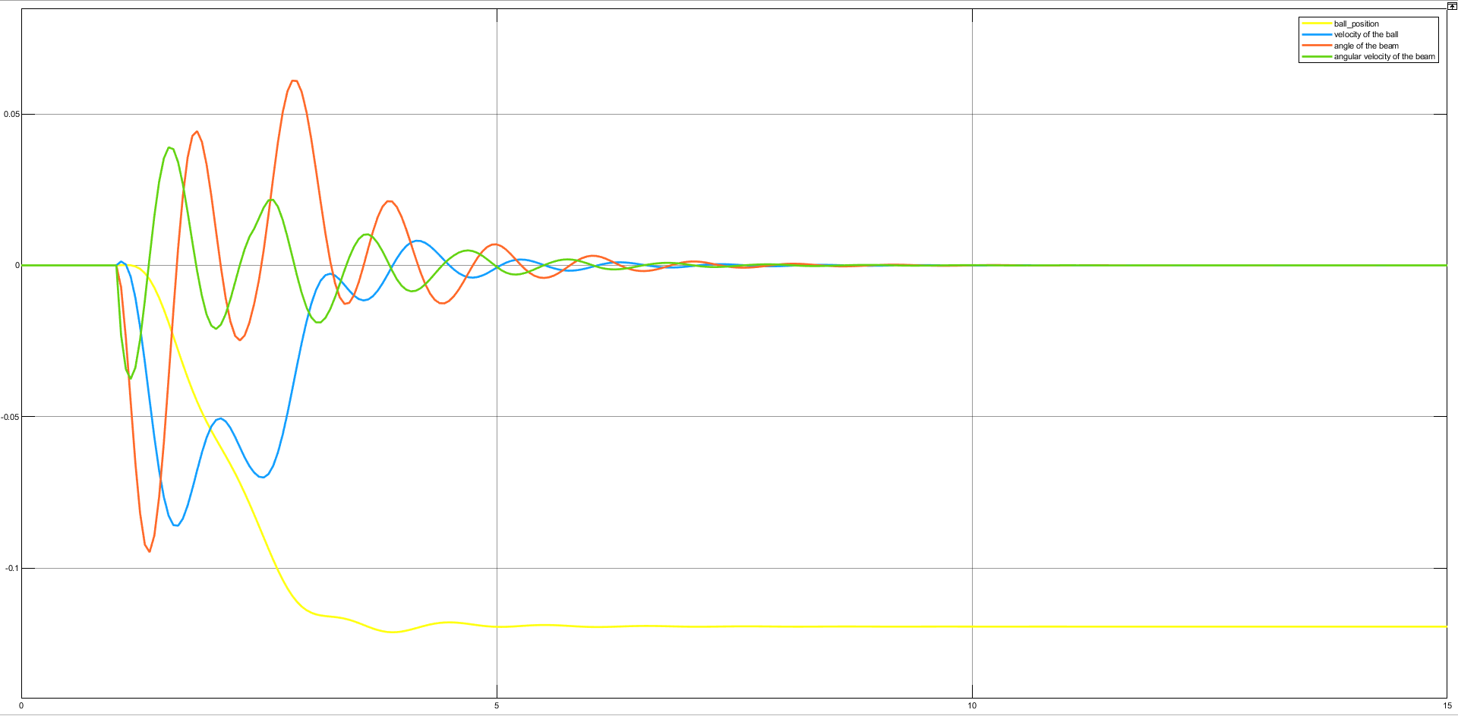
All states in one plot

Slide 23
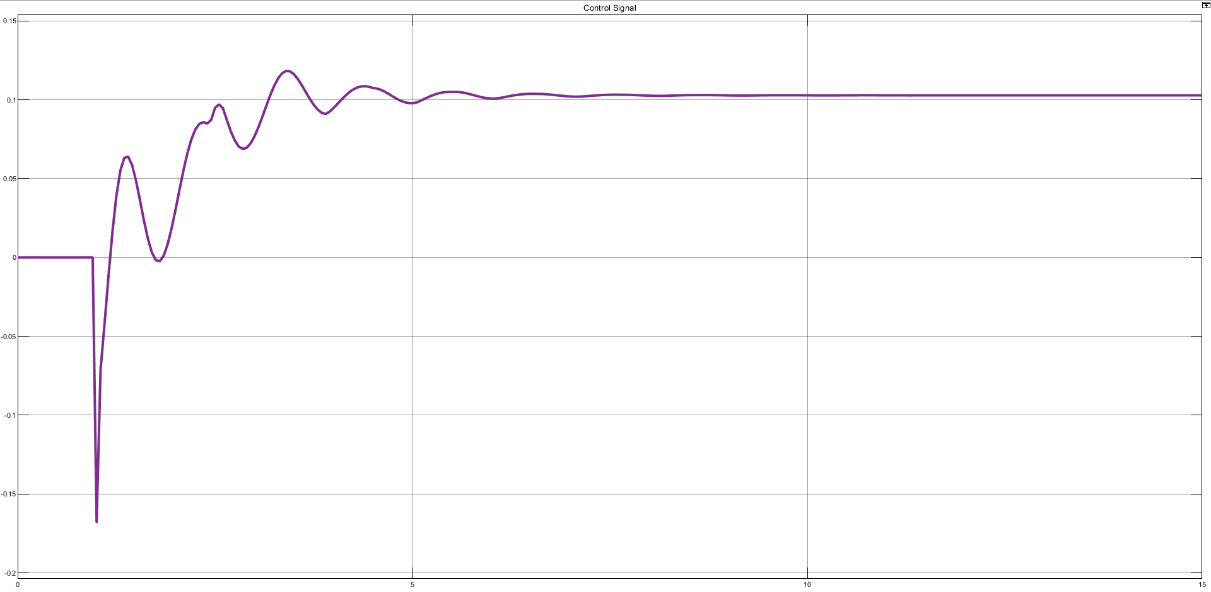
Control signal for step input

Slide 24
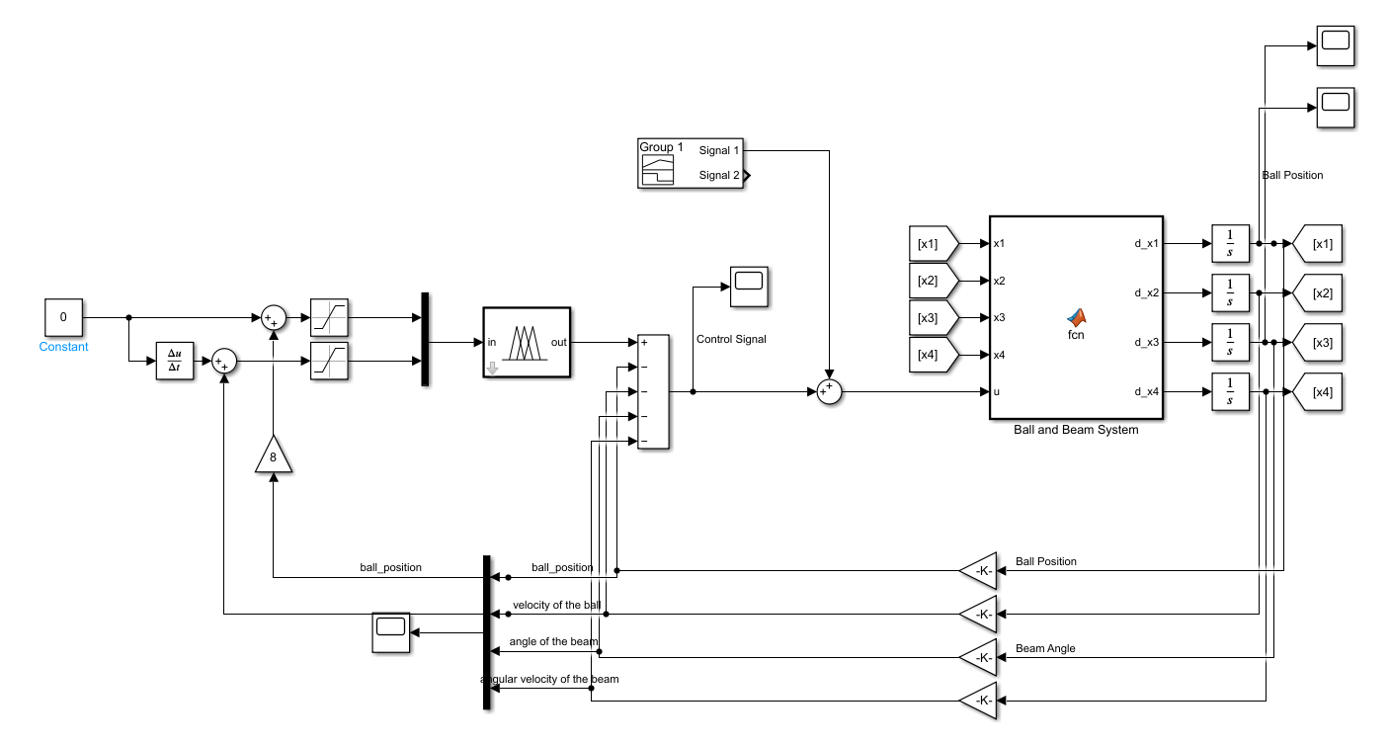
Bonus: System Performance In Disturbance
Block diagram to see systems disturbance performance

Slide 25
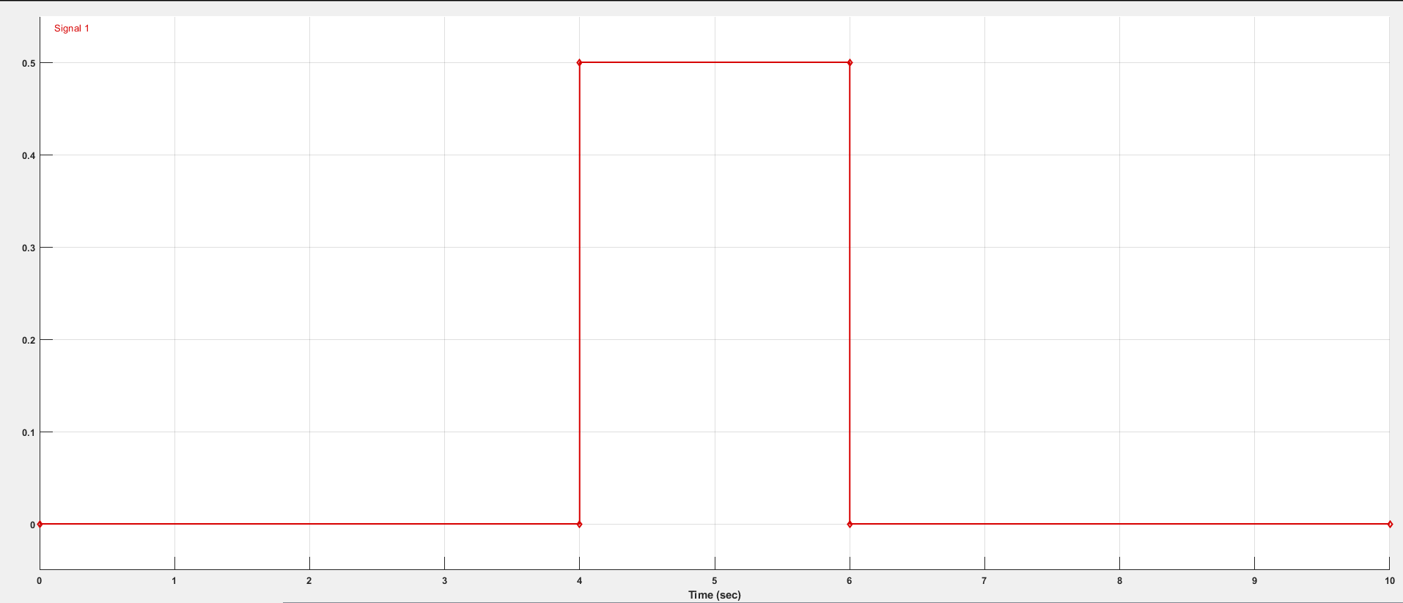
Given disturbance

Slide 26
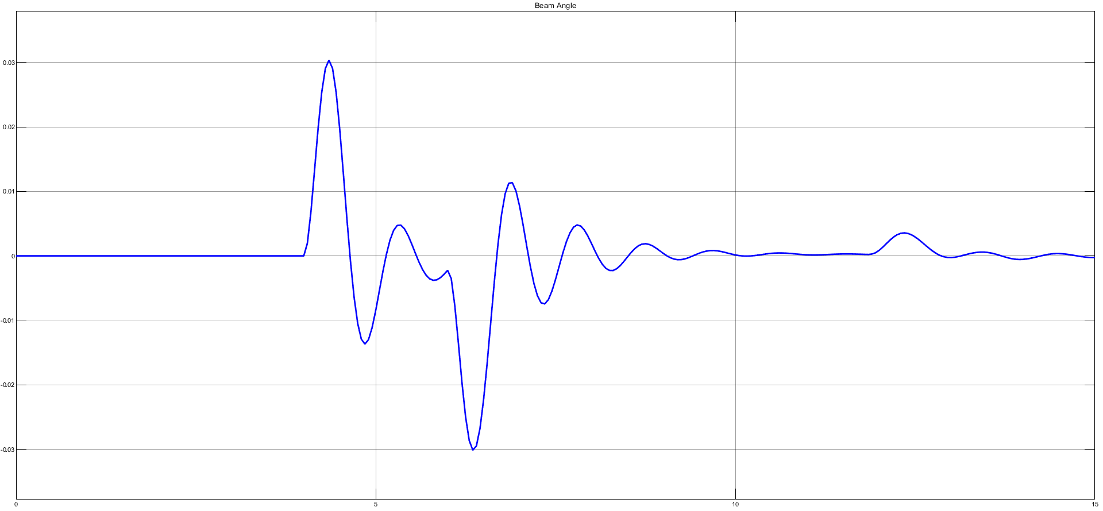
Beam angle for disturbed system

Slide 27
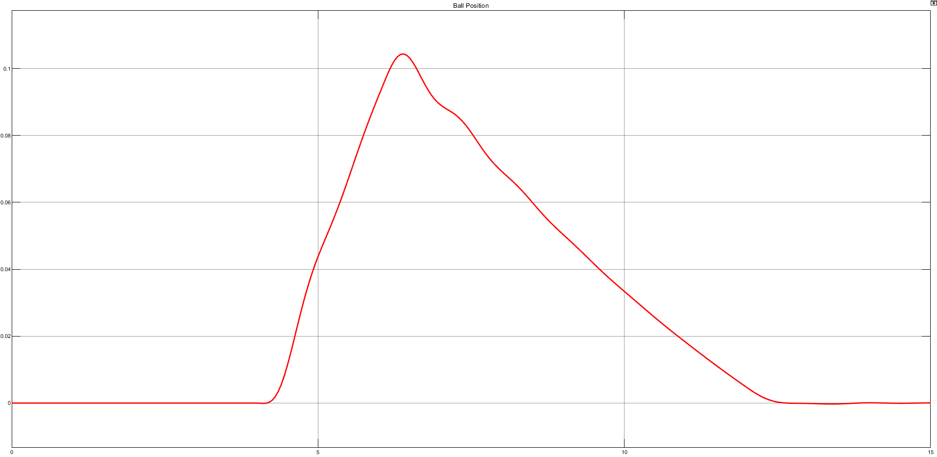
Ball position for disturbed system

Slide 28
Conclusion
Firstly, we searched literature to find a widely used method to control nonlinear ball and beam system. After researching literature, its obtained that state feedback controller is the commonly used to control ball and beam system. So, we designed our four stated system to state feedback controller to control it. We can not say that our system was succesful for state feedback controller but we learned and gained experience of systems dynamics. And that gained experience lead up to design fuzzy for the ball and beam. We implemented a fuzzy for two input and one output but this was not enough to control the system since it has four states. If we design a fuzzy with four inputs with 3 membership, this situation will obligate us to determine 81 rules. So we decided to combine state feedback and fuzzy to control ball and beam. After combining two controllers we determined feedback gains with genetic algorithm. And changed some membership boundaries to increase performance of the system. After some error-trial we found some optimum values to take stable response from step input.

Slide 29
references
Amira GMBH, Ball and Beam BW500 Setup for Laboratary Experiments, 1999.

