Slide 1

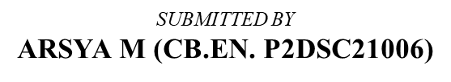
Amrita Vishwa Vidyapeetham Amrita School of Engineering, Coimbatore
Centre For Computational
Engineering And Networking
Presentation On
IMPLEMENTATION & ANALYSIS OF RKS & RADIAL BASIS KERNEL

Slide 2

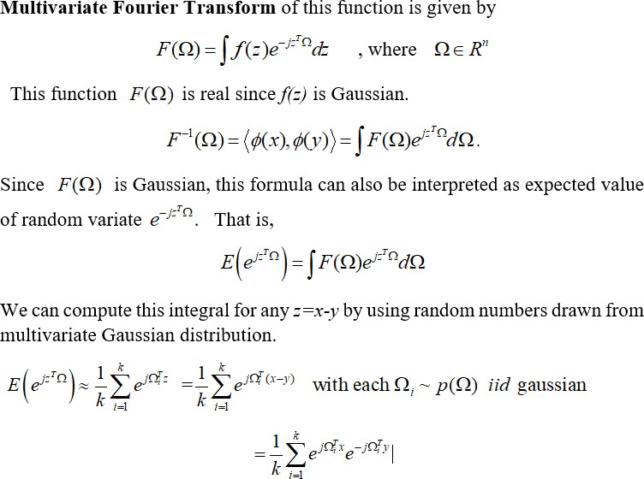
Random Kitchen Sink Algorithm:
Random Kitchen sink algorithm provides a very efficient method for explicitly mapping linearly non-separable data into appropriate higher dimensional space where it is linearly separable.
The motivation for this method is that, for large complex data sets, number of support vectors is of the order of 20% to 40% of training data points and kernel methods become very slow during both training and testing. RKS provide a way to overcome this difficulty.
One of the kernel function used in SVM based classification is gaussian kernel given by :

Slide 3
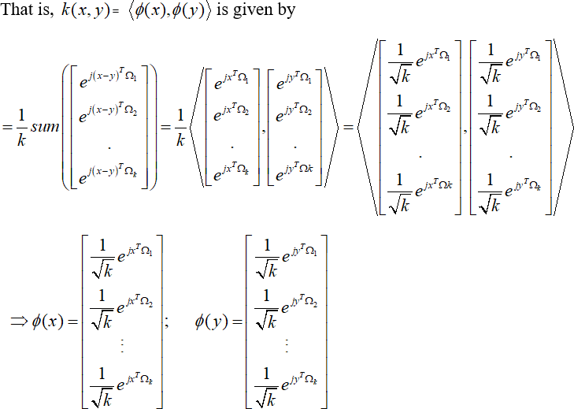
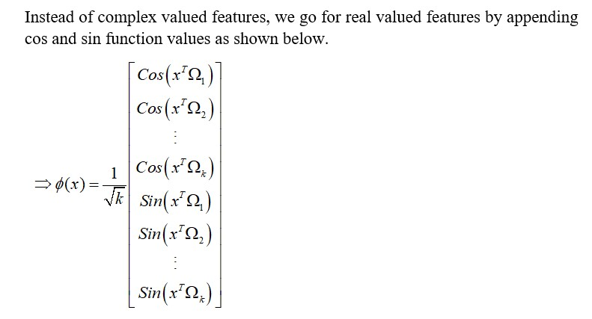
# importing the necessary libraries
from sklearn.preprocessing import LabelBinarizer import pandas as pd
from sklearn.datasets import load_iris
from sklearn.preprocessing import StandardScaler from sklearn.model_selection import train_test_split import numpy as np
from sklearn.metrics import accuracy_score

Slide 4
RKS for Linear Data (3 Classes)
0 1 2 3
0 5.1 3.5 1.4 0.2
1 4.9 3.0 1.4 0.2
2 4.7 3.2 1.3 0.2
3 4.6 3.1 1.5 0.2
4 5.0 3.6 1.4 0.2
(150, 4)
['sepal length (cm)', 'sepal width (cm)', 'petal length (cm)', 'petal width (cm)']
# LOAD THE DATA
iris = load_iris()
features = pd.DataFrame(iris.data)
print(features.head())
print(features.shape)
print(iris.feature_names)
target=iris.target
tar=pd.DataFrame(target)
data = pd.DataFrame(iris.data)
tar.columns =['Target’]
extracted = tar['Target']
data = data.join(extracted)
data
 | 0 | 1 | 2 | 3 | Target
0 | 5.1 | 3.5 | 1.4 | 0.2 | 0
1 | 4.9 | 3.0 | 1.4 | 0.2 | 0
2 | 4.7 | 3.2 | 1.3 | 0.2 | 0
3 | 4.6 | 3.1 | 1.5 | 0.2 | 0
4 | 5.0 | 3.6 | 1.4 | 0.2 | 0
... | ... | ... | ... | ... | ...
145 | 6.7 | 3.0 | 5.2 | 2.3 | 2
146 | 6.3 | 2.5 | 5.0 | 1.9 | 2
147 | 6.5 | 3.0 | 5.2 | 2.0 | 2
148 | 6.2 | 3.4 | 5.4 | 2.3 | 2
149 | 5.9 | 3.0 | 5.1 | 1.8 | 2
150 rows × 5 columns
data0= data.loc[data['Target'] == 0] data1= data.loc[data['Target'] == 1] data2= data.loc[data['Target'] == 2] data00=data0.loc[0:10,:] data11=data1.loc[50:60,:] data22=data2.loc[100:110,:] D=pd.DataFrame()
D = D.append([data00,data11,data22])

Slide 5
D=D.reset_index(drop=True)
y = D['Target'].values
D.drop(['Target'], axis='columns', inplace=True) x=D
scaler = StandardScaler()
X_scaledL = scaler.fit_transform(x) X_scaleddf=pd.DataFrame(X_scaledL)
# RANDOM MATRIX
rand_num = np.random.normal(0,1,[4,64]) print(rand_num.shape)
rk_data=np.matmul(X_scaledL,rand_num) rks_data=np.hstack((np.cos(rk_data),np.sin(rk_data))) rks_data.shape
(4, 64)
(33, 128)
#Split the data into training and test set in the ratio of 70:30 respectively
X_train, X_test, y_train, y_test = train_test_split(rks_data, y, test_size= 0.30, random_s
df_ytrain = pd.DataFrame(y_train) df_ytest = pd.DataFrame(y_test)
print('In Training Split:') print(df_ytrain[0].value_counts())
print('\nIn Testing Split:') print(df_ytest[0].value_counts())
print('Train set shape:',X_train.shape) print('Test set shape:',X_test.shape)
mlb = LabelBinarizer()
y_train = mlb.fit_transform(y_train) y_test = mlb.fit_transform(y_test)
In | Training Split:
1 | 8
0 | 8
2 | 7
Name: 0, dtype: int64
In | Testing Split:
2 | 4
0 | 3
1 | 3
Name: 0, dtype: int64 Train set shape: (23, 128)
Test set shape: (10, 128)

Slide 6
REGULARISED LEAST SQUARE
def model(X_train,X_test,y_train,y_test,n): I=np.identity(n)
weight=[]
for i in range(1,100): w=np.matmul(np.matmul(np.linalg.inv(np.matmul(X_train.T,X_train)+i*I),X_train.T),
y_train)
weight.append(w)
trainaccuracy=[] testaccuracy=[]
for i in range(len(weight)): y_pred=(np.matmul(X_train,weight[i]))
y_predd = (pd.DataFrame(y_pred)).apply(lambda x: x.argmax(), axis=1) y_trainn=(pd.DataFrame(y_train)).apply(lambda x: x.argmax(), axis=1)
ytest_pred=np.matmul(X_test,weight[i]) y_testpred=(pd.DataFrame(ytest_pred)).apply(lambda x: x.argmax(), axis=1) y_test_=(pd.DataFrame(y_test)).apply(lambda x: x.argmax(), axis=1)
acc=accuracy_score(y_predd,y_trainn) trainaccuracy.append(acc)
acctest=accuracy_score(y_testpred,y_test_) testaccuracy.append(acctest)
return weight,trainaccuracy,testaccuracy
weights,trainaccuracy,testaccuracy = model(X_train,X_test,y_train,y_test,128) print('Train Accuracy',trainaccuracy)
print('Test Accuracy',testaccuracy)
Train Accuracy [1.0]
Test Accuracy [0.9]
RKS for non-linearly separable Data(Binary Class)
# importing libraries import numpy as np
import matplotlib.pyplot as plt
from sklearn.datasets import make_circles from mpl_toolkits.mplot3d import Axes3D
# generating data
X, Y = make_circles(n_samples = 500, noise = 0.02)

Slide 7
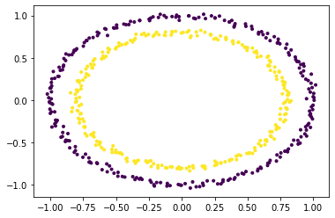
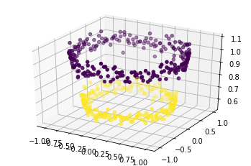
2/13/22, 12:04 PM
opti.ipynb - Colaboratory
# visualizing data
plt.scatter(X[:, 0], X[:, 1], c = Y, marker = '.') plt.show()
# adding a new dimension to X X1 = X[:, 0].reshape((-1, 1))
X2 = X[:, 1].reshape((-1, 1)) X3 = (X1**2 + X2**2)
#X = np.hstack((X, X3))
# visualizing data in higher dimension fig = plt.figure()
axes = fig.add_subplot(111, projection = '3d') axes.scatter(X1, X2, X1**2 + X2**2, c = Y, depthshade = True) plt.show()

Slide 8
from math import *
nd=100
angle=[]
radius=[]
x=[]
y=[]
for j in range(0,nd):
angle1 = j * (pi/16) angle.append(angle1) radius1 = 6.5*(104-j)/104 radius.append(radius1) x1 = radius1*sin(angle1) x.append(x1)
y1 = radius1*cos(angle1); y.append(y1)
x1 = np.transpose(x) y1 = np.transpose(y) x2 = -x1
y2 = -y1
d1=np.ones((nd)); d2=-d1
df1={'x':x1,'y':y1,'class':d1}
df2={'x':x2,'y':y2,'class':d2} import pandas as pd A1=pd.DataFrame(data=df1) A2=pd.DataFrame(data=df2) A=A1.append(A2)
y = A['class'].values
A.drop(['class'], axis='columns', inplace=True) x=A
scaler = StandardScaler()
X_scaledR = scaler.fit_transform(x) X_scaleddf=pd.DataFrame(X_scaledR)
rand_num = np.random.normal(0,1,[2,64]) print(rand_num.shape)
rks_data=np.matmul(X_scaledR,rand_num) rks_data=np.hstack((np.cos(rks_data),np.sin(rks_data))) rks_data.shape
(2, 64)
(200, 128)

Slide 9
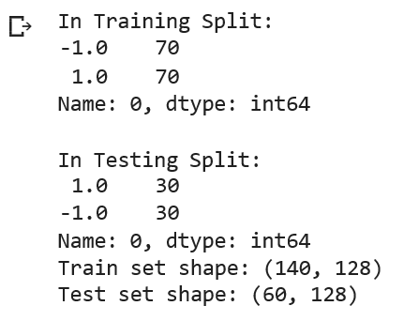
#Split the data into training and test set in the ratio of 70:30 respectively
X_train, X_test, y_train, y_test = train_test_split(rks_data, y, test_size= 0.30, random_state=42)
df_ytrain = pd.DataFrame(y_train) df_ytest = pd.DataFrame(y_test)
print('In Training Split:’)
print(df_ytrain[0].value_counts())
print(‘\n In Testing Split:’)
print(df_ytest[0].value_counts())
print('Train set shape:',X_train.shape)
print('Test set shape:',X_test.shape)
weights,trainaccuracy,testaccuracy = model(X_train,X_test,y_train,y_test,128) print('Train Accuracy',trainaccuracy)
print('Test Accuracy',testaccuracy)
Train Accuracy [1.0]
Test Accuracy [1.0]

Slide 10
RKS REALTIME DATA
# LOAD THE DATA
Data = pd.read_csv("/content/drive/MyDrive/oasis_longitudinal.csv") print(Data.head())
pdData = Data.copy() # making a copy of the dataset
print('\033[1mThe Dementia dataset having "{0}" rows and "{1}" columns\033[0m.'.format(pdData.shape[0],pdData.shape[1]))
# Converting Categorical Data to Numerical Data pdData['M/F'] = pdData['M/F'].replace(['M', 'F'], [1,0])
pdData['Group'] = [-1 if each == "Demented" or each == "Converted" else 1 for each in pdData['Group']]
# checking missing values in dataset for each attributes / columns print("\033[1m Column_Name No_of_Missing_Values") print("*"*50)
print("\033[0m{0}".format(pdData.isnull().sum())) print("\033[1m*"*50)
# checking if any duplicate rows available in the dataset print("Showing Duplicate rows if any in the dataset: ") print("\033[0m{0}".format(pdData[pdData.duplicated()])) print("\033[0m")
# filling the missing values with median value of the feature median = pdData['MMSE'].median() pdData['MMSE'].fillna(median, inplace=True)
median = pdData['SES'].median() pdData['SES'].fillna(median, inplace=True)
pdData.isnull().sum()
# X contains features & y contains the target class
X = pdData[['Visit','MR Delay', 'M/F', 'Age', 'EDUC', 'SES', 'MMSE', 'eTIV','CDR', 'nWBV',
y = pdData['Group'].values DATA=pd.DataFrame(X)
# X contains features & y contains the target class
X = pdData[[ 'M/F', 'Age', 'EDUC','MMSE', 'eTIV','CDR', 'nWBV', 'ASF']].values
y = pdData['Group'].values

Slide 11
2/13/22, 12:04 PM
opti.ipynb - Colaboratory
Subject ID | MRI ID | Group | Visit ... CDR | eTIV | nWBV | ASF
0 OAS2_0001 | OAS2_0001_MR1 | Nondemented | 1 ... 0.0 | 1987 | 0.696 | 0.883
1 OAS2_0001 | OAS2_0001_MR2 | Nondemented | 2 ... 0.0 | 2004 | 0.681 | 0.876
2 OAS2_0002 | OAS2_0002_MR1 | Demented | 1 ... 0.5 | 1678 | 0.736 | 1.046
3 OAS2_0002 | OAS2_0002_MR2 | Demented | 2 ... 0.5 | 1738 | 0.713 | 1.010
4 OAS2_0002 | OAS2_0002_MR3 | Demented | 3 ... 0.5 | 1698 | 0.701 | 1.034
[5 rows x 15 columns]
The Dementia dataset having "373" rows and "15" columns. Column_Name No_of_Missing_Values
**************************************************
Subject ID | 0
MRI ID | 0
Group | 0
Visit | 0
MR Delay | 0
M/F | 0
Hand | 0
Age | 0
EDUC | 0
SES | 19
MMSE | 2
CDR | 0
eTIV | 0
nWBV | 0
ASF dtype: int64 | 0
************************************************** Showing Duplicate rows if any in the dataset:
Empty DataFrame
Columns: [Subject ID, MRI ID, Group, Visit, MR Delay, M/F, Hand, Age, EDUC, SES, MMS Index: []
scaler = StandardScaler()
X_scaled = scaler.fit_transform(X) X_scaleddf=pd.DataFrame(X_scaled)
rand_num = np.random.normal(0,1,[8,128]) print(rand_num.shape)
rk_data=np.matmul(X_scaled,rand_num) rks_data=np.hstack((np.cos(rk_data),np.sin(rk_data))) rks_data.shape
(8, 128)
(373, 256)

Slide 12
X_train, X_test, y_train, y_test = train_test_split(rks_data, y, test_size= 0.30, random_s df_ytrain = pd.DataFrame(y_train)
df_ytest = pd.DataFrame(y_test)
print('In Training Split:') print(df_ytrain[0].value_counts())
print('\nIn Testing Split:') print(df_ytest[0].value_counts())
print('Train set shape:',X_train.shape) print('Test set shape:',X_test.shape)
In Training Split:
1
-1
133
128
Name: 0, dtype: int64
In Testing Split:
1
-1
57
55
Name: 0, dtype: int64
Train set shape: (261, 256)
Test set shape: (112, 256)
weights,trainaccuracy,testaccuracy = model(X_train,X_test,y_train,y_test,256) print('Train Accuracy',trainaccuracy)
print('Test Accuracy',testaccuracy)
Train Accuracy [1.0]
Test Accuracy [1.0]
SVM RBF INBUILT
X_train, X_test, y_train, y_test = train_test_split(X_scaled, y, test_size= 0.30, random_s
df_ytrain = pd.DataFrame(y_train) df_ytest = pd.DataFrame(y_test)
print('In Training Split:') print(df_ytrain[0].value_counts())
print('\nIn Testing Split:') print(df_ytest[0].value_counts())
print('Train set shape:',X_train.shape) print('Test set shape:',X_test.shape)

Slide 13
In Training Split:
1
-1
133
128
Name: 0, dtype: int64
In Testing Split:
1
-1
57
55
Name: 0, dtype: int64 Train set shape: (261, 8)
Test set shape: (112, 8)
from sklearn.svm import SVC
from sklearn.model_selection import GridSearchCV
from sklearn.metrics import confusion_matrix,f1_score,accuracy_score,classification_report import matplotlib.pyplot as plt
import seaborn as sns
def plot_confusion_matrix(y_test, yhat): cm = confusion_matrix(y_test, yhat) ax= plt.subplot()
sns.heatmap(cm, annot=True, ax=ax, fmt='g', cmap=plt.cm.Blues, cbar=False); ax.set_xlabel('Predicted labels')
ax.set_ylabel('True labels') ax.set_title('Confusion Matrix', size=8);
ax.xaxis.set_ticklabels(['Nondemented', 'Demented']); ax.yaxis.set_ticklabels(['Nondem
# SVM
def svm(X_tr,Y_tr,X_te,Y_te):
# Normally, C = 1 and gamma = 'scale' are default values
# C controls how wide the margin will be with respect to how many misclassification we a # C is increasing --> reduce the size of the margin and fewer misclassification and vice param_grid = [
{'C': [0.5, 1, 2, 3, 4, 5, 6, 7, 8, 9, 10, 30, 50, 80, 100],
'gamma': ['scale', 0.5, 0.125, 1, 0.1, 0.01, 0.001, 0.0001, 0.00001],
'kernel': ['rbf']
]
optimal_params = GridSearchCV(SVC(),
param_grid,
cv=10, # taking 10-fold as in k-fold cross validation scoring='accuracy',
verbose=0, n_jobs=-1)
optimal_params.fit(X_train, y_train) print(optimal_params.best_params_)
#svm
C = optimal_params.best_params_['C']
gamma = optimal_params.best_params_['gamma'] kernel = optimal_params.best_params_['kernel']
svm = SVC(C=C, gamma=gamma, kernel=kernel)

Slide 14
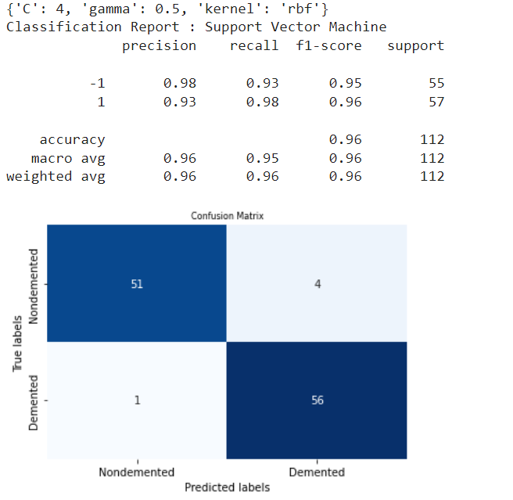
svm.fit(X_tr,Y_tr)
# predict the response svm_y_pred = svm.predict(X_te)
# Confusion Matrix for the Support Vector Machine Model plot_confusion_matrix(Y_te,svm_y_pred)
# Classification Report for the Support Vector Machine Model print("Classification Report : Support Vector Machine") classRep = classification_report(Y_te, svm_y_pred, digits=2) print(classRep)
svm(X_train, y_train,X_test,y_test)

Slide 15
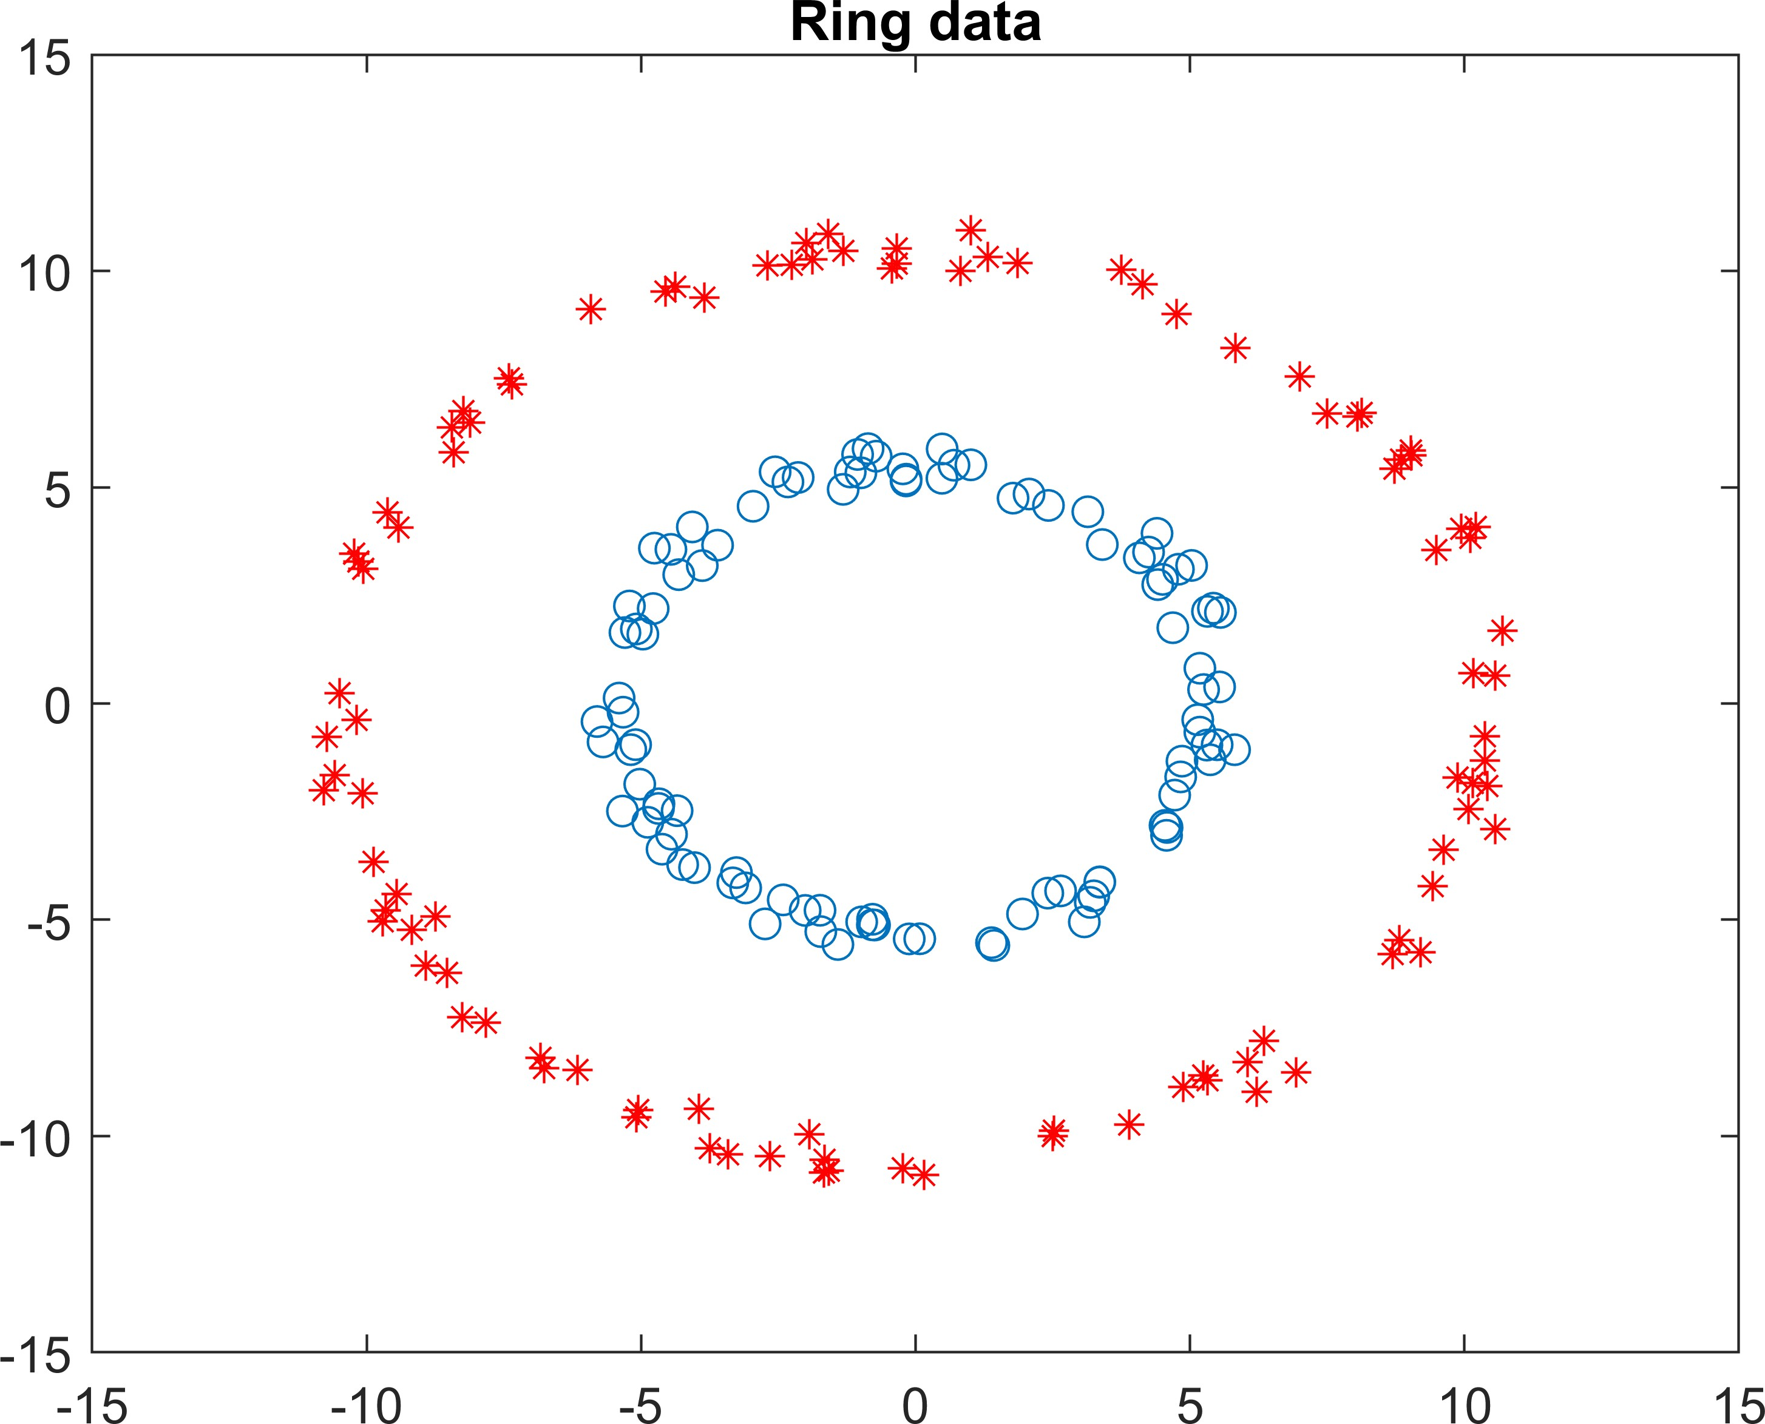
RING DATA
clear all; clc;
d = 100;
r1 = 5+rand(d,1); theta = 2*pi*rand(d,1); x1 = r1.*cos(theta);
y1 = r1.*sin(theta);
r2 = 10+rand(d,1); x2 = r2.*cos(theta); y2 = r2.*sin(theta); figure(3)
plot(x1,y1,'o');hold on; plot(x2,y2,'*','Color','red');title('Ring data') hold off;
A=[x1 y1; x2 y2];
c=ones(d,1);
class=[c;-c];
x = A;
y = class;
[n d]=size(x); m=nonlinear_svm(x,y,1,1);

Slide 16
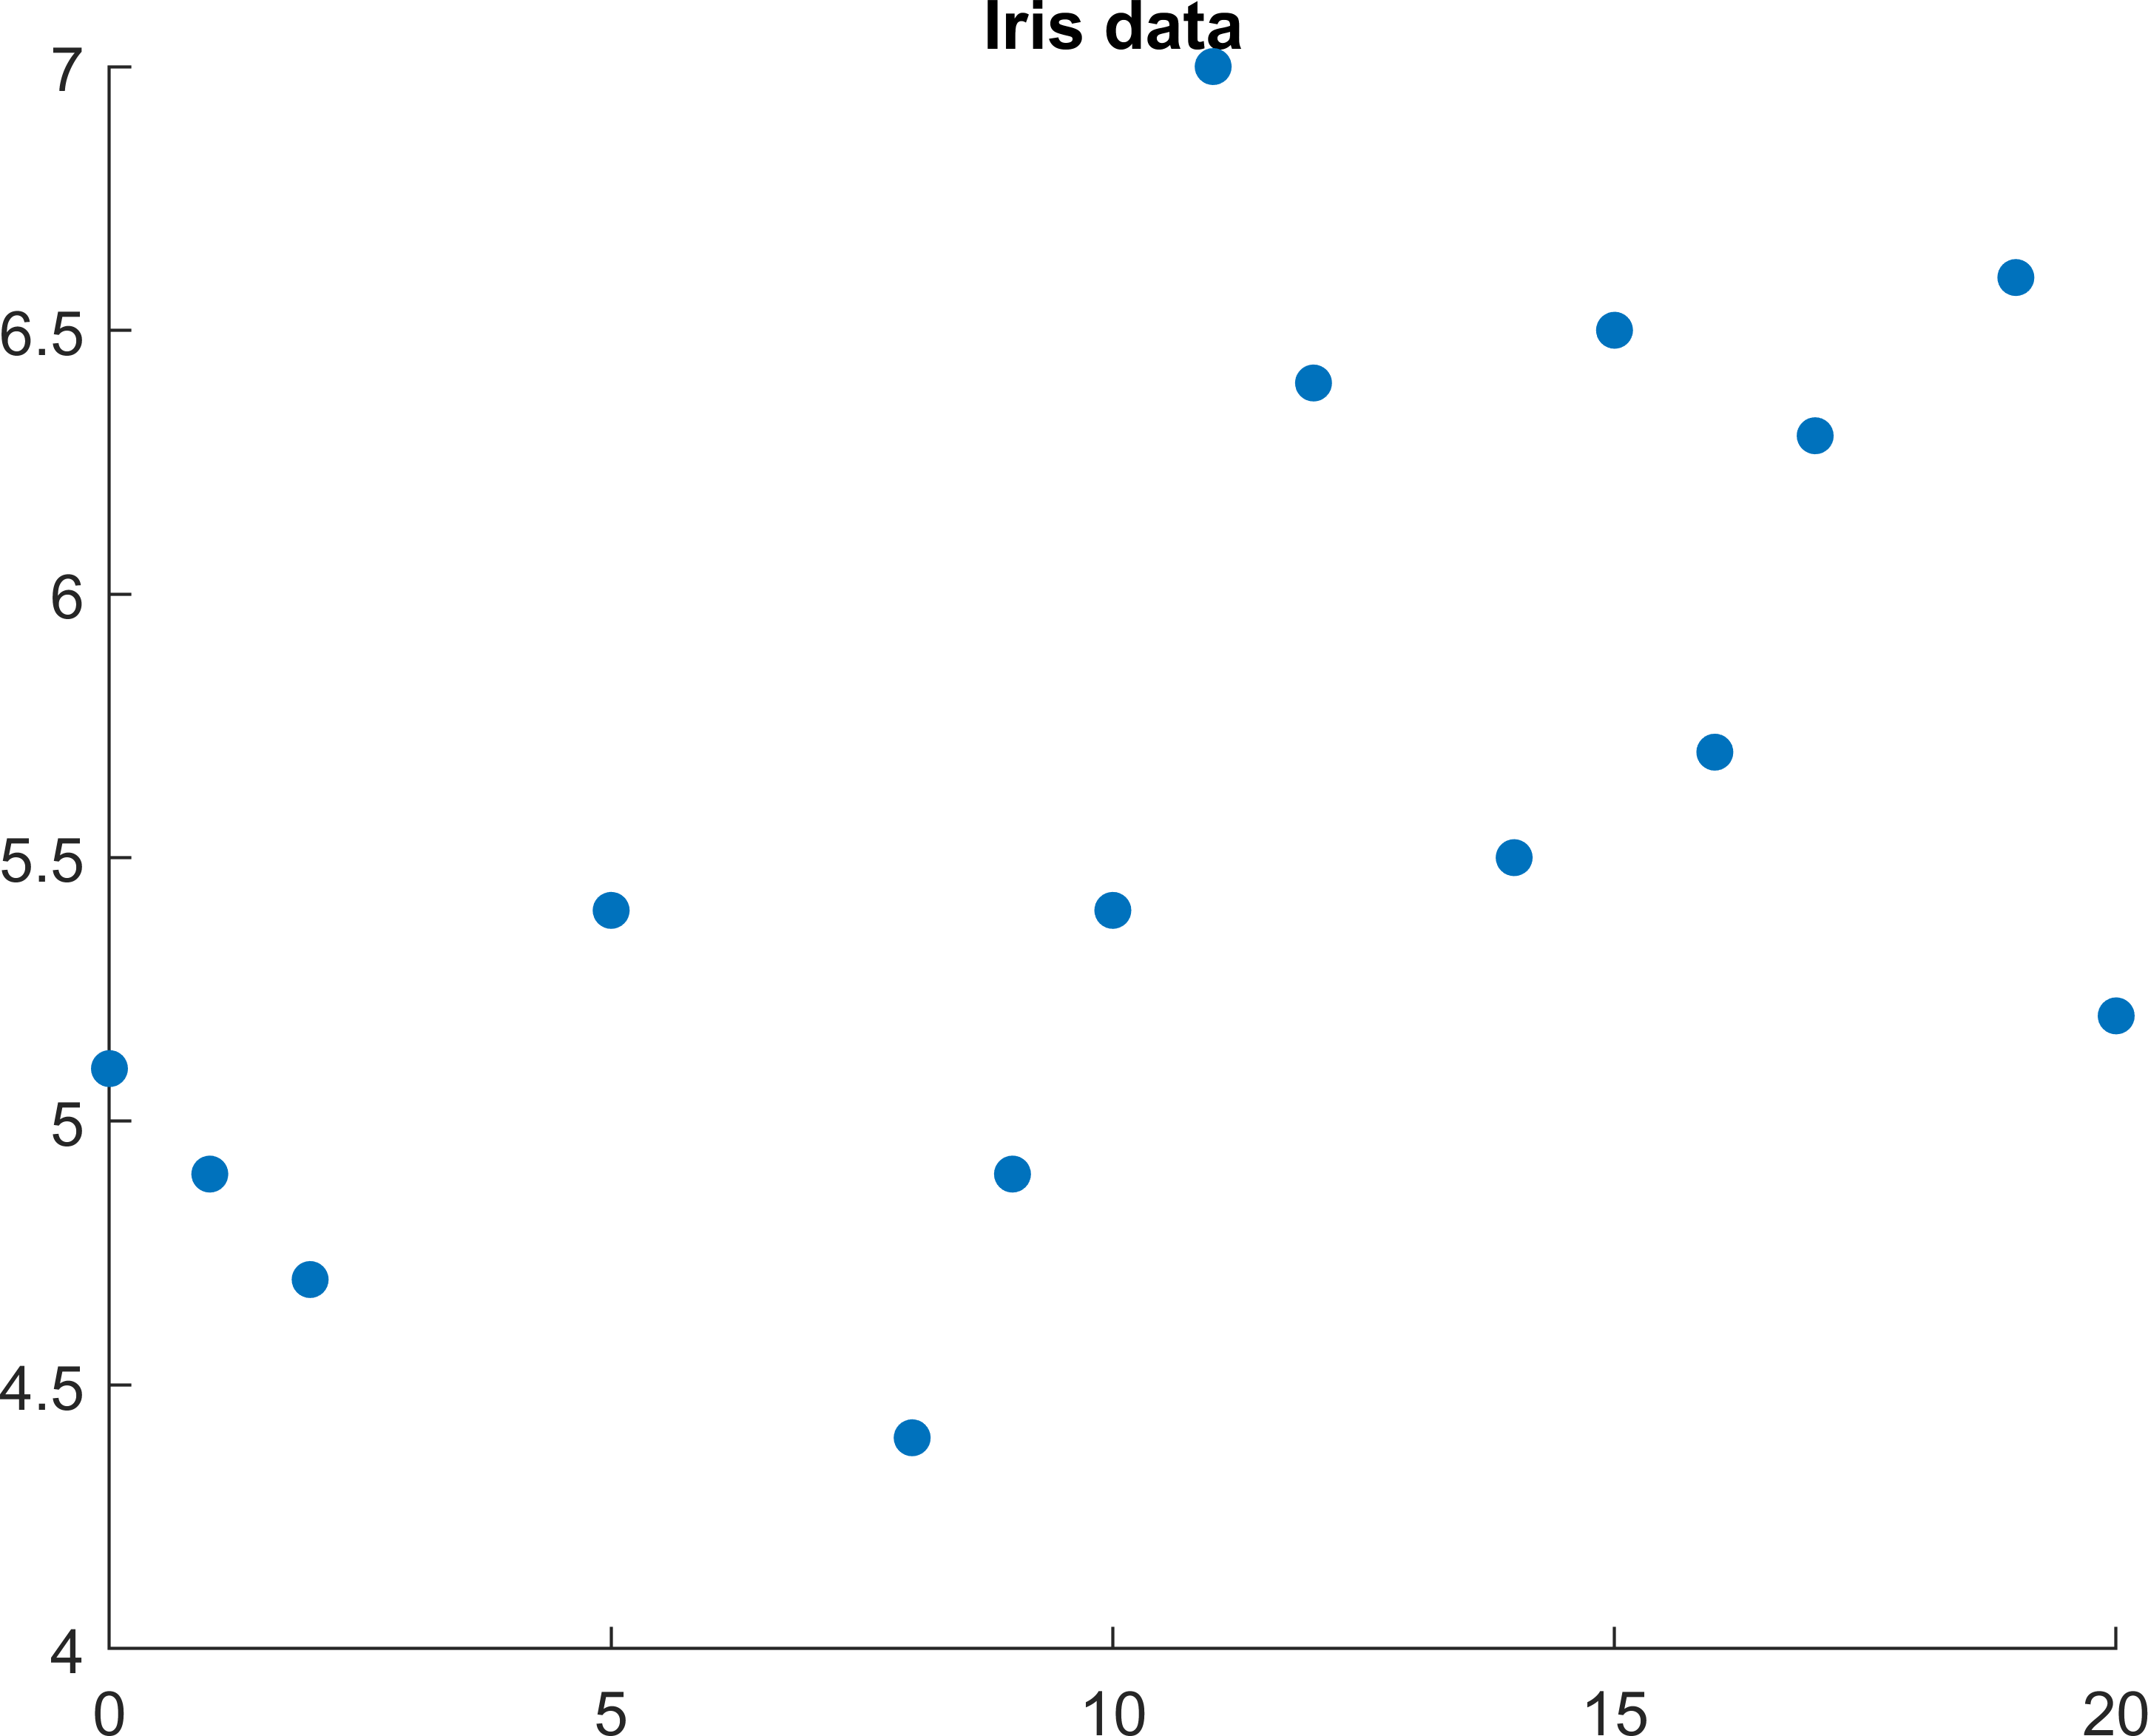
y_pred=sign(svmPredict(x,m)); for i=1:size(y_pred)
if y_pred(i)==1 y_pred(i)=1; else y_pred(i)=-1; end
end
count=0;
for i=1:size(y_pred) if y_pred(i)==y(i)
count=count+1;
end
end
fprintf("Accuracy is");disp(count/200*100)
Accuracy is 100
IRIS DATA
clear all; clc;
% importing data
X_train = readmatrix("Xtrain.csv"); y_train = readmatrix("ytrain.csv");
% x --> features , y --> label x = X_train(:,1:4);
x = x(2:end,:);
y = y_train(2:end,2:end);
[n d]=size(x);
m=nonlinear_svm(x,y,1,1);
scatter(x(:,1),x(:,2),'filled') title('Iris data')
hold off

Slide 17
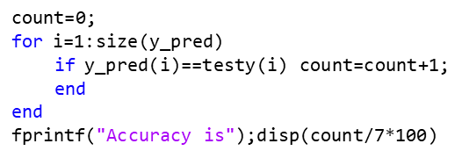
X_test = readmatrix("Xtest.csv"); y_test = readmatrix("ytest.csv"); testx = X_test(2:end,1:4);
testy = y_test(2:end,2:end);
y_pred=sign(svmPredict(testx,m))
y_pred = 7×1
0
0
1
0
0
1
1
for i=1:size(y_pred) if y_pred(i)==1 y_pred(i)=1; else
y_pred(i)=-1; end
end
Accuracy is 100
Dual Formulation
- kernel matrix

Slide 18
function model = nonlinear_svm(X,Y,C,sigma)
% Nonlinear SVM with RBF Kernel N = size(X,1);
K = zeros(N,N);
for i=1:N % RBF kernel for j = 1:N
K(i,j) = exp(-1*sum((X(i,:)-X(j,:)).^2)/(2*(sigma)^2));
end
end
cvx_begin
cvx_precision best variable a_m(N);
minimize (0.5.*quad_form(Y.*a_m,K) - ones(N,1)'*(a_m)); subject to
a_m >= 0;
Y'*(a_m) == 0;
a_m <= C;
cvx_end
a_m(a_m<10^-5)=0;
%X_m = X(a_m > 0,:);
%Y_m = Y(a_m > 0);
%a_m = a_m(a_m > 0);
K=zeros(length(X(:,1)),length(X(:,1))); for i=1:length(X(:,1)) % RBF kernel
for j = 1:length(X(:,1))
K(i,j) = exp(-1*sum((X(i,:)-X(j,:)).^2)/(2*(sigma)^2));
end
end
b_m = mean(Y-K*(a_m.*Y));
model = getModel(X, Y, a_m, b_m, sigma, "nonlinear"); end
function model = getModel(X_m, Y_m, a_m, b_m, s_m, type) model.type = type;
model.X = X_m; model.Y = Y_m;
model.a = a_m; model.b = b_m; model.s = s_m;
end
function predictions = svmPredict(X, model) if model.type == "nonlinear"
K=zeros(length(X(:,1)),length(model.X(:,1))); for i=1:length(X(:,1))% RBF kernel
for j = 1:length(model.X(:,1))
K(i,j) = exp(-1*sum((X(i,:)-model.X(j,:)).^2)/(2*(model.s)^2));
end
end
predictions = K *(model.a.*model.Y) - model.b>0;
end
end

Slide 19
KEY TAKEAWAYS
ANALYSED RKS AND RBF
IMPLEMENTED ON THREE DIFFERENT DATASETS
EVALUATED THE MODEL PERFORMANCE
THANK YOU

Slide 20
Calling SDPT3 4.0: 403 variables, 201 equality constraints
For improved efficiency, SDPT3 is solving the dual problem.
num. of constraints = 201
dim. of socp var
= 202, num. of socp blk = 1
= 200
dim. of linear var
dim. of free var = 1 *** convert ublk to lblk
******************************************************************* SDPT3: Infeasible path-following algorithms
*******************************************************************
version predcorr gam expon NT 1 0.000 1 it pstep dstep pinfeas dinfeas | scale_data 0 gap prim-obj | dual-obj | cputime
0|0.000|0.000|2.7e+01|1.0e+02|8.0e+04| 0.000000e+00 |  | 0.000000e+00| 0:0:00| chol |  | 1 | 1
1|0.378|0.377|1.7e+01|6.2e+01|5.9e+04| 2.212630e+02 |  | 1.395601e+02| 0:0:01| chol |  | 1 | 1
2|0.421|0.421|9.8e+00|3.6e+01|4.0e+04| 7.733800e+02 |  | -2.199295e+02| 0:0:01| chol |  | 1 | 1
3|0.448|0.196|5.4e+00|2.9e+01|3.2e+04| 1.464366e+03 |  | -4.982143e+02| 0:0:01| chol |  | 1 | 1
4|1.000|0.362|3.3e-06|1.9e+01|9.0e+03| 1.270141e+03 |  | -1.960734e+03| 0:0:01| chol |  | 1 | 1
5|1.000|0.955|7.1e-07|8.5e-01|1.3e+03| 6.432137e+02 |  | -4.629835e+02| 0:0:01| chol |  | 1 | 1
6|0.657|0.284|3.1e-07|6.1e-01|6.5e+02| 1.906780e+02 |  | -4.043552e+02| 0:0:01| chol |  | 1 | 1
7|1.000|0.223|1.4e-06|4.7e-01|6.4e+02| 3.264003e+02 |  | -2.633669e+02| 0:0:01| chol |  | 1 | 1
8|0.832|0.489|3.7e-07|2.4e-01|2.5e+02| 9.770523e+01 |  | -1.425496e+02| 0:0:01| chol |  | 1 | 1
9|1.000|0.303|8.2e-08|1.7e-01|1.7e+02| 7.301423e+01 |  | -8.890805e+01| 0:0:01| chol |  | 1 | 1
10|1.000|0.414|3.0e-08|9.8e-02|8.9e+01| 4.441348e+01 |  | -4.289564e+01| 0:0:01| chol |  | 1 | 1
11|1.000|0.424|9.6e-09|5.7e-02|4.7e+01| 3.112906e+01 |  | -1.539847e+01| 0:0:01| chol |  | 1 | 1
12|1.000|0.561|3.2e-09|2.5e-02|1.8e+01| 2.298460e+01 |  | 4.659917e+00| 0:0:01| chol |  | 1 | 1
13|1.000|0.292|2.6e-10|1.8e-02|1.2e+01| 2.045854e+01 |  | 8.753562e+00| 0:0:01| chol |  | 1 | 1
14|1.000|0.413|3.3e-10|1.0e-02|6.9e+00| 1.973400e+01 |  | 1.287735e+01| 0:0:01| chol |  | 1 | 1
15|1.000|0.358|3.8e-11|6.6e-03|4.4e+00| 1.933706e+01 |  | 1.499529e+01| 0:0:01| chol |  | 1 | 1
16|1.000|0.400|5.1e-11|4.0e-03|2.7e+00| 1.917220e+01 |  | 1.653416e+01| 0:0:01| chol |  | 1 | 1
17|1.000|0.343|7.8e-11|2.6e-03|1.7e+00| 1.907059e+01 |  | 1.733955e+01| 0:0:01| chol |  | 1 | 1
18|0.947|0.572|8.7e-11|1.1e-03|7.4e-01| 1.898505e+01 |  | 1.824426e+01| 0:0:01| chol |  | 1 | 1
19|0.690|0.525|8.6e-11|5.3e-04|3.5e-01| 1.895705e+01 |  | 1.860463e+01| 0:0:01| chol |  | 1 | 1
20|0.891|0.181|5.4e-10|4.4e-04|2.9e-01| 1.894596e+01 |  | 1.866120e+01| 0:0:01| chol |  | 1 | 1
21|0.797|0.395|1.4e-10|2.6e-04|1.8e-01| 1.893971e+01 |  | 1.876173e+01| 0:0:01| chol |  | 1 | 1
22|1.000|0.364|2.2e-09|1.7e-04|1.1e-01| 1.893156e+01 |  | 1.881861e+01| 0:0:01| chol |  | 1 | 1
23|0.818|0.739|2.4e-10|4.4e-05|3.0e-02| 1.892482e+01 |  | 1.889497e+01| 0:0:01| chol |  | 2 | 2
24|0.510|0.206|1.2e-10|4.3e-05|2.4e-02| 1.892376e+01 |  | 1.890016e+01| 0:0:01| chol |  | 1 | 1
25|0.664|0.856|3.8e-11|2.1e-05|6.0e-03| 1.892285e+01 |  | 1.891686e+01| 0:0:01| chol |  | 1 | 1
26|0.831|0.787|7.6e-12|5.4e-06|1.7e-03| 1.892073e+01 |  | 1.891908e+01| 0:0:02| chol |  | 1 | 1
27|0.948|0.958|4.6e-12|1.5e-06|2.4e-04| 1.891985e+01 |  | 1.891961e+01| 0:0:02| chol |  | 1 | 1
28|0.964|0.980|6.3e-11|2.1e-07|1.6e-05| 1.891973e+01 |  | 1.891971e+01| 0:0:02| chol |  | 1 | 2
29|0.902|0.975|2.7e-12|1.4e-08|1.8e-06| 1.891972e+01 |  | 1.891972e+01| 0:0:02| chol |  | 2 | 2
30|0.963|0.971|8.3e-12|1.6e-09|1.9e-07| 1.891972e+01 |  | 1.891972e+01| 0:0:02| chol |  | 2 | 2
31|1.000|0.985|6.9e-11|1.7e-10|4.9e-09| 1.891972e+01 |  | 1.891972e+01| 0:0:02| chol |  | 3 | 3
32|1.000|0.942|3.6e-10|5.1e-12|3.2e-10| 1.891972e+01 |  | 1.891972e+01| 0:0:02| chol |  | 3 | 3
33|0.953|0.859|4.3e-11|2.0e-12|6.6e-11| 1.891972e+01 |  | 1.891972e+01| 0:0:02| chol |  | 5 | 4
34|1.000|0.988|2.6e-11|9.1e-14|1.6e-12| 1.891972e+01 |  | 1.891972e+01| 0:0:02| chol |  | 5 | 5
35|1.000|0.968|3.7e-11|3.1e-14|1.0e-12| 1.891972e+01 |  | 1.891972e+01| 0:0:02| chol
linsysolve: Schur complement matrix not positive definite linsysolve: solution contains NaN or inf.
stop: difficulty in computing predictor directions
number of iterations = 36
primal objective value = 1.89197212e+01 dual objective value = 1.89197212e+01
gap := trace(XZ) relative gap actual relative gap
= 1.62e-12
= 4.18e-14
= -1.14e-11
rel. primal infeas (scaled problem) rel. dual " " "
= 2.61e-11
= 9.06e-14
rel. primal infeas (unscaled problem) = 0.00e+00 rel. dual " " " = 0.00e+00
norm(X), norm(y), norm(Z) = 2.8e+01, 2.0e+01, 2.8e+01 norm(A), norm(b), norm(C) = 2.9e+01, 1.5e+01, 2.0e+00 Total CPU time (secs) = 1.82
CPU time per iteration = 0.05 termination code = 0
DIMACS: 2.0e-10 0.0e+00 9.1e-14 0.0e+00 -1.1e-11 4.2e-14
Status: Solved
Optimal value (cvx_optval): -19.4197

Slide 21
Calling SDPT3 4.0: 33 variables, 16 equality constraints
For improved efficiency, SDPT3 is solving the dual problem.
num. of constraints = 16
dim. of socp var
= 17, num. of socp blk = 1
= 15
dim. of linear var
dim. of free var = 1 *** convert ublk to lblk
******************************************************************* SDPT3: Infeasible path-following algorithms
*******************************************************************
version predcorr gam expon NT 1 0.000 1 it pstep dstep pinfeas dinfeas | scale_data 0 gap prim-obj | dual-obj | cputime
0|0.000|0.000|8.5e+00|2.0e+01|1.5e+03| 0.000000e+00 |  | 0.000000e+00| 0:0:00| chol |  | 1 | 1
1|0.497|0.494|4.3e+00|1.0e+01|9.5e+02| 2.787607e+01 |  | 7.288514e+00| 0:0:00| chol |  | 1 | 1
2|0.594|0.591|1.7e+00|4.1e+00|5.0e+02| 7.190794e+01 |  | -2.572591e+01| 0:0:01| chol |  | 1 | 1
3|1.000|0.636|3.2e-07|1.5e+00|1.7e+02| 7.635832e+01 |  | -3.442815e+01| 0:0:01| chol |  | 1 | 1
4|0.958|0.316|8.0e-07|1.0e+00|8.1e+01| 3.073061e+01 |  | -3.230420e+01| 0:0:01| chol |  | 1 | 1
5|1.000|0.461|2.2e-07|5.5e-01|4.6e+01| 2.666061e+01 |  | -1.149967e+01| 0:0:01| chol |  | 1 | 1
6|0.896|0.578|5.5e-08|2.3e-01|1.6e+01| 1.176501e+01 |  | -2.116263e+00| 0:0:01| chol |  | 1 | 1
7|1.000|0.279|1.4e-08|1.7e-01|9.6e+00| 8.881822e+00 |  | 1.042831e-01| 0:0:01| chol |  | 1 | 1
8|1.000|0.563|6.3e-09|7.3e-02|3.2e+00| 5.721385e+00 |  | 2.717632e+00| 0:0:01| chol |  | 1 | 1
9|1.000|0.530|1.1e-09|3.4e-02|1.2e+00| 4.806933e+00 |  | 3.697836e+00| 0:0:01| chol |  | 1 | 1
10|0.962|0.930|2.0e-10|2.4e-03|7.6e-02| 4.512418e+00 |  | 4.438519e+00| 0:0:01| chol |  | 1 | 1
11|0.916|0.572|1.2e-11|1.0e-03|2.0e-02| 4.477095e+00 |  | 4.457808e+00| 0:0:01| chol |  | 1 | 1
12|0.868|0.859|7.0e-12|1.5e-04|2.9e-03| 4.470583e+00 | 4.467828e+00| 0:0:01| chol | 1 | 1
13|0.988|0.570|5.3e-13|6.9e-05|5.6e-04| 4.468927e+00 | 4.468433e+00| 0:0:01| chol | 1 | 1
14|0.899|0.978|1.7e-13|6.0e-06|2.0e-05| 4.468849e+00 | 4.468830e+00| 0:0:01| chol | 1 | 1
15|0.984|0.987|1.0e-13|2.1e-07|5.5e-07| 4.468841e+00 | 4.468840e+00| 0:0:01| chol | 1 | 2
16|0.981|0.987|1.5e-13|5.7e-09|1.6e-08| 4.468840e+00 | 4.468840e+00| 0:0:01| chol | 2 | 2
17|0.983|0.986|1.6e-12|1.7e-10|5.8e-10| 4.468840e+00 | 4.468840e+00| 0:0:01| chol | 2 | 2
18|1.000|0.986|5.9e-12|6.3e-12|1.4e-11| 4.468840e+00 | 4.468840e+00| 0:0:01| chol | 3 | 3
19|0.997|0.986|5.6e-11|1.5e-13|2.1e-13| 4.468840e+00 | 4.468840e+00| 0:0:01| chol | 5 | * 5
20|0.878|0.629|1.8e-10|7.8e-15|5.8e-14| 4.468840e+00 | 4.468840e+00| 0:0:01| chol
warning: symqmr failed: 0.3 switch to LU factor. lu 30 1
21|1.000|0.986|8.3e-11|1.6e-15|3.3e-14| 4.468840e+00 4.468840e+00| 0:0:01|
lack of progress in infeas
number of iterations = 21
primal objective value = 4.46884022e+00 dual objective value = 4.46884022e+00
gap := trace(XZ) relative gap actual relative gap
= 1.37e-11
= 1.37e-12
= 1.42e-12
rel. primal infeas (scaled problem)
= 5.90e-12
= 6.26e-12
rel. dual " "
"
rel. primal infeas (unscaled problem) = 0.00e+00 rel. dual " " " = 0.00e+00
norm(X), norm(y), norm(Z) = 7.7e+00, 6.1e+00, 8.2e+00 norm(A), norm(b), norm(C) = 8.9e+00, 5.0e+00, 2.0e+00 Total CPU time (secs) = 1.09
CPU time per iteration = 0.05 termination code = 0
DIMACS: 1.5e-11 0.0e+00 6.3e-12 0.0e+00 1.4e-12 1.4e-12
Status: Solved
Optimal value (cvx_optval): -4.96884
21

