Slide 1

PYTHIA event generator tuning using Bayesian optimization
Artyom Gromov MIPT
Scientific Adviser Fedor Ratnikov

Slide 2
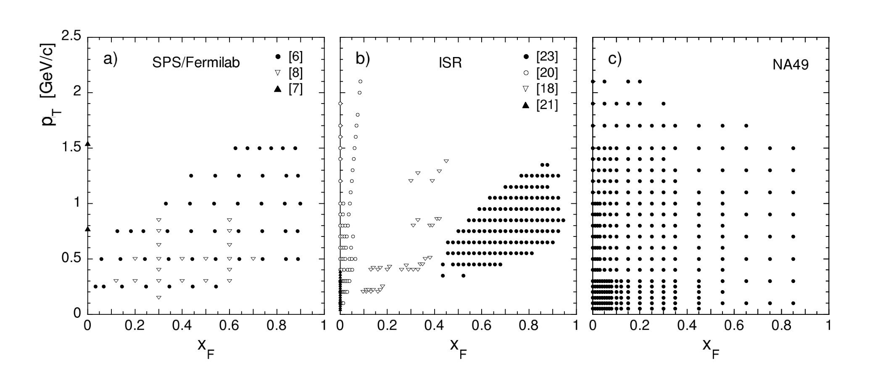
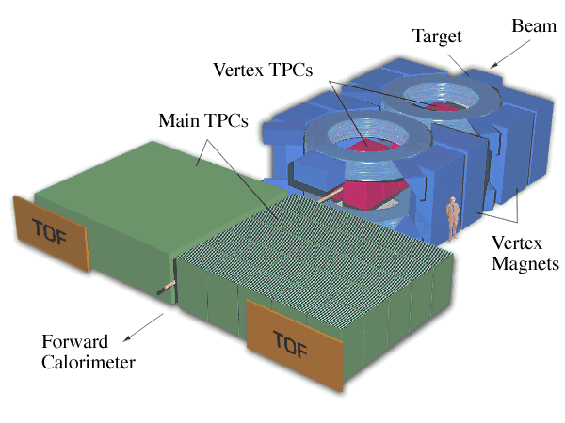

NA49 Experiment
Investigates some predictions of latice QCD
Works at SPS energies (158 GeV/c)
Fixed tareget experiment
Particularly double differential inclusive cross sections of pions in pp collisions was measured
$f\left(x_{F}, p_{T}\right)=E\left(x_{F},p_{T}\right)\frac{d^{3}σ}{dp^{3}}=\frac{E\left(x_{F},p_{T}\right)}{π\sqrt{s}/2}⋅\frac{d^{2}σ}{dx_{F}dp_{T}^{2}}$
$x_{F}=\frac{ p_{L}}{\sqrt{s}/2 }$
$f_{m}\left(x_{F},p_{T},Δp^{3}\right)=\frac{E\left(x_{F},p_{T},Δp^{3}\right)σ_{inel}}{N_{ev}}⋅\frac{Δn(x_{F},p_{T}, Δp^{3})}{Δp^{3}}$

Slide 3
Bayesian Optimization
Evaluate OF at a given point
Build SM
Calculate AF
Minimize AF
Get new point to evaluate OF
Objective function (OF)
Surrogate model (SM)
Acquisition function (AF)

Slide 4
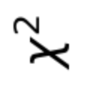
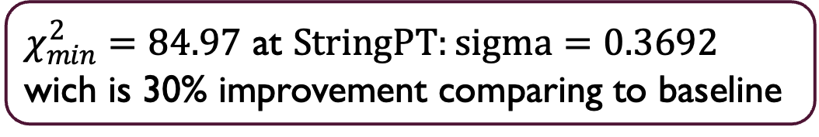
Optimization of one parametr
StringPT:sigma parametr was optimized
Better value of metric function was achived
Global minimum was found
This is proof of principe that baysean optimization could be used for building a PYTHIA tune
$χ_{min}^{2}=84.97$ at $StringPT:sigma=0.3692$ wich is 30% improvement comparing to baseline

Slide 5

Problems with multiparameter optimization
To carry out a multiparameter optimization it is needed to estimate function at many points of parameter space (the higher space dimensionality the more points needed)
It is computationally expensive to calculate a lot of points so some kind of compromise is needed to be found
Our idea was to estimate function values at the beginning using smaller statistics and get coarse view of function relief in parametric space
Then increase statistics and search more carefully for global minimum of the function

Slide 6
Mean shift effect
Statistics (amount of events) | Mean value | Standart Deviation
10⁴ | 973.39 | 82.97
10⁵ | 354.66 | 17.84
10⁶ | 301.55 | 5.62
10⁷ | 294.39 | 1.74
For our method to work the mean value of the distribution must stay the same with increase in statistics
It was found out that the mean value decreases with increase of statistics
Some explanation of the effect should be found to use our method

Slide 7
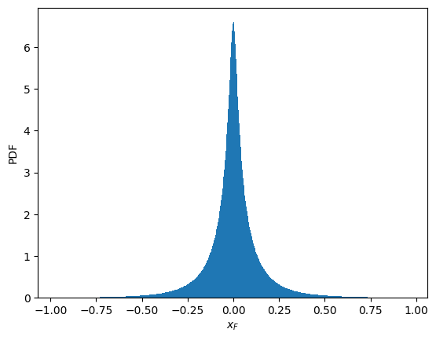
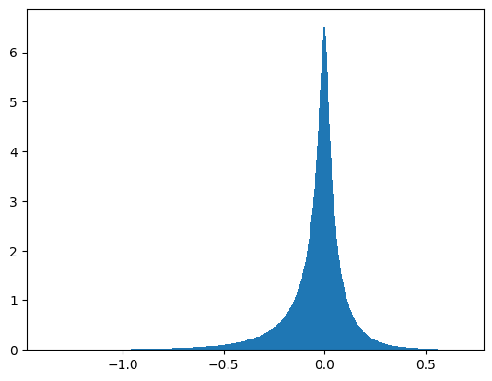
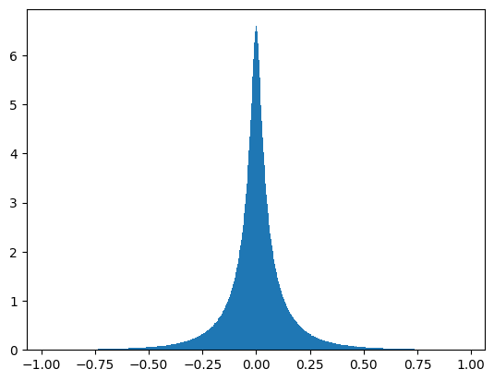
Generator analysis
Manual boost
PYTHIA boost
During analysis of the generator wrong calculation of a boost to the CM frame was found
It was fixed with built in PYTHIA method
The mean shift effect was not explained by this correction

Slide 8
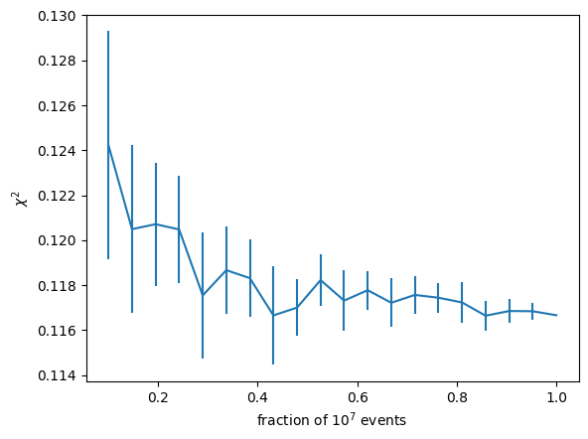
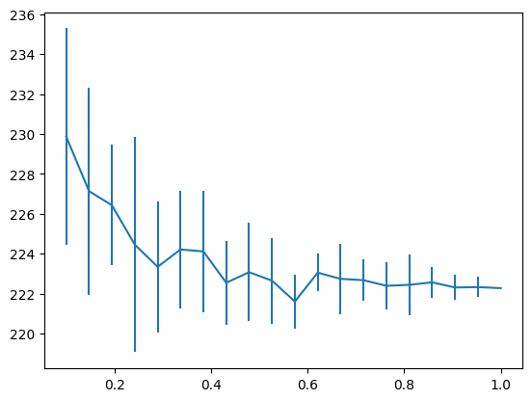
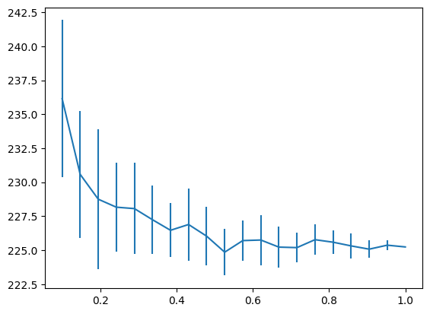
Cross section computation analysis
Mean bin energy
Fixed bin energy

Slide 9
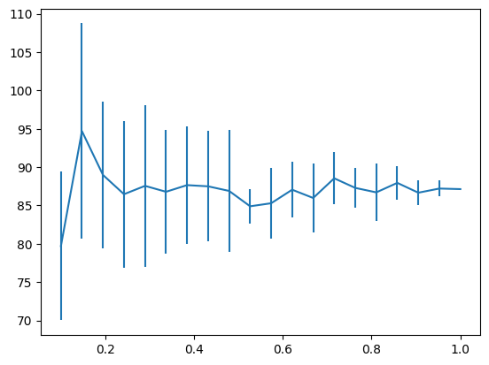
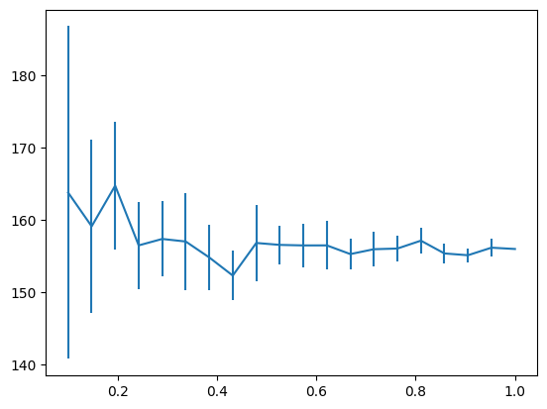
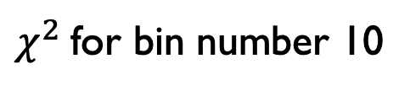
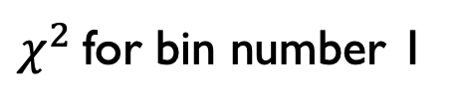
Per Bin Analysis
$χ^{2}$for bin number 1
$χ^{2}$for bin number 10

Slide 10
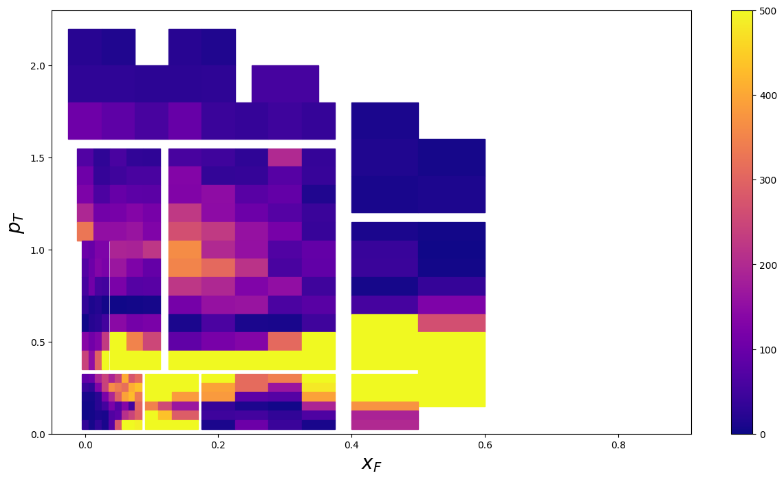
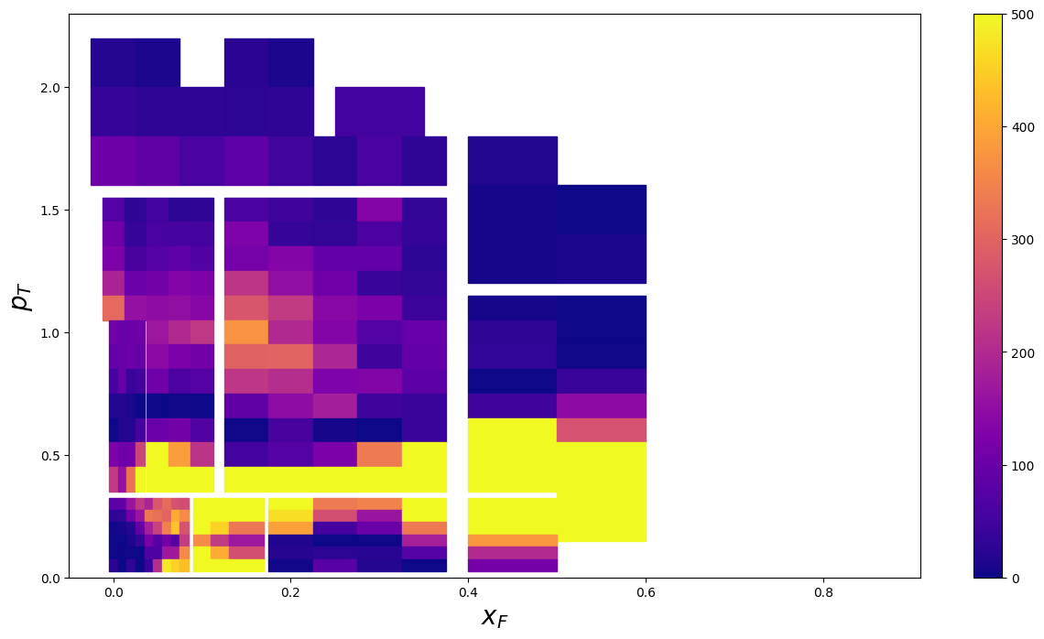
Per Bin Analysis
Per bin distribution for 10⁶ events
Per bin distribution for 10⁷ events

Slide 11
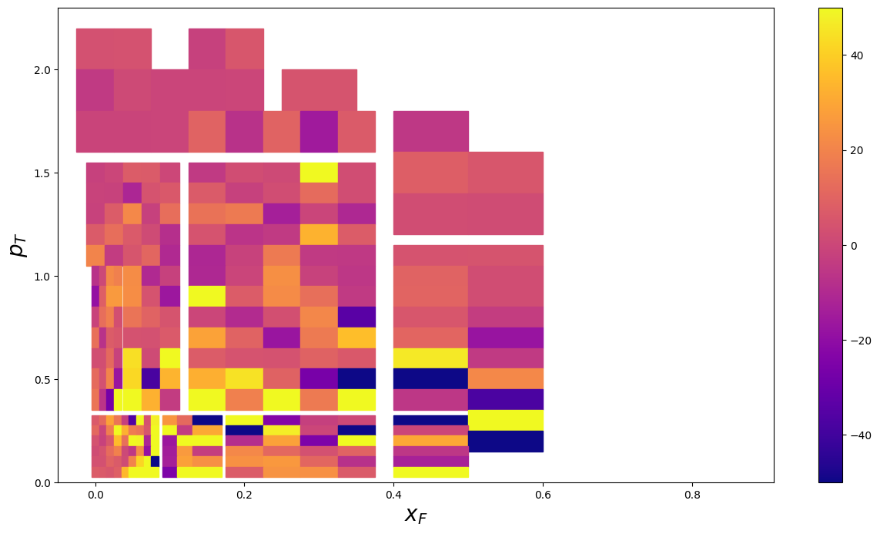
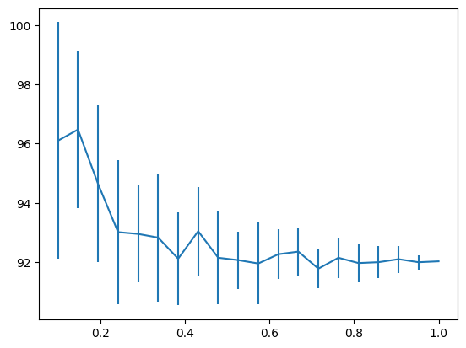
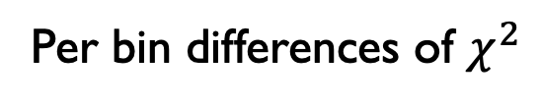
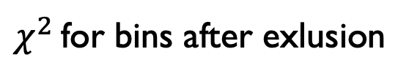
Per bin Analysis
Per bin differences of $χ^{2}$
$χ^{2}$ for bins after exlusion
It seems that individual bins show no mean shift effect
Some bins have too high deviation from avereage error level and could be treated as outliers
Exlusion of outliers has not explained mean shift effect

Slide 12
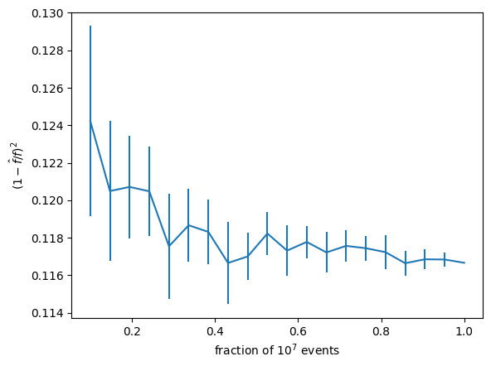
Metric Analysis
It was assumed that bins with different cross section values have different effect on mean value with increase in statistics
All bins were normalized to their experimental value
Although all bins are believed to have the same distribution the mean shift effect still arises during averaging
Mean shift effect for different metric

Slide 13

Conclusion
Mean shift effect was studied
No sufficient explanation was found out
Proposed method of gradually increasing statistics is not applicable
According to the plots at around $5⋅{10}^{6}$ events some sort of saturation is observed so during multiparametric optimization it is chosen to be the starting point for some computational optimization

Slide 14
References
A Tutorial on Bayesian Optimization https://arxiv.org/abs/1807.02811
Improving the Expected Improvement Algorithm https://arxiv.org/abs/1705.10033
Gaussian Processes: A quick Introduction https://arxiv.org/abs/1505.02965
Inclusive Production of Charged Pions in p+p Collisions at 158 GeV/c Beam Momentum https://arxiv.org/pdf/hep-ex/0510009
scikit-learn documentation https://scikit-learn.org/stable

