Slide 1
GROUP 2
FN-Bert
FN-Bert
A few-shot Bert-based Model for
Chinese Nested Medical NER
Zhang Le 2030026202
Zhang Siruna 2030026215
Li Xiaole 2030026077
Deng Shenhua 2030026026
Luo Hengyi 2030026102

Slide 2
CONTENT
01
02
03
04
05
Introduction
Model
Experiment
Conclusion

Slide 3
Introduction
/ 01
Core Part · Aim

Slide 4
Brief Introduction
Core Part
Aim
Improve the accuracy of TCM text information QA Chatbot in clinical diagnosis and provide more effective support for the research of Chinese medicine.
Name Entity Recognition (NER) through the deep learning model for Traditional Chinese Medicine (TCM) text information.

Slide 5
Model
/ 02
Baseline · Nested NER · Few-shot

Slide 6
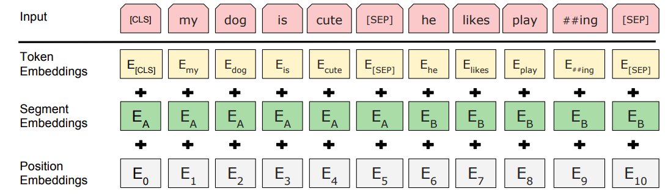
Baseline: Bert-CRF
Bert: Bidirectional Encoder Representation from Transformers
CRF: Conditional Random Field
Decide whether to use in the classification tasks
To separate two sentences

Slide 7
Two Pre-trained Model
Motivation: make model more suitable for sentence-level tasks
Masked Language Model
Next Sentence Prediction
Normal language model:
Modeled from left to right
(or right to left)
Loss function is intuitive:
Predict the probability of
the next word
Bert:
Collect all the words
No concept of next word
No loss function
∴ Adopt cloze to measure its loss
In many
downstreamtasks:
Judge the relationship
between two sentences
QA question
Judge whether one sentence
is the answer to another sentence
Natural Language Inference (NIL) question
Three kinds of relationship judgment between two sentences
Due to the uniqueness of Bert, it adopts two pre-trained tasks.

Slide 8
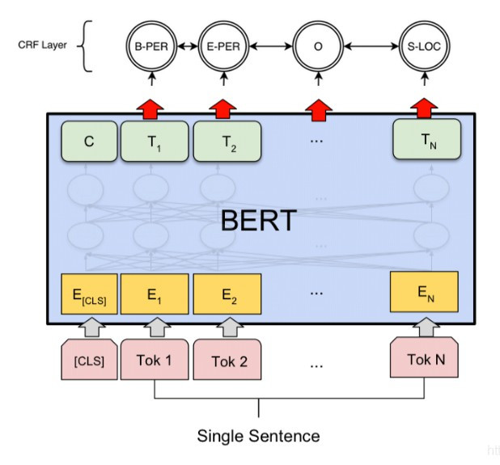
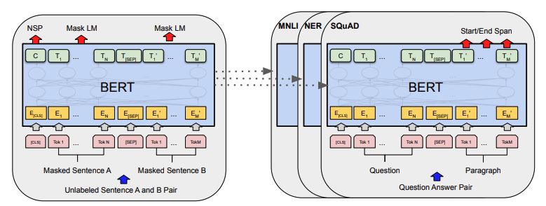
Fine-Tuning in NER: CRF
Different
Output Layer
Same Architecture
Pre-training
Fine-Tuning
Above is the overall architecture of Bert.
In addition to the output layer, the same architecture is used
during the pre-training and fine-tuning phases.
The parameters of pre-trained model are used to
initialize the models for different downstream tasks, such as Multi-Genre Natural Language Inference and Question Answering.
For NER task, it is simple that
we only need a single sentence and add a CRF layer on the top.

Slide 9
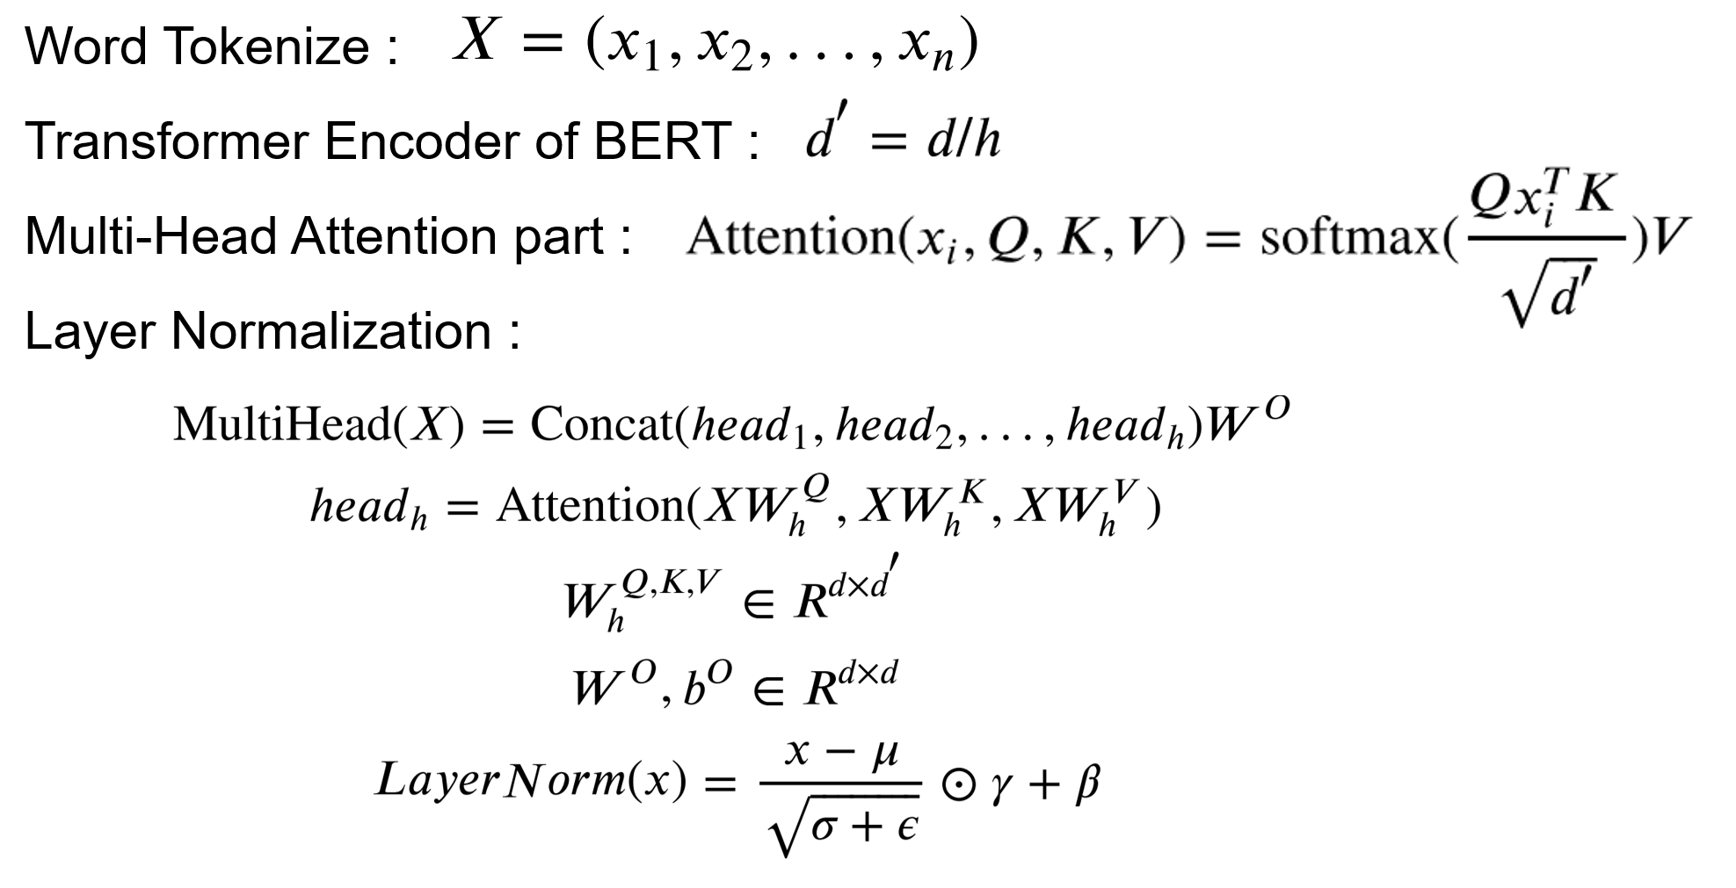
Nested NER: Bert-Span
Word Tokenize :
Transformer Encoder of BERT :
Multi-Head Attention part :
Layer Normalization :
Mathematical derivation

Slide 10
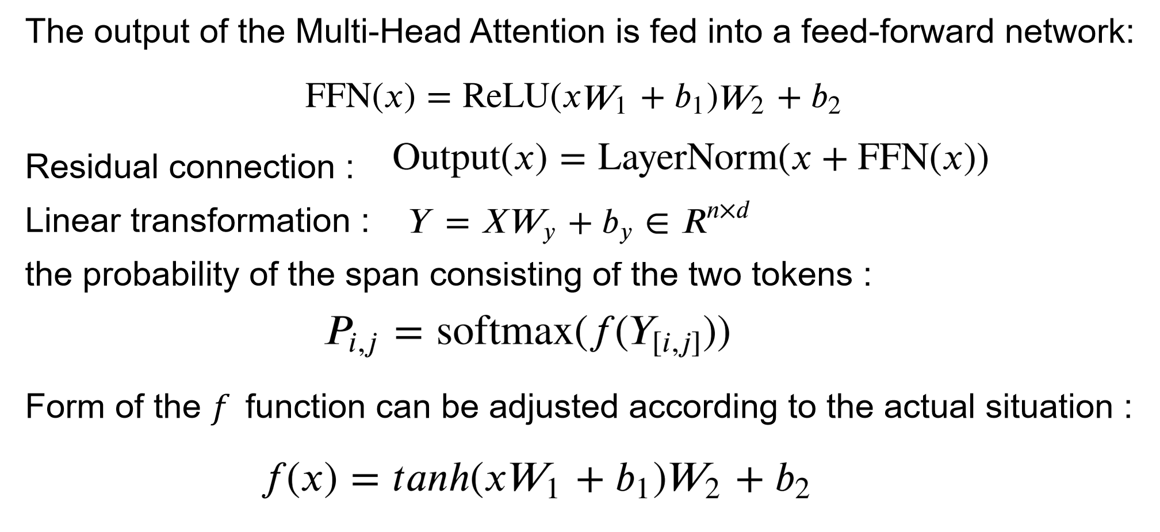
Nested NER: Bert-Span
Mathematical derivation

Slide 11
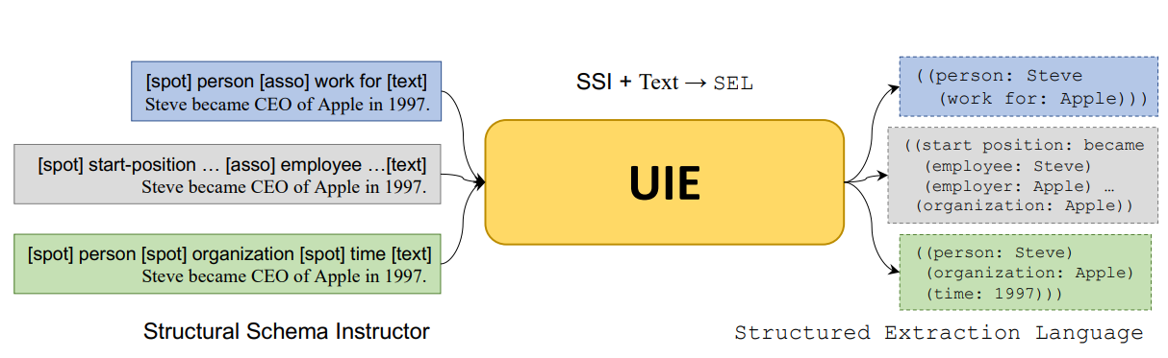
Universal Information Extraction

Slide 12
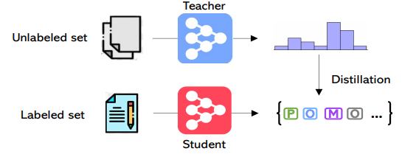
Self-Training

Slide 13
Experiment
/ 03
Implementation · Experimental Results

Slide 14
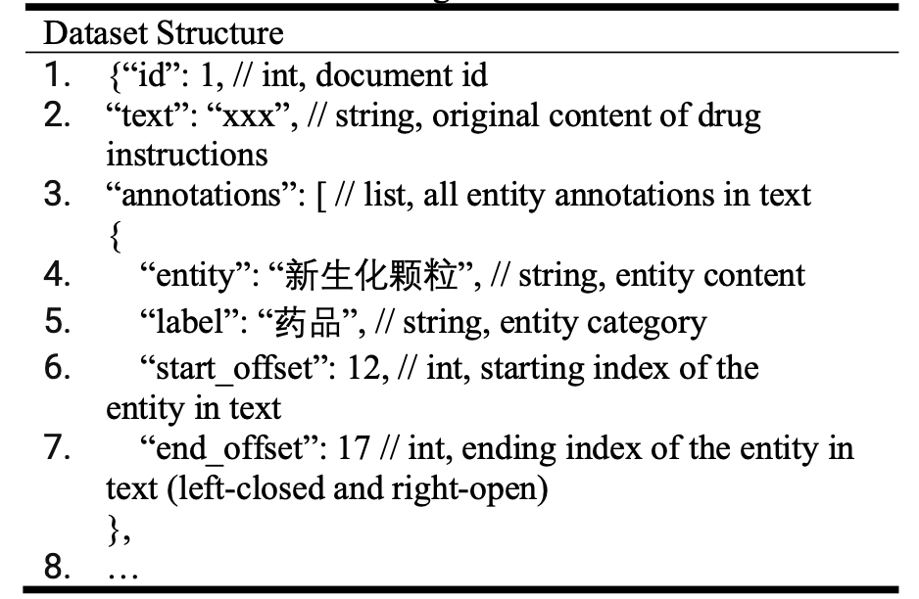
Dataset
The label is char-level
Using char-level Bert tokonizer

Slide 15
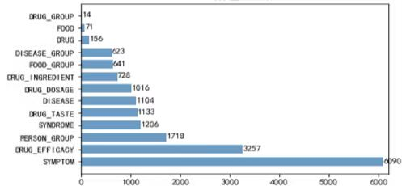
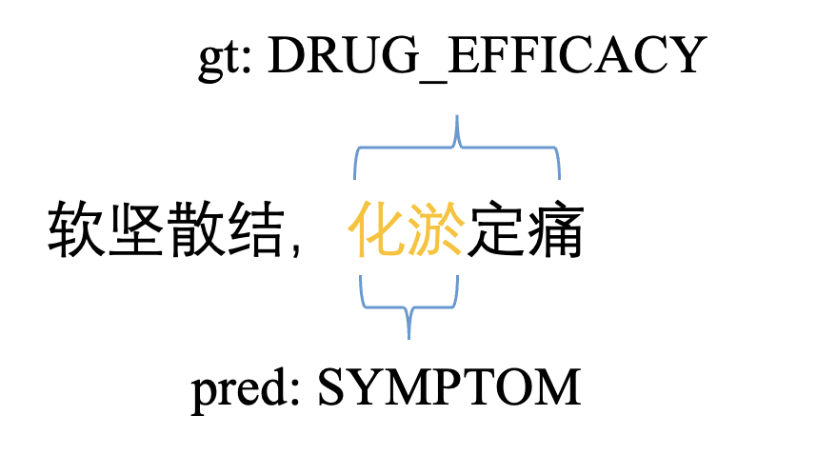
Dataset
Distribution of the dataset.
An example of nested entity

Slide 16
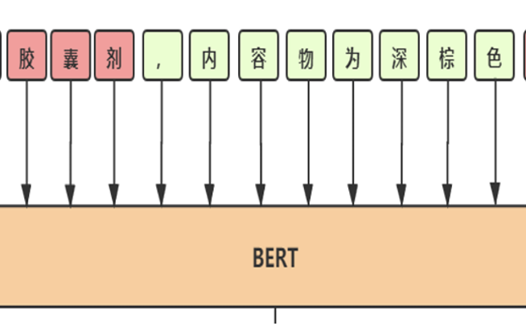
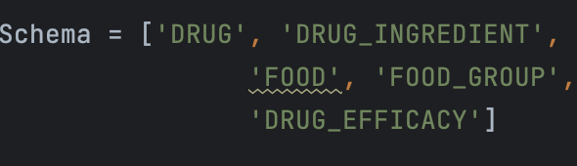
Data Preprocessing
S:0
E:3
糖尿病人
I:1,2
tokenize
indexing
UIE
Using char-level tokenizor
Define the finegrained entitiy position index
Using UIE to make prediction on unlabeled example and use them as training data

Slide 17
Experiment Result
Methods | Precision | Recall | F1 | Speed s/20 epochs
Bert-base-CRF | 0.8193 | 0.8283 | 0.8237 | 4
Roberta-large- CRF | 0.7822 | 0.8727 | 0.8249 | 17
Roberta-large- CRF-Auto | 0.8136 | 0.8492 | 0.8310 | 17
UER-large-CRF | 0.8065 | 0.8677 | 0.8360 | 17
UER-large-CRF-Auto | 0.8248 | 0.8643 | 0.8440 | 17
UER-large-CRF-Auto-UIE | 0.8726 | 0.8769 | 0.8747 | 17
UER-large-Span-Auto-UIE | 0.8124 | 0.8482 | 0.8299 | 11

Slide 18
Conclusion
UER model is the best backbone model for preprocessing.
CRF layer can solve NER task well.
Auto-training + LLM can makes precision and recall balance and therefore improve F1 score up to 5%.
Span pointer network can speed up running time up to 35% and solve nested entity well.
Future work:
Find better prompt method and predict on large scale data to get better and larger pseudo training data.
Find method to the model ensemble to make the span pointer model perform better not only on nested entities but also on flat entities

