Slide 1
The future of presenting starts here.
GDG Android WEAR HACKATHON BOSTON JAN 2015

Slide 2
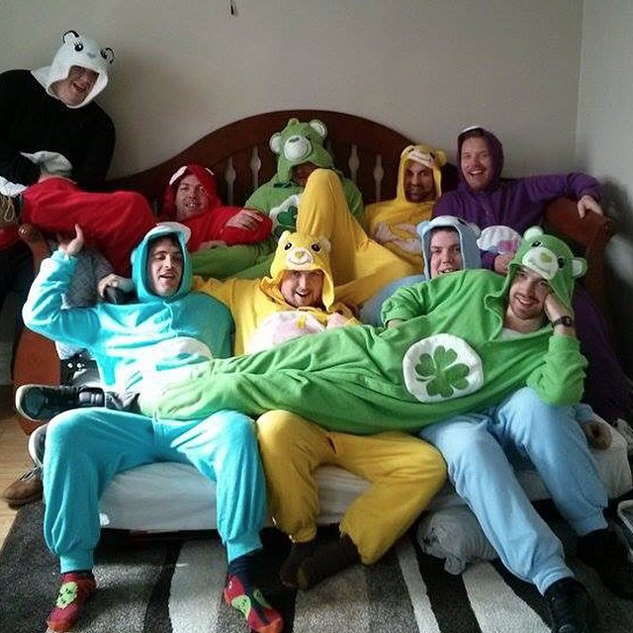
About us
Triple d
PHOTO OF STAFF OR WORKPLACE
(876X 272H)
Enthusiastic about technology and originally from Ireland, all of us have been working in various areas of the IT world for a number of years.

Slide 3
flow

Slide 4
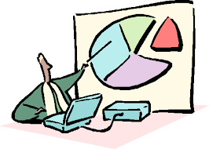
IDEA OR HERO IMAGE HERE
(876W X 553H)

Slide 5
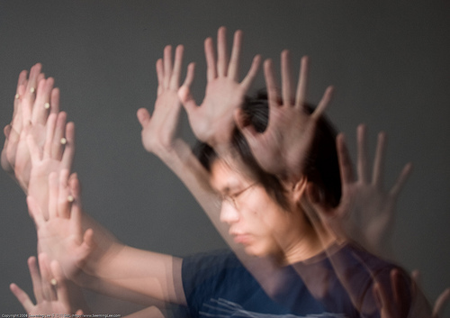
A Case study
USE CASE
CASE STUDY HERO IMAGE
(572W X 449H)
Hackathon Presentation.
TODAY
Have to manually control a presentation while presenting.
NEXT GEN
Use wearables to run the presentation using natural gestures.

Slide 6
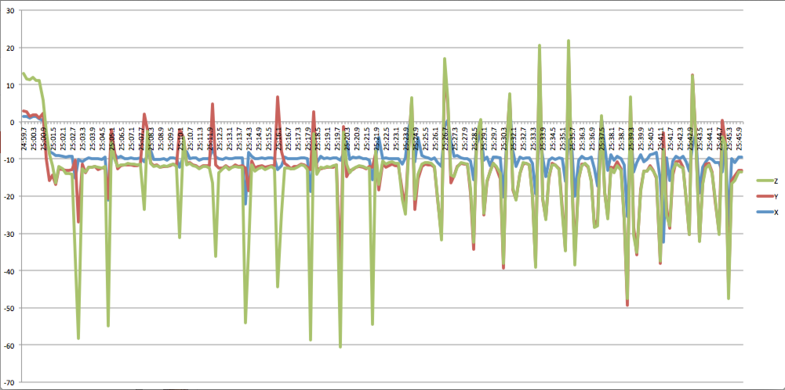
Graph example
A Sub header can go here
CASE STUDY HERO IMAGE
(572W X 449H)
Action B
Action a

Slide 7

Other Applications

Slide 8
Thank you.
Any questions?

