Slide 1
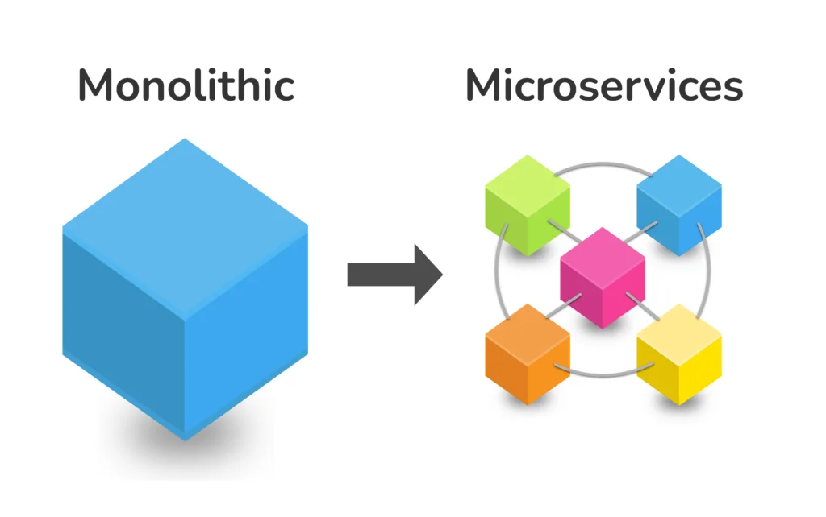
MicroServices RoadMap
Dr. Maryam lotfi
Seyed Alireza tabatabaeian

Slide 2
What we need to know
Docker
Container Orchestration
Container Management
API gateway
Load Balancing
Service Discovery
Event Bus
Logging
Monitoring
Distributed Tracing
Data Persistence
Caching

Slide 3
roadmap
Learn a language
Docker
Container Orchestration
Docker Container Management
API Gateway
Load Balancing
Service Discovery
Event Bus
Logging
Monitoring And Alerting
Distributed Tracing
Click on each topic to see its details

Slide 4
Learn a language
Learn a language
C#
Python
Go
The green icons have its own roadmap (ctrl-click to view)
Back

Slide 5
Docker
What
Docker is an open-source platform for containerizing your applications, with the libraries, and dependencies that your application needs to run in various environments.
Why
Docker is one of the tools to containerize applications safer and faster.

Slide 6
Docker
Docker
Docker Desktop
Docker CLI
Back

Slide 7
Container Orchestration
What
After you containerize your application, you will need some tools for managing containerized applications for doing some manual and automated operations like horizontal scaling.
Why
These tools provide some services for your application management like automated load-balancing, guarantee high service availability.

Slide 8
Container Orchestration
Container Orchestration
Kubernetes
K8s
Docker Swarm
Back

Slide 9
Docker Container Management
What
Managing Docker environment, configuration management, and providing the environment security, etc. These concerns can be centralized and automated by a docker container management tool.
Why
A Docker container management tool provides a GUI-based tool for users, and they do not have to deal with CLI which is not comfortable for all users.

Slide 10
Docker Container Management
Docker Container Management
Portainer
DockStation
Kitematic
Rancher
Back

Slide 11
API Gateway
What
An API gateway can be considered as an API management tool that works as a middleware between your application services and different clients.
Why
Without an API gateway, you may need to do some cross-cutting concerns in every service, for example, if you want to log the request and response for services.
It can handle, Routing, logging, authorization, profiling and caching.
Besides, if your application consists of several services, your client needs to know about each service address

Slide 12
API Gateway
API Gateway
Kong
Ocelot
Back

Slide 13
Load balancing
What
One of the most important reasons that we have chosen the microservice architecture is scalability, Which means we will be able to handle more requests by running more instances of our services. Load Balancing means sharing the income traffic between a service instance
Why
In order to scale your independent services, you need to run several instances of the services. With a load balancer, clients do not need to know the right instances which serving.

Slide 14
Load balancing
Load balancing
Traefik
NGINX
Seesaw
Back

Slide 15
Service discovery
What
As your application services count getting more and more, services need to know each other service instance addresses, but in large applications with lots of services, this cannot be handled. So we need service discovery which is responsible to provide all components addresses in your application.
Why
When you can have several services in your application, service discovery is a must have for your application.

Slide 16
Service discovery
Service discovery
Consul
Zookeeper
Eureka
Etcd
Keepalived
Back

Slide 17
Evet bus
What
you may use GRPC or HTTP call between services to get the response, sync and async programming etc. need event bus.
Why
If you want to have a scalable application with several services, one of the principles you would follow is to create loosely coupled services that interact with each other through an event bus.

Slide 18
Evet bus
Evet bus
RabbitMQ
Kafka
Back

Slide 19
Logging
What
When using a microservice architecture pattern it’s better to centralize your services logs. These logs would be used in debugging a problem.
Why
In case of any need to debug a request, you may face difficulty if you do not gather services logs in one place. You are also able to correlate the logs related to a specific request with a unique correlation Id.

Slide 20
Logging
Logging
Elastic Logstash
Back

Slide 21
Monitoring And Alerting
What
In a microservice architecture, if you want to have a reliable application or service you have to monitor the functionality, performance, communication, and any other aspects.
Why
You need to monitor the overall functionality and services health, also need to monitor performance bottlenecks and prepare a plan to fix them. Optimize user experience by decreasing downtime.

Slide 22
Monitoring And Alerting
Monitoring And Alerting
Prometheus
Kibana
Grafana
Back

Slide 23
Distributed Tracing
What
when it comes to microservice architecture, because a request may be passed through different services, which makes it difficult to debug and trace because the codebase is not in one place, so here distributed tracing tool can be helpful.
Why
Without a distributed tracing tool it's frustrating or maybe impossible to trace your request through different services.

Slide 24
Distributed Tracing
Distributed Tracing
OpenTelemetry
Jeager
Zipkin
Back

Slide 25
Sources
name | link
Medium - Matt Ghafouri | Ctrl-Click
Roadmap | Ctrl-Click

