Slide 1
Capstone Project
by Glyne G, Kevin E, Kevin Y

Slide 2


What is our project?
Users make music inside sessions
Inside the session users can create music or just hang out and listen
Users create music using a step-sequencer pad
User created music is streamed to all users inside the session on the listen page

Slide 3
Glyne G
Set up Paperspace webserver to make our code and results deployable.
Did this by configuring Nginx, pm2, nodejs, and mongodb to run on the server and expose it to the internet
Worked on the backend of the project
Creating the code to:
Establish a connection to the database
Migrate seed data into the database
Serve routes that load webpages
Save data to the database and audio files to our designated directory

Slide 4
Backend Routes
/index | Root of the project
/session | Root route for a Song creating Session
---/:session_id | Look at the Details of a Session
---/new | Create a new Session
---/createSong | Create a song that is a part of current Session
---/list | Show a list of current Sessions
---/listen | Listen to the music created in that Session
/song | Root route for a Song
---/upload | Upload a song to the backend server
/signup | Route for signing up for the site
/login | Route for logging into the site

Slide 5

Backend Routes: Sample

Slide 6
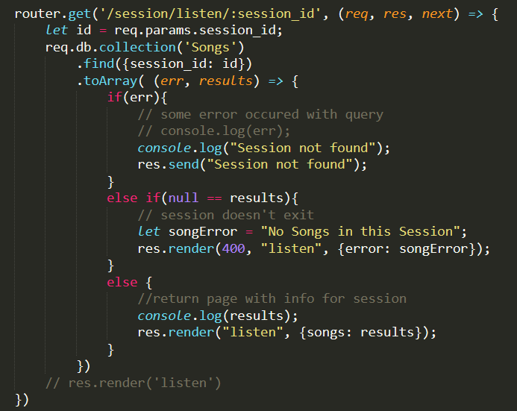

Slide 7

Kevin Y
Worked on how to stream to the front-end.
By using the MSE API it made things easier with streaming and buffering videos.
FFMPEG was used to decode the audio file and streaming it to the front end
Located the paths of audio files through mongodb

Slide 8

APIs
Media Source Extensions (MSE) - used to provide functionality enabling plugin-free web-based streaming media. Using MSE, media streams can be created via JavaScript, and played using <audio> and <video> elements.

Slide 9
Kevin E
Worked on the frontend.
The pad itself, generating sound using the WebAudio API.
Recording the music using the MediaStream API.

Slide 11

Frameworks
MongoDB
Express
NodeJS
Nginx
API
WebAudio
MediaStream-Recording
Media Source Extensions (MSE)
Languages
JavaScript
HTML (ejs)
CSS

Slide 12
“Working” Presentation
74.82.53.202
Click on Sign up

