Slide 1
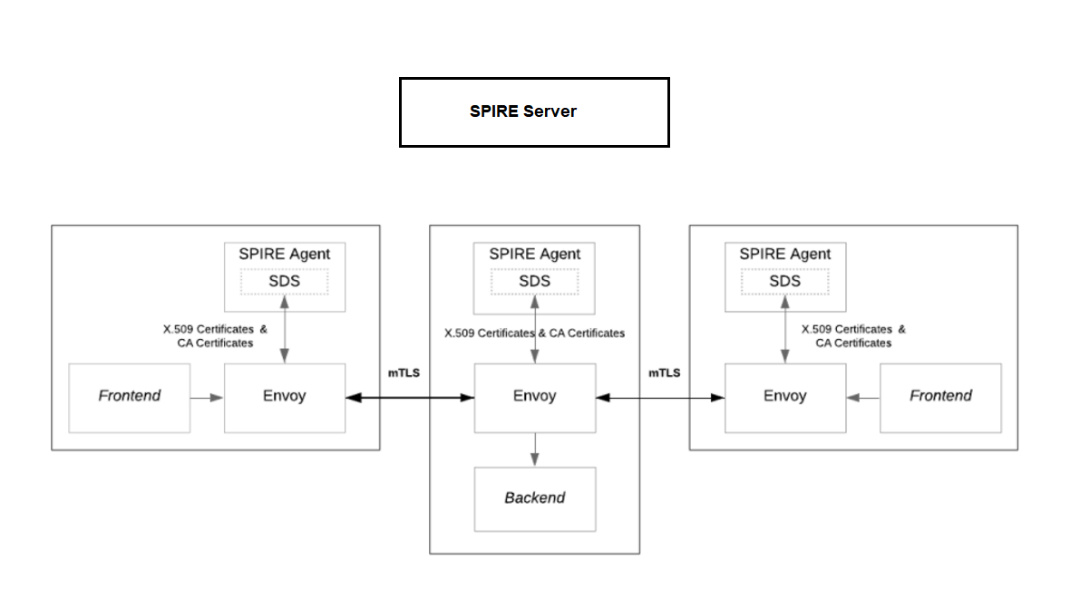
Workload Registration entries
K8s worker node
K8s worker node
K8s worker node

