Slide 1
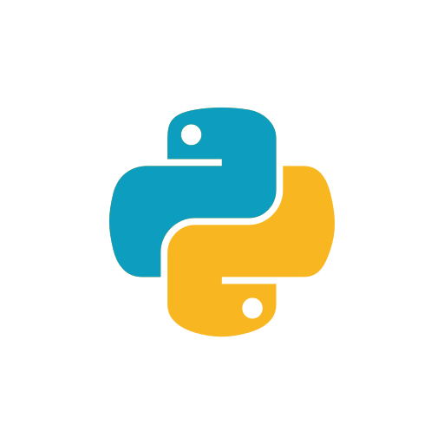
Introduction to
Python Programming

Slide 2
What is Python?
→Python is a General Purpose Programming Language
→ Its Objected Oriented, Dynamically Typed, Interpreted Language
→ Its also considered as one of the Easiest
Programming Language to learn
→ It runs on all popular Operating systems like Mac, Linux and Windows.

Slide 3
Python is highly readable because it uses white space indentations to delimit code blocks rather than using curly braces.

Slide 4
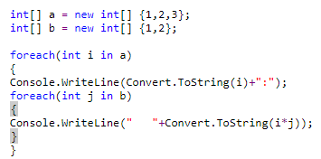
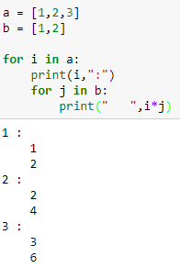

Python is highly readable because it uses white space indentations to delimit code blocks rather than using curly braces.

Slide 5
Some of the big companies like google,yahoo,NASA,Red hat,IBM and many more use python.
What Can you do with Python?
Web development using frameworks like Django, TurboGears, web2py.
Game development using PyGame
Data analysis using Pandas, matplotlib, numpy.
Machine Learning using scikit learn.
Natuaral Language Processing using NLTK.
Image processing using OpenCV.
Deep Learning using Tensorflow,Keras CNTK.
.... and the list is endless.

Slide 6
Installing Python !
Method 1)Anacondas
Method 2) python.org

