Slide 1
Transfer Function
CS171-1 TA Team

Slide 2
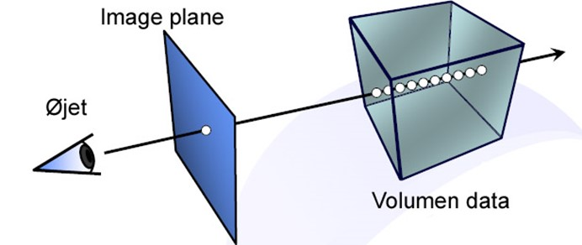
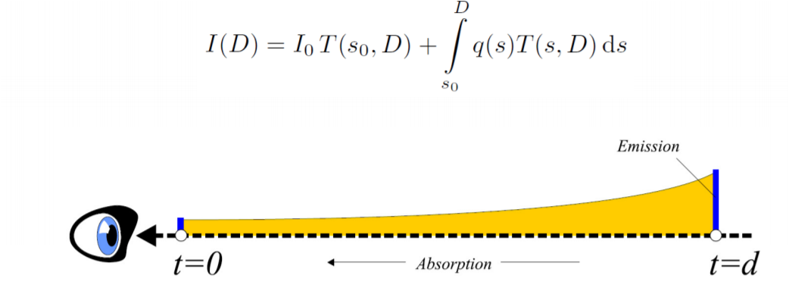
Integration (Continuous）

Slide 3
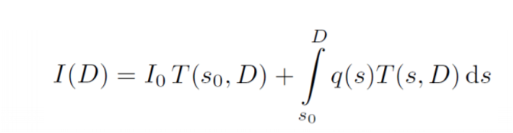
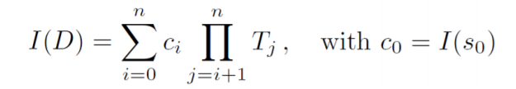
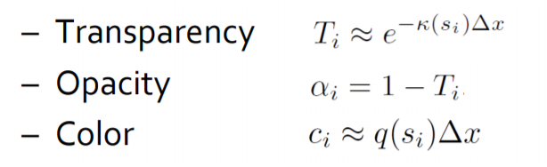
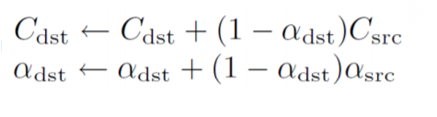
Integration (Discrete）
?

Slide 4
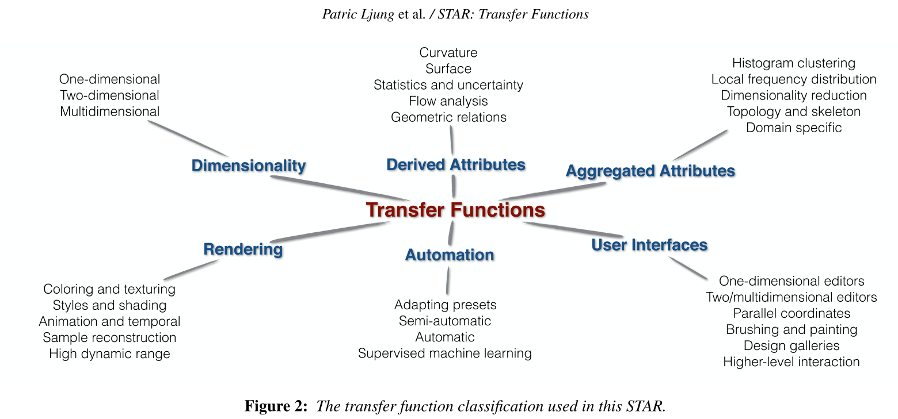
Transfer Function
translating scalar and multivariate data into color and opacity
Notes:
可以根据用途或者数据来源对Transfer function分类，从这张图上也可以发现，transfer function的数据来源和种类也是非常多的。

Slide 5
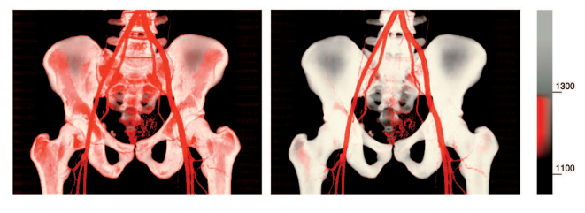
Render Iso-surface
Input:
Volume data -> 1d scalar ( intensity)
Ouput:
Opacity / Color

Slide 6
What we want
Input:
Volume data -> 1d scalar ( intensity)
Ouput:
Opacity / Color
opacity
intensity
Combination of delta functions

Slide 7

Opacity
Input:
Volume data -> 1d scalar ( intensity)
Ouput:
Opacity / Color
opacity
intensity
Combination of Gaussian pdf

Slide 8
Emission
Input:
Volume data -> 1d scalar ( intensity)
Ouput:
Opacity / Color
emission
intensity
Combination of Gaussian pdf

Slide 9
Resources
Paper: State of the Art in Transfer Functions Direct Volume Rendering

