Slide 1
VolumeRendering
CG1 TA Team

Slide 2
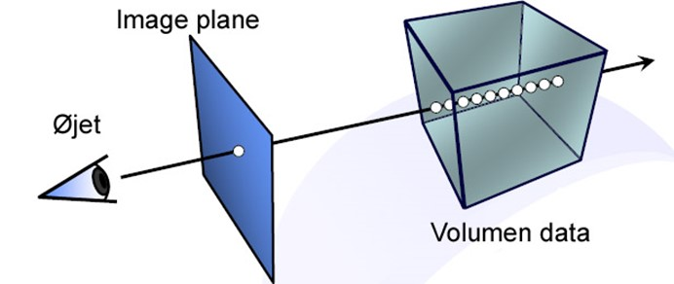
Ray-casting Volume Rendering

Slide 3
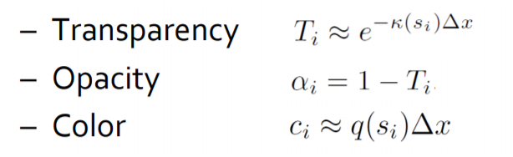
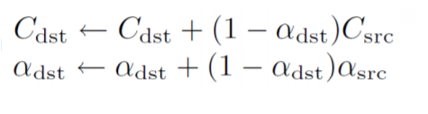

Front to Back Composition
Initialization
$$c_{dst}= \left(0,0,0\right)$$
$$α_{dst}=0$$
Notes:
每一个点代表对局部区域内介质情况的估计，包含了颜色和不透明度。
从眼睛出发去看，当前看到的颜色 = 已累计的能量+ 累积的前面所有介质的吸收*该点能量
对于下一点来说，它能透过多少多少能量最终到达眼睛，取决于前累积的吸收加上和自己该点的吸收

Slide 4

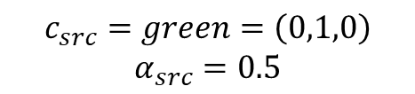
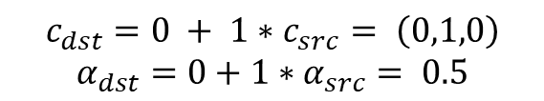
Front to Back Composition
$$c_{src}=green=\left(0,1,0\right)$$
$$α_{src}=0.5$$
$$c_{dst}= \left(0,0,0\right)$$
$$α_{dst}=0$$
Update 1 sample
$$c_{dst}=0 + 1∗c_{src}= \left(0,1,0\right)$$
$$α_{dst}=0+1∗α_{src}= 0.5$$

Slide 5

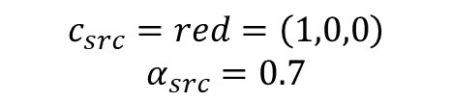
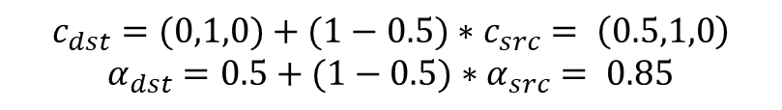
Front to Back Composition
$$c_{src}=red=\left(1,0,0\right)$$
$$α_{src}=0.7$$
$$c_{dst}= \left(0,1,0\right)$$
$$α_{dst}= 0.5$$
Update 1 sample
$$c_{dst}=(0,1,0)+(1−0.5)∗c_{src}= \left(0.5,1,0\right)$$
$$α_{dst}=0.5+(1−0.5)∗α_{src}= 0.85$$

Slide 6


Back to Front Composition
Initialization
$$c_{dst}= \left(0,0,0\right)$$
Notes:
从后往前，想象成能量传输到眼睛过程中需要经过层层衰减
首先每一步累积的能量通过该点之后都会被吸收一部分，
然后再加上该点的能量

Slide 7

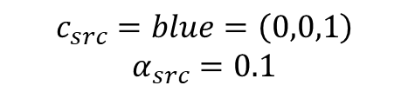
Back to Front Composition
$$c_{src}=blue=\left(0,0,1\right)$$
$$α_{src}=0.1$$
$$c_{dst}= \left(0,0,0\right)$$
Update 1 sample
$$c_{dst} =\left(1−0.1\right)∗0 + c_{src}= \left(0,1,1\right)$$

Slide 8

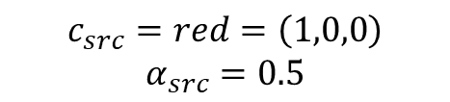
Back to Front Composition
$$c_{src}=red=\left(1,0,0\right)$$
$$α_{src}=0.5$$
$$c_{dst}= \left(0,0,1\right)$$
Update 1 sample
$$c_{dst} =\left(1−0.5\right)∗(0,0,1) + c_{src}= \left(1,0,0.5\right)$$

Slide 9
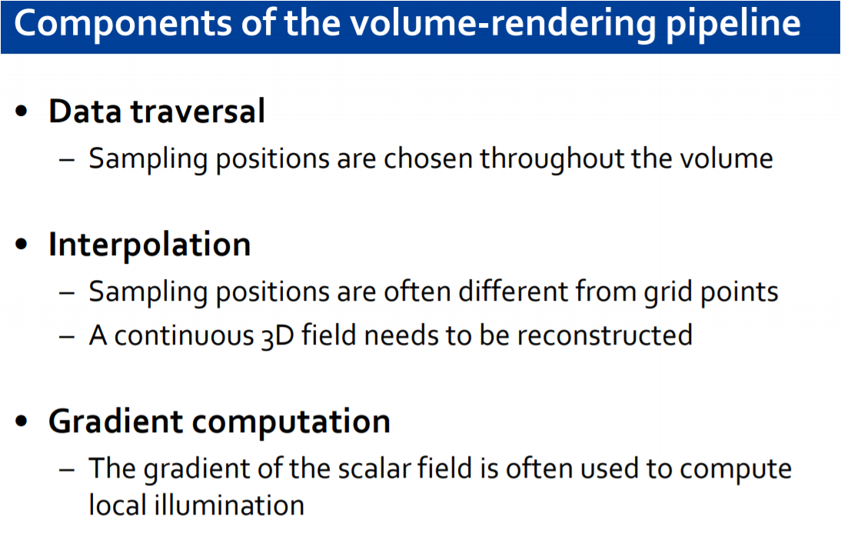

Slide 10
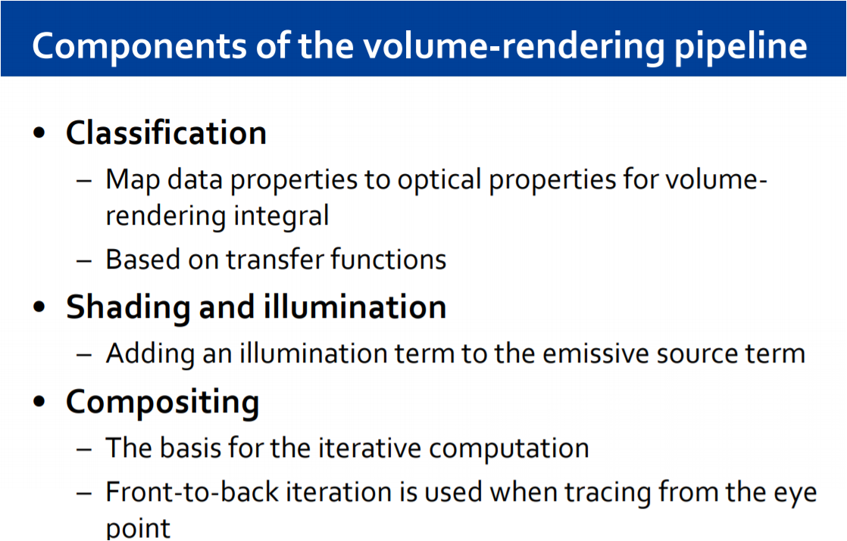

Slide 11
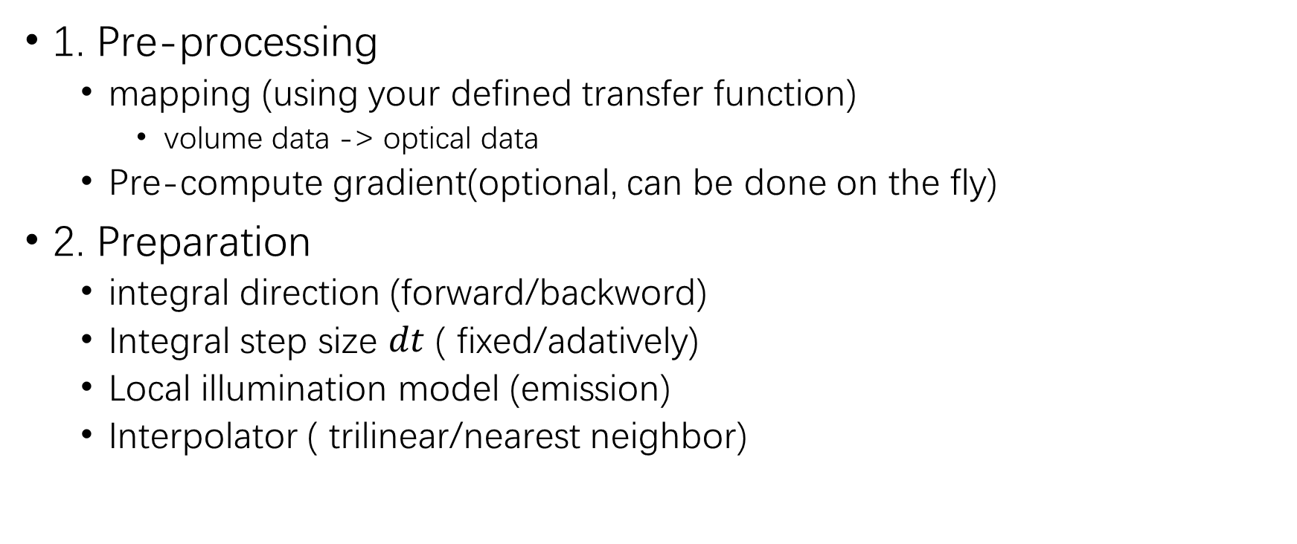
Steps
1. Pre-processing
mapping (using your defined transfer function)
volume data -> optical data
Pre-compute gradient(optional, can be done on the fly)
2. Preparation
integral direction (forward/backword)
Integral step size $dt$ ( fixed/adatively)
Local illumination model (emission)
Interpolator ( trilinear/nearest neighbor)

Slide 12
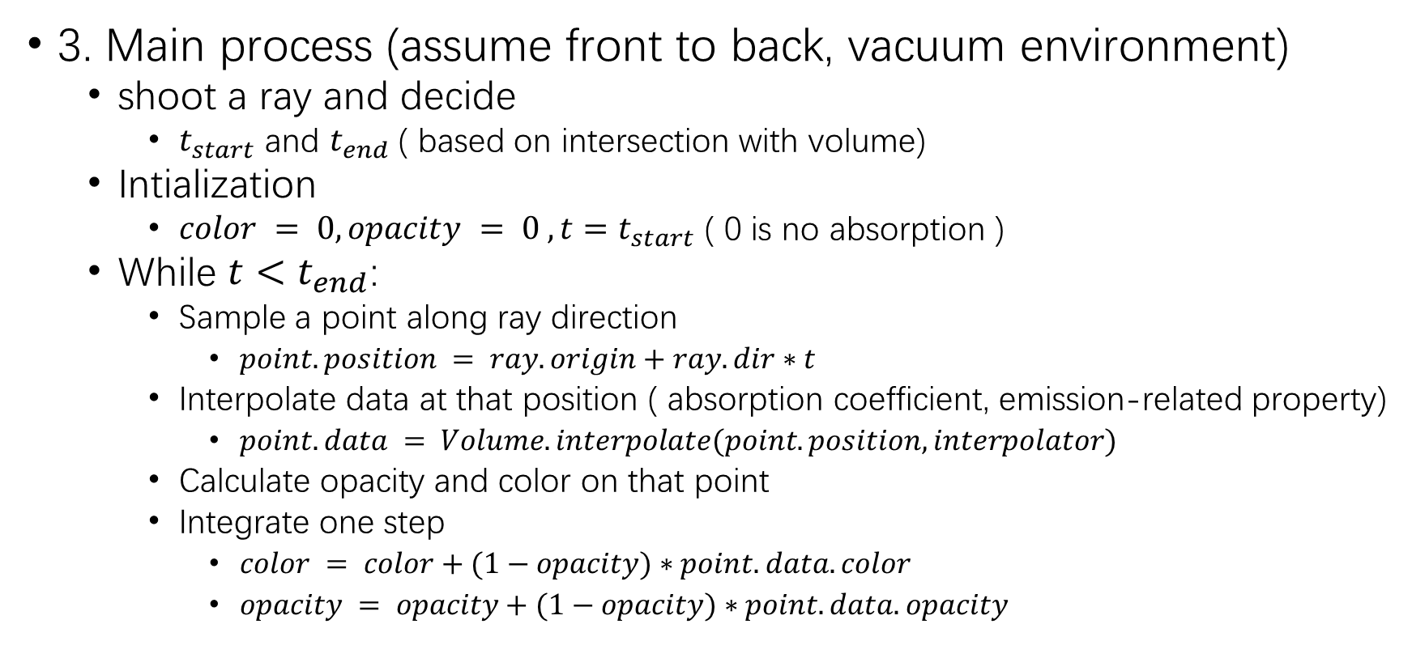
Steps
3. Main process (assume front to back, vacuum environment)
shoot a ray and decide
$t_{start}$ and $t_{end}$ ( based on intersection with volume)
Intialization
$color = 0, opacity = 0 ,t=t_{start}$ ( 0 is no absorption )
While $t<t_{end}$:
Sample a point along ray direction
$point.position = ray.origin+ray.dir∗t$
Interpolate data at that position ( absorption coefficient, emission-related property)
$point.data = Volume.interpolate(point.position,interpolator)$
Calculate opacity and color on that point
Integrate one step
$color = color+(1−opacity)∗point.data.color$
$opacity = opacity+(1−opacity)∗point.data.opacity$

