Slide 1
SI151 Project
movie review classification
qiult@shanghaitech.edu.cn
shqj@shanghaitech.edu.cn fuxiang@shanghaitech.edu.cn

Slide 2
1
Data Introduction
2
Feature Generation
Outline
3
Classfier Methods
4
Result Evalution

Slide 3
Part .01
Data Introduction

Slide 4
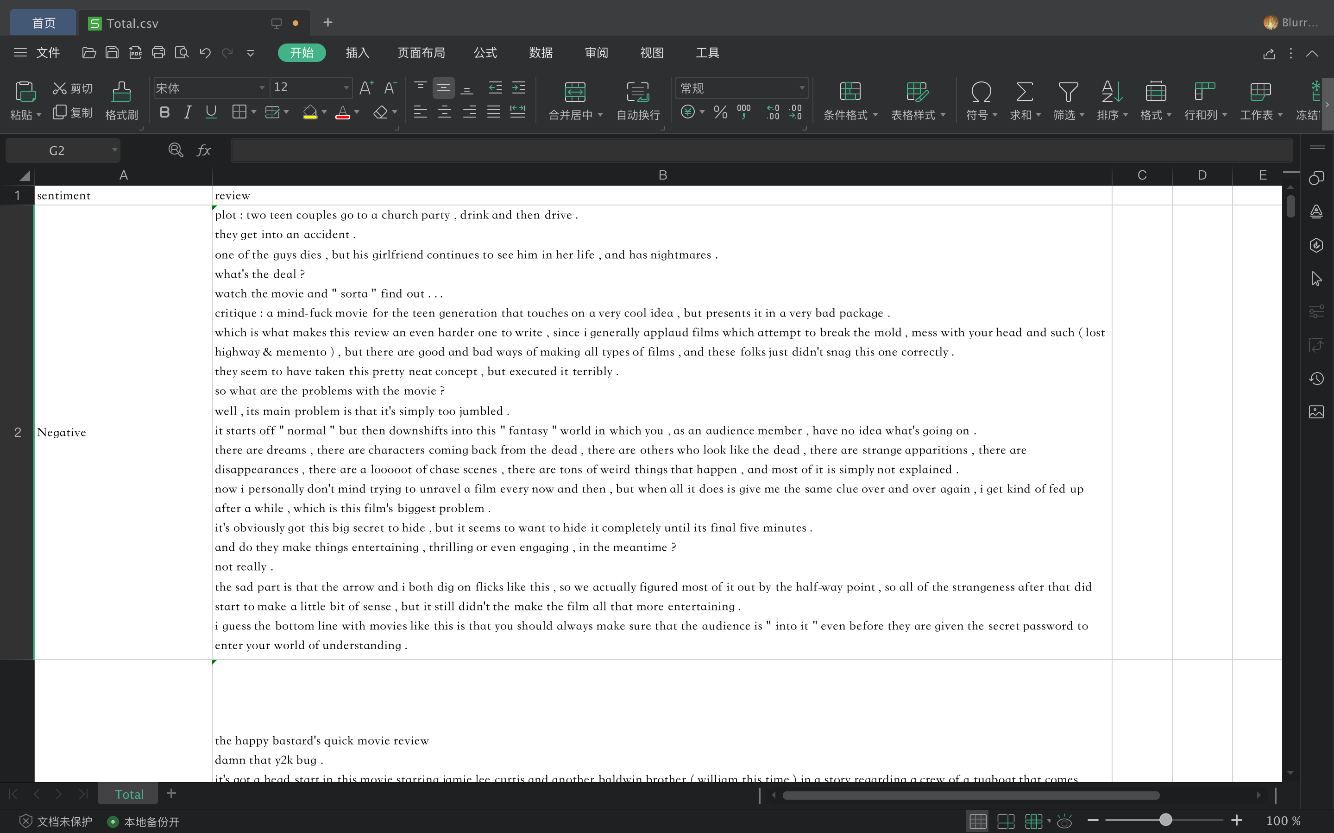
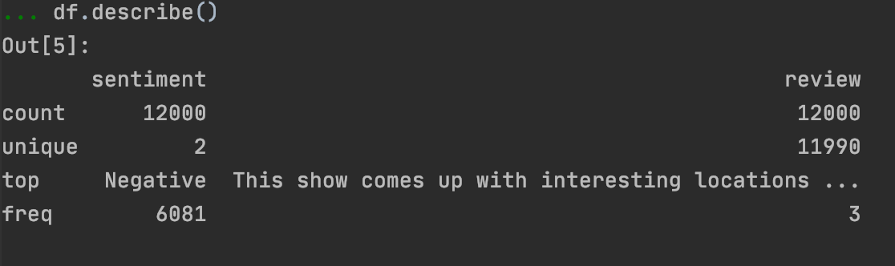
Data Introduciton
Data source: Kaggle, Cornell
Columns:
sentiment: positive or negatvie
review: movie reviews

Slide 5
Part .02
Feature Generation

Slide 6
Feature Generation
Methods:
1.LDA
2.Doc2Vec
3.Top2Vec
4.Sentence Bert
5.Bert Topic
Result:
1.Doc2Vec(200) + LDA(20) + Top2Vec(20) + Sentence Bert(20) + Bert Topic(20)
2.Doc2Vec(200) + LDA(80)
3.Doc2Vec(200) + Top2Vec(80)
4.Doc2Vec(200) + Sentence Bert(80)
5.Doc2Vec(200) + Bert Topic(10)

Slide 7
Part .03
Classifier Methods

Slide 8
Classifier method
Classification of several methods, code implementation
Neural network
SVM
Random Forest

Slide 9
Classifier
Classification of several methods, code implementation
Neural network
n cells
50 cells
20 cells
1 output

Slide 10
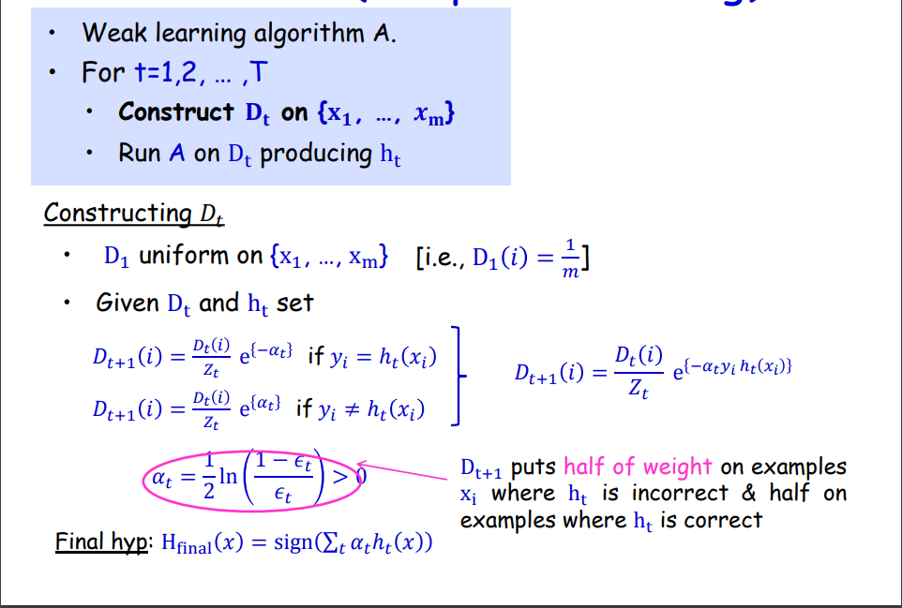
Classifier
Classification of several methods, code implementation
Adaboost

Slide 11
Part .04
Result Evalution

Slide 12
Result Evalution
error rate for different features and classifiers

