Slide 1
Visualization type selection (ex: number of mutations, class switch)
query parameters that depend on visualization type selection (ex: for antibody types, select one/more)
Zoomable stacked area time series render here

Slide 2
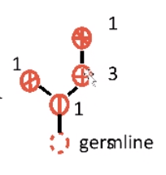
select
Visualization type selection (ex: number of mutations, class switch)
query parameters that depend on visualization type selection (ex: for antibody types, select one/more)
input
Zoomable stacked area time series render here
click
render
render
Show (possible based on data) germline
Pan/ zoom
Pan/ zoom

Slide 3
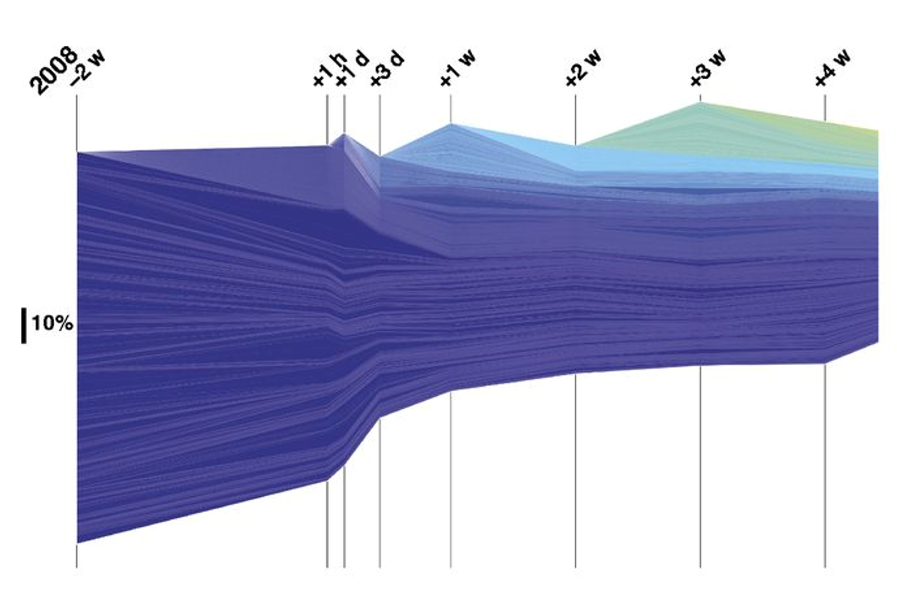
select
Visualization type selection (ex: clone mutations, class switch)
query parameters that depend on visualization type selection (ex: for antibody types, select one/more)
input
Zoomable stacked area time series render here
click
render
render
Show (possible based on data) germline
Pan/ zoom
Pan/ zoom

Slide 4
filter
parameters:
select 10/100/100 top clones (mandatory) select one/more tissues (optional)
Select time period (mandatory)
Visualization type selection: clone frequency
select
Zoomable stacked area time series render here
click
render
render
Show (possible based on data) germline
Pan/ zoom
Pan/ zoom

Slide 5
parameters:
select 10/100/100 top clones (mandatory) select one/more tissues (optional)
Select time period (mandatory)
Tree shape (optional, disabled by default)
filter
Enable and set
Visualization type selection: clone frequency
select
Zoomable stacked area time series render here
select
render
render
Show (possible based on data) germline
select
Pan/ zoom
Pan/ zoom

Slide 6
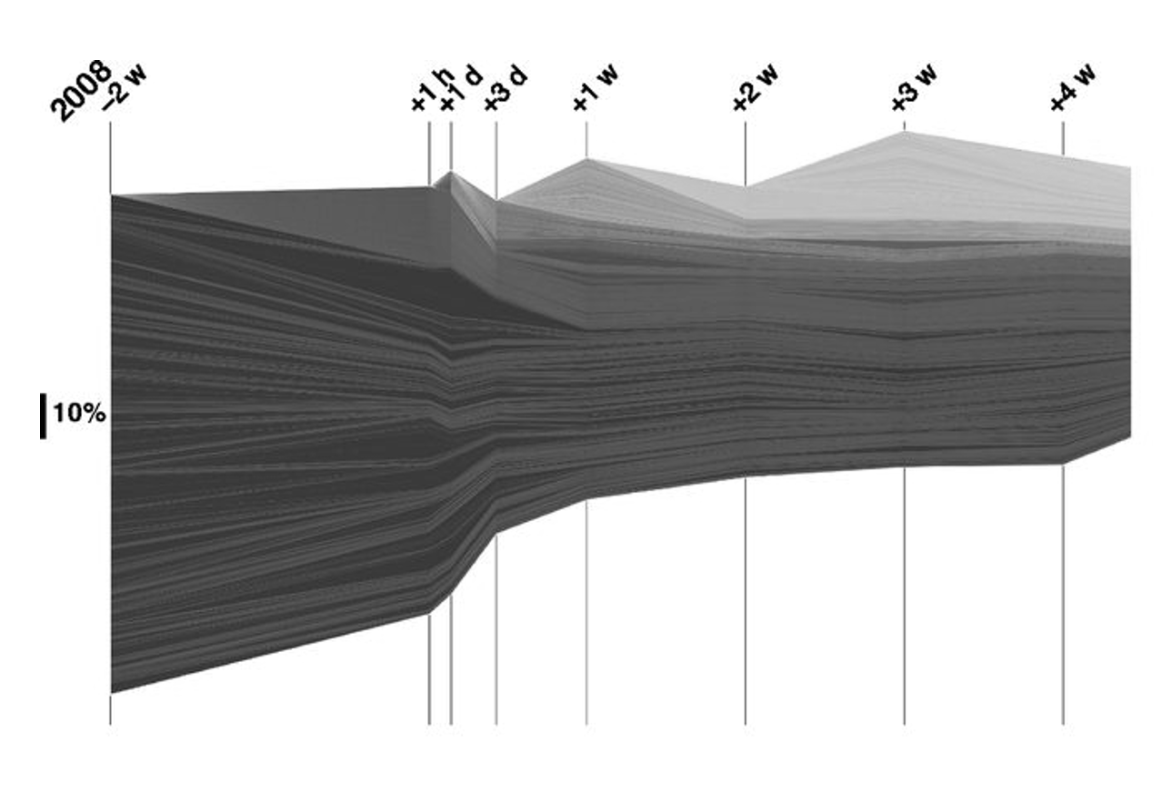
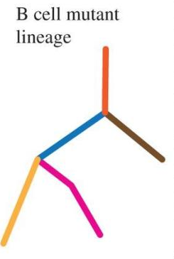
parameters:
select 10/100/100 top clones (mandatory) select one/more tissues (optional)
Select time period (mandatory)
Tree shape (optional, disabled by default)
filter
Enable and set
Visualization type selection: clone frequency
select
Zoomable stacked area time series render here
select
render
render
Show (possible based on data) germline
select
Pan/ zoom
Pan/ zoom

Slide 8
select
Dynamic features? ON/OFF (default OFF)
filter
Static features:
- select 10/100/100 top clones (high frequency)
- select one/more/all tissues
- select clones with the most mutations
- select clones with high class switching
- select time periods (one, several, all)
- select shape (optional, disabled by default)
Dynamic parameters (across time periods):
- clones that had high frequency and decreased a lot (or the inverse) - clones that had high prevalence in one tissue and now have high frequency in another
- clones in which the number of mutations increased a lot
- clones that had high class switching (across time points)
- clones which lineage tree went from lean to a large clonal expansion
Zoomable stacked area time series render here
Enable and set
select
render
render
Show (possible based on data) germline
select
Pan/ zoom
Pan/ zoom

Slide 9
Details on filtering (dynamic features)
clones that had high frequency and decreased a lot (or the inverse)
Largest variation between consecutive time points
Largest variation between given (chosen) time points

Slide 10
Comments from Michal
Suggestions: 1. Select hypothetical sequences (hypothetical most recent common ancestors) at the end of the time sequence and visualize that sequences throughout the whole time series: Are the late hypothetical sequences early real sequences? In what tissue are they?
2. To answer the question how clones move in time from tissue to tissue: Select one clone and show the distribution of number of mutations and localization (tissue)
3. Select for trees of a certain shape (because they might mean a specific type of evolutionary process) and show across time only the clones with that tree shape so answer the question: When and where are happen certain types of processes

Slide 11
Comments from Michal
4. The data stems from a mixture of many different processes. A clone might be large and change frequency and make beautiful phylogenetic trees, but not show any interesting dynamics in the time series, because it is not taking part in the immune reaction. So it`s important to catch the interesting dynamics underneath such uninteresting clones. Possible criteria to filter for interesting dynamics: Clones that show over time class-switch, acquisition of mutations, change in shape of trees, change in tissue location, etc
5. We define a given skalar criterium and use the sorting according to this criterium to filter data and visualize filtered data. Examples: a. Clonal frequency at a given time point, b. Maximal clonal frequency across all time points, c. Percentage of identical sequences within two time points; . d. Maximal outdegree number of a node, e. Kidera factors, etc, etc These skalar criteria can be put in a vector (clonal signature) and the highest variance of all signature vectors will show what criteria vary most (hence are a cadidate for the largest amount of informaton)
6. One of the feature visualization could be a PCA of the signature vectors

Slide 12

Mapping in time
Alex Stew, Alex Carvalho, Artur Rocha, Marco Oliveira, Michal

Slide 13
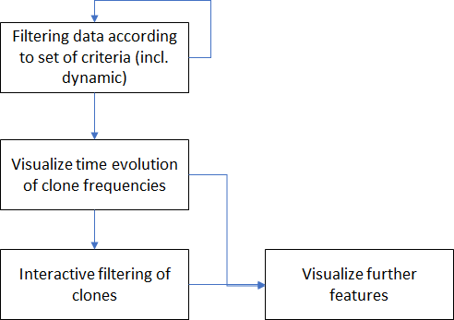
Overall pipeline (visualization) concept
Current use case: clone dynamics across different time periods

Slide 14
Features (cumulative):
- select 10/100/1000 top clones (high frequency)
- select one/more/all tissues
- select clones with the most mutations
- select clones with high class switching
- select time periods (one, several, all)
- select shape (lean vs wide)
- (filter by clone size to eliminate small clones)
Features (only active if involving multiple time periods):
- clones that had high frequency and decreased a lot (or the inverse) - clones that had high prevalence in one tissue and now have high frequency in another
- clones in which the number of mutations increased a lot
- clones that had high class switching (across time points)
- clones which lineage tree went from lean to a large clonal expansion
Select / filter
Zoomable stacked area time series render here
select
Enable and set
render
render
Show (possible based on data) germline
select
Pan/ zoom
Pan/ zoom

Slide 15
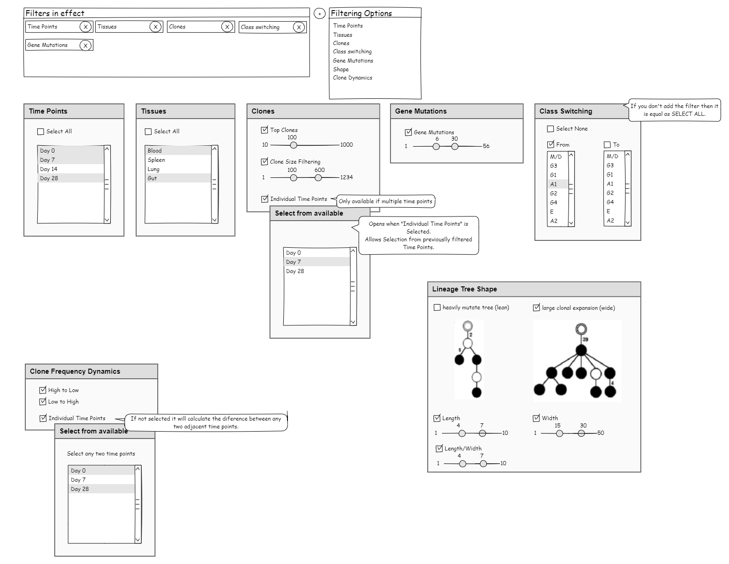

Slide 16
Zoomable stacked area time series render here
select
From a selection of multiple clones (discrete set of points or lines):
Find diferences between them
From a selected clone (point or line):
Draw a heatmap of clones that are similar, based on:
Levenshten distance
Aminoacid properties (eg Kidera factors)
Selected clone becomes the reference (highlighted) and other clones can be displayed according to a gradient based on similarity. Further filtering may be necessary.
Draw the lineage trees across different time points, and
try to link them (across time) – see next slide
try to stack them in a single lineage tree

Slide 17
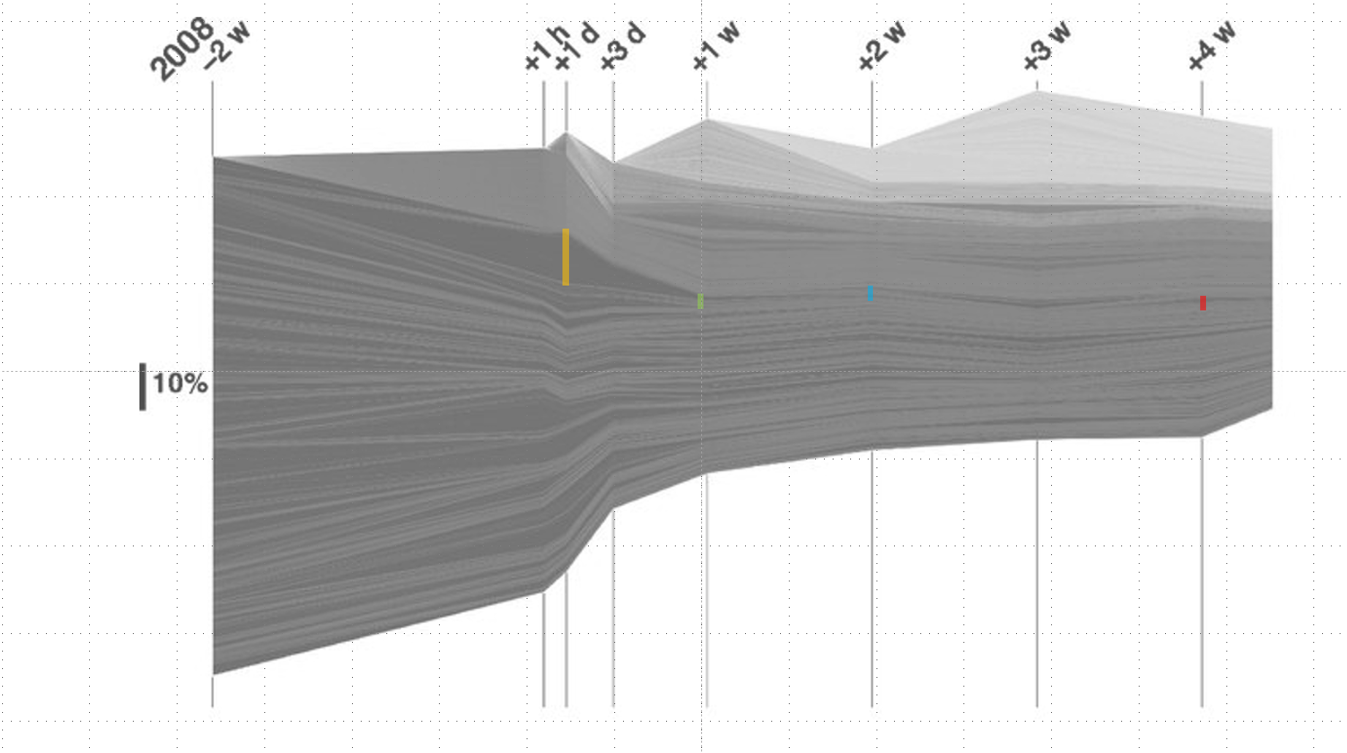
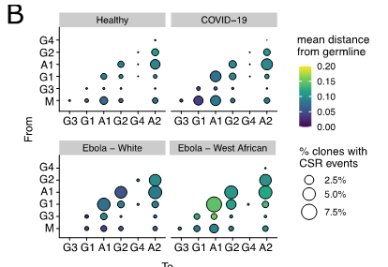
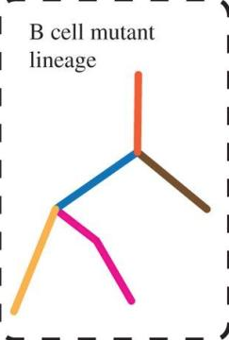
Slider applies to the
selected clone (line)
Will update here
Time
Change here

Slide 19
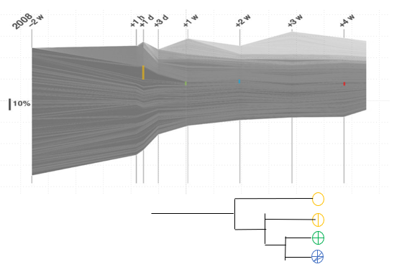

Slide 20
Desapeares here
Found it here

Slide 21
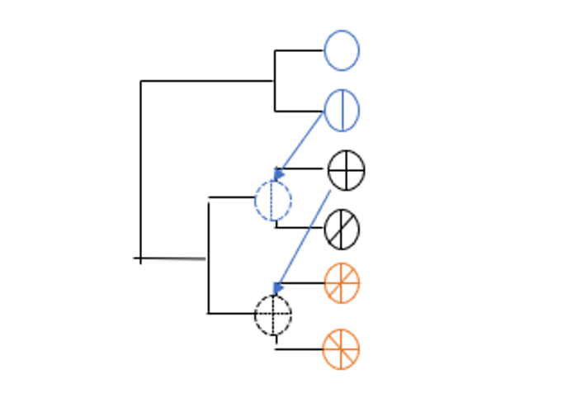

Slide 22
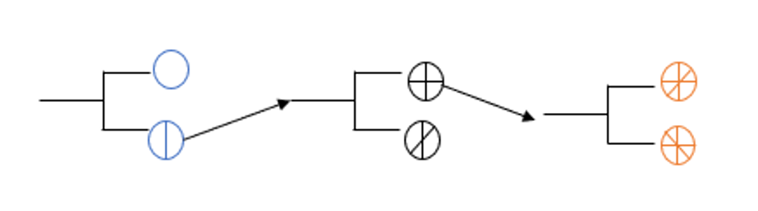

Slide 23
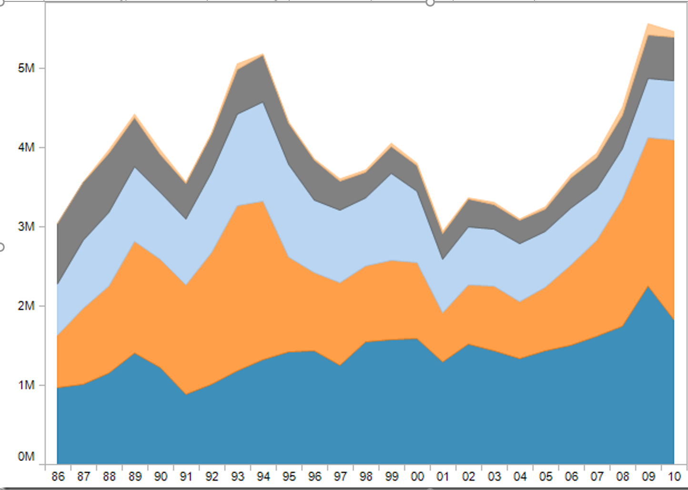
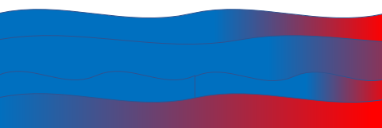
Multiple clones selection
Change color gradient according to:
Mutation frequency
Class switch frequency
Hydrophobicity
Peptide stats
Biding affinity (10x)
Selecting n clones will restrict the chart to those clones
Add metadata or some additional parameters to enrich the data and “redraw” the chart

Slide 24
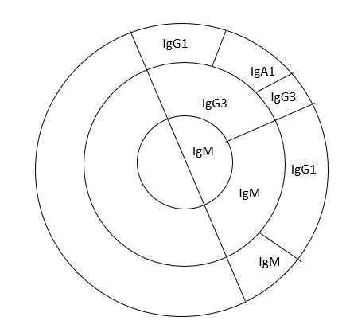
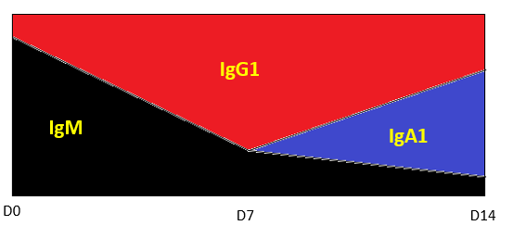
Single clone selection
Selecting 1 clone
Class switch with time
Time outwards

