Slide 1
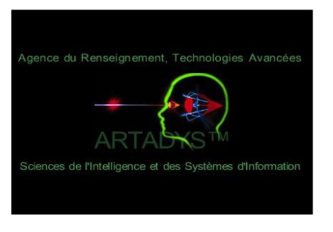

ARTADYS
Spatial Inner Dynamic Connectivity
Predict live the Human behaviour
https://artadys.com/
Esomar Research Rallye June 2017,22th
Christine Caggia (Askia) /Hervé Tranger (BVA)

Slide 2
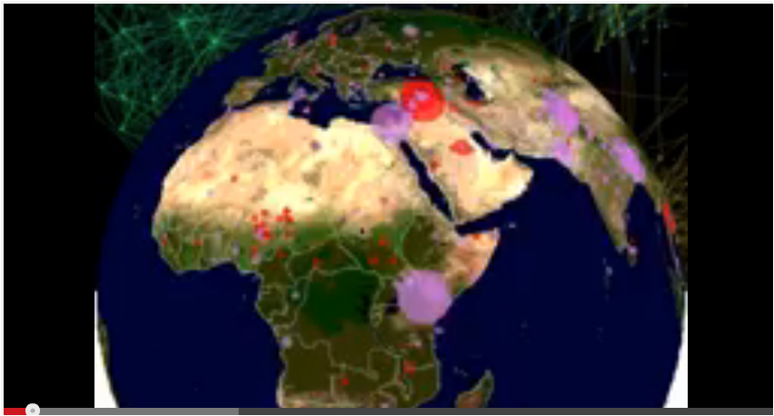
1. Get tweets and its location

Slide 3
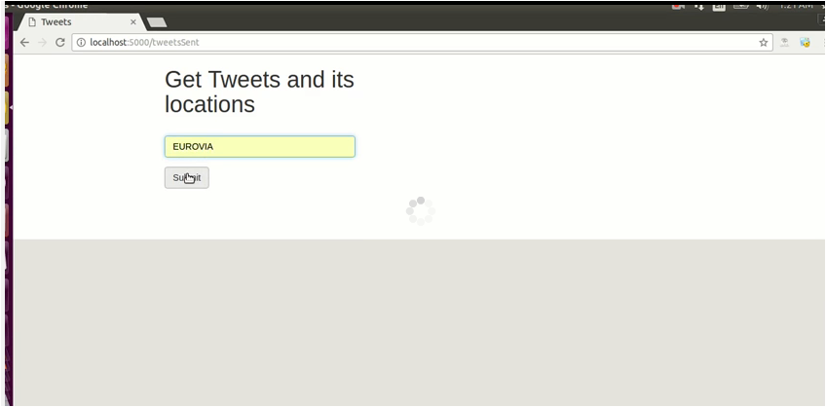
2. Impact Analysis

Slide 4
Benefits client
Media planning digital advertising
=> “The right message to the right community at the right time”
Live & dynamic measure - Cost reduction & Efficiency increase
Targeted communication
Speak to real people (Remove any bot interaction : - 75%)
Targets client
Advertisers
Media agencies
Politics
Case Studies

Slide 5
The change
  Inner Spatial/global listen in and dynamic connectivity
  Predict the change of behaviour
  When display is going to become digital, Artadys allows a complete renovation of the market.

Slide 6
If you invest 1 million early on the morning , you will win 10 millions on the evening !
Merci
For more Information contact ARTADYS

