Slide 1

Green Pace
SECURITY POLICY PRESENTATION
Gurman Dhot | CS 405 | October 18, 2026
Green Pace • Project Two

Slide 2

OVERVIEW | DEFENSE IN DEPTH
WHY IT MATTERS
One repeatable policy for Green Pace developers.
HOW IT WORKS
Prevent → detect → respond.
THE LAYERS
Validation, safe design, testing, encryption, identity controls, and audit trails.

Slide 3
THREATS MATRIX | PROPOSED RISK
ASSESSMENT
10 standards
Level 5 | highest
Level 4 | high
Level 3 | medium
Planning judgments, not production incident counts.
LIKELY / LEVEL 5 003 Buffer overflow 004 SQL injection | PRIORITY / LEVEL 4–5 005 Use-after-free (5) 001 Unsafe conversions (4) 002 Uninitialized reads (4) 008 Container bounds (4) 010 Deadlock (4)
LOWER PRIORITY / LEVEL 3 006 Misused assertions 007 Exception handling 009 File lifecycle | UNLIKELY / NOT VERIFIED No risk assumed impossible. Reassess after scans, unit tests, and exposure review.

Slide 4
10 PRINCIPLES | POLICY ALIGNMENT
01 Validate input
STD 001, 003, 004, 008
06 Least privilege
STD 004
02 Heed compiler warnings
STD 001, 002, 006
07 Sanitize outgoing data
STD 004
03 Design for security
STD 005, 007, 010
08 Defense in depth
STD 005, 007, 009, 010
04 Keep it simple
STD 003, 009
09 Quality assurance
STD 002, 003, 005–010
05 Default deny
STD 004
10 Secure coding standards
STD 001, 002, 006, 008
STANDARDS ARE CROSS-REFERENCED TO PROJECT ONE

Slide 5
CODING STANDARDS | TRIAGE ORDER
LEVEL 5 • FIRST
LEVEL 4 • NEXT
LEVEL 3 • MONITOR
• 003 String storage / bounds
• 001 Integer conversions
• 006 Assertions
• 004 Parameterized SQL
• 002 Uninitialized memory
• 007 Exceptions
• 005 Memory lifetime / UAF
• 008 Container indices
• 009 File handling
• 010 Lock ordering
PRIORITY USES IMPACT × LIKELIHOOD, THEN REMEDIATION EFFORT; ALL RATINGS ARE PROVISIONAL

Slide 6
ENCRYPTION | THREE DATA STATES
IN FLIGHT
AT REST
IN USE
Modern TLS (1.2 / 1.3), certificate validation, authenticated channels.
Approved encryption for sensitive files, databases, devices, and backups.
Least-privilege processing, memory hygiene, and short-lived secrets.
Protects traffic between browsers, APIs, and services.
Protect keys separately; restrict access and rotate by policy.
Consider confidential computing when risk justifies it.

Slide 7
TRIPLE-A | IDENTITY AND EVIDENCE
AUTHENTICATION
AUTHORIZATION
ACCOUNTING
Who are you?
What may you do?
What happened?
Unique identities, MFA for privileged access, safe credential storage.
Least privilege, default deny, RBAC or ABAC at each sensitive endpoint.
Record logins, data changes, access, account creation and outcomes.
GREEN PACE ALREADY COLLECTS OPERATING-SYSTEM, FIREWALL AND ANTI-MALWARE LOGS; EXPAND APPLICATION-LEVEL COVERAGE

Slide 8
UNIT TESTING | CONTAINER BOUNDS
SECURITY STANDARD STD-008-CPP • CTR50-CPP
The vulnerability: unchecked container indexes can trigger undefined behavior or a crash.
Approach: a bounds-checked C++ function + Microsoft Visual Studio Native Unit Tests.
Six assertions: three valid inputs and three rejected invalid inputs.
Observed October 18, 2026: 6 passed, 0 failed, 0 skipped.
Limitation: these tests validate this example, not the entire Green Pace codebase.

Slide 9
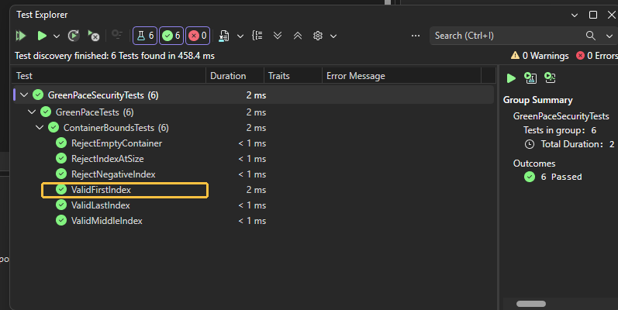
UNIT TEST 1 | Can the first element be read safely?
POSITIVE TEST • VALIDFIRSTINDEX
ACTUAL TEST EXPLORER EVIDENCE
INPUT
{10, 20, 30} | index 0
EXPECTED RESULT
Returns 10 without exception
ACTUAL TEST EXPLORER RUN • ValidFirstIndex HIGHLIGHTED
OBSERVED: PASSED | Test Explorer: 6 PASSED, 0 FAILED

Slide 10
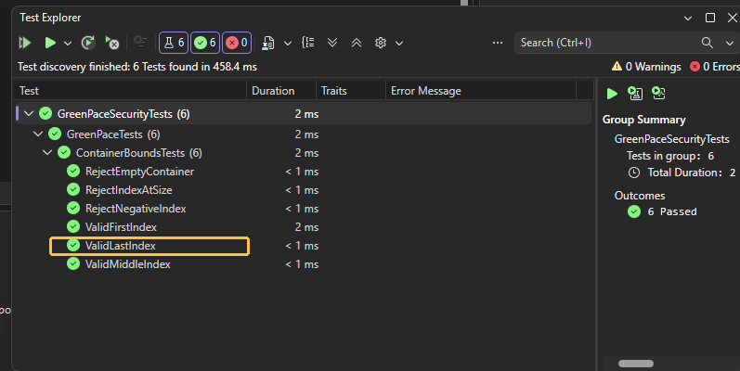
UNIT TEST 2 | Does the final valid index work?
POSITIVE TEST • VALIDLASTINDEX
ACTUAL TEST EXPLORER EVIDENCE
INPUT
{10, 20, 30} | index 2
EXPECTED RESULT
Returns 30 without exception
ACTUAL TEST EXPLORER RUN • ValidLastIndex HIGHLIGHTED
OBSERVED: PASSED | Test Explorer: 6 PASSED, 0 FAILED

Slide 11
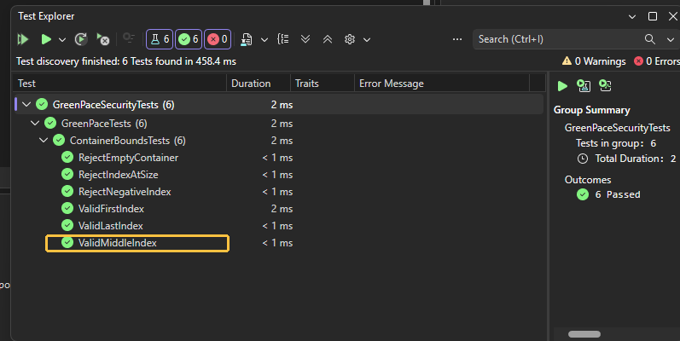
UNIT TEST 3 | Are middle values returned correctly?
POSITIVE TEST • VALIDMIDDLEINDEX
ACTUAL TEST EXPLORER EVIDENCE
INPUT
{10, 20, 30} | index 1
EXPECTED RESULT
Returns 20 without exception
ACTUAL TEST EXPLORER RUN • ValidMiddleIndex HIGHLIGHTED
OBSERVED: PASSED | Test Explorer: 6 PASSED, 0 FAILED

Slide 12
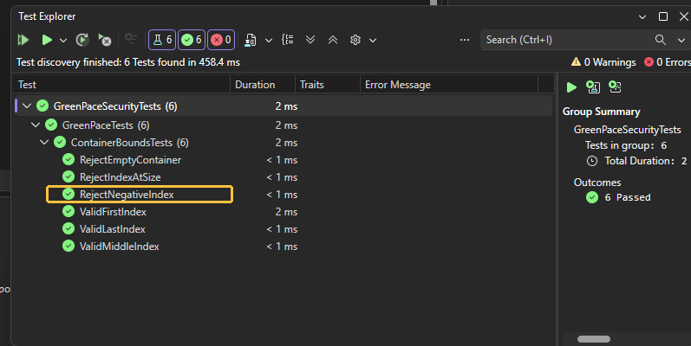
UNIT TEST 4 | Is a negative index rejected?
NEGATIVE TEST • REJECTNEGATIVEINDEX
ACTUAL TEST EXPLORER EVIDENCE
INPUT
{10, 20, 30} | index -1
EXPECTED RESULT
std::out_of_range thrown
ACTUAL TEST EXPLORER RUN • RejectNegativeIndex HIGHLIGHTED
OBSERVED: PASSED | Test Explorer: 6 PASSED, 0 FAILED

Slide 13
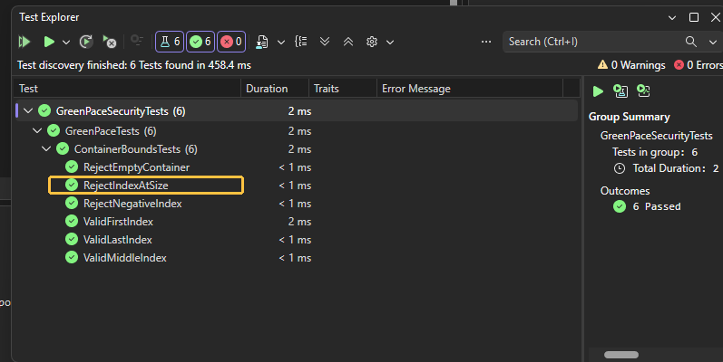
UNIT TEST 5 | Is an index equal to size rejected?
NEGATIVE TEST • REJECTINDEXATSIZE
ACTUAL TEST EXPLORER EVIDENCE
INPUT
{10, 20, 30} | index 3
EXPECTED RESULT
std::out_of_range thrown
ACTUAL TEST EXPLORER RUN • RejectIndexAtSize HIGHLIGHTED
OBSERVED: PASSED | Test Explorer: 6 PASSED, 0 FAILED

Slide 14
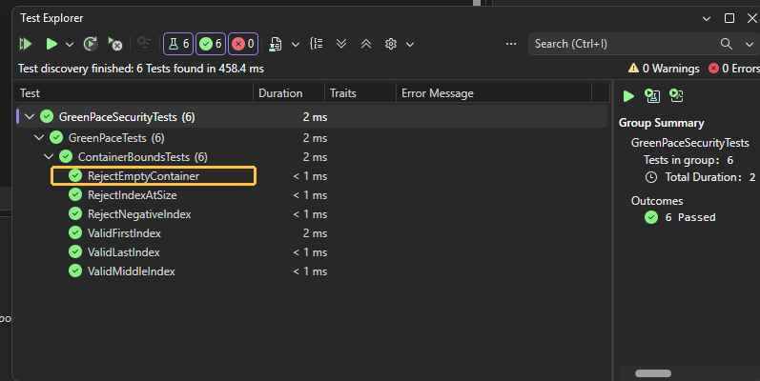
UNIT TEST 6 | Is empty-container access rejected?
NEGATIVE TEST • REJECTEMPTYCONTAINER
ACTUAL TEST EXPLORER EVIDENCE
INPUT
{} | index 0
EXPECTED RESULT
std::out_of_range thrown
ACTUAL TEST EXPLORER RUN • RejectEmptyContainer HIGHLIGHTED
OBSERVED: PASSED | Test Explorer: 6 PASSED, 0 FAILED

Slide 15

AUTOMATION SUMMARY | SECURITY EVERYWHERE

Slide 16
DEVSECOPS | TOOLS AND CHECKPOINTS
PLAN + CODE
Threat review, input rules, reviewer checks.
BUILD
MSVC warnings, clang-tidy, Cppcheck.
VERIFY
Native unit tests, AddressSanitizer, CodeQL.
RELEASE
Signed artifacts, approvals, blocking high risks.
OPERATE
Access logs, alerting, response, feedback.
TOOL VERSIONS IN PROJECT ONE ARE PROPOSED BASELINES—NOT EVIDENCE OF INSTALLATION OR SCANS

Slide 17
RISKS AND BENEFITS | ACT OR WAIT?
ACT NOW
WAIT
WATCH OUT
Manage exposure
Accept avoidable risk
Automation is not enough
Catch vulnerable code before shipping.
Reduce cost of rework.
Improve release traceability.
Defects travel into production.
More expensive incident response.
Weaker evidence for audits.
Scanners miss context.
False positives require triage.
Human review and runtime tests still matter.

Slide 18
RECOMMENDATIONS | CLOSE THE GAPS
01
Missing real scan evidence
Run and save Cppcheck / clang-tidy outputs.
02
Coverage gaps
Add negative-input, fuzz, and boundary tests.
03
Policy-to-release traceability
Map each finding to STD-001…010.
04
Exception lifecycle
Require owners, due dates, sign-offs and review.
05
Audit and monitoring
Add app/API events to existing infrastructure logs.

Slide 19
CONCLUSION | KEEP IMPROVING
Standardize secure development
• Enforce the 10 policy standards in code review and CI.
• Make risk-weighted gates and unit tests repeatable.
• Preserve scan, test, approval, and exception evidence.
• Review the policy annually and after significant changes.
GOAL: FEWER PREVENTABLE DEFECTS AND MORE DEFENSIBLE RELEASES

Slide 20
REFERENCES | CORE SOURCES
Dhot, G. (2026). Green Pace secure development policy guide [Unpublished course project].
Carnegie Mellon University, SEI. (n.d.). SEI CERT C++ coding standard.
https://cmu-sei.github.io/secure-coding-standards/sei-cert-cpp-coding-standard/rules/
Microsoft. (n.d.). Unit testing C++ in Visual Studio. https://learn.microsoft.com/en-us/visualstudio/test/writing-unit-tests-for-c-cpp
Cppcheck. (n.d.). Cppcheck static analysis tool. https://github.com/danmar/cppcheck
LLVM Project. (n.d.). Clang AddressSanitizer. https://clang.llvm.org/docs/AddressSanitizer.html
GitHub. (n.d.). CodeQL: C++ SQL injection query. https://codeql.github.com/codeql-query-help/cpp/cpp-sql-injection/

