Slide 1
SOFTWARE ENGINEERING
INTRODUCTION
GEORGIOS DIMITRAKOPOULOS
dimitrakopoulos@ionio.gr

Slide 2
Teaching
MONDAY 19-21.00 TABM 2.45
THURSDAY 17-19.00 AIT 3

Slide 3
Evaluation
Teamwork 40%
Written exams 60%

Slide 4
Books
1 | BASIC PRINCIPLES OF SOFTWARE TECHNOLOGY | IAN SOMMERVILLE | Kleidaritmos Publications | 2009
2 | THE PRACTICAL PROGRAMMER | ANDREW HUNT, DAVID THOMAS | Kleidaritmos Publications | 2008
3 | READING CODE | DIOMIDES SPINELLIS | Kleidaritmos Publications | 2005

Slide 5
What is Software Engineering?
Systematic, disciplined and measurable approach to software development, operation and evolution.
People
Procedures
Product
Users, customers, developers, testers, operations and management.
From need and requirements to operation and withdrawal.
Code, data, documentation, infrastructure and user experience.
Goal: reliable software that meets real needs within constraints.

Slide 6
DEFINITION
Software engineering includes the various tools, techniques, and methods used in the design, development, implementation, and maintenance of software systems.
This field is constantly evolving, driven by innovation and the need to solve complex problems more effectively.
It is the field that deals with the creation and development of software, as well as the processes and tools used for this purpose.

Slide 7
Why isn't just planning enough?
Scale
Change
Quality
Coordination
Many subsystems, groups, interfaces and dependencies.
Needs, technology and the environment are evolving.
Safety, reliability, performance, usability and maintainability.
Decisions, communication, cost, time and risk management.
Code is part of the product; engineering is about the entire sociotechnical system.

Slide 8
Key areas
Some key areas in software engineering include:
Programming Languages: These are the official languages ​​used to create software programs. Some popular programming languages ​​are Java, the Python, the JavaScript, C++ and C#.
Frameworks and libraries: These are collections of pre-written code and tools that help developers build applications more efficiently. Examples include Angular, the React and Vue.js for web development, TensorFlow and the PyTorch for machine learning and Django and the Flask for applications web Python.

Slide 9
Key areas
Development methodologies: These are the processes and practices followed to develop software systems. Some popular methodologies include: Agile, Scrum, Waterfall and DevOps.
Software architecture: It deals with the overall structure and organization of a software system, including its components, relationships, and properties. Common architectural patterns include microservices, monolithic and event-based architectures.

Slide 10
Key areas
Databases and data storage: These technologies store, manage, and retrieve data used by software applications. Some popular databases include: MySQL, PostgreSQL and MongoDB.
Cloud computing: Refers to the provision of computing services over the Internet, allowing users to access software, storage, and processing resources on demand. The most important cloud providers include Amazon Web Services (AWS), Microsoft Azure and the Google Cloud Platform (GCP).

Slide 11
Key areas
Software Testing and Quality Assurance: These processes ensure that software systems meet specified requirements and function properly. Techniques include manual testing, automated testing, and performance testing.

Slide 12
Hardware
Hardware - Harware
Software -Software
Software System
Application Software
Hardware: Hardware refers to the physical components of a computer system, such as the processor, memory, storage devices, and input/output devices. Hardware is responsible for executing the instructions provided by the software.
In a computer-based system, software and hardware work together to perform various tasks. The software sends instructions to the hardware, which processes data according to these instructions and returns the results to the software. This interaction between software and hardware allows the system to perform complex operations and provide users with various features.

Slide 13
Software
Hardware - Harware
Software -Software
Software System
Application Software
Software: Software is a collection of programs, data, and instructions that tell hardware what to do and how to do it. It acts as the “brain” of the system, controlling the hardware and managing resources. Software can be classified into two main categories:
System software: This type of software manages the system hardware and provides a platform for running application software. Examples of system software include operating systems (e.g., Windows, macOS, Linux), device drivers and utilities.
Application software: This type of software is designed for specific tasks or applications, such as word processing, web browsing, or gaming. Ex: Office, Chrome, Firefox etc.

Slide 14
Software Lifecycle —
Software Development Lifecycle
Need &
Requirements
Analysis &
design
Implementation
Tests
Release &
deployment
Operation &
Maintenance
Retirement
Activities exist in every project; the development model determines when, how much, and how often they are performed.
Lifecycle ≠ a single version: the product evolves through many versions, fixes and changes.

Slide 15
Software release life cycle
Needs and Requirements: This phase involves gathering and defining the functional and non-functional requirements of the software. Stakeholders, such as customers, users, and developers, work together to define the goals, capabilities, and constraints of the software. The output of this phase is usually a requirements document.
Analysis and design: In this phase, the architecture, elements and interfaces of the software are designed based on the requirements. This includes the creation of data flow diagrams, entity relationship diagrams, and flowcharts. The result of this phase is a detailed design document that guides the development process.

Slide 16
Software release life cycle
Implementation (Coding): During the implementation phase, developers write the actual code for the software using programming languages ​​and tools. This phase turns the design into a working software product. Developers may use version control systems to manage and track changes to the code.
Testing: Once the software is implemented, it is subjected to a series of tests to identify and fix any defects, errors, or inconsistencies. Testing methods may include unit testing, integration testing, system testing, and user acceptance testing. The goal is to ensure that the software meets the specified requirements and performs as expected.

Slide 17
Software release life cycle
Release and deployment: After successful testing, the software is deployed to a production environment, making it available to end users. This phase may include activities such as installation, configuration, and data migration. Depending on the type of software, it may be deployed on-premises, in cloud or as a hybrid solution.
Maintenance and Support: Once the software is developed, it requires ongoing maintenance and support to address any issues, bugs, or changes in requirements. This phase includes activities such as bug fixes, performance optimization, and feature enhancements. Software updates and patches may also be released during this phase to ensure that the product remains secure and up-to-date.

Slide 18
Software release life cycle
Retirement (decommissioning): Eventually, software may become obsolete or no longer meet the needs of its users. At this stage, the software is retired and any data or resources associated with it are are relocating or archived. Users can switch to an updated or alternative solution.

Slide 19
1. Needs and Requirements
WHY
WHAT
CONTEXT
Problem & goals
Requirements
Stakeholders & domain
What need are we solving? For whom? How will we recognize the value?
Functional behaviors, quality characteristics and limitations.
Roles, processes, data, regulations, risks and exceptions.
Deliverables: shared understanding, models, user stories/use cases and testable acceptance criteria.

Slide 20
2. Software design
ARCHITECTURE
DATA
INTERFACES
TRADE-OFFS
System structure
Data
Interfaces
Decisions
Components, services, layers, communication and deployment topology.
Models, storage, consistency, privacy and lifecycle.
APIs, UI, conventions, protocols and user interaction.
Performance, security, cost, scalability and maintainability.
Good design means documented trade-offs — not the most complicated diagram.

Slide 21
3. Code implementation and management
CODE
VERSION CONTROL
BUILD
Construction
Change history
Automation
Converting design into functional, readable and maintainable code.
Branches, commits, reviews and secure collaboration between multiple developers.
Dependencies, repeatable builds, static analysis and continuous integration.
The source code must be able to be built, tested, and reproduced consistently.

Slide 22
4. Testing and quality assurance
UNIT
INTEGRATION
SYSTEM
ACCEPTANCE
Unit
Consolidation
System
Acceptance
They control small logic units quickly and in isolation.
They control the cooperation of modules, APIs, databases and external services.
They control end-to-end behavior and non-functional requirements.
They confirm that the product meets user needs and criteria.
Verification: did we build the product correctly? • Validation: did we build the right product?

Slide 23
5. Release, deployment, operation and maintenance
RELEASE
DEPLOY
OPERATE
EVOLVE
Issue
Installation
Operation
Maintenance
Feature selection, release notes, approvals and deployment plan.
Production, configuration, migrations, rollout and rollback capability.
Monitoring, logging, incidents, security, backups and support.
Corrective, adaptive, improvement and preventive change.
Most of the life of a successful product lies after the initial launch.

Slide 24
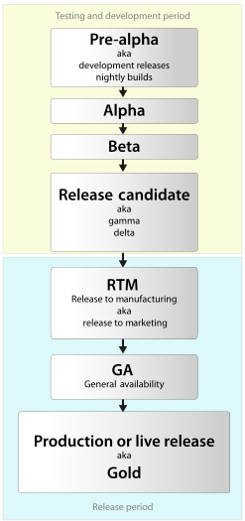
Software release life cycle
The software release life cycle refers to the various stages of development and distribution that a software product goes through before being made available to the public.
This lifecycle helps ensure that software is developed, tested, and released in a structured and organized manner.
The stages of the software release life cycle may vary depending on the organization or product.

Slide 25
Software release life cycle
PRE-ALPHA
ALPHA
BETA
RC
STABLE
Investigation
Internal test
External feedback
Release candidate
General mood
Prototypes, architecture and imperfect functionality.
Basic capabilities are there, but stability is limited.
Feature-complete product candidate to selected users.
Possible final release, if no critical issues are found.
Supported production version with updates and patches.

Slide 26
Software release life cycle
Pre-alpha: This is the initial stage of software development, during which the product is still in the design and planning phase. The requirements and overall structure of the software are defined, and the development team can start working on the core code and architecture.
Alpha: At this stage, the software is in a preliminary form, with some functionality implemented but not yet complete. The software may have many bugs and is usually not stable enough for general use. Alpha releases are often used for internal testing and development purposes.

Slide 27
Software release life cycle
Beta: The software is now fully featured and has undergone some level of internal testing. It is distributed to a select group of external users (testers) beta) to identify any remaining issues, bugs, or user experience problems. The versions beta are often considered "pre-release" versions of the software and feedback from testers beta they contribute to polishing the product before its final release.
Release Candidate (RC): This stage takes place after the software has gone through the testing process. beta and most known issues have been resolved. The release candidate is considered stable and almost ready for public release. It may undergo further testing and minor bug fixes before the final release, but no major changes are expected.

Slide 28
Software release life cycle
General Availability (GA) or Final Release: The software is now considered stable, well-tested, and ready for public distribution. It has passed all previous stages of the release lifecycle and is deemed suitable for widespread use. This version of the software is available to the general public and users can download, install, and use it.
Maintenance and updates: After software is released, it will typically undergo maintenance to address any new issues, bugs, or security vulnerabilities that are discovered. This may include issuing patches, updates, or new versions of the software to keep it up-to-date and secure.

Slide 29
Software release life cycle
End of Life (EOL): Eventually, a software product may reach the end of its life cycle, either due to antiquity, release of a new major version, or other factors. At this point, the software will no longer be supported or maintained, and users are encouraged to upgrade to a newer version or alternative product.

Slide 30
Publications: Major.Minor.Patch
2
4
1
.
.
MAJOR
MINOR
PATCH
BREAKING
FEATURE
FIX
Incompatible changes
New compatible mode
Compatible correction
Major increase.
Minor increase.
Patch increase.

Slide 31
Development process models
WATERFALL
INCREMENTAL
ITERATIVE
AGILE / SPIRAL
Sequential
Augmentative
Repetitive
Risk- or feedback-driven
The basic phases are mainly performed once and sequentially.
The product is delivered to functional departments.
The solution is improved through successive cycles.
Next actions are determined by risk, learning, and value.
The models organize the same activities in different order and frequency.
Software Technology • Ionian University
12

Slide 32
The model Waterfall
Main features
REQUIREMENTS
Each phase produces deliverables and is completed before the next.
Return is possible but usually expensive.
PLANNING
IMPLEMENTATION
TESTS
RELEASE
Software Technology • Ionian University
13

Slide 33
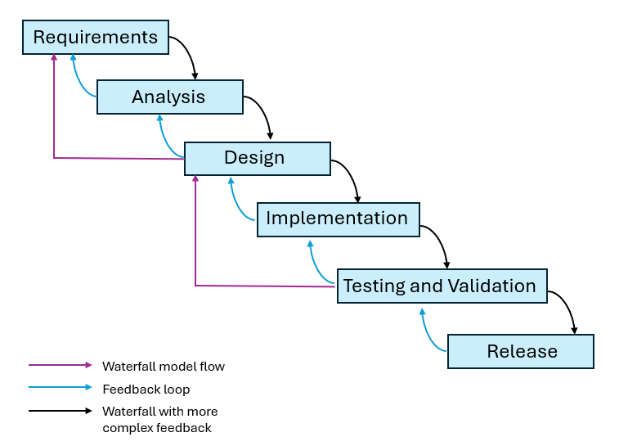
Waterfallmodel
Sequential software development process => progress flows downward through discrete phases, like a waterfall.
It is one of the first software development methodologies and it is based on a linear and rigid approach.
The Waterfall model is particularly suitable for projects with clearly defined requirements and little chance of change during development.

Slide 34
The main phases of the Waterfall Model include:
Requirements Analysis: In this phase, the project team gathers and documents the functional and non-functional requirements of the software. This results in a detailed requirements document, which serves as the basis for the subsequent phases.
System design: Based on the requirements, the system architecture, components and Interfaces The design phase may include the creation of data flow diagrams, entity relationship diagrams, and flowcharts to represent the structure and operation of the system.

Slide 35
The Waterfall Model
Implementation: During this phase, the actual code for the software is written based on the design documentation. Programmers use programming languages ​​and tools to create the software components and integrate them into an operating system.
Testing: After the software is implemented, it undergoes a series of tests to identify and correct any defects, errors, or inconsistencies. This includes unit testing, integration testing, and system testing to ensure that the software meets its requirements and functions properly.

Slide 36
The Waterfall Model
Release and Deployment: After successful testing, the software is deployed to a production environment, making it available to end users. This may include installation, configuration, and data migration tasks.
Maintenance: Once software is developed, it requires ongoing maintenance and support to address any issues, bugs, or changes in requirements. This includes bug fixes, performance optimization, and feature enhancements to ensure the product remains secure and up-to-date.

Slide 37
The Waterfall Model
One of the key features of the Waterfall Model is that each phase must be completed before moving on to the next phase. Additionally, there is usually no going back to previous phases unless a significant issue is discovered.
This linear approach is both an advantage and a weakness, as it provides a structured framework for software development, but may not be suitable for projects with evolving requirements or a need for flexibility.

Slide 38
Waterfall: what helps and what makes it difficult
ADVANTAGES
DISADVANTAGES
Structure & predictability
Delayed learning
Clear phases and milestones.
Strong documentation.
Easier initial budget.
Suitable when requirements are stable.
Functional product late.
Feedback after a large investment.
High switching costs.
Risk of incorrect initial assumptions.
The need for more frequent feedback leads to iterative, incremental and Agile approaches.
Software Technology • Ionian University
14

Slide 39
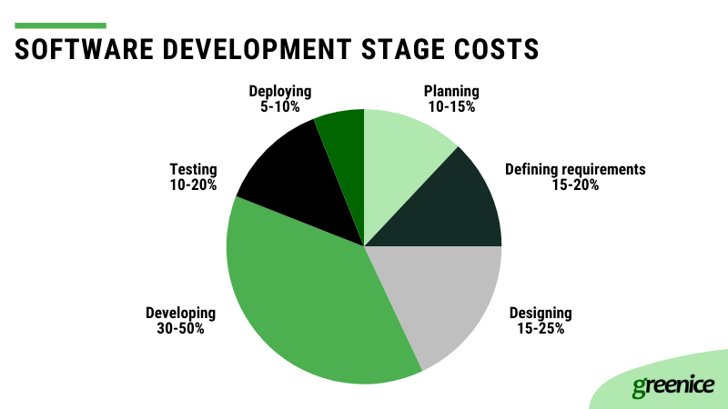
Development is not the majority of cost!

Slide 40
The prototype model
The prototyping model is a software development methodology that involves creating a preliminary version of the software, called a prototype, before building the final product.
This approach allows developers and stakeholders to evaluate and improve the design, functionality, and user experience of the software early in the development process.

Slide 41
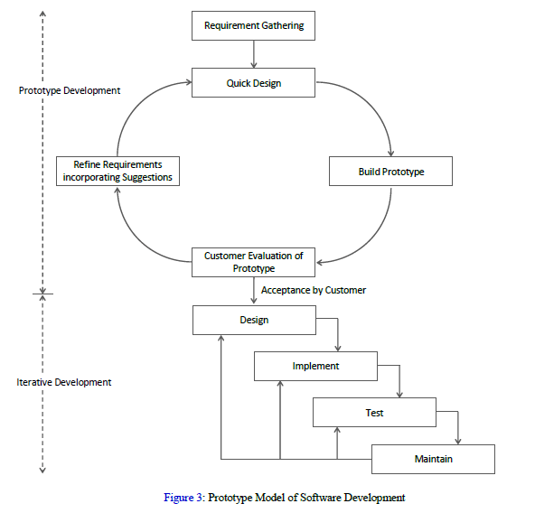
The prototype model

Slide 42
Prototype model phases
Requirements gathering:
Developers and stakeholders gather and analyze project requirements, including desired functionality, interface user and performance.
Initial prototype development:
A basic prototype is created, which can be a mock-up, awireframe or a simple model of the software's operation. The primary goal is to represent the basic features and functions of the software, without focusing on details or complex implementation.

Slide 43
Prototype model phases
Prototype review:
The prototype is presented to stakeholders, end users, and the development team for feedback. They evaluate the prototype to determine if it meets the project requirements, provides the desired user experience, and identify any necessary changes or improvements.
Improvement and repetition:
Based on the feedback received, the development team refines and iterates the prototype, making the necessary changes and improvements. This process is repeated until the prototype meets the requirements and meets the expectations of the stakeholders.

Slide 44
The prototype model
Final development:
Once the prototype is perfected and approved, the development team proceeds to the final implementation of the software, using the prototype as a guide.
Testing and development:
The completed software is tested and any issues or bugs are fixed. Once the software is stable and meets all requirements, it is deployed to end users.

Slide 45
The Incremental model
Combines the sequential development of the waterfall model and the piecemeal development of the model prototyping.
The central idea is partitioning the software under construction into parts that are developed independently, following each sequential development, according to the waterfall model.
During the initial analysis and design phase, the sections to divide the application are established, then the development of each is carried out independently and in parallel.
When the development of each section is completed, itis integrated into the entire application, a process which justifiesand the title "functional increment".

Slide 46
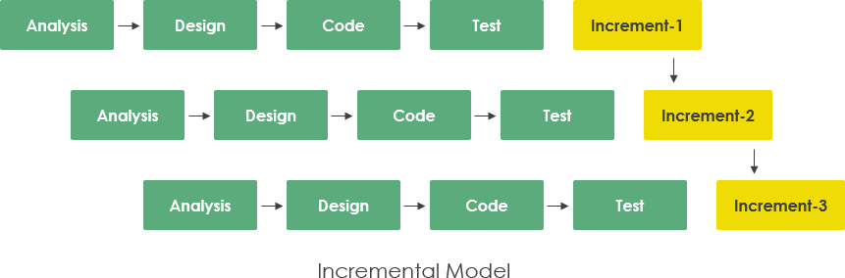
The incremental model

Slide 47
The incremental model
In the prototyping model, as well as in that of incremental, the partition is more or less arbitrary. The risk is not valued, so every setback or reversal impacts costs and time required, often resulting in total project failure.
On the other hand, the disciplined acceptance of the strict phases proposed by the waterfall model is not easy to follow, since certain specific steps "must" be followed regardless of the circumstances.

Slide 48
Agile Model
It is an iterative and incremental software development methodology that emphasizes flexibility, collaboration, and customer satisfaction.
Developed in response to the limitations of traditional methodologies for software development, like the Waterfall model, which is more rigid and linear.
The Agile model focuses on delivering small, functional pieces of the software product in short iterations, allowing teams to respond quickly to changes in requirements or priorities.
Detailed presentation in next lecture

Slide 49
The spiral software life cycle model
The helical software life cycle model, or Spiral Model, is a software development methodology that combines the iterative nature of Agile model with its gradual analysis and design Waterfall model.
This model is organized into spirals, with each spiral consisting of four sections:
goal setting
identifying and resolving risks
execution of development processes
verification and programming tasks

Slide 50
Spiral model

Slide 51
Spiral model
• Goal setting: The scope of work for each iteration is defined and the constraints on the product and the process are recorded, for which a detailed management plan is constructed. The risks inherent in the process and alternative solutions, where they exist, are also recorded.
• Risk resolution: The risks that have been recorded are analyzed and each alternative solution is evaluated. At this point, decisions are made on whether or not to continue development, on the model that will be followed in this particular iteration, on whether or not to build a prototype, etc.
• The following is execution of development process of the selected software parts that the current iteration concerns.
• Finally, after verifying the results – intermediate software products, follows the programming of the next cycle.

Slide 52
Spiral model
The spiral model does not specify in advance exactly what software development tasks need to be performed or to what extent of the system they will be applied. Different development processes may be chosen for different parts of the software.
What it suggests is that defining implementation details should be done continuously during development (and not once, as is the case with the lifecycle models mentioned so far) with responsibility and documentation on the part of the manufacturer himself.

