Slide 1

SOFTWARE ENGINEERING
Agile Methodology
George Dimitrakopoulos
dimitrakopoulos@ionio.gr
Department of Informatics
Ionian University

Slide 2
Learning objectives
Explain
Recognize
Apply
The difference Agile–Scrum and the logic of empirical development.
Accountabilities, events, artifacts and commitments of Scrum.
Sprint Goal, backlog, Definition of Done and inspect–adapt cycle.
Software Technology • Ionian University
03

Slide 3
When did you learn a piece of information too late?
Remember a project where feedback came after a lot of work.
What did we assume?
What did we learn late?
How would we reduce the cost of learning?
Software Technology • Ionian University
04

Slide 4
Why Agile? The problem of uncertainty
PRINCIPLE
CYCLE
LEARNING
Cases
Small experiment
Adjustment
We do not fully know either the problem or the best solution.
We deliver a small portion of value and collect real data.
We change product and design based on what we learn.
Agile = risk management through short learning cycles.
Software Technology • Ionian University
05

Slide 5
The 4 values ​​of the Agile Manifesto
People & interactions
Operating software
from processes and tools
from extensive documentation
Collaboration with the client
Response to change
from contract negotiation
by following a plan
The right side has value; we just give more value to the left.
Software Technology • Ionian University
06

Slide 6
Principles
VALUE
CHANGE
PEOPLE
QUALITY
Frequent value
We embrace change
Collaboration & trust
Quality & simplicity
Timely and continuous delivery of operating software.
Even late, when they improve the result.
Daily collaboration, self-management, sustainable pace.
Technical excellence, good design, regular reflective improvement.
Software Technology • Ionian University
07

Slide 7
Types of Methodology Agile
Scrum
Extreme Programming (XP)
Crystal
Lean
Kanban
Feature Driven Development
Dynamic Systems Development Method
Adaptive Software Development
Software Technology • Ionian University
08

Slide 8
Agile ≠ Scrum
MINDSET
FRAMEWORK
Agile
Scrum
Values ​​and principles for adaptive development.
It does not define specific roles or events.
It can be implemented with different approaches.
Lightweight framework for complex problems.
Defines team, events, artifacts and commitments.
It is based on empiricism and lean thinking.
Scrum is a way of working flexibly — not synonymous with Agile.
Software Technology • Ionian University
09

Slide 9
Scrum Summary
SPRINT
DailyStand-up
Build & test
Product
Backlog
Sprint
Planning
Increment
+ feedback
Review: product inspection • Retrospective: improvement of working methods
Each Sprint is a complete value creation cycle lasting up to 1 month.
Software Technology • Ionian University
10

Slide 10
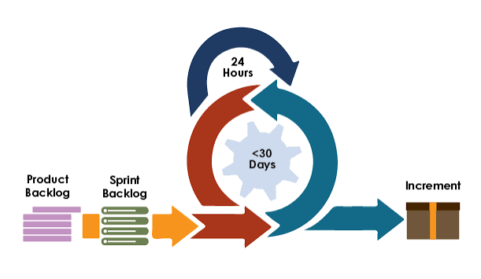
Scrum Summary
Daily stand-up
Software Technology • Ionian University
08

Slide 11
The 5 values ​​of Scrum
Commitment
Focus
Openness
Respect
Courage
In goals and quality.
In Sprint work and Sprint Goal.
For work, progress and problems.
For skills and independence.
To do the right thing and face difficult issues.
Software Technology • Ionian University
11

Slide 12
Scrum Team: one team, three accountabilities
Product Owner
Scrum Master
Developers
Maximizes the Value and effectively manages the ProductBacklog.
It helps the understanding of Scrum and the effectiveness of the group.
They create a usable one Increment every Sprint.
Small, cross-functional, self-managed team — no subgroups or hierarchies.
Software Technology • Ionian University
12

Slide 13
Product Owner: value decisions
DEFINES
WE CLASSIFY
REPRESENTS
Product Goal
Product Backlog
Value & stakeholders
Clear direction for the intended future of the product.
Clear items, visible order, trade-off decisions.
He listens to many, but accountability does not become a committee.
The Product Owner can delegate work — not accountability.
Software Technology • Ionian University
13

Slide 14
Scrum Master: serves the system
TEAM
PO
ORG
Coaching
Facility
Change of organization
Self-management, interoperability, focus on high-value Increment.
Product Goal, backlog management, stakeholder collaboration.
Removing obstacles and adopting empirical work.
He is not a project manager, secretary, or meeting "police".
Software Technology • Ionian University
14

Slide 15
Developers: property of tradition
PLAN
QUALITY
GOAL
ACCOUNT
They are planning
Quality
Sprint Goal
They are accountable.
They create a Sprint Backlog and adjust the plan daily.
They adhere to the Definition of Done.
They maintain a common focus, not individual silos.
To each other as professionals.
Software Technology • Ionian University
15

Slide 16
Artifacts and commitments
PRODUCT BACKLOG
SPRINT BACKLOG
INCREMENT
Product Goal
Sprint Goal
Definition of Done
The long-term target outcome that gives direction.
The only Sprint goal that allows flexibility in how.
Common, formal description of the required quality.
Commitments enhance transparency, focus, and progress measurement.
Software Technology • Ionian University
16

Slide 17
Product Backlog: live options map
1 Guest checkout — value 9 — size 5
Continuous development
It emerges from learning.
The items become clearer closer to implementation.
The series expresses choices of value and risk.
2 Save cart — value 7 — size 3
3 Recommended products — value 5 — size 8
4 Dark mode — value 2 — size 3
Software Technology • Ionian University
17

Slide 18
Sprint Goal: the “why” of Sprint
"Visitors can complete a purchase without creating an account."
Shared focus
Stable because
Observable result
Not a list of unrelated tasks.
The scope can be negotiated without jeopardizing the goal.
In Review we evaluate results, not just output.
Software Technology • Ionian University
18

Slide 19
Increment & Definition of Done (DoD)
INCREMENT
DEFINITION OF DONE
Actionable step towards the Product Goal
Common quality threshold
Integrated with previous increments.
Verified.
It can be delivered before the Sprint Review.
Code review completed.
Tests pass.
Security checks clear.
Documentation updated.
If an item does not meet the DoD, it is not part of the Increment.
Software Technology • Ionian University
19

Slide 20
The 5 events and their purpose
CONTAINER
WHY / WHAT / HOW
ADAPT PLAN
ADAPT PRODUCT
ADAPT SYSTEM
Sprint
Planning
Daily Stand-up
Review
Retrospective
Steady pace and full learning cycle.
It defines value, goal and initial plan.
Review progress towards Sprint Goal.
Result, feedback, next options.
Improving quality and efficiency.
Software Technology • Ionian University
20

Slide 21
Sprint Planning: why, what, how
WHY
WHAT
HOW
Why is it valuable?
What can be done?
How will it be done?
The Product Owner proposes how the Sprint adds value. The team formulates a Sprint Goal.
Developers select items through capacity discussion and Definition of Done.
Developers plan as much as needed to get the work started.
Output: Sprint Goal + selected items + plan = Sprint Backlog.
Software Technology • Ionian University
21

Slide 22
DailyStand-up: 15 minutes of adjustment
The right question
NO STATUS MEETING
For Developers
“Based on what we know now, what is the best plan to achieve the Sprint Goal?”
Same time and place.
Any structure helps.
Obstacles are not all solved within 15 minutes.
The Daily Scrum produces a decision and a new plan — not a report to a boss.
Software Technology • Ionian University
22

Slide 23
Sprint Review ≠ demo
INSPECT
DIALOGUE
ADAPT
What changed?
What did we learn?
What's next?
The result is presented and progress towards the Product Goal is examined.
Scrum Team and stakeholders discuss usage, market, technology and limitations.
The Product Backlog adapts to new opportunities and decisions.
Review success = better product decisions, not more applause.
Software Technology • Ionian University
23

Slide 24
Sprint Retrospective: system improvement
DATA
INSIGHT
ACTION
What happened?
Why did it happen?
What are we changing?
People, interactions, processes, tools and Definition of Done.
We look for patterns and causes, not culprits.
A specific, high-impact improvement, integrated immediately.
Small change + next experiment + observation of result.
Software Technology • Ionian University
24

Slide 25
Backlog refinement: a necessary practice, not an event
UNDERSTAND
SPLIT
ESTIMATE
Understanding
Break
Size
Purpose, user, value, limits and exceptions.
Smaller vertical segments that generate value.
Shared understanding of complexity, uncertainty and effort.
Refinement is an ongoing activity; Scrum does not define a meeting or timebox.
Software Technology • Ionian University
25

Slide 26
User story + acceptance criteria
As a guest, I want to purchase without registering so I can complete the purchase faster.
GIVEN
WHEN
THEN
Since
When
Then
I have products in my cart and I am not logged in.
I select "Shop as a guest" and provide a valid email.
I can pay and receive confirmation.
User story: a topic for discussion — not a complete specification.
Software Technology • Ionian University
26

Slide 27
Estimate: relative size, not a promise
EFFORT
COMPLEXITY
UNCERTAINTY
Effort
Complexity
Uncertainty
How much work is required compared to a known item?
How many parts, interactions and technical difficulties?
What don't we know and how much might it surprise us?
Story points help the conversation. They don't reliably convert into man-hours.
Software Technology • Ionian University
27

Slide 28
Exercise: build a Product Backlog
Product: campus food ordering app.
Create
Sort
Here you go.
5 Product Backlog Items with clear user value.
Based on value, risk, dependencies and learning.
A Product Goal and 2 acceptance criteria for the first item.
Deliverable: a sorted list — not a perfect analysis.
Software Technology • Ionian University
28

Slide 29
Sprint simulation: plan a Sprint
Sprint Goal
Selection
Change!
Review
Write an outcome that gives a common purpose.
Select items for a capacity of 10 points.
Payment provider is unavailable. Please adjust scope/plan.
Show decision and explain how the Sprint Goal is protected.
Criterion: adaptation without loss of transparency or quality.
Software Technology • Ionian University
29

Slide 30
What we measure — without “gaming” the metrics
OUTCOME
FLOW
QUALITY
LEARNING
Value
Flow
Quality
Improvement
Usage, conversion, completion time, satisfaction.
Cycle time, work item age, throughput, WIP.
Defects, escaped defects, reliability, rework.
Experiments, hypotheses, time to feedback.
Velocity: a team-wide planning tool — not a productivity or comparison KPI.
Software Technology • Ionian University
30

Slide 31
Common Scrum antipatterns
01
02
03
Mini-waterfall inside Sprint
Daily status to the manager
Review without stakeholders
Analysis → dev → test in sequential silos.
Developers do not adjust their own plan.
Demo without meaningful feedback or decisions.
04
05
06
PO as mailbox
Changing Sprint Goal
Done ≈ “on the test”
It doesn't decide order or trade-offs.
Every “urgency” breaks focus.
Hidden work queue and unusable Increment.
Diagnosis: which pillar — transparency, inspection or adaptation — has been weakened?
Software Technology • Ionian University
31

Slide 32
Quick comprehension check
Q1
Q2
Q3
Who cancels a Sprint?
When is an item Done?
Main purpose of Review?
1 Scrum Master
2 Product Owner
3 Developers
1 When encoded
2 When QA passes (Quality Assurance)
3 When it meets the DoD (Definition of Done)
1 Status report
2 Feedback & adaptation
3 Approval by ProjectManager
Software Technology • Ionian University
33

Slide 33
Quick comprehension check
Q1
Q2
Q3
Who cancels a Sprint?
When is an item Done?
Main purpose of Review?
1 ScrumMaster
2 ProductOwner
3 Developers
1 When encoded
2 When QA passes
3 When it meets the DoD
1 Status report
2 Feedback & adaptation
3 Approval by ProjectManager
Software Technology • Ionian University
33

Slide 34
Takeaways: Scrum in 5 sentences
We deliver small usable items increments for quick learning.
One ScrumTeam shares goals, quality and accountability.
Artifacts + commitments they make reality visible.
Events exist for inspect & adapt — not for calendar theater.
Success is measured by value, quality, and learning — not by “employment.”
Software Technology • Ionian University
34

Slide 35
Extreme Programming (XP): technical excellence
FEEDBACK
QUALITY
COLLABORATION
Short cycles
Engineering practices
Close cooperation
Small releases, continuous integration, and rapid feedback.
Test-Driven Development, refactoring, simpledesign and collective code ownership.
Pair programming, shared understanding and available customer.
Scrum organizes the work cycle; XP offers practices for how to build high-quality software.
It is particularly suitable for software teams with frequent changes and the possibility of continuous testing.
Software Technology • Ionian University
35

Slide 36
Pair programming: two roles, one common goal
DRIVER
NAVIGATOR
Operator
Observer / navigator
He writes the code.
It focuses on the immediate step.
He explains his thinking.
Controls the overall direction.
Identifies risks and errors.
It suggests next steps.
They change roles frequently. Benefits: shared knowledge and immediate review; costs: requires concentration and good cooperation.
Software Technology • Ionian University
36

Slide 37
Kanban: optimizing the flow
NEXT
IN PROGRESS • 2
CONTROL • 1
COMPLETED
New checkout
Payment API
Security test
VISUALIZE
LIMIT WIP
MANAGE FLOW
Visible work
Less at the same time
Predictable delivery
We model the real flow.
New work starts when capacity is available.
Lead time, delivery rate and WIP guide improvements.
Software Technology • Ionian University
37

Slide 38
Scrum and Kanban: different lenses
SCRUM
KANBAN
Pace through Sprints
Flow through pull & WIP limits
Stable SprintGoal.
Defined accountabilities and events.
Inspection in clear cadence.
Workflow visualization.
Work in progress control.
Managing service flow and expectations.
They can be combined: Scrum provides an accountability framework, Kanban enhances flow.
Software Technology • Ionian University
32

Slide 39
Crystal: the method is adapted to the project
PEOPLE
CONTEXT
TAILORING
Human-powered
Size & criticality
Minimum necessary procedure
Emphasis on communication, closeness, trust and reflective improvement.
Different “shades” depending on the number of people and the consequences of failure.
Practices are adapted rather than a single set of rules being applied.
Crystal Clear: very small groups • Crystal Yellow/Orange: increasing scale • family up to about 50 people.
Software Technology • Ionian University
38

Slide 40
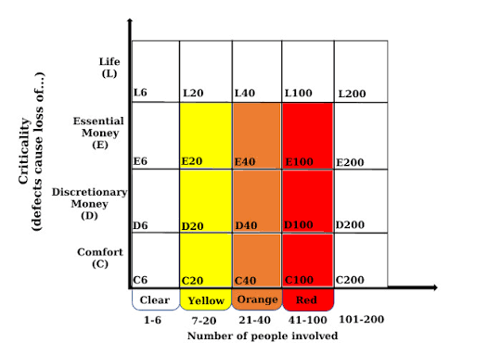
Crystal
C: Comfort
D: Discretionary money
E: Essential money
L: Life
Number: # of programmers
Software Technology • Ionian University
33

Slide 41
Scrum, XP, Kanban and Crystal comparison
DIMENSION
SCRUM
XP
KANBAN
CRYSTAL
Main focus
Value in Sprints
Code quality
Workflow
People & context
Rhythm
Timeboxed
Continuous / small editions
Continuous pull
Adaptable
Clock
3 accountabilities
Team practices
Maintains existing ones
Depending on the version
Standard scale
Small group • usually ≤10
Small dev team
Group to multiple services
Small–medium • up to ~50
Ideal use
Composite product
High-change software
Continuous influx of work
Context-sensitive projects
Size limits are guidelines, not rigid rules.
Software Technology • Ionian University
39

Slide 42
How much are they used? A comparative snapshot
Scrum
87%
Kanban
56%
XP
12%
State of Agile 2022 • Multiple choice: percentages do not add up to 100%.
Trend reading: Scrum dominates; Kanban is often combined; XP is mainly used as a set of practices.
Software Technology • Ionian University
40

Slide 43
Agile vs Waterfall
Crumple | Agile | Waterfall
Design | Adaptive, flexible design | Comprehensive advance planning
Development approach | Iterative and gradual | Serial –linear / successive phases: Requirements → design → implementation → control
Change management | Embraces change, easily adapts to new requirements | Resists change, difficult to adapt once growth begins
Priorities | Prioritize operations based on customer value | Prioritize operations based on the project plan
Tests | Continuous testing throughout the iterations | Testing phase following implementation
Customer participation | High, frequent feedback and collaboration | Low, mainly involved in debt collection
Software Technology • Ionian University
33

Slide 44
Agile vs Waterfall
Crumple | Agile | Waterfall
Team structure | Interfunctional, self-organized groups | Specialized, hierarchical groups
Documentation | Minimal, focus on functional software | Extensive, detailed documentation
Project visibility | High, due to regular reviews and demonstrations | Low, visibility only at specific landmarks
Risk management | Early risk detection and mitigation | Risks may not be discovered until late in the project
Time to market | Faster, as features are provided gradually | Later, as the entire product is delivered in one go
Project control | Decentralized, team-based decision-making | Centralized, strict control from top to bottom
Software Technology • Ionian University
33

Slide 45
Agile vs Waterfall
AGILE • +
AGILE • −
WATERFALL • +
WATERFALL • −
Advantages
Challenges
Advantages
Challenges
Quick feedback.
Timely value.
Better adaptation.
Visible risk.
Requires an active client.
Difficult to predict full scope.
It takes a mature, collaborative team.
Clear milestones.
Strong documentation.
Easier initial contracting.
Feedback late.
High switching costs.
There is a great risk of building the wrong solution.
Many real projects are hybrid: predictable points with iterative development where there is uncertainty.
Software Technology • Ionian University
42

Slide 46
Which approach is suitable?
SCRUM
XP
KANBAN
CRYSTAL
WATERFALL
Composite product
Technical risk
Continuous flow
Frame
Frame
Frequent product choices, a common goal, and a steady pace are needed.
Code quality and safe frequent change are critical.
Unforeseen influx, operations/support or need evolutionarychange.
Crystal for context-sensitive small groups
Waterfall when requirements and technology are stable.
Methods are not religions: we choose and adapt based on risk, flow, criticality, and feedback.
Software Technology • Ionian University
43

Slide 47
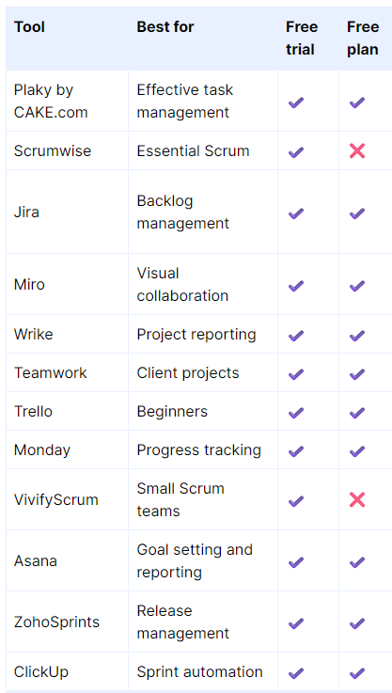
Tools Agile
Software Technology • Ionian University
33

