Slide 1

SOFTWARE ENGINEERING
Software Requirements
George Dimitrakopoulos
dimitrakopoulos@ionio.gr
Department of Informatics
Ionian University

Slide 2
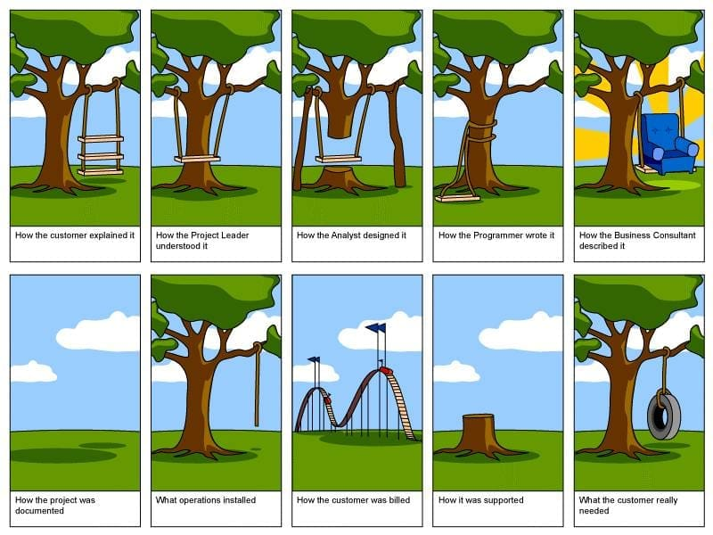
Software Technology • Software Engineering

Slide 3
Learning objectives
Discrimination
Wording
Control
Distinguish between functional, non-functional and domain requirements.
Write requirements that are clear, measurable, and testable.
Identify ambiguity, conflict, gaps, and unrealistic goals.
In the end: from a “good idea” to acceptance criteria that can be tested.
need → requirement → specification → implementation → control
Software Technology • Software Engineering

Slide 4
What is a requirement?
Requirement ≠ design decision
“What should the system do — and under what constraints?”
REQUIREMENT
The user retrieves their password
The result that has value.
Description of a service, behavior, property, or constraint that a stakeholder needs.
DESIGN
Sending JWT via SendGrid
A possible way of implementation.
Software Technology • Software Engineering
03

Slide 5
Levels of requirements
BUSINESS
USER
SYSTEM
Operational
Users
System
Why do we invest? • • Example: reducing cart abandonment by 15%.
What does the user need to achieve? • • Example: complete a purchase as a guest.
What exactly should the system do or ensure? • • Example: final cost calculation.
Each lower level must be linked to a higher need.
Software Technology • Software Engineering
04

Slide 6
The basic taxonomy
REQUIREMENTS
WHAT
HOW WELL
CONTEXT
Functional
Non-functional
Field
Services, rules, reactions to inputs.
Quality, limitations, service levels.
Laws, standards and rules of the domain.
Software Technology • Software Engineering
05

Slide 7
Functional requirements
They describe services, calculations, rules, and behaviors of the system.
INPUT
PROCESS
OUTPUT
Entry
Processing
Output
When the customer submits a valid coupon…
…the system calculates the discount based on the active rules…
…and displays new total before payment.
Pattern: When [event], the system should [behavior].
Software Technology • Software Engineering
06

Slide 8
Non-functional requirements (Non-functionalrequirements)
They determine how well the system works and what limitations apply.
PERFORMANCE
AVAILABILITY
SECURITY
Performance
Availability
Security
p95 response time ≤ 2 s.
≥ 99.9% per calendar month.
MFA for administrator accounts.
USABILITY
RELIABILITY
PORTABILITY
Ease of use
Reliability
Portability
90% success in the basic task without help.
RPO ≤ 15 min, RTO ≤ 2 h.
Support for the last 2 browser versions.
Software Technology • Software Engineering
07

Slide 9
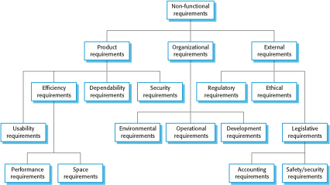
Non-functional requirements (Non-functionalrequirements)
Software Technology • Software Engineering

Slide 10
From “fast” to measurable
INFINITE
CONTROL
The system should be fast.
p95 ≤ 2 s
How fast? For what function? With how many users? On what infrastructure?
For product search, with 1,000 concurrent users and a catalog of 100,000 products.
Measure + target + conditions + measurement period = testable NFR
Software Technology • Software Engineering
08

Slide 11
Domain requirements
They come from the application environment — not just from customer preference.
LEGISLATION
STANDARDS
BUSINESS
Privacy / GDPR
Payments
Accounting rules
Consent, data minimization, subject rights.
Security, logging and card data handling rules.
VAT, cancellations, credits and retention periods.
Ask domain experts: the most dangerous requirements are often considered “self-evident”.
Software Technology • Software Engineering
09

Slide 12
Stakeholders: who has a claim?
User
Customer
SYSTEM
Ops
Regulator
Needs conflict. Requirements analysis is also negotiation.
Software Technology • Software Engineering
10

Slide 13
Requirements elicitation (Elicitation)
ASK
WATCH
CREATE
LEARN
Interviews
Observation
Workshops
Prototypes
Open questions, “why?”, critical incidents.
The actual workflow often differs from the described one.
Common vocabulary, conflict resolution, story mapping.
Quick feedback on something specific.
We don't just ask "what do you want?" — we explore goals, exceptions, and current problems.
Software Technology • Software Engineering
11

Slide 14
User story + acceptance criteria
As a guest, I want to purchase without registering, so I can complete the purchase faster.
GIVEN
WHEN
THEN
Since
When
Then
I have products in my cart and I am not logged in.
I select “Shop as a guest” and provide a valid email.
I can pay and I receive a confirmation email.
Software Technology • Software Engineering
12

Slide 15
Use case: the full flow
ACTOR
Main flow
Alternatives / exceptions
Customer
Choose delivery method
Import data
Payment option
Order confirmation
• Product unavailable
• Payment rejection
• Invalid address
• End of session
Goal: purchase completion.
Precondition: active cart.
Trigger: “Checkout”.
Software Technology • Software Engineering
13

Slide 16
What makes a requirement “good”?
CLEAR
COMPLETE
CONSISTENT
Clear
Complete
Consistent
A reasonable interpretation.
Terms, limits and exceptions.
Without conflict with others.
FEASIBLE
VERIFIABLE
TRACEABLE
Feasible
Verifiable
Traceable
Technically and financially.
There is objective control.
It has a source and a downstream connection.
If we can't agree on how it will be controlled, it's not done.
Software Technology • Software Engineering
14

Slide 17
SMALL EXERCISE
Identify the ambiguity
"The system will quickly send notifications to relevant users."
QUICKLY;
RELATED?
NOTIFICATIONS?
Year
Public
Channel
In 1 s, 1 min or 1 day?
Which roles and by what rule?
Email, push, SMS; what happens if it fails?
2 minutes: rewrite the requirement so that it is testable.
Software Technology • Software Engineering
15

Slide 18
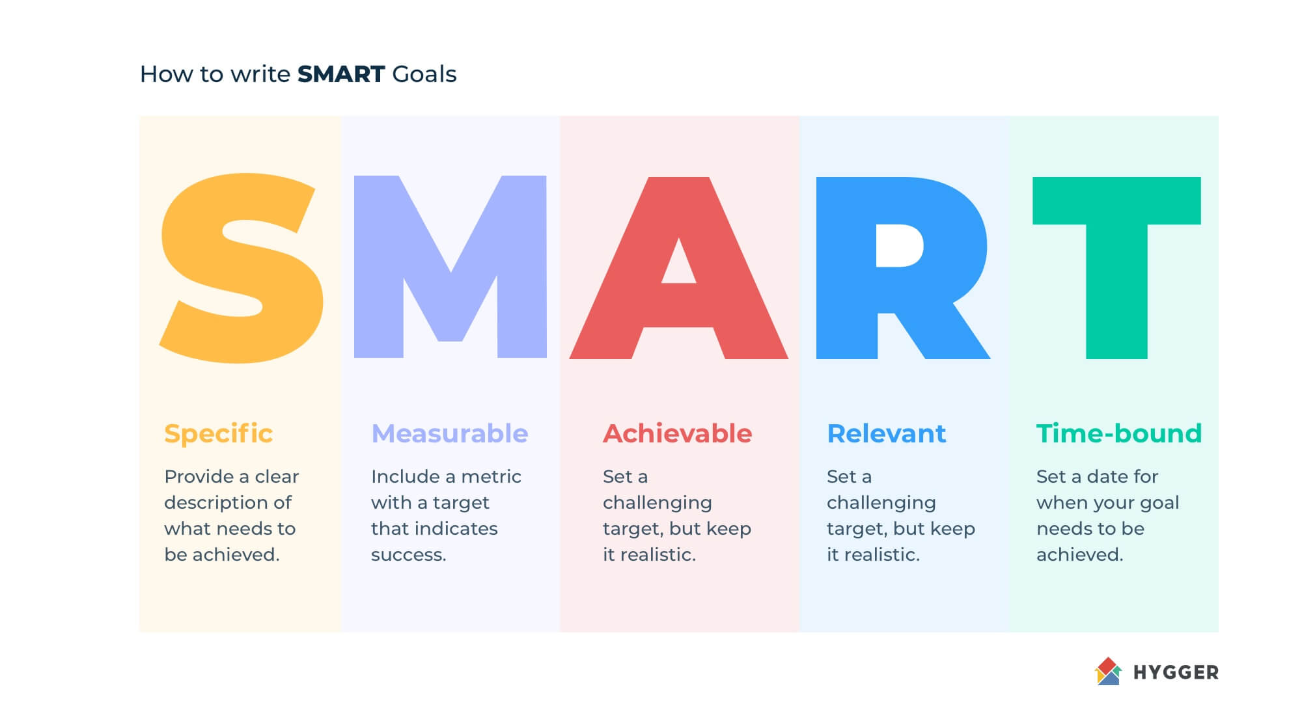
SMALL EXERCISE
Goals SMART
Software Technology • Software Engineering
15

Slide 19
SMALL EXERCISE
Goals SMART
The SMART is a mnemonic acronym that provides criteria that guide the setting of goals that yield better results, for example in project management, employee performance management, and personal development. The term was first proposed by George T. Doran in 1981.
He suggested that the goals should be:
  Specific – Specific: a specific area for improvement
  Measurable –Measurable: quantification or indicators to indicate progress
  Assignable – Possibility of assignment: determining who does what //alternative to Achievable
  Realistic – Realistic: (what results can be achieved with the available resources) //alternative to Relevant
  Time-related – Time determination: when will they be achieved
Software Technology • Software Engineering
15

Slide 20
SMALL EXERCISE
Other target definitions
CLEAR: Collaborative; Limited; Emotional; Appreciable; Refinable
PURE: Positively stated; Understood; Relevant; Ethical
CPQQRT: Context; Purpose; Quantity; Quality; Resources; Timing
ABC: Achievable; Believable; Committed
Software Technology • Software Engineering
15

Slide 21
Prioritization: MoSCoW
MUST
SHOULD
COULD
WONT — NOW
Must
Good to
Could
Not now
Without this, the publication is meaningless or not legal.
High value, but there is a temporary workaround.
Useful, if there is time and capacity.
Conscious release from the current scope.
Priority ≠ who shouts the loudest. Value, risk, cost and dependencies.
Software Technology • Software Engineering
16

Slide 22
Traceability
WHY
WHAT
BUILD
VERIFY
Business goal
REQ-17
Story / code
TC-42
Abandonment reduction
Checkout as a guest
Guest checkout flow
Completion without login
When a requirement changes, we know which stories, tests, and releases are affected.
Software Technology • Software Engineering
17

Slide 23
Validation: we build the right system
VALID
CONSISTENT
COMPLETE
Validity
Consistency
Completeness
Solves a real need
Conflicts with another requirement
Missing flows or exceptions
REALISTIC
VERIFIABLE
AGREED
Realism
Controllability
Agreement
Countries in time, budget, technology
We can prove satisfaction
The relevant stakeholders are committed
Reviews • prototypes • test-case derivation • walkthroughs • stakeholder sign-off
Software Technology • Software Engineering
18

Slide 24
Requirements change
Market change, feedback, technology, law, new knowledge — change is not failure.
1 Request
2 Analysis
3 Decision
4 Update
IMPACT ANALYSIS
BASELINE
What is affected?
Which version?
Scope, architecture, data, tests, cost, schedule.
Recording version, owner, status and rationale.
Software Technology • Software Engineering
19

Slide 25
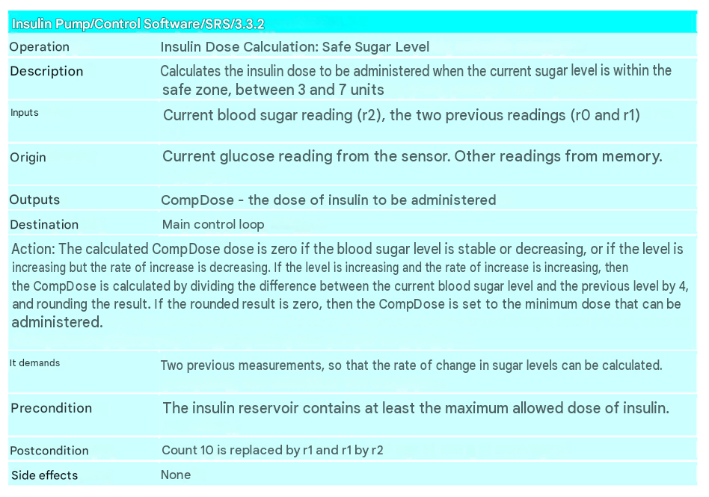
Requirements Document – ​​Predefined Form
Software Technology • Software Engineering
19

Slide 26
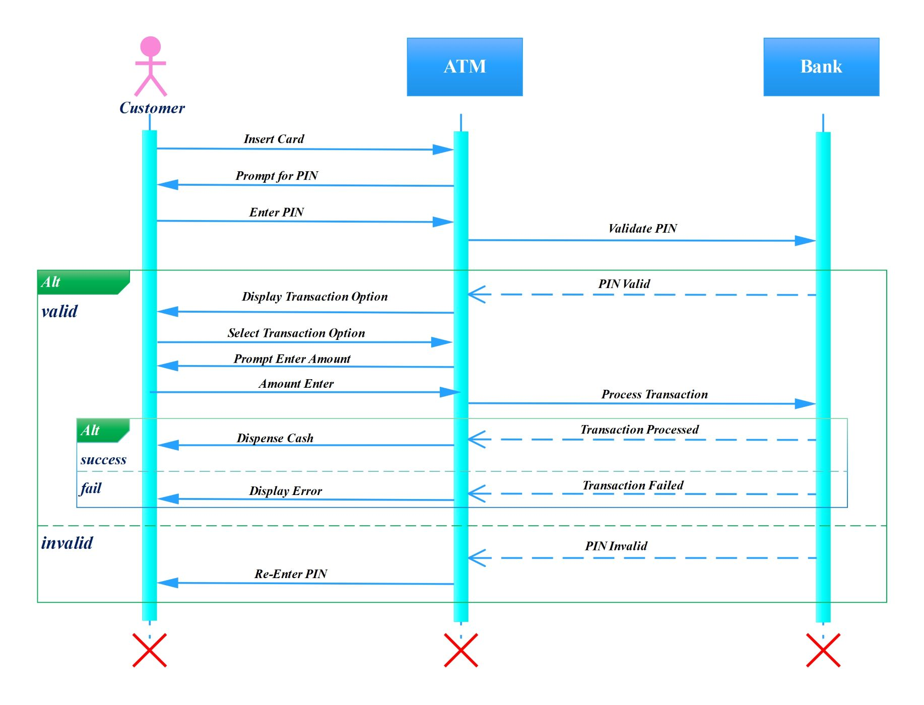
Requirements Document - Diagram
*More on UML diagrams in next lectures!
Software Technology • Software Engineering
19

Slide 27
Exercise: StudentFood
You are designing a food ordering app for students.
Requirements
Acceptance criteria
Review
Write 3 functional + 2 non-functional requirements.
Give Given–When–Then for a functional requirement.
Swap with another group and find an ambiguity.
Bonus: add a domain requirement and document its source.
Software Technology • Software Engineering
21

