Slide 1
Software Technology UML
George Dimitrakopoulos

Slide 2
UML
Unified Modeling Language
Standard language for designing and modeling software engineering.
It is used to graphically display, identify, construct, and document the elements of asoftware system.

Slide 3
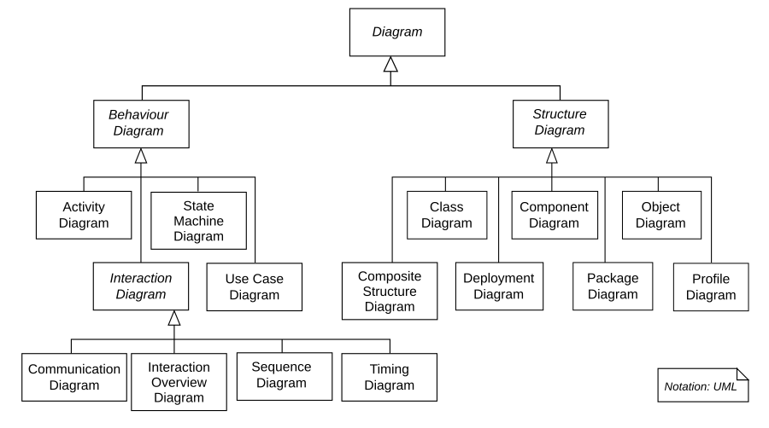
Diagrams UML

Slide 4
Basic diagrams
Activity diagrams (Activitydiagrams), which show the activities involved in a process or data processing.
Use case diagrams (Usecasediagrams), which present the interactions between a system and its environment.
Sequence diagrams (Sequencediagrams), which depict interactions between users (actors) and the system, as well as between the individual elements of the system.
Class diagrams (Classdiagrams), which show the classes of objects within the system and the relationships between these classes.
State diagrams (Statediagrams), which show how the system reacts to internal and external events.

Slide 5
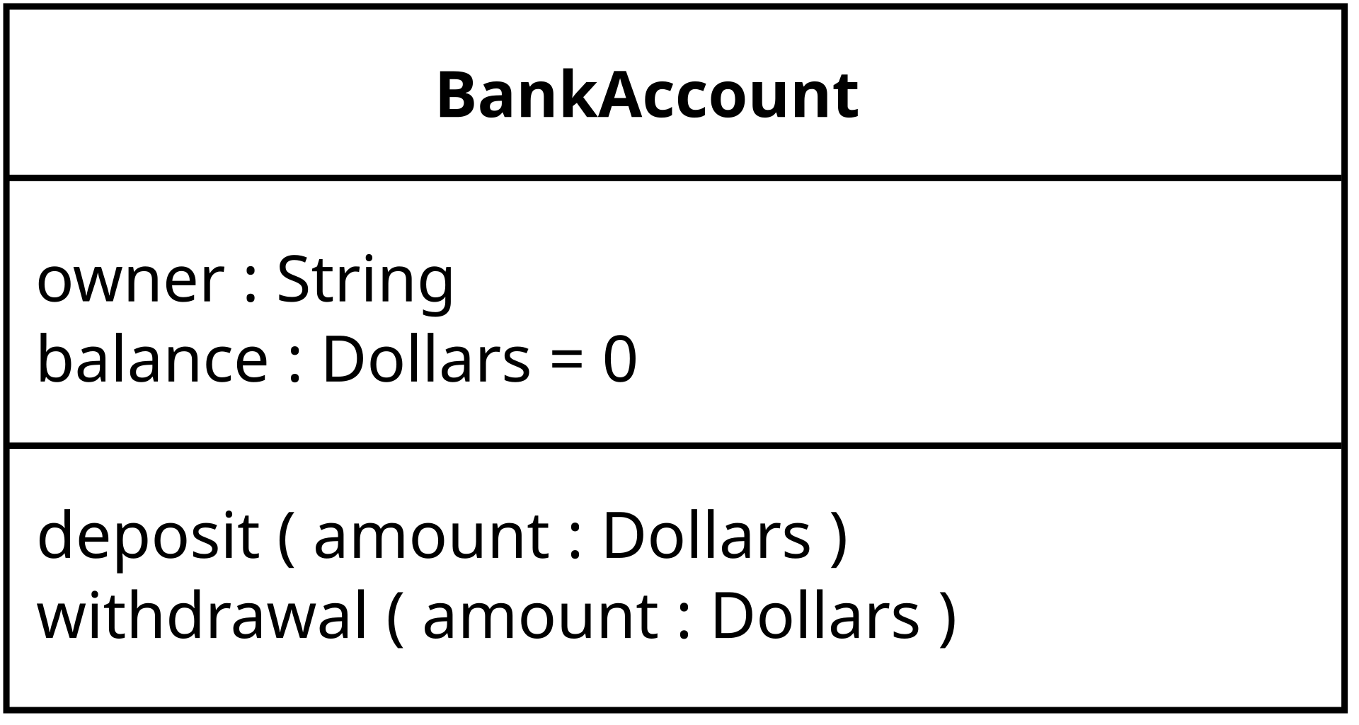
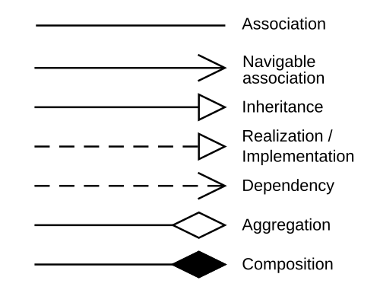
Class diagram

Slide 6
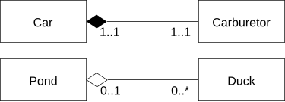
Examples – aggregation, composition

Slide 7
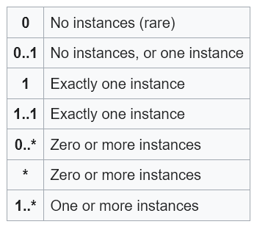
Multiplicity (cardinality)

Slide 8
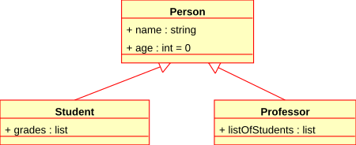
Examples - inheritance

Slide 9
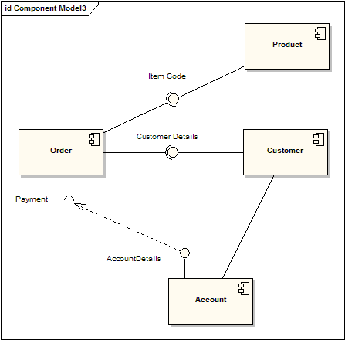
Component diagram

Slide 10
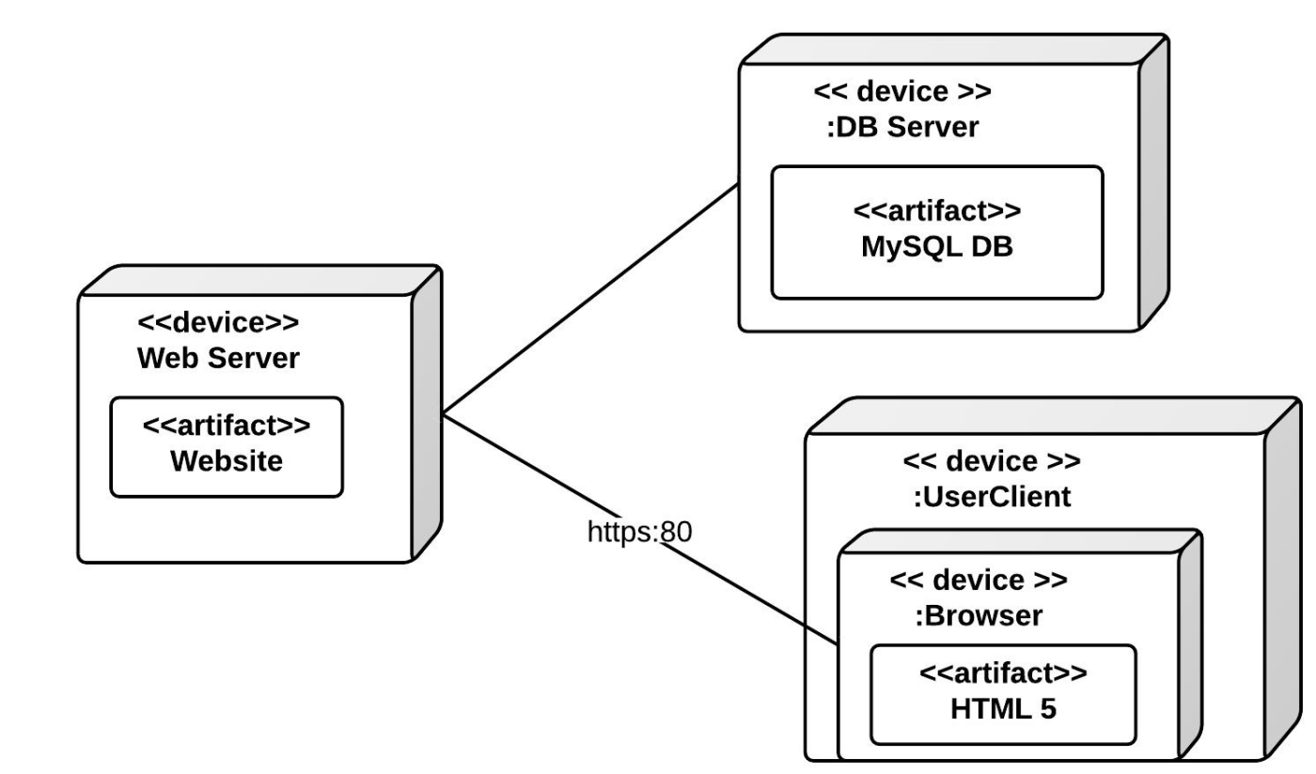
Deployment diagram
Two types of nodes:
Device Node
Execution Environment Node

Slide 11
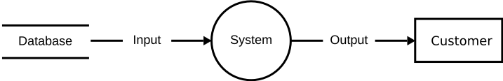
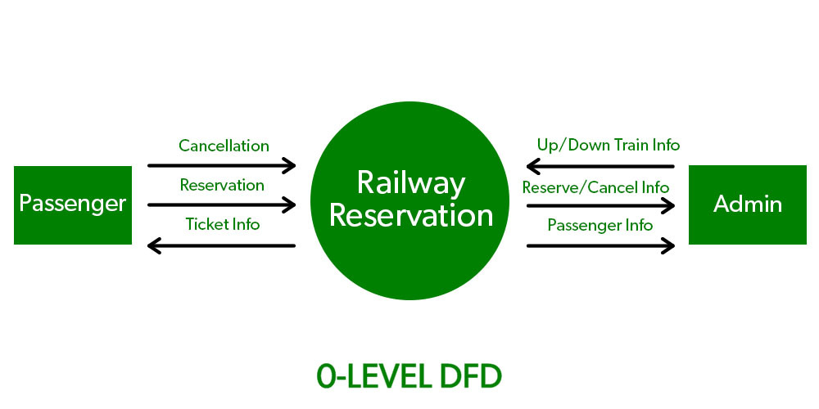
Data flow diagram
Level 0 DFD

Slide 12
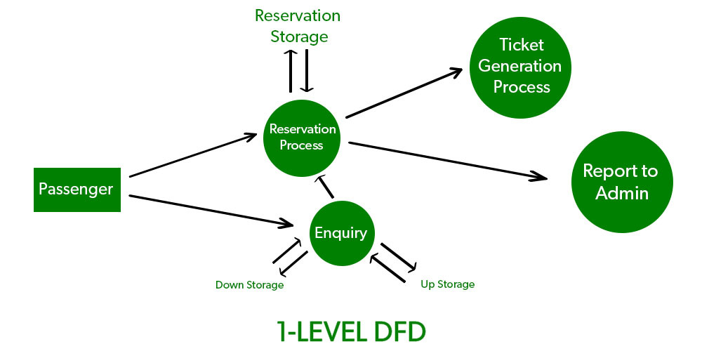
Data flow diagram
Level DFD 1

Slide 13
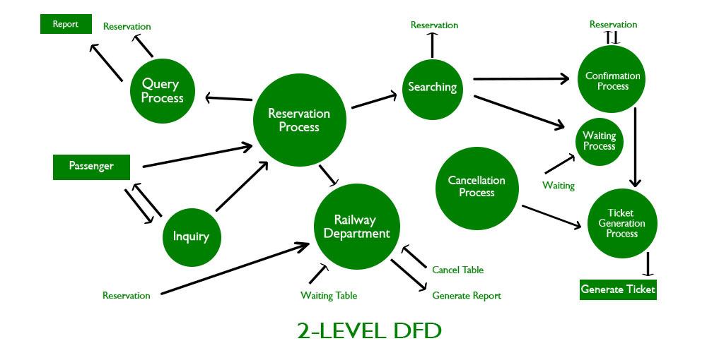
Data flow diagram
Level DFD 2

Slide 14
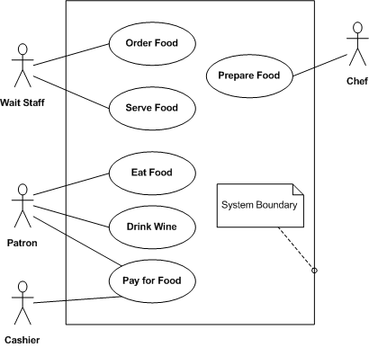
Use case diagram (use case)

Slide 15

Description Use case in a table
Use Case: data transfer
Roles (Actors) | Medical receptionist, patient records system (PRS)
Description (Description) | The receptionist can transfer data from the MHC-PMS to a general patient record database managed by a health authority. The information transferred can be updated personal details (address, telephone number, etc.) or a summary of the patient's diagnosis and treatment.
Data (Data) | Patient personal information, treatment summary
Stimulus (Stimulus) | User order issued by the medical receptionist
Response (Response) | Confirmation that the PRS system has been updated
Comments (Comments) | The receptionist must have the appropriate security permissions to access patient information and the PRS system.

Slide 16
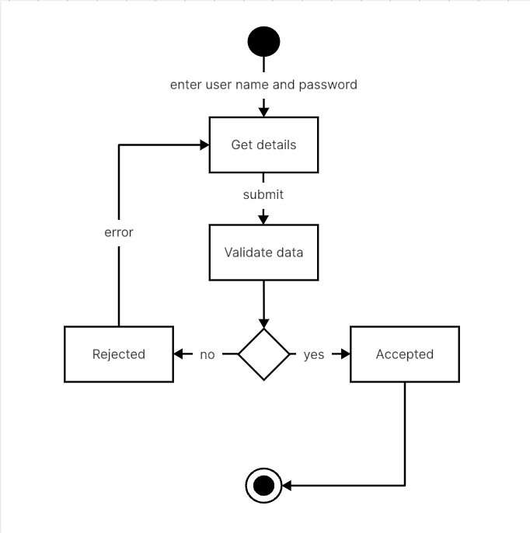
Action diagram (Activity)

Slide 17
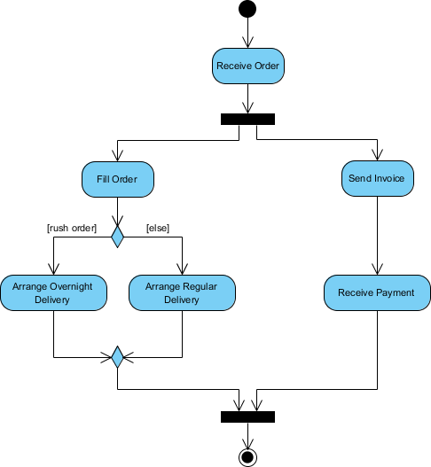
Action diagram (Activity)

Slide 18
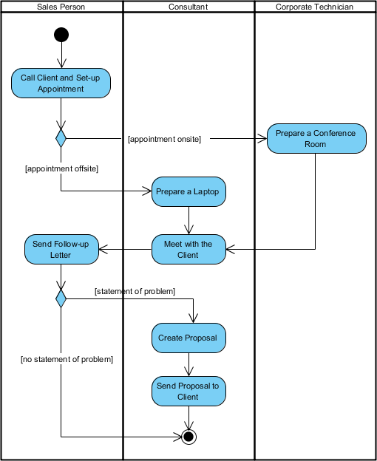
Action diagram (Activity)

Slide 19
Action diagram (Activity)
The stages (stadia) represent actions.
The rhombuses (diamonds) represent decisions.
The bars (bars) represent the beginning (separation) or the end (union) of simultaneous activities.
A black circle represents the beginning (initial node) of the workflow.
A black circle within a circle (encircledblackcircle) represents the end (terminal node).

Slide 20
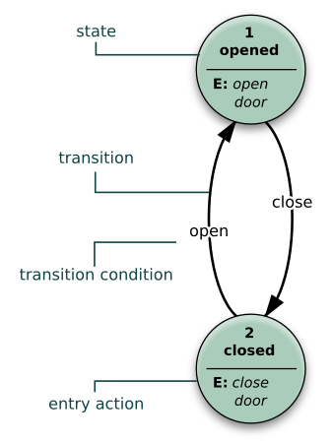
State diagram (state machine)

Slide 21
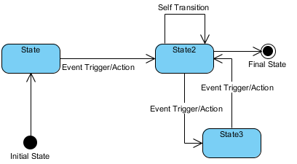
State diagram (state machine)

Slide 22
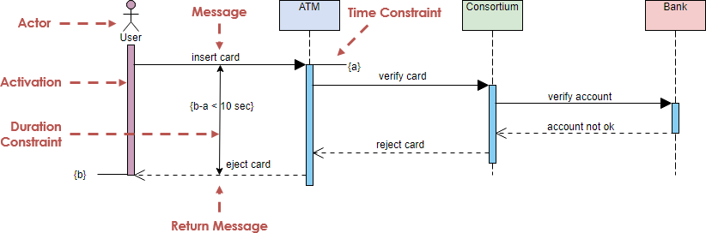
sequence diagrams (Sequence)

Slide 23
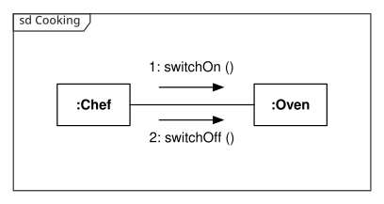
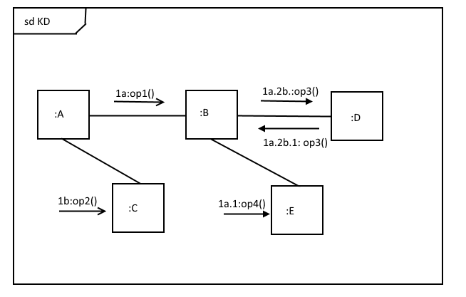
Communications diagram

Slide 24
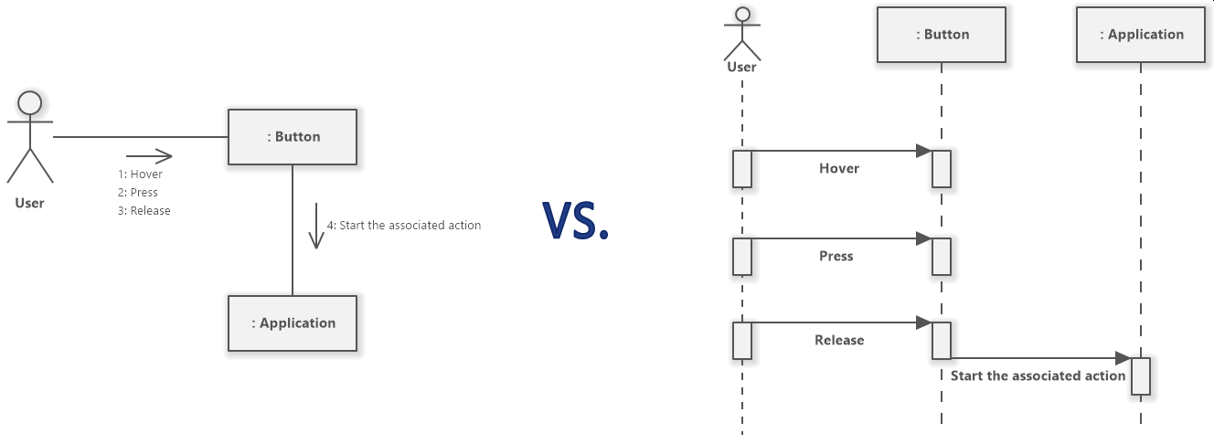
Communication Diagrams vs. Sequence Diagrams

Slide 25
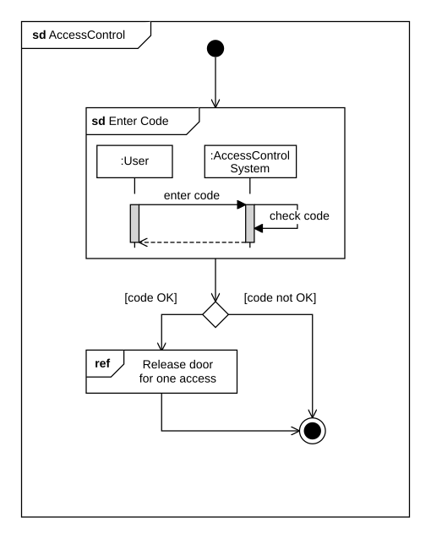
Interaction diagram (interaction diagram)

