Slide 1
Visio
By: Peyrer & Artelsmair

Slide 2
Overview
Layout
General
Advantages
Disadvantages
Example

Slide 3
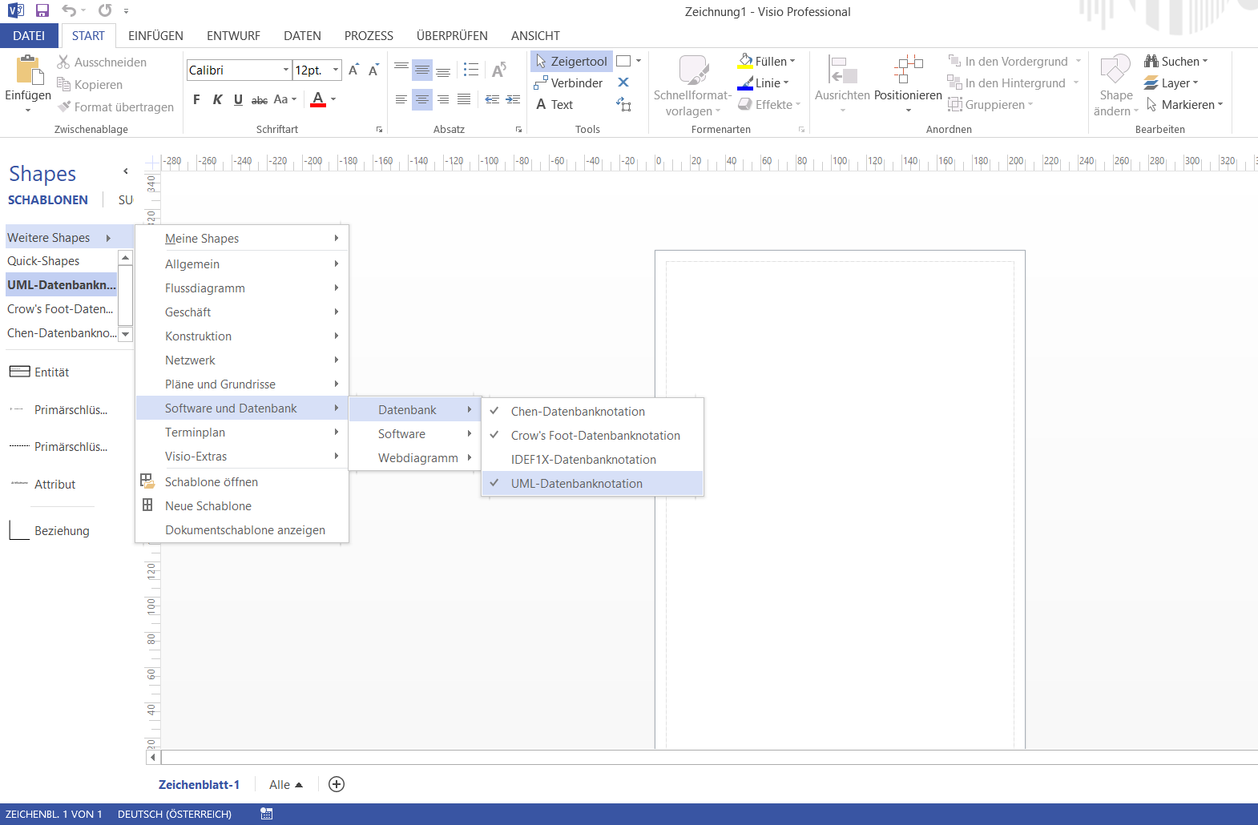
Layout

Slide 4
General
Is a diagramming and vector graphics application and is part of the Microsoft Office family
Introduced in 1992
Acquired by Microsoft in 2000
Microsoft Visio 2016 (385,08€)

Slide 5
Advantages
The software has a great layout
You can use it for many different kinds of diagrams
Some different types of functions
The software is simple to manage
Several types of different notations
Notes:
Chen; Crow-foot; IDEF1X; UML-Data Base notation

Slide 6
Disadvantages
Has a high prize
Older Versions are only available for Windows

Slide 7
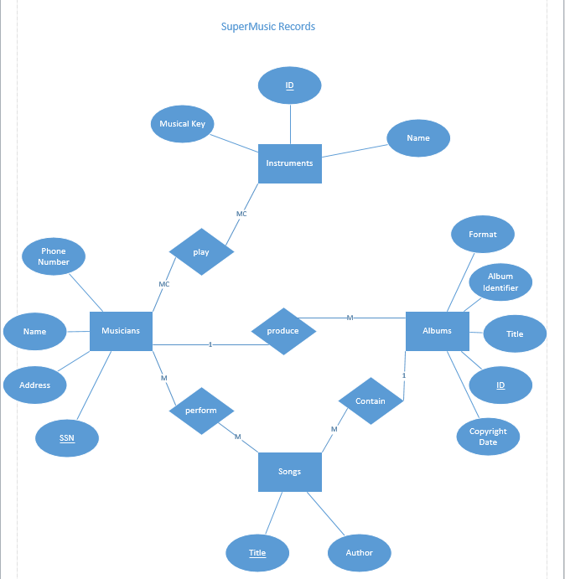
Example

Slide 8
Sources
https://en.wikipedia.org/wiki/Microsoft_Visio
My own experience

