Slide 1
Visio
By: Peyrer & Artelsmair

Slide 2
Overview
Layout
General
Advantages
Disadvantages
Example

Slide 3
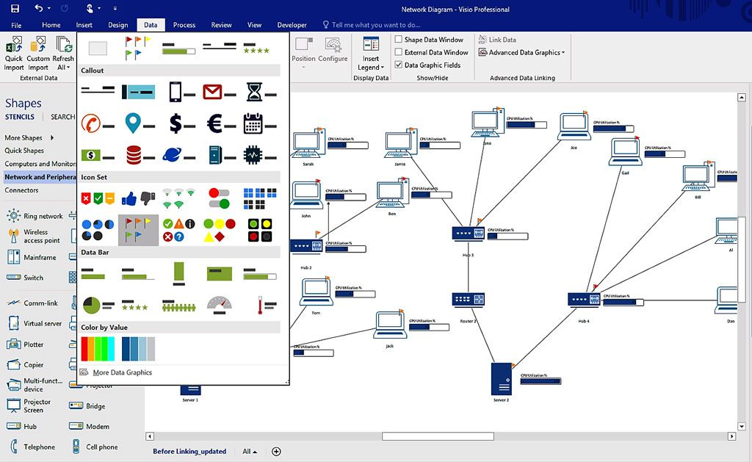
Layout

Slide 4
General
Microsoft Visio 2016 (385,08€)
Is a diagramming and vector graphics application and is part of the Microsoft Office family
Introduced in 1992
Acquired by Microsoft in 2000

Slide 5
Advantages
The Software has a great layout
You can use it for different kinds of Diagrams
Capabilities to go beyond simple diagramming
Excellent software for creating flow charts and flow diagrams
Several different types of functions
The Software is simple to manage

Slide 6
Disadvantages
Has a high prize
The user can be overwhelmed by so many things

Slide 7
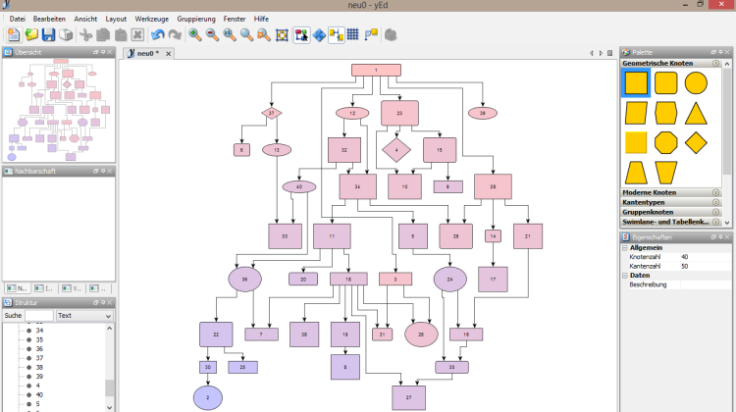
Example

Slide 8
Sources
Alexander Artelsmair
https://en.wikipedia.org/wiki/Microsoft_Visio

