Slide 1
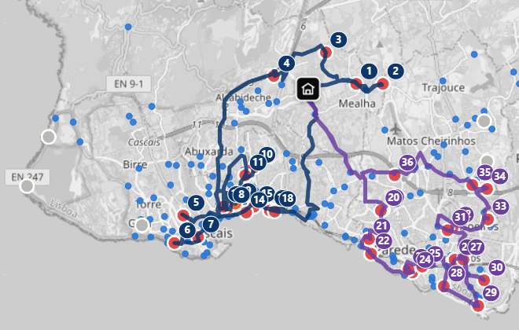
HACK THE CITY 2026 · CHALLENGE #9
Cascais Sweep
Find abandoned scooters.
Plan the van.
Clear the streets.
Collection runs planned on real streets
Artem Tkachev · NOVA IMS
Notes:
Hi, I am Artem. This is Cascais Sweep — a tool that helps the city find abandoned scooters and plan how to collect them.

Slide 2
The problem
Bird (private operator) must keep its scooters at stations. If one stays > 30 m outside for > 2 h, Cascais Próxima (the city) removes it and Bird pays a €4.5 fine. 3 weeks of Bird data:
44
13.6 h
~10
new abandoned
vehicles every day
median time on the street
after the 2 h limit
collected by the city per day
in our data period (one run)
16,888 trips · 1,388 vehicles · 157 stations · 920 abandonment cases · 24,791 vehicle-hours abandoned
Notes:
In Cascais, a scooter left more than 30 metres from a station for over 2 hours is abandoned, and the municipality has to collect it. We analysed three weeks of Bird data: 44 new abandoned vehicles every day, and the typical one stays on the street for another 13 and a half hours. In our data period the city team made one 2-hour run a day and collected about 10.

Slide 3



Who is affected
Pedestrians
30 cases blocked a bus stop (within 20 m) for 657 hours in total — wheelchairs, prams, visually impaired people.
Cascais Próxima team
One van, 18 places, no tool: which vehicles matter most, and in which order to drive?
The city vs the operator
Two different organisations: Bird earns from rides, the city keeps the streets clear. Every scooter the city removes costs Bird €4.5.
Rules designed with João Silva, Cascais Próxima: depot, van capacity, how the team works, the fine.
Notes:
These scooters block pavements and bus stops — a real problem for wheelchair users and parents with prams. The city team has one van and no tool to decide what to collect first.

Slide 4
Why they stay so long
94%
of Bird pickups happen 06:00–14:00. Riders peak in the evening, so vehicles left after lunch wait until morning.
109
times a Bird technician serviced an abandoned vehicle on the spot and left it there: 6,652 more hours.
6–14%
of cases would disappear even with the 8 best new stations. Abandonment is everywhere: collect, don't build.
Notes:
We found why they stay so long: 94% of Bird pickups happen before 2 pm, but riders peak in the evening, so anything left in the afternoon waits until the next morning. In 109 cases a Bird technician was right there, serviced the scooter, and left it. And new stations will not fix it: even the 8 best sites would cover under 15% of cases.

Slide 5



Detect → Prioritise → Route
1. Detect
2. Prioritise
3. Route
→
→
History: 3 weeks of Bird events.
Live: Bird's public GBFS feed, every minute. Vehicles matched between snapshots by position.
Time abandoned, distance from a station, blocking a bus stop, and a model: will a rider take it anyway? Weights are sliders.
Pick the vehicles worth most per minute of detour, within 18 places and the time available. Order and path on real streets (OSRM).
Open source only: Python, Leaflet, OpenStreetMap, OSRM. No API keys.
Notes:
Three steps: detect, prioritise, route. Then switch to the live website for the demo.

Slide 6
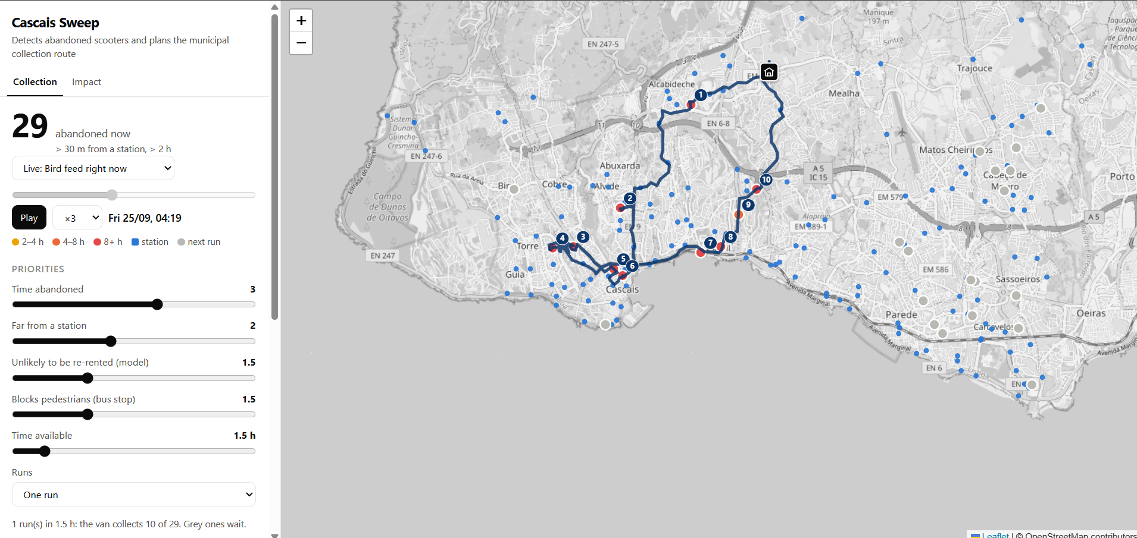
Live demo
github.com/Artem-Tkachev/cascais-sweep
Notes:
Demo: Thursday 15:00 in history mode — priorities, one run on real streets. Switch Runs to many. Switch to Live: Bird feed right now, refreshed every minute. Demand tab: imbalance per hexagon. If the internet fails, show this screenshot.

Slide 7
Impact
Simulation on 3 weeks of real data: one van, weekdays 09:00–18:00, 18 vehicles per run
−59%
vehicle-hours abandoned
24,791 → 10,246
30.7
vehicles a day
instead of ~10 in our data
−30%
km driven vs first-come order
94 vs 134 km a day
+€2,000
fines a month
€45 → €138 a day
In one 2-hour run: 12.7 vehicles instead of ~10. Vehicles at bus stops collected first.
Notes:
We simulated three weeks: the time scooters stay abandoned drops by 59%. One van collects 30 a day instead of 10 and drives 30% fewer kilometres than in first-come order. Fines go from 45 to about 138 euros a day.

Slide 8




What's next
Any operator, any city
Pilot with Cascais Próxima
Built only on GBFS, the open standard of shared mobility.
Live feed on a small server; store events instead of snapshots.
Smarter multi-run plans
Where are buses missing?
A VRP solver (VROOM on OSRM) to balance vehicles between runs.
Scooter trips from bus stops show where and when people need new bus links. Cascais Próxima already shared its stops and routes data.
Thank you · github.com/Artem-Tkachev/cascais-sweep
Notes:
It uses only GBFS, the open standard, so it works for any operator and any city. Next: a pilot with Cascais Próxima, and they already gave us their bus data to find where people need buses that do not exist yet. Thank you.

