Slide 1


I have written a paper. Where do I publish it?
Risk it
Can be prestigious paper
Wasted 3 months if rejected
Play it safe
A run-of-the-mill paper
Can move on sooner
Prestigious
journals
Non-selective
journals

Slide 2
I have written a paper. Where do I publish it?
Risk it
Can be prestigious paper
Wasted 3 months if rejected
Play it safe
A run-of-the-mill paper
Can move on sooner
Ghandour-Lebedev
model
Precise targeting
Get into the best journal possible
Try small tweaks to improve chances
Prestigious
journals
Non-selective
journals

Slide 3
Ghandour-Lebedev model
76
768
1251
Token embeddings
Token embeddings
Token embeddings
Token embeddings
Token embeddings
400
833
Text
Title +
Abstract text
sciBERT
Cls token
Pooled token
1
Number of authors
Length of the abstract
Num. pages
Cited ref. count
Current year
Numbers
Linear
5
Author’s country (23 levels)
Publisher’s country (20 levels)
Funding situation (2 levels)
Author’s country embedding (23 dim)
Publisher’s country embedding (20 dim)
Funding situation embedding (2 dim)
Categories

Slide 4
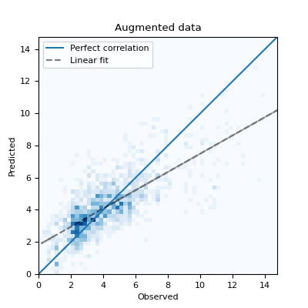
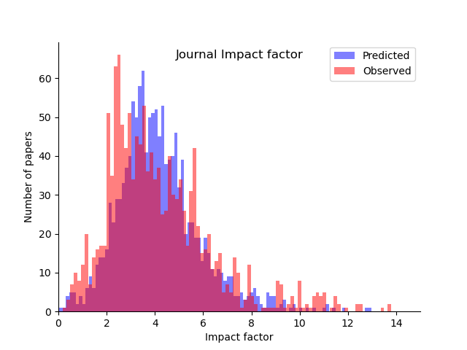
Model performance: 73% correlation between predicted and observed JIF

