Slide 1
Regional Market Assessment
FY10 Priority Markets
24 Jul 09

Slide 2
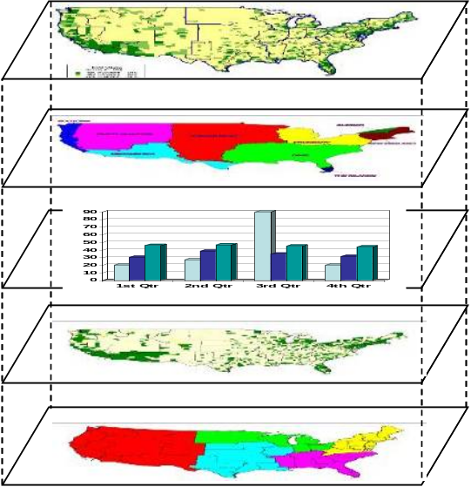
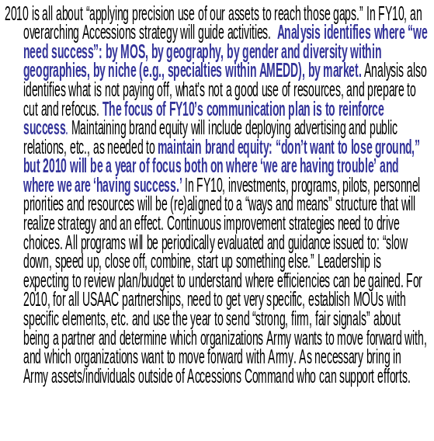
Purpose
Sources: USAAC partnered with USAREC, USACC and MWG to develop a consolidated market priority market methodology.
Commander’s
Planning Guidance
Spatial &
Temporal Overlays
Market Analysis
Demographic Analysis
Economic Analysis
Socio-Political Analysis
Competitive Analysis
Performance Analysis
Address:
  Which regions are most strategically important?
  Is the Army sufficiently reaching certain diversity(*) objectives?
  Market and Marketing priorities to determine how to best use available resources.
Develop a list of priority markets to assist marketing/communications planners in developing COAs that meet the Commander’s Guidance.
* Diversity refers to Ethnic, Geographic, Academic, Skills, Component (AR, RA, etc), Gender in order to represent America.

Slide 3
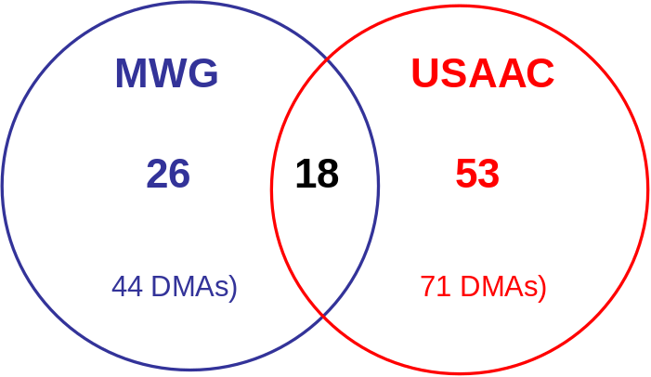
Methodology
McCann Worldgroup (MWG) and USAAC G2 developed separate methodologies to identify and prioritize “Successful Markets” and “Markets of Opportunity”.
Although common data sources were used, the metrics developed varied between the approaches but ultimately lead to a more holistic look at markets.
Criteria Considered in Methodology:
Army Enlisted Production (VOL / GSA)
DoD Enlisted Production (VOL / GSA)
Army ROTC Production (Commissions and Current Cadets)
Unemployment Rates
Obesity Rates
Propensity Rates
Potential Enlisted Production Estimates (Based on ACS)
Total Population (17/18 -24, QMA and/or Nielsen)
Ethnic Populations (17/18-24, QMA and/or Nielsen)
DMA Geographic Size
Leads
ROTC School Locations
STEM Degree Opportunities in Post-Secondary Schools
Ethnic Student Enrollments in Post-Secondary Schools
Market factors and the organizations’ rankings were used to compile the 2 listings into one prioritized market list and a better regional market understanding.

Slide 4
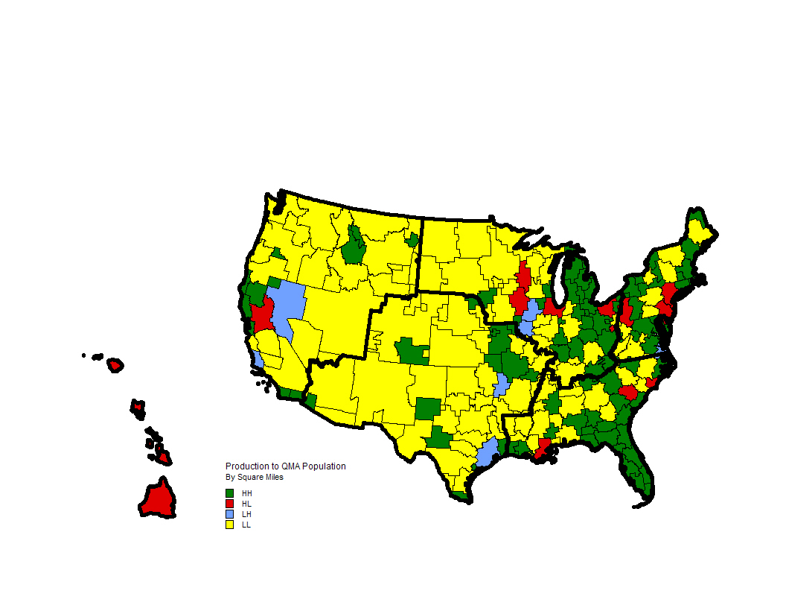
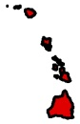
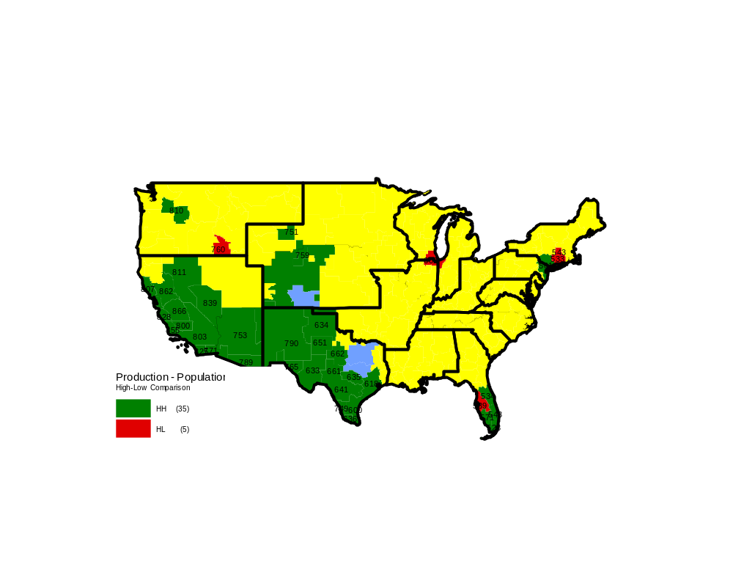
Overall Regional Market Assessment
Production to QMA Population
TAKEAWAYS:
In general, the Army is producing well in areas with high QMA (green). There are high-QMA areas of opportunity in the Northeast, North Central, Southeast and Western Regions. The greatest barriers at the DMA level include obesity, propensity and high population but LOW QMA. High unemployment, positive shifts in propensity and growing QMA continue to create and reinforce recruiting and accessions success.
USAREC
Boundaries
 | Reinforce Success
 | Market of Opportunity
USACC Boundaries

Slide 5
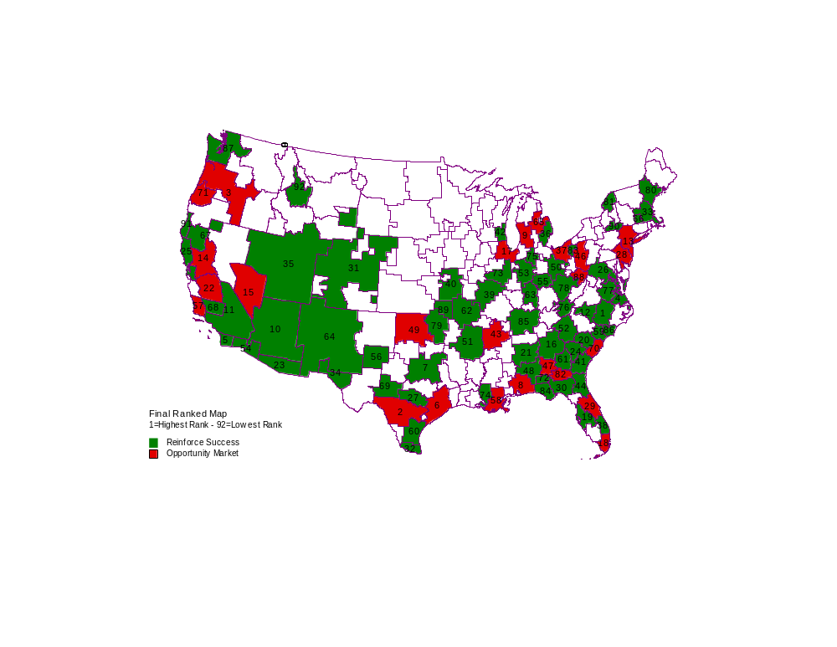
The Top 15 Markets
 | Reinforce Success
 | Market of Opportunity
Final Rank Map
Raleigh-Durham (Fayetteville) NC
San Antonio, TX
Portland, OR
Norfolk-Portsmouth-Newport News, VA
San Diego, CA
Houston, TX
Dallas-Ft Worth, TX
Mobile-Pensacola, AL-FL
Grand Rapids-Kalamazoo-Battle Creek, MI
Phoenix (Prescott), AZ
Los Angeles, CA
Greensboro-High Point-Winston Salem, NC
New York, NY
Sacramento-Stockton-Modesto, CA
Las Vegas, NV
Numbers on map are priority order (1 is top priority)
The Army must sustain success in critical core DMAs to effectively attain mission success. Some of these DMAs are near military installations and may not require a great deal of marketing resources for sustainment, but their contributions are significant enough that they cannot be ignored.
The Army can gain efficiency by targeting DMAs that indicate under-tapped potential for service in the Army.

Slide 6
Supporting Enterprise Priority Markets
Our Approach
Support highest priority markets, extending support until funding is depleted
  Each discipline considered several COAs, allowing for the most robust market list penetration
Intended as a supplement to national activity and individual command local activity

Slide 7
PRIORITY MARKET
“HEAVY UP” EXECUTION
Three examples of regional operations

Slide 8
Northeast Market Recommendations
Success Designated Market Area (DMA) | Opportunity DMA’s
506 – Boston, MA 511 – Washington DC 500 – Portland/ Auburn, ME 543 – Springfield-Holyoke, MA 531 – Tri-Cities, TN/VA 564 – Charleston/Huntington WV 549 – Watertown, NY 502 - Binghamton, NY 556 – Richmond-Petersburg, VA 544 – Norfolk-Portsmouth, VA | 501 – NYC 504 – Philadelphia 508 – Pittsburg 598-- Clarksburg/ Weston, WV
By DMA
(502, 543, 549) Producing well overall despite low propensity
and low unemployment. Focus on intangible benefits of
service (leadership) and influencer outreach.
(511) High quality/production market with higher propensity despite low unemployment. AA/API target. Focus on ethnic messaging and patriotism.
(500) High Unemployment paired with low propensity. Focus on value based messaging that communicates the benefit of service
(501) Low overall quality, production and propensity although diversity targets for HCM, AA and API
(508, 598, 504) High QMA/Low Production and propensity with obesity being an issue. Leverage AEC influence. AA/API target
(531, 564) Reinforce success. AA Target

Slide 9
Marketing Heavy up Presence
Northeast Region
Heavy up TV to increase overall awareness of the Army
  Norfolk
Events to help target specific ethnic segments of the population and leverage entry into schools
Leverage Hispanic Outreach in key DMA
  NYC
  Boston
  Pittsburgh
  Philly
Leverage Planning for Life to impact DMAs such as:
  NYC
  Springfield, MA
Use SR/JR DM in areas with a history of results in DMAs such as:
  Roanoke
  Johnstown-Altoona
  Wilkes Barre-Scranton
  Harrisburg
  Harrisonburg
  Erie
  Richmond
  Tri-Cities
  Norfolk

Slide 10
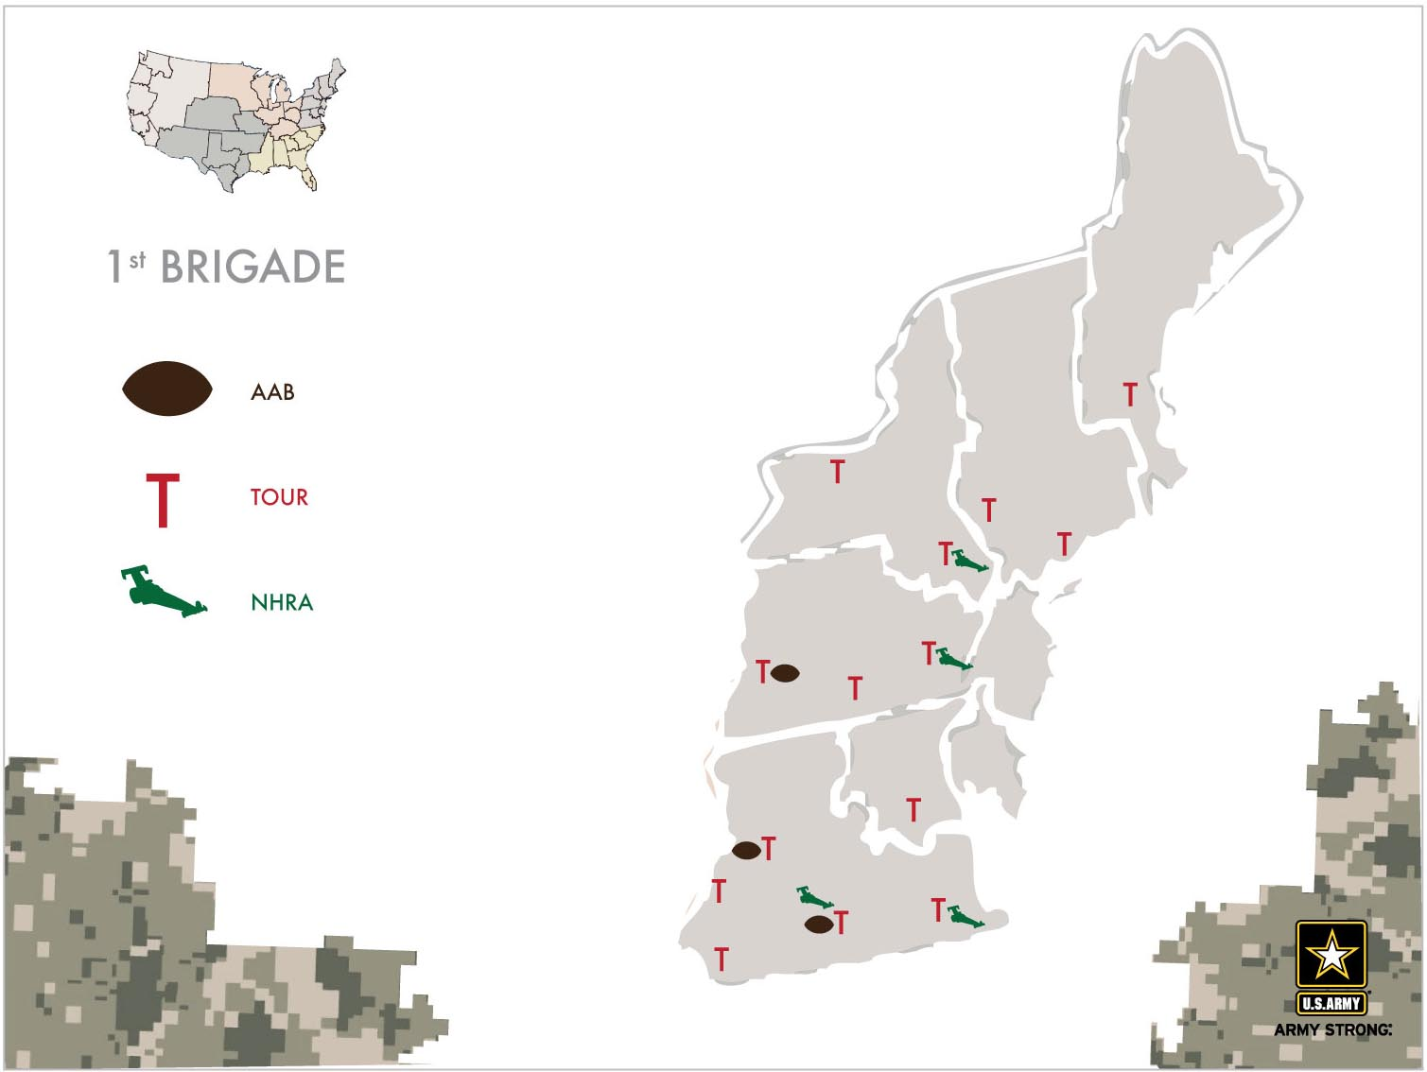
Northeast Event Priority Market Reach
USAREC BDEs used for illustration.

Slide 11
Southeast Market Recommendations
Success DMA’s | Opportunity DMA’s
507 – Savannah, GA 525 - Albany, GA 561 – Jacksonville, FL 606 – Dothan, AL 656 – Panama City, FL 550 – Wilmington, NC 560 – Raleigh-Durham, NC 518 – Greensboro-High Point-Winston Salem, NC 548 – West Palm Beach/Ft. Pierce 567 – Greenville-Spartanburg-Asheville, SC/NC 524 – Atlanta, GA 539 – Tampa-St Petersburg, FL 546 – Columbus, SC 630 – Birmingham, AL 520 – Augusta, GA 530 – Tallahassee, FL 698 – Montgomery-Selma, AL 570 – Myrtle Beach-Florence, SC 503 – Macon, GA 716 – Baton Rouge, LA | 528 – Miami/Ft. Lauderdale 519 – Charleston, SC 622 – New Orleans, LA 534 – Orlando-Daytona Beach 522 – Columbus, GA 686 – Mobile-Pensacola, AL-FL 525 – Albany, GA
(525, 567) AA Target Only. Overall low QMA, production and propensity
(507, 519) Low QMA is primary concern. Focus efforts on educational and community outreach AA Target
(507, 561, 656) High QMA with high obesity creates need for health related community outreach/ AA target.
(528, 548) High QMA/low unemployment. Reinforce quantitative benefits. HCM Target
(606). Overall high QMA, although obesity and low unemployment threaten production. AA Target
(550) High overall quality/high obesity. Focus outreach specifically on health related barriers. AA target.
(534). High QMA/unemployment but low propensity. Focus on influencer outreach and tangible benefits. HCM Target
(622) Low QMA overall, but under-producing in areas with high QMA. Focus on education initiatives and community outreach. AA target

Slide 12
Marketing Heavy up Presence
Southeast Region
Heavy up TV to increase overall awareness of the Army
Use Events to reach out to specific ethnic targets
  Albany
  Greenville
  West Palm
  Orlando
Leverage Hispanic Outreach in specific DMAs
  Miami
Use SR/JR DM in areas with a history of results in DMAs such as (but not limited to):
  Tampa - Wilmington, NC
  Columbia, SC -New Orleans
  Jacksonville, SC - Charlotte, NC
  Montgomery - Panama City, FL
  Charleston, SC - Huntsville, AL

Slide 13
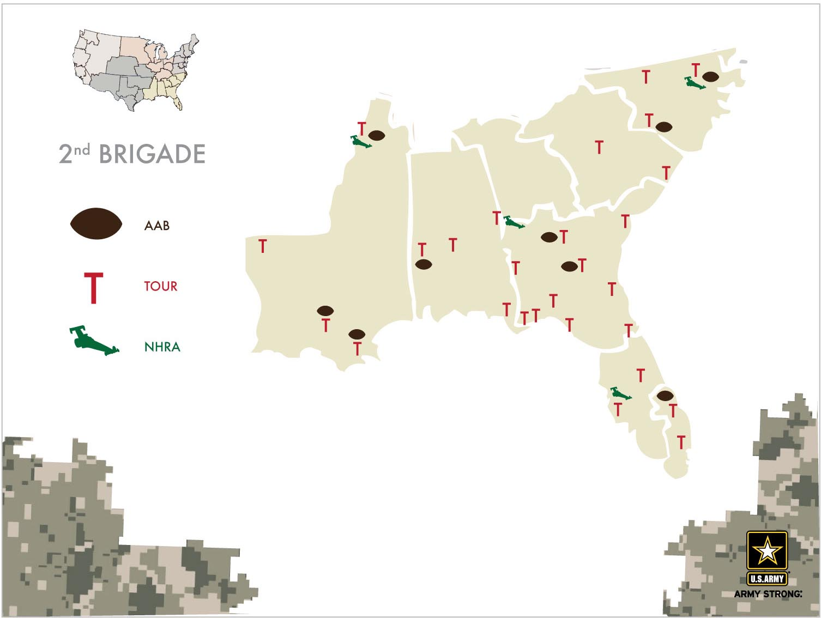
Southeast Event Priority Market Reach
USAREC BDEs used for illustration.

Slide 14

Western Market Recommendations
Success DMA’s | Opportunity DMA’s
807 - San Francisco/Oakland, CA 868 – Chico-Redding, CA 754 - Butte-Bozeman, MT 770 – Salt Lake City, UT 802 – Eureka, CA 825 – San Diego, CA 803 – Los Angeles, CA 800 – Bakersfield, CA 819 – Seattle-Tacoma, WA | 744 – Honolulu, HI 862 – Sacramento/Stockton, CA 801 - Eugene, OR 839 – Las Vegas, NV 866 – Fresno-Visalia, CA 820 – Portland, OR 855 – Santa Barbara, CA
(744, 801) High QMA and unemployment paired with low
propensity and production in pocket areas. Higher obesity
rates decreasing production. API target.
Focus on positive qualitative messaging
(802, 868, 862) Low propensity but producing well in high
QMA pocket areas. Reinforce success and focus on qualitative
messaging in AOP areas. API target
(754) Reinforce success in high QMA/high production areas
(825) High quality market overall. Reinforce success and focus on HCM and API targets
(807) High quality/unemployment but low propensity. Focus on Hispanic and API targets

Slide 15
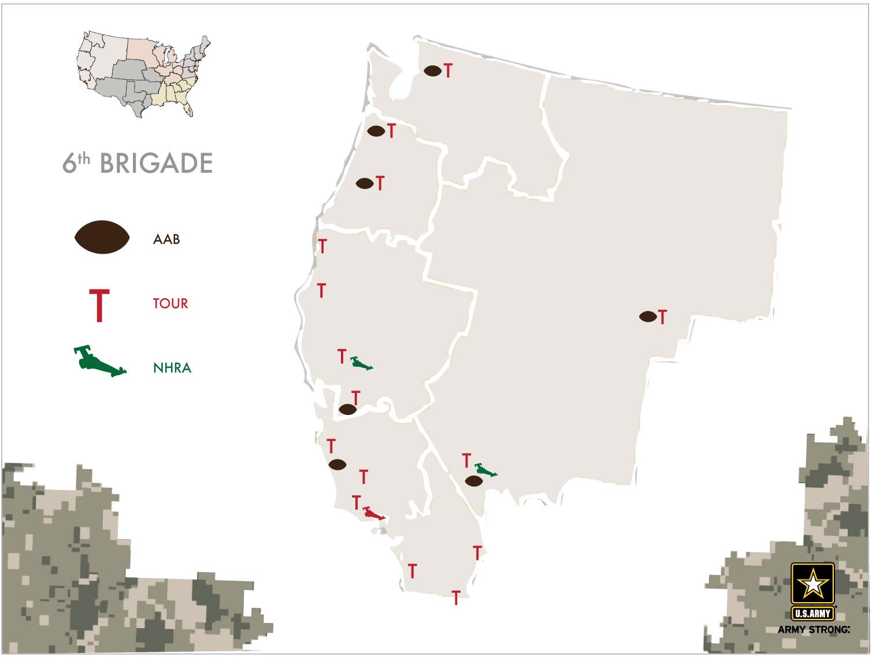
Western Event Priority Market Reach
USAREC BDEs used for illustration.

Slide 16
Marketing Heavy up Presence
Western Region
Heavy up TV to increase overall awareness of the Army
Events will be leveraged to support the overall Army Platform Messaging through:
  SIAT – Event
  SIAT – Schools
  AAB
  NHRA
Strategic Media Outreach and Grassroots Outreach will be utilized in key DMA
Leverage Hispanic Outreach to reach this critical demographic
  San Francisco
  Bakersfield
  Seattle
  Santa Barbra
Recommend local LAMP funds to be used to reach API markets

Slide 17
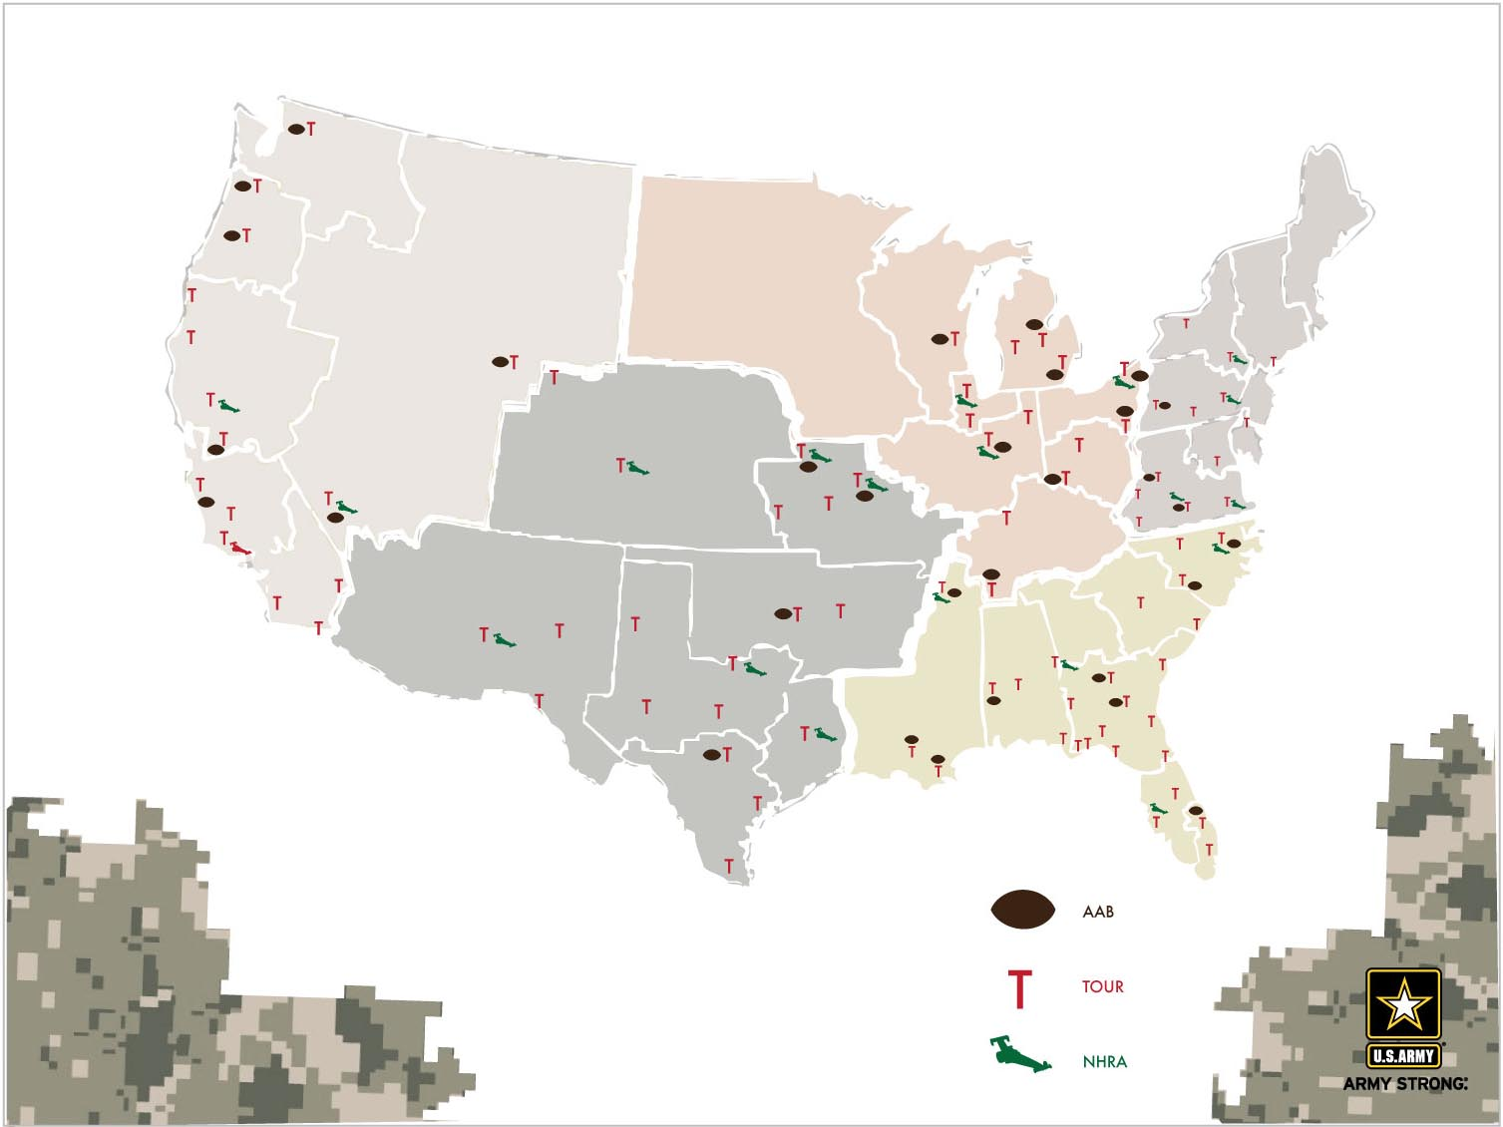
Events Priority Market Tactical Approach
Integrate timing of event outreach with other disciplines
  PFL to soft sell in Houston prior to Houston SIAT and motorsports events in Q2
  Select DM to follow event outreach in the following states (SC, WV, AL, TN, GA, OH, MI, IN, WI, VA, MT, KS, PA)
  Coordinate event and sponsorships platform messaging with broad reach support in priority markets
    San Antonio, Norfolk, Portland, San Diego, Houston, Dallas, Mobile, Grand Rapids, Phoenix, Greensboro, Sacramento, Las Vegas and Atlanta

Slide 18
AAB Projected Priority Market Support
Priority Market Hit by 2010 AAB Player (Within 100 miles or less) | Market Rank
Raleigh-Durham (Fayetteville), NC | 1
San Antonio, TX - GAME LOCATION | 2
Portland, OR | 3
Norfolk-Portsmouth-Newport News, VA | 4
San Diego, CA | 5
Houston, TX | 6
Dallas-Ft. Worth, TX | 7
Mobile-Pensacola (Ft. Walton Beach), AL-FL | 8
Grand Rapids-Kalamazoo-Battle Creek, MI | 9
Phoenix (Prescott), AZ | 10
Los Angeles, CA | 11
Greensboro-High Point-Winston Salem, NC | 12
New York, NY | 13
Sacramento-Stockton-Modesto, CA | 14
Atlanta, GA | 16
Chicago, IL | 17
Miami-Ft. Lauderdale, FL | 18
Tampa-St. Petersburg (Sarasota), FL | 19
Columbia, SC | 20
Birmingham (Anniston and Tuscaloosa), AL | 21
Augusta, GA | 24
San Francisco-Oakland-San Jose, CA | 25
Washington (Hagerstown), DC-MD | 26
Austin, TX | 27
Philadelphia, PA | 28
Orlando-Daytona Beach-Melbourne, FL | 29
Salt Lake City, UT | 35
Detroit, MI | 36
Cleveland-Akron (Canton), OH | 37
Priority Market Hit by 2010 AAB Player (Within 100 miles or less) | Market Rank
WPB-Ft. Pierce, FL | 38
St. Louis, MO | 39
Kansas City, MO-KS | 40
Milwaukee, WI | 42
Memphis, TN | 43
Pittsburgh, PA | 46
Montgomery-Selma, AL | 48
Greenville-Spartanburg-Asheville-Anderson, SC-NC | 52
Indianapolis, IN | 53
Cincinnati, OH | 55
Santa Barbara-Santa Maria-San Luis Obispo, CA | 57
New Orleans, LA | 58
Macon, GA | 61
Flint-Saginaw-Bay City, MI | 65
Bakersfield, CA | 68
Eugene, OR | 71
Baton Rouge, LA | 74
Richmond-Petersburg, VA | 77
Tulsa, OK | 79
Youngstown, OH | 83
Nashville, TN | 85
Seattle-Tacoma, WA | 87
Clarksburg-Weston, WV | 88

Slide 19
NHRA Projected Priority Market Support
Week | Event | Primary Market Effected | Rank | Secondary Market Effected | Rank | Tertiary Effected Market | Rank
13-19 September | NHRA Charlotte | Raleigh-Durham, NC | 1 | Greensboro-Winston Salem, NC | 13 | Columbia, SC | 21
22-28 March | NHRA Houston, TX | Houston, TX | 6 | San Antonio, TX | 2 | Dallas- Fort Worth, TX | 7
20-26 September | NHRA Dallas | Dallas -Fort Worth, TX | 7 | San Antonio, TX | 2 | Houston | 6
15-21 February | NHRA Phoenix (Prescott), AZ | Phoenix, AZ | 10
1-7 February | NHRA Pomona, CA | Los Angeles, CA | 11 | Fresno, CA | 22 | Santa Barbara, CA | 57
8-14 November | NHRA Pomona | Los Angeles, CA | 11 | Fresno, CA | 22 | Santa Barbara, CA | 57
10-16 May | NHRA Bristol, TN | Greensboro-WS, NC | 13 | Columbia, SC | 20 |  | 21
19-25 July | NHRA Sonoma | Sacramento, CA | 14 | San Francisco-Oakland-SJ, CA | 25 | Bakersfield, CA | 68
25-30 October | NHRA Las Vegas, NV | Las Vegas, NV | 15
29 March- 4 April | NHRA Las Vegas, NV | Las Vegas, NV | 15
12-18 Apr | NHRA Atlanta, GA | Atlanta, GA | 16 | Birmingham, AL | 21 | Augusta, GA | 24
31 May-6 June | NHRA Chicago, IL | Chicago, IL | 17 | Milwaukee, WI | 42 | Indianapolis, IN | 53
8-14 March | NHRA Gainesville, FL | Tampa, FL | 19 | Orlando/ Daytona, FL | 29 | Jacksonville, FL | 44
16-22 August | NHRA Reading, PA | Philadelphia, PA | 28
7-13 June | NHRA Englishtown | Philadelphia, PA | 28
5-11 July | NHRA Denver | Denver, CO | 31
21-27 June | NHRA Norwalk | Cleveland, OH | 37 | Columbus, OH | 50
26 April- 2 May | NHRA St. Louis, MO | St. Louis, MO | 39 | Kansas City, MO-KS | 40
24-30 May | NHRA Topeka, KS | Kansas City, KS | 40 | St. Louis, MO | 39
27 September- 3 Oct. | NHRA Memphis | Memphis, TN | 44
30 August-5 September | NHRA Indy | Indianapolis, IN | 53 | Chicago, IL | 17 | Columbus, OH | 54
4-10 October | NHRA Richmond | Richmond-Petersburg, VA | 77 | Norfolk, VA | 4

Slide 20
Events Priority Market Support Summary
All-American Bowl (players within 100 miles of DMA)
  Football selection tour supports in 51 of 92 (55%)
  All but Las Vegas in top 20 markets will be supported
NHRA
  Supports 11 of top 20 are primary markets (55%)
  Additional 2 of the top 10 as secondary markets
  Penetrates 74 of the top 92 markets (80%)
Strength in Action Tours and Youth Conventions
  50 weeks of school outreach (25 deep on priority list)
  Two weeks of school outreach in all of the top 15 markets
  Multiple event support for many markets in top 40
  Projected 4-6 weeks in Raleigh, LA and New York
  Supports 85 of the priority markets (92%)

Slide 21
Questions / Guidance

