Slide 1
Marketing Value Analysis
Example of Steps
Pricing and Product Strategy Course
Dr. Jared Hansen
UNC Charlotte

Slide 2
Value Analysis (Steps)
1. Research Purpose
2. Major Attributes Consumers Value
3. Attribute - Image, Functional Benefits, Emotional - Affective Benefits
* Hierarchal Value Map
4. Brand Design Schematic
5. Person – Situation Segmentation Scheme
6. Importance – Performance and Gap Analysis
7. Marketing Strategy

Slide 3
2. Major Attributes Consumers Value
Focus Group (example)
Quantitative laptop attributes valued are:
  Price, Speed, Wireless, Battery Life, Weight, Screen Resolution/Size, Processor, RAM, Warrenty, Keyboards Ergonomics/Functions, Mouse Useability, Size, Memory/Storage, Programs, Video Cards.
Qualitative laptop attributes valued are:
  Reliability, Customization, Ease of Use, Functionality, Newest Capabilities,Tech Support, User Reviews.
Salient attributes that drive the buying are (in no particular order):
  Brand Reputation (A1), Price (A2), Customer Care (A3), Availability (A4), Warrenty (A5), Weight (A6), Battery Life (A7), Reliability (A8), and Design/Asthetics (A9).

Slide 4
3. Attribute - Image, Functional Benefits, Emotional - Affective Benefits
Value Questionnaires
  Demographic & Usage Questions
  Importance Scores
    Semantic Differential Questions
    Constant Sum Questions
  Performance Scores
    Focus Brand
    Competing Brands

Slide 5
3. cont…Hierarchical Values Map
TERMINAL
VALUES
Accomplishment
V7
Harmony
V8
Maximize
Potential
V9
TERMINAL
VALUES
INSTRUMENTAL
VALUES
Self
Confidence
V1
Balanced
Life V2
Better
Person
V3
Independence
V5
Smart
V6
INSTRUMENTAL
VALUES
Peace of
Mind V4
PSYCHOSOCIAL
CONSEQUENCES
Family
Time
C22
PSYCHOSOCIAL
CONSEQUENCES
Money
Making
C20
Organized
C21
Self Image
C15
Less Worry
C17
Control of life
C18
Frugal
C19
More Efficient
C16
Control of budget C14
Use More Often
C8
Dependable
C13
Social Status
C7
Less Down
Time C9
Less Debt
C11
Save More
Money
C12
Techno
Savvy
C1
Get More
Done C2
More Portable
C3
Les Risk
C10
FUNCTIONAL
CONSEQUENCES
Less
Break-down
C4
Better
Value
C6
FUNCTIONAL
CONSEQUENCES
More Trust C5
ATTRIBUTES
ATTRIBUTES
Cool
Design
AA1
Functionality
AC1
Speed
AC2
Weight
AC3
Reliability
AA2
Battery
Life
AC4
Customer
Service
AA3
Brand
Reputation
AA4
(Low)
Price
AC7
Warranty
AC5
Availability
AC6

Slide 6
3. cont…Linkage Breakage Map
TERMINAL
VALUES
Accomplishment
V7
Harmony
V8
Maximize
Potential
V9
TERMINAL
VALUES
INSTRUMENTAL
VALUES
Self
Confidence
V1
Balanced
Life
V2
Better
Person
V3
Peace of
Mind
V4
Independence
V5
Smart
V6
INSTRUMENTAL
VALUES
PSYCHOSOCIAL
CONSEQUENCES
Family
Time
C22
PSYCHOSOCIAL
CONSEQUENCES
Money
Making
C20
Organized
C21
Self
Image
C15
Less
Worry
C17
control
of life
C18
Frugal
C19
More
Efficient
C16
Use More Often
C8
Dependable
C13
control
of budget
C14
Social
Status
C7
Less Down
Time
C9
Less
Debt
C11
Save More
Money
C12
Get More
Done
C2
More
Portable
C3
Techno
Savvy
C1
Less Risk
C10
FUNCTIONAL
CONSEQUENCES
Less
Break-down
C4
Better
Value
C6
FUNCTIONAL
CONSEQUENCES
More Trust C5
ATTRIBUTES
ATTRIBUTES
Cool
Design
AA1
Functionality
AC1
Speed
AC2
Weight
AC3
Reliability
AA2
Battery
Life
AC4
Warranty
AC5
Customer
Service
AA3
Availability
AC6
Brand
Reputation
AA4
(Low) Price
AC7
Importance
70%
59%
70%
69%
87%
75%
70%
77%
66%
71%
77%
Cluster
1
2
2
2
2
2
1
1
1
1
3

Slide 7
4. Brand Design Schematic
Visual
Verbal
Brand Expression
WORDING
PICTURING
Meaningful Relevant Values
NAMING
SYMBOLIZING
DESCRIBING
ANIMATING

Slide 8









4. Brand Design Schematic
Visual
Verbal
Brand Expression
WORDING
PICTURING
Home Computing
Laptop
Desktop
PDA
Tablet PC
Meaningful Relevant Values
Price-Oriented Laptop Purchase Decision
NAMING
SYMBOLIZING
Compaq
Presario
DeskPro
iPaq
Armada
EVO
DESCRIBING
Value Pricing
Volume Sales
Computer Tradition
Availability
ANIMATING

Slide 9
5. Person Situation Segmentation Scheme
Person
Male/Female under 30
Male/Female, 30-39
Male/female, over 40
Work
Organized
Functionality
Get more done
Less risk
Brand reputation
Dependable
School
Social status
Cool design
Self-image
More trust
Availability
Less down time
Save money
Good price
Frugal
Situation
Home
Less debt
Low price
Control of life

Slide 10
Example
 |  |  |  | Classwork | Prof Work | Communication | Media
Undergrad | Business | M | Benefits
 |  |  | Media Choices
 |  |  | Pyscholgraphic
Undergrad | Business | F | Benefits
 |  |  | Media Choices
 |  |  | Pyscholgraphic
Undergrad | Non-Business | M | Benefits
 |  |  | Media Choices
 |  |  | Pyscholgraphic
Undergrad | Non-Business | F | Benefits
 |  |  | Media Choices
 |  |  | Pyscholgraphic

Slide 11
6. Importance Performance Analysis
Gap Analysis
  Compare Focus Brand Performance scores with the attribute importance scores
  Example:
Attribute | Importance | Compaq | Apple | Dell
Reputation | 7.1 | 5.9 | 7.6 | 7.5
Price | 7.7 | 6.6 | 5.5 | 7.3
Customer Care | 7.7 | 6 | 6.9 | 7
Available | 6.6 | 6.9 | 6.5 | 7.2
Warranty | 7 | 6.7 | 7.3 | 7.4
Weight | 6.9 | 6.5 | 7.5 | 6.5
 | 7.5 | 6.4 | 7 | 6.9
Reliable | 8.7 | 6.3 | 7.4 | 7.1
Design | 7 | 6.4 | 7.9 | 6.9

Slide 12
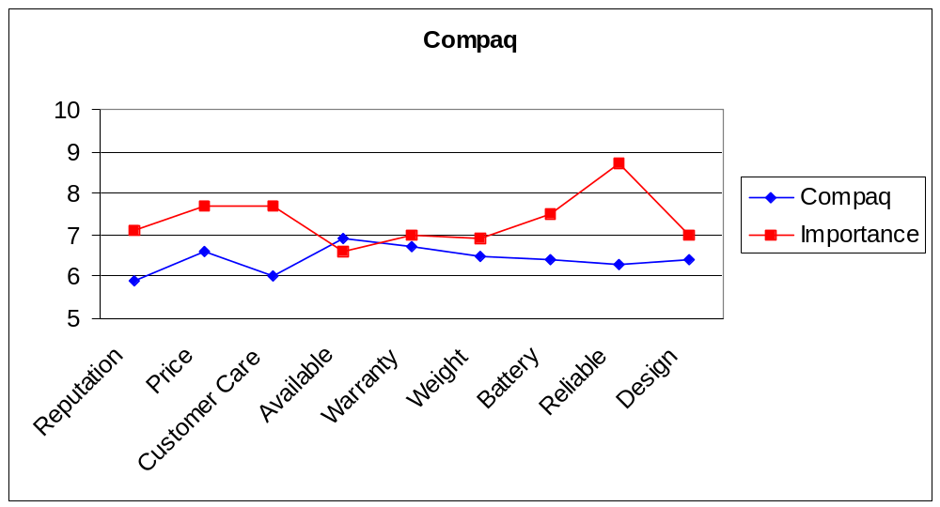
Gap Analysis Charts

Slide 13
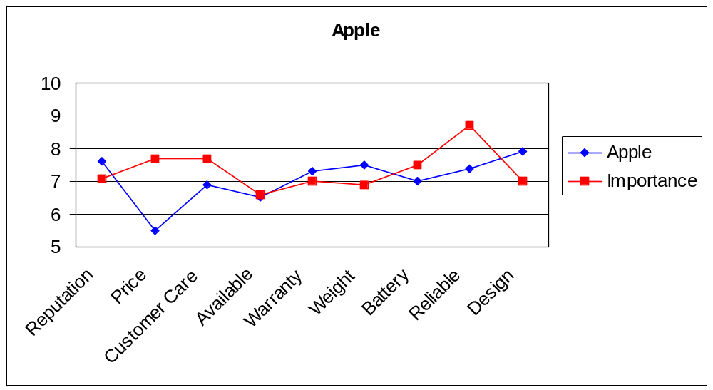
Gap Analysis Charts

Slide 14
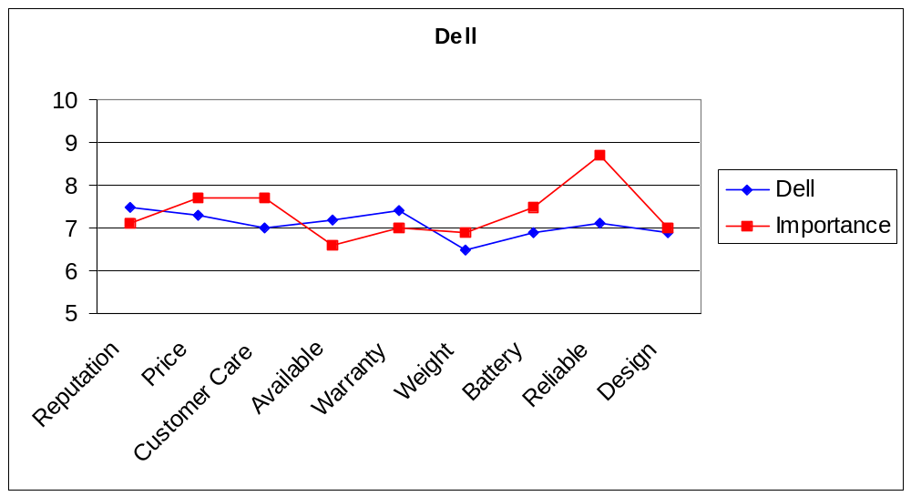
Gap Analysis Charts

Slide 15
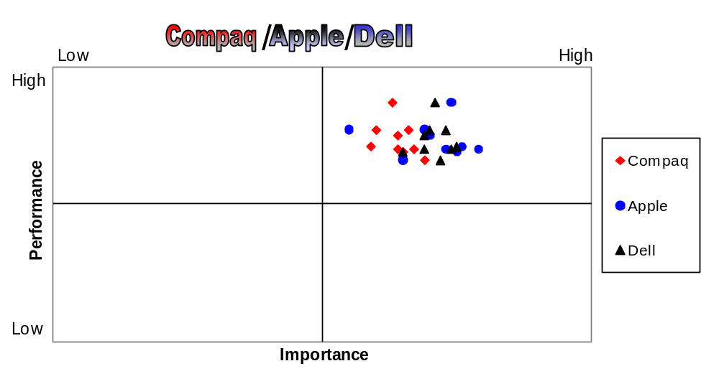
Gap Analysis Charts

Slide 16
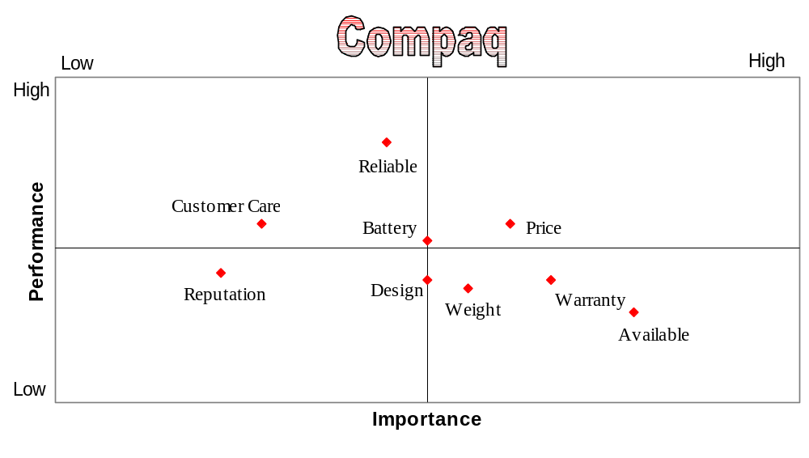
Gap Analysis Charts

Slide 17
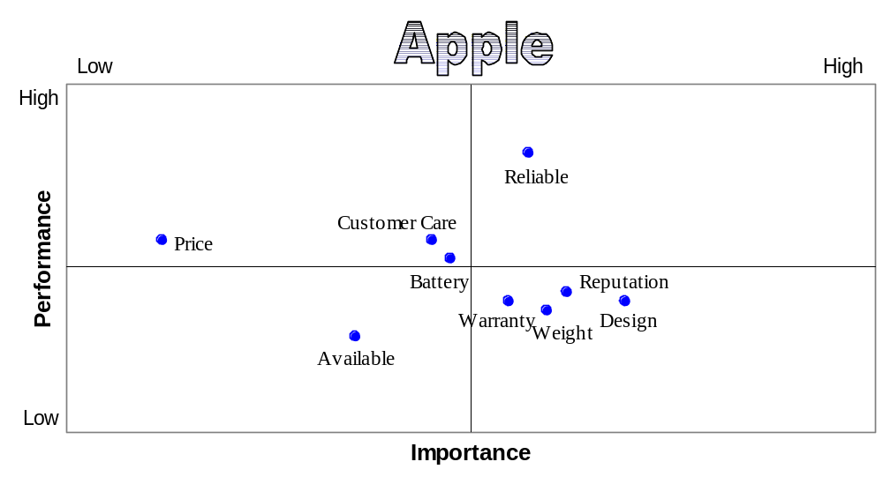
Gap Analysis Charts

Slide 18
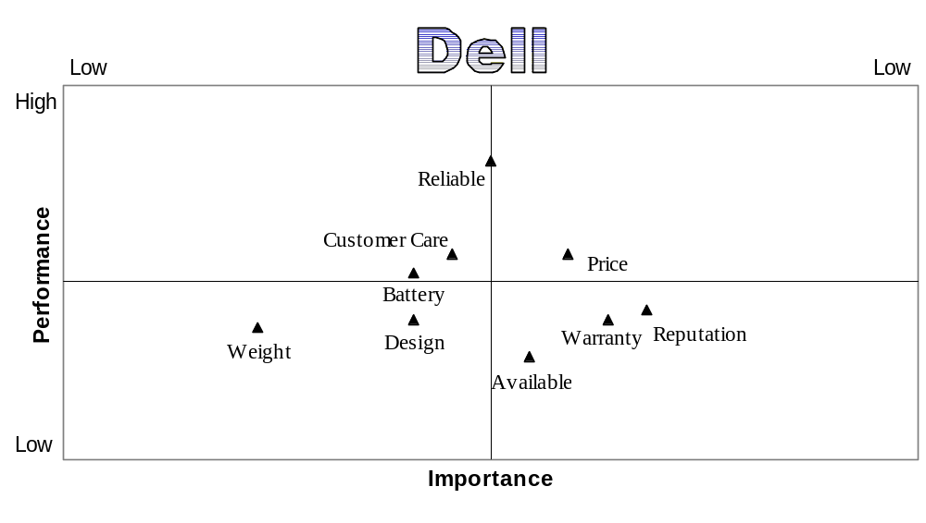
Gap Analysis Charts

Slide 19
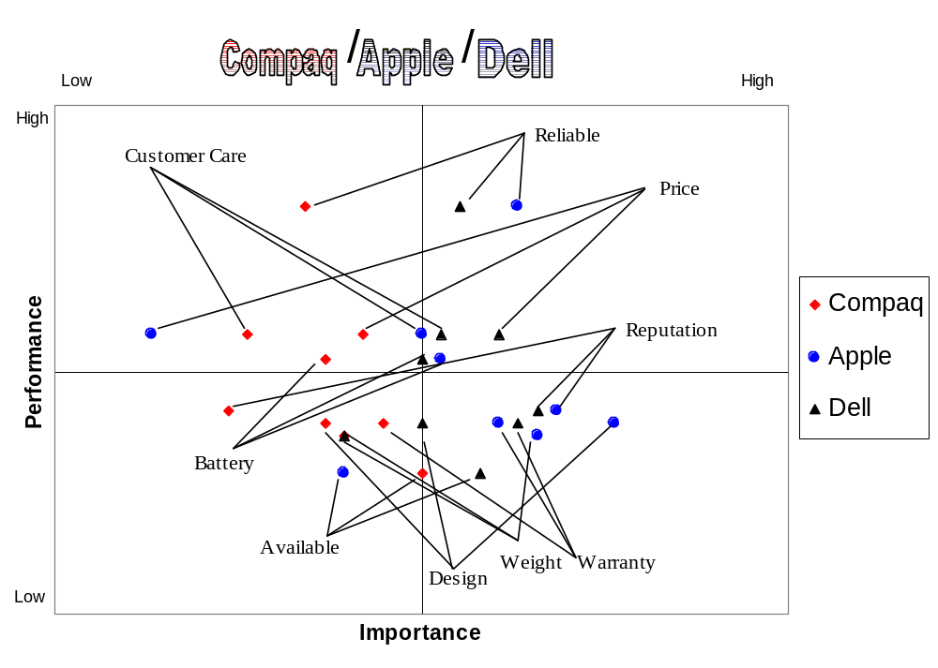
Gap Analysis Charts

Slide 20
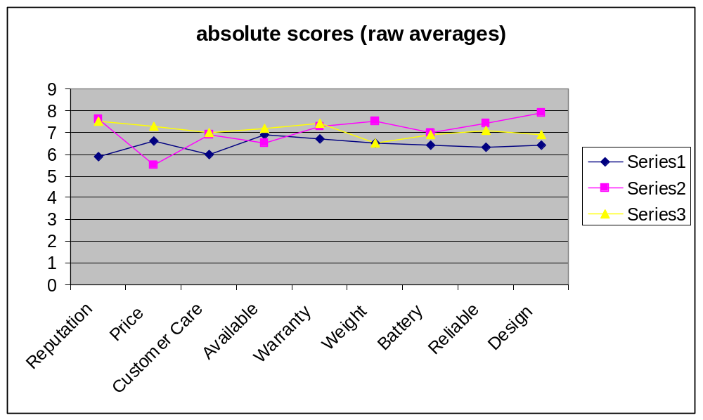
7. Marketing Strategy
Q1. How should the firm market the core benefit, product, and augmented product?

Slide 21
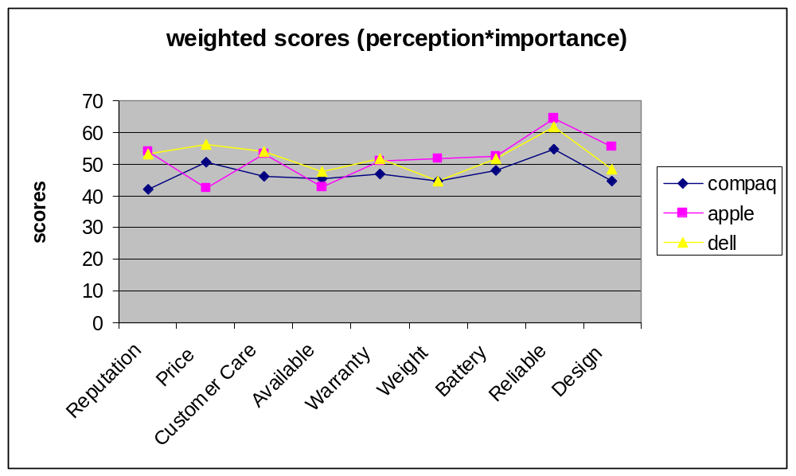
7. Marketing Strategy
Q1. How should the firm market the core benefit, product, and augmented product?

Slide 22
7. Marketing Strategy
Regression/Correlation Analysis
Regression Statistics
Multiple R | 0.999988
 | 0.999976
Adjusted | 0.999974
Standard Error | 0.869615
Observations | 43
ANOVA
 | df | SS | MS | F | Significance F
Regression | 3 | 1214443 | 404814.2 | 535305 | 5.24E-90
Residual | 39 | 29.493 | 0.756231
Total | 42 | 1214472

Slide 23
7. Marketing Strategy
 | Coefficients | Standard Error | t Stat | P-value | Lower 95% | Upper 95% | Lower 95.0% | Upper 95.0%
Intercept | 0.21 | 0.44 | 0.48 | 0.63 | -0.68038 | 1.10 | -0.68 | 1.10
product | 0.15 | 0.02 | 5.6 | <.01 | 0.100823 | 0.21 | 0.10 | 0.21
value | 3.66 | 0.01 | 312.7 | <.01 | 3.640186 | 3.68 | 3.64 | 3.68
risk | 7.17 | 0.02 | 241.7 | <.01 | 7.11504 | 7.23 | 7.11 | 7.23

