Slide 1

Cost Sharing Primer
February, 2011
McCormick, WCAS, and University Research Center Administrators

Slide 2
What is cost sharing?
University financial contributions to a sponsored project
Three types:
Mandatory = University contribution required by the terms of the project, must be formally tracked
Voluntary committed = University contribution not a specific sponsor requirement, must be formally tracked
Voluntary uncommitted = University contribution not a specific sponsor requirement, does not need to be formally tracked

Slide 3
Why do we care about cost sharing?
If cost sharing is mandatory or voluntary committed, we must honor that commitment, or face disallowances and damaged reputation/relationships
Cost sharing is a shared responsibility between the PI, Co-I(s), the lead unit, the funding unit(s), the dean’s office(s), OSR, ASRSP
Current cost sharing processes and systems at NU presume the unit-level administrator will lead this shared responsibility

Slide 4
Cost sharing considerations – Big picture
Cost sharing is uncommon, and most government agencies have moved away from it (NIH, NSF)
  Some agencies still “encourage” it in their solicitations (DOE, DOD)
  It will not disappear anytime soon
Cost sharing is burdensome and a matter of high risk
  Important to match resources to these risks
  Cost sharing increases the overall complexity of a sponsored project

Slide 5

Fund 191 Cost Share – Case Study
Keep a copy of the final commitment email generated at the proposal stage. If you are unsure that you have a copy of the final commitment contact your Dean’s Office. There is cost share commitment information recorded in InfoEd, however, you will want the source document to verify accuracy.

Slide 6
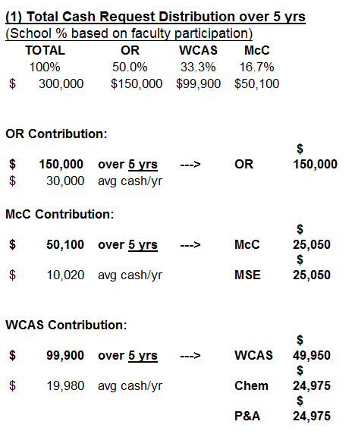
Fund 191 Cost Share – Sample Financial Section of the Commitment Email
Total commitment is $300,000
OR matches the $50,100 total from McC and the $99,900 total from WCAS and commits $30,000 per year for 5 years – sub total is $150,000
MSE Dept commits $5,010 per year for 5 years and McC Dean’s Office commits a matching amount of $5,010 per year for 5 years – sub total is $50,100
Chem Dept commits $4,995 per year for 5 years; Physics Dept commits $4,995 per year for 5 years and WCAS Dean’s Office commits a matching amount of $9,990 for 5 years – sub total is $99,900

Slide 7
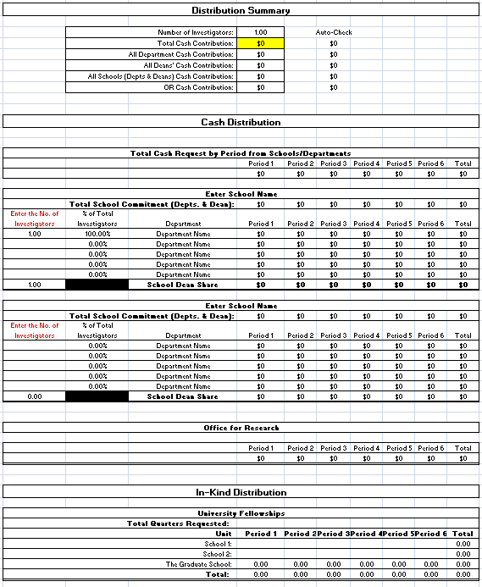
Fund 191 Cost Share – ORD-Ez Form

Slide 8
Fund 191 Cost Share – Step #1: OSR Opens Fund Type and Establishes Expense Budget
To determine whether or not the 191 fund type is open on a particular project run a GM045 report for that project. If the fund type is open, it will be included and budgeted on the report. If the 191 fund type has not been opened on the project, contact OSR and request that the fund type be opened.
This establishes an expense budget on the project, and as a result, spending authority.
You will need to provide oversight that appropriate expenses are charged to the 191 fund type.

Slide 9
Fund 191 Cost Share – Step #2: OSR Prepares a Budget Journal to Create a Revenue Budget
This Budget Journal creates a liability which indicates funds are owed from each unit that made commitments. The journal will be routed electronically to the area approver(s). No funds are moved at this time.
To determine if a Revenue Budget has been established you can use the GL068, GL069, GL005 or Budget Overview.

Slide 10
Fund 191 Cost Share – Step #2: OSR Prepares a Budget Journal to Create a Revenue Budget
If the Revenue Budget has not been processed contact OSR. To expedite the process provide OSR with (1) a copy of the original commitment and (2) the dept id’s of the contributing units.
OSR needs to process a new Revenue Budget each fiscal year.

Slide 11
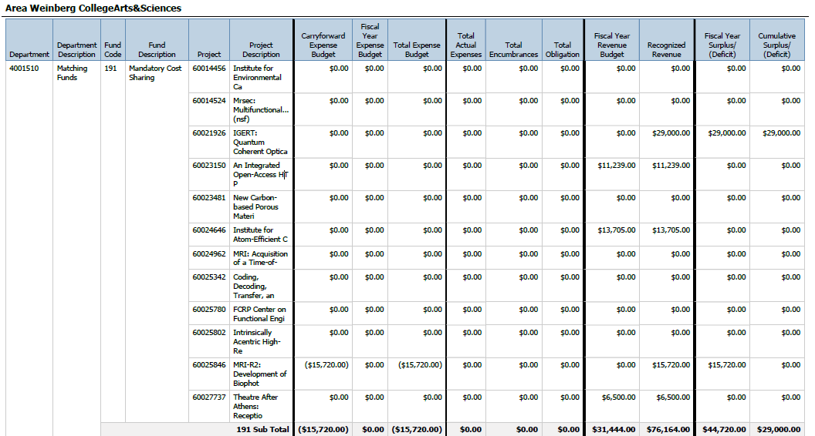
Fund 191 Cost Share – GL068/GL069 (run by dept id)
Revenue Budget
Recognized Revenue

Slide 12
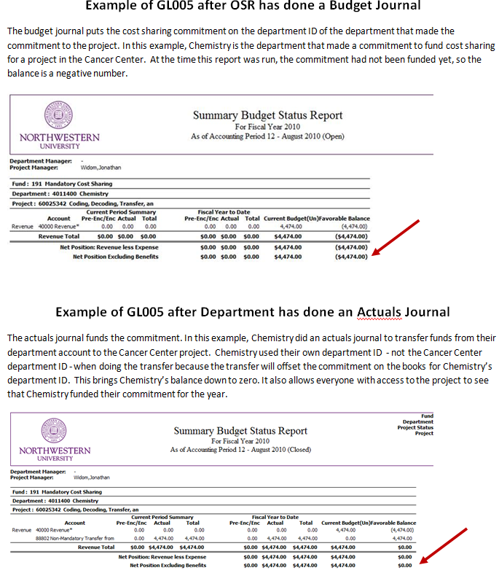
Fund 191 Cost Share – GL005

Slide 13
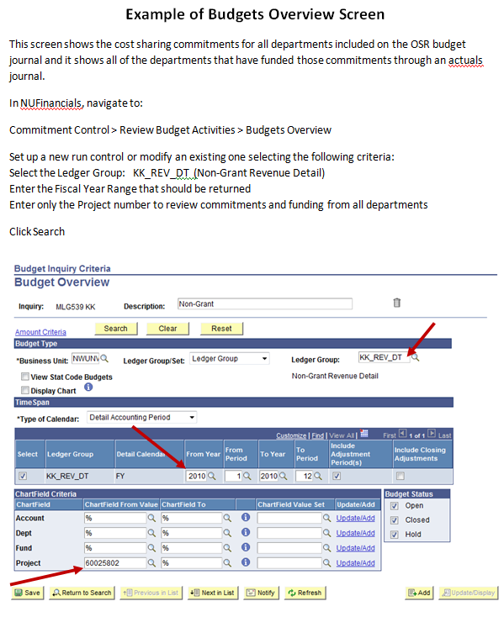
Fund 191 Cost Share – Budget Overview

Slide 14
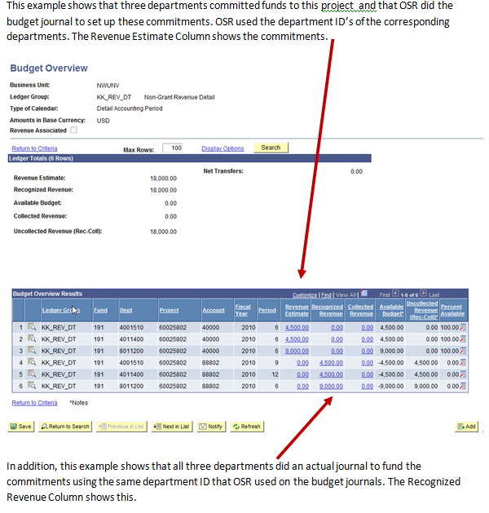
Fund 191 Cost Share – Budget Overview

Slide 15
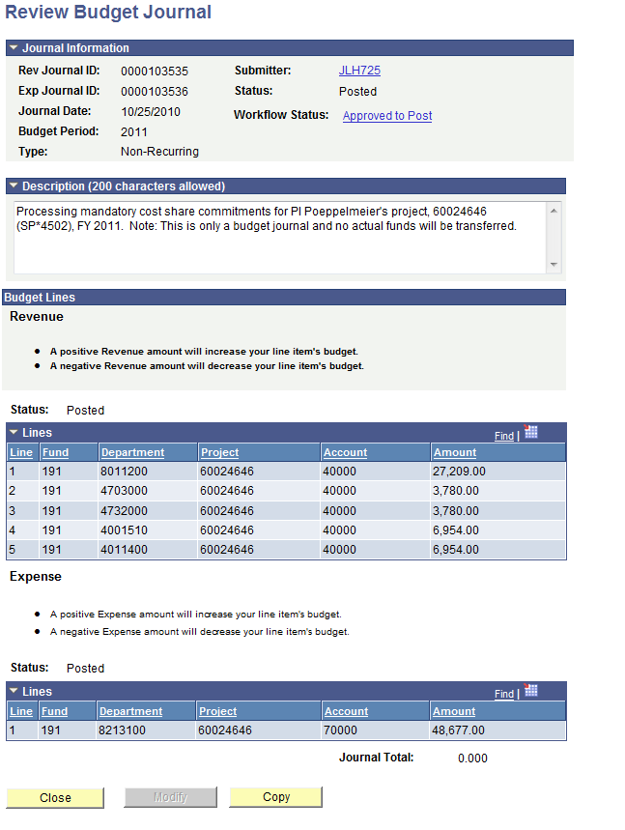
Fund 191 Cost Share – Budget Journal Prepared by OSR to Establish the Revenue Budget
A positive revenue amount will increase your line item’s budget. This indicates you have a liability (you owe $ to the project).
Note:
The figures differ from the original commitment because the award was awarded at a lower amount than proposed – all commitments are reduced on a percentage basis.
Note:
Fund = 191
Dept ID = funding unit
Project ID = managing unit

Slide 16
Fund 191 Cost Share – Step #3: Funding Units Transfer Funds with Transfer Journal
Each contributing unit will prepare an transfer journal to fulfill their cost share commitment and fulfill their liability. Each contributing unit will debit (+) to increase expense to the chart string they use to fund cost share commitments and credit (-) to 191-their dept id-project id to increase revenue on the project.
The managing unit for this project will run reports by project id (because it’s on the funding units dept id) in order to track this revenue. Make sure you run it for the fiscal year to date rather than project end date.

Slide 17
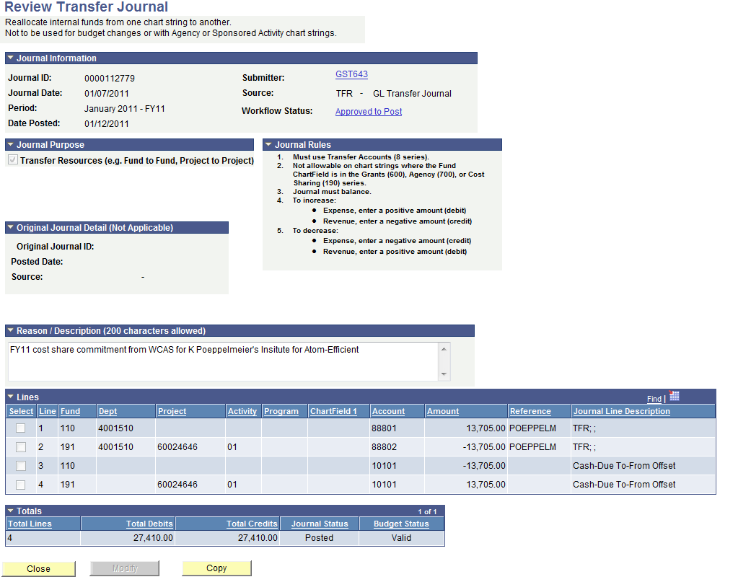
Fund 191 Cost Share – WCAS Dean’s Office Transfer Journal (FY10 and FY11)

Slide 18
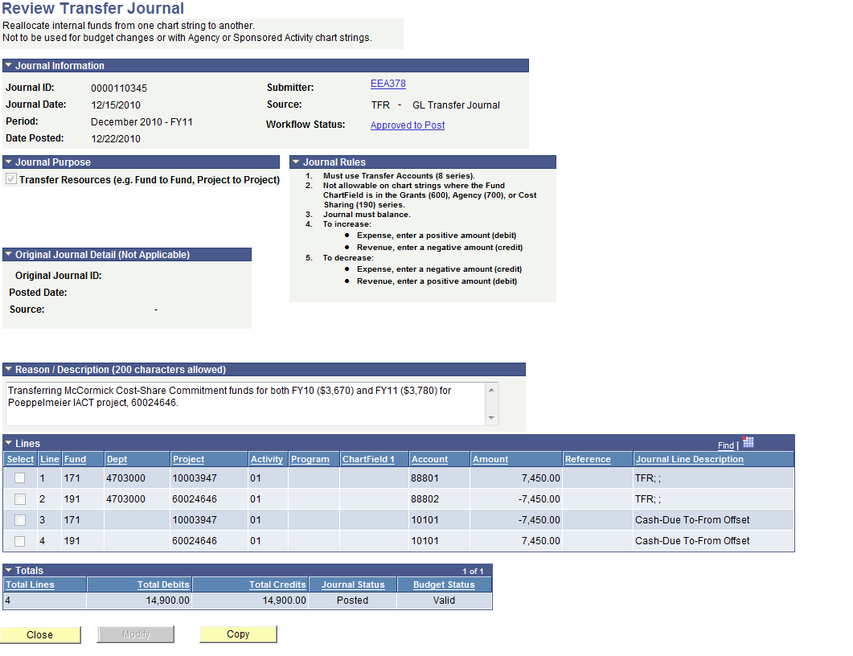
Fund 191 Cost Share – McC Deans Office Transfer
Journal (FY10 and FY11)

Slide 19
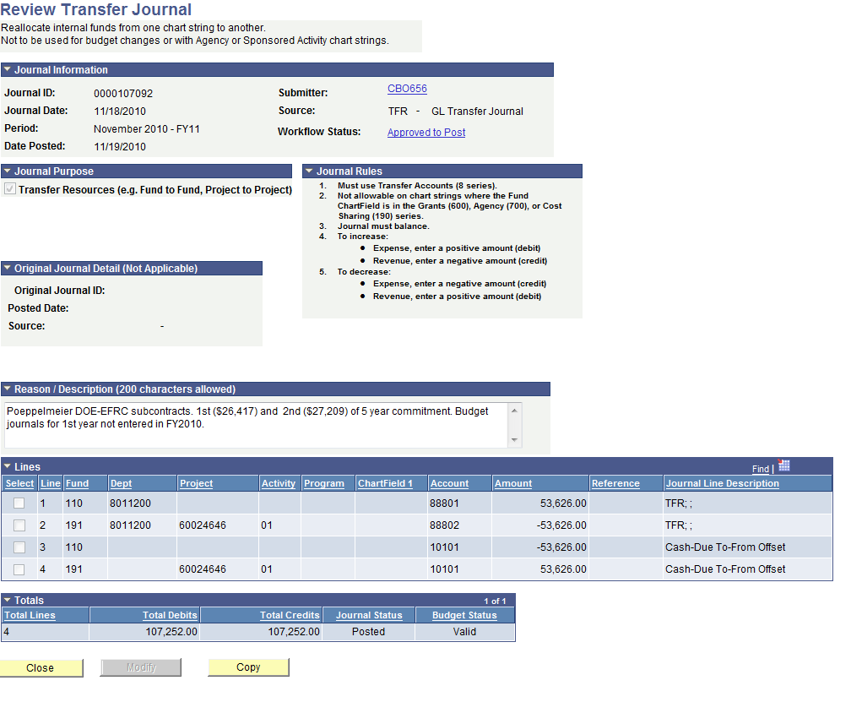
Fund 191 Cost Share – OR Transfer
Journal (FY10 and FY11)

Slide 20
Fund 191 Cost Share – Helpful Tips
You may find it helpful to refer to the quick guide “NU Financials Journals: A Quick Guide” on the WCAS staff finance & budget page if you are not comfortable with processing transfer journals.
You may find it helpful to maintain an excel spreadsheet on the status of your cost share commitments. WCAS, McC and OR Dean’s Offices all have a format they are currently utilizing which they will be happy to share.

Slide 21
Fund 192 Cost Share- Differences and Tips
As currently defined, Fund 192 is used for most salary cost share (except mandatory)
  Typically includes administrative core expenses
No formal budgets for tracking:
  NO BUDGET JOURNAL
  No appropriated budget in NUFinancials
    Fund 192 on budget statements accumulate expenses against $0 budget

Slide 22
Fund 192 Commitments
Commitments created at proposal submission and are funded by transfer journals
  Responsibility for Tracking these commitments twofold:
    Funding unit needs to know their outstanding liabilities
    Managing unit each year communicates with funding unit to initiate transfer journal

Slide 23
Fund 192 Journals
Journals differ from 191 journals- DEPARTMENT ID
Journals transfer funds from the “funding department” to the fund 192 of the managing unit of the award
Department | Fund | Dept | Project | Account | Expense | (Revenue)
McCormick | 171 | 4703000 | 10003947 | 88801 | $10,000
Center X | 192 | 8200000 | 60000000 | 88802 |  | ($10,000)

Slide 24
Reports and Tracking All Cost Share
Spending occurs and is tracked on GM045 for both Fund 191 and Fund 192
  Spending (fiscal year) will also track on the managing unit’s GL005 for managing unit
Funding of cost share commitments is NOT reflected on GM045

Slide 25
Tracking Cost Share Commitments and Funding
Tracking by Unit: Cognos
  Funding Unit
    GL068: Track ALL cost share commitments and transfers for a given department ID (eg. Chemistry or McCormick Deans’ Office)
    GL005: Track by PROJECT ID
  Managing Unit
    GL005: Track by Project ID (leave out dept ID!!) to track which funding units have funded commitments in the current fiscal year
    TIP: many funding units don’t transfer until August!
    Refer to handout

Slide 26
Tracking Cost Share Commitments and Funding
Tracking by Unit: NUFinancials
  Budget Overview can be used to track by Department ID or Project
  Will track both journals and funding transfers
    Refer to handout

Slide 27
RA & BA Tips for Interpreting, Reconciling and Oversight
Tips for interpreting your PAS and Budget Statements
The budget amounts listed under fund 191 on the PAS and GM045 only represent the spending authority (or expense budget); they are not an indication of dollars collected from the funding units.
The following types of cost sharing will NOT be reflected on the PAS or GM045:
  Cost Shared Fellowships
  Third Party Cost Sharing
  Unrecovered F&A

Slide 28
RA & BA Tips for Interpreting, Reconciling and Oversight
A few notes about unrecovered F&A:
Some sponsors allow institutions to count as cost sharing the F&A that would have been assessed had an expense been applied to the sponsored funds rather than the cost sharing. This is referred to as “unrecovered F&A.”
Although you will see an F&A budget account under fund 610 (or 650, 620, etc.), you will never see a budget for unrecovered F&A on fund 191 or 192, as it is not tracked in NUFIN.
If you are counting on a certain amount of unrecovered F&A to meet a cost sharing threshold, be careful about spending more cost sharing dollars on tuition and/or capital equipment than originally planned.

Slide 29
RA & BA Tips for Interpreting, Reconciling and Oversight
Tips for interpreting your PAS and Budget Statements, Cont’d.
There are currently two primary methods used at NU to capture and track cost shared faculty effort:
  Charging the salary directly to fund 191 or 192
  Using certified effort reports from ERS (Effort Reporting System) as documentation
If you use the second method, but the faculty salary and fringe have been budgeted on fund 191 or 192, the bottom line available balance on the GM045 will appear greater than it truly is.
If you have expenses hitting fund 192, the bottom line available balance on the GM045 will appear lower than it truly is due to the $0 budget.

Slide 30
RA & BA Tips for Interpreting, Reconciling and Oversight
Tips for spending on cost sharing budget lines
Make sure faculty and staff are aware of the cost sharing budget, including how much they need to spend and what types of purchases can be made. Stress that not only can they spend the budgeted amount, they must spend it. Explain how to list fund 191 on the requisitions for all purchases they want counted as cost sharing.
The sponsor may become concerned if financial reports indicate slow cost share spending. If you notice slow spending, check back in with faculty and staff.
  Purchases not allowed as direct costs on the sponsored portion of the chart string CANNOT be charged to its 191 or 192 accounts. Just like charging a sponsored project, all expenses must be allowable, allocable, reasonable, and consistently treated.

Slide 31
RA & BA Tips for Interpreting, Reconciling and Oversight
Tips for spending on cost sharing budget lines, Cont’d.
At initial award setup, the managing unit may need to decide if they would like cost sharing account codes opened on chart strings that have been redistributed to other departments. Factors to consider include:
  This allows multiple investigators to spend the cost sharing funds, which may help prevent slow spending.
  Redistribution may make it more challenging for the managing unit to closely monitor and reconcile cost sharing expenditures.
  If using fund 191, the budget journal(s) must set up revenue budgets for all chart strings on which cost sharing account codes have been opened.

Slide 32
RA & BA Tips for Interpreting, Reconciling and Oversight
Miscellaneous Tips
It can be very helpful to keep a spreadsheet tracking information related to your department’s cost sharing commitments. Important information to track includes:
  All commitments made to pending and awarded proposals, broken down by fiscal year
  Which commitments you have funded
  Fellowships your department has committed as cost sharing
  Required academic year salary recovery related to cost sharing
  Mandatory cost sharing of faculty academic effort
Prototypes of these spreadsheets are available; contact your Dean’s office or the presenters if you would like to see an example.

Slide 33
RA & BA Tips for Interpreting, Reconciling and Oversight
Miscellaneous Tips, Cont’d.
  If your department’s cost sharing commitment is dependent upon released funds from academic salary charged to the sponsored project, make sure the required SDA or direct charging is processed in a timely fashion.
  Communication between the managing unit and ASRSP is often necessary to ensure that all sources of cost sharing are reported to the sponsor. These sources may include unrecovered F&A, fellowships, and certified cost shared effort that was not charged to fund 191 or 192.

