Slide 1
High School Top Ten

Slide 2

High School Top Ten

Slide 3
10. Target What is Important to Your Faculty
Start with the Critical Elements Your Faculty Will Support:
  PBS Team, Administrative Support
  Faculty Commitment, Participation
  Effective Discipline
  Data Entry & Analysis
  Expectations & Rules
  Reward/Recognition Program
  Lesson Plans for Teaching Behavior
  Implementation Planning
  Crisis Planning
  Evaluation
  Classroom PBS Systems
Notes:
Typically this is the one that high school teachers buy-into first. They want to know that kids are going to still receive “consequences” when students misbehave

Slide 4
Video: Terry Tate
http://video.google.com/videoplay?docid=6759620933099471522#docid=-2602229974531953634

Slide 5
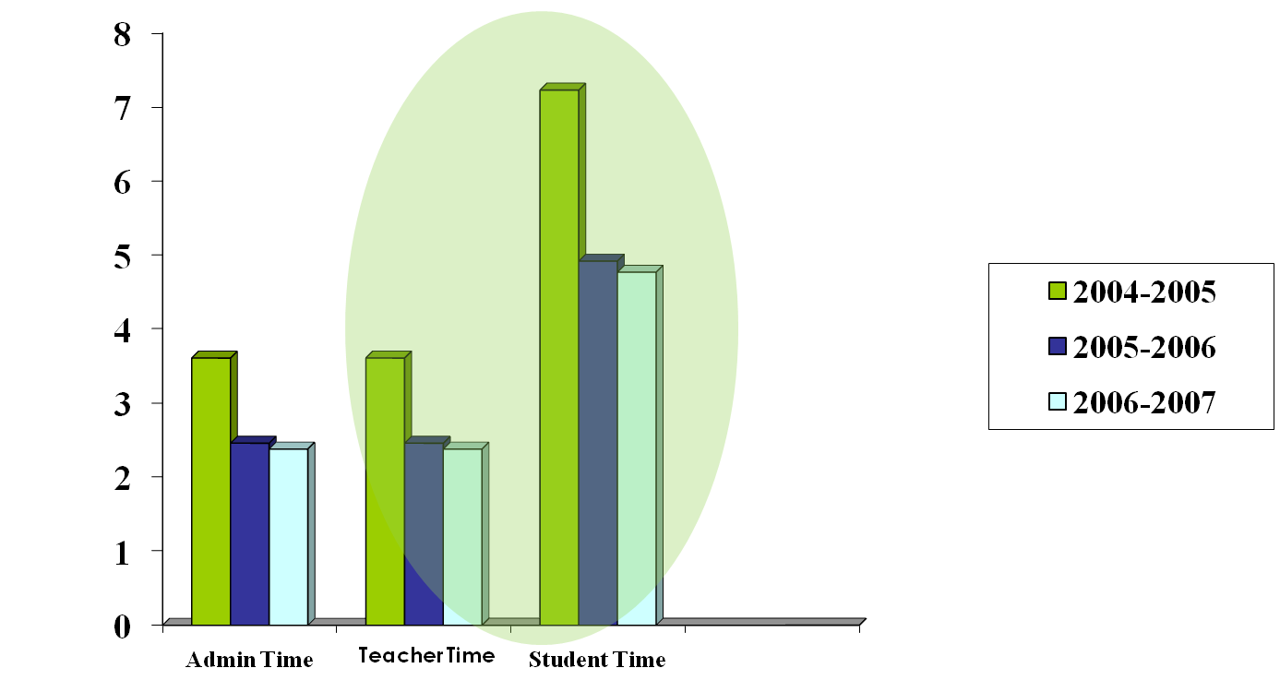
9. What’s In It For Me? Part 1
Gain of instructional time:

Slide 6
8. What’s in it for me? Part Deux
Tell your staff Thank You!!!!
Kudos Awards
Mascot Acknowledgements
Wear jeans an extra day
Leave with the students
Free lunch in the cafeteria
Get out duty pass for a week

Slide 7

7a. You Guessed it. What Is In It For Me?
Students will be taught and know expectations.

Slide 8
7b. Followed up with: “Teach. You Mean I have to teach behavior”
We are not asking you to teach another subject!!!!
We are asking you to embed it into your already existing curriculum.
Bell work
Essays
Subject area (i.e. Literature)

Slide 9
6. “I never have any say in these things but am expected to do them”
Develop a team that represents all staff
  Gen Ed
  ESE
  All content areas including electives
  AP, IB
Ask for their input, ask again, ask again, and again, again, and one more time. When you think you are done ask again.

Slide 10

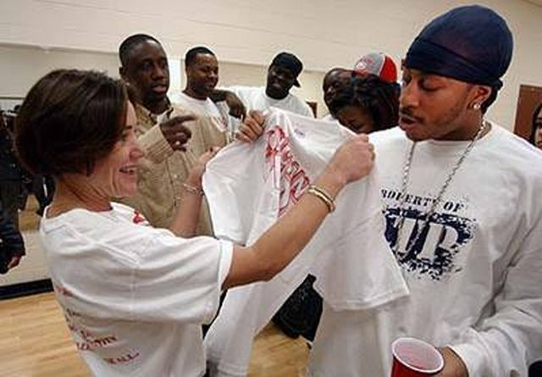
5. Reward the students. I don’t give out M &M’s

Slide 11
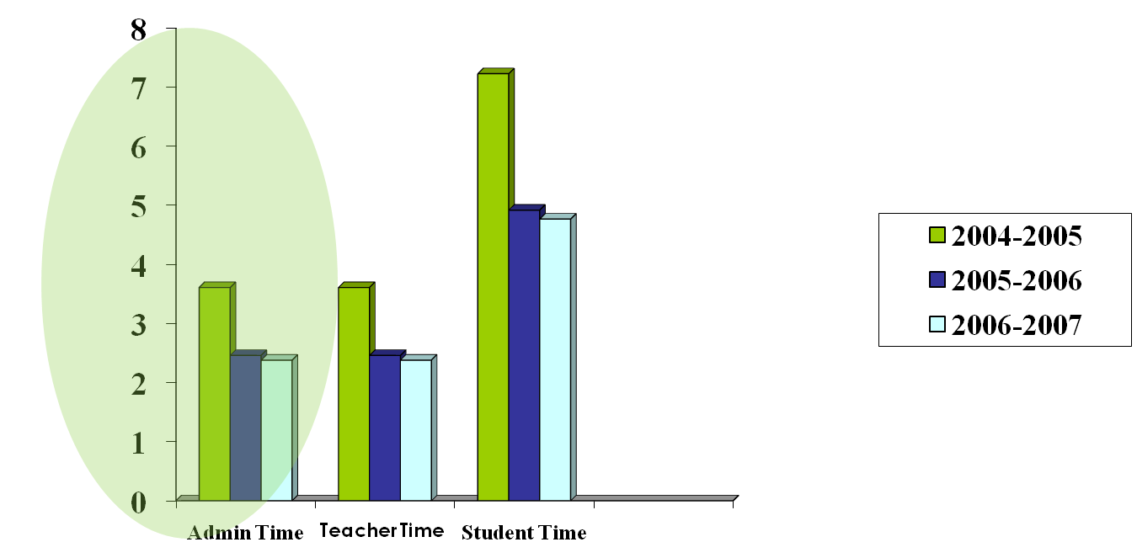
4. This is going to take too much administrator’s time. We do not see them enough as it is.

Slide 12
Video: Administrator Dance
http://www.teachertube.com/viewVideo.php?video_id=30&title=Walkthroughs_and_Learning_Objectives&vpkey=&show=all

Slide 13
3. I don’t want to change.
I think this says it all:
http://www.youtube.com/watch?v=47rQkTPWW2I
Change is not a bad thing!!!!

Slide 14
2. This is just another program that does not fit the context of OUR school.
Step 1: Problem Identification
What’s the problem?
Step 4: Response
to Intervention
Step 2: Problem Analysis
Why is it occurring?
Is it working?
Step 3: Intervention Design
What are we going to do about it?
http://www.youtube.com/watch?v=KbY-Ofg8WaQ
Notes:
BRIEFLY go over the steps…the steps will be explained in more detail as teams progress through the problem-solving process (we’ll explain step 1 when they DO step 1, etc…)…

Slide 15
If you decide you are ready for PBS, the number one thing to consider is…. http://www.wptv.com/mediacenter/local.aspx?videoid=15011@wptv.dayport.com&navCatId=3

Slide 16
1. You MUST have administrator support.
ADD a picture here of either your school administrative team or some “administrator” figure (President of US, etc.)

