Slide 1

Proposal Budgeting for Administrators
NURAP at Noon-Evanston
January 10, 2010

Slide 2
Proposal Budgeting for Administrators
Perspectives:
  The PI Ellen Feldman
  The Department Andrea Zakrzewski
  The OSR and NSF Mary Lynne Williams

Slide 3
Proposal Budgeting for Administrators
The Set-Up
The PI Perspective

Slide 4
The Set-Up
Set up meeting between yourself & PI
  Critical to smooth process for submission
  Schedule 3-4 weeks before due date
  Use Checklist to guide the discussion
Notify your GO of pending submission
  Your GO is your BFF

Slide 5
Checklist-What Do You Need to Know?
Key Non-budgetary items:
  Title (get spelling correct!)
  Sponsor and Funding Opportunity
  Project Team
  Human/Animals Involved
  Subcontractors, consultants

Slide 6
Checklist-What Do You Need to Know?
Key Non-budgetary items:
  Title (get spelling correct!)
  Sponsor and Funding Opportunity
  Project Team
  Human/Animals Involved
  Subcontractors, consultants
  Anticipated Attachments

Slide 7
Checklist- What do you Need to Know
Budgetary Items
  Dates: Start, end, # years
  Target Costs: Direct and total by year
  Personnel: Key and Non-Key (with effort)
  Travel
  Supplies
  Equipment
  Subcontracts

Slide 8
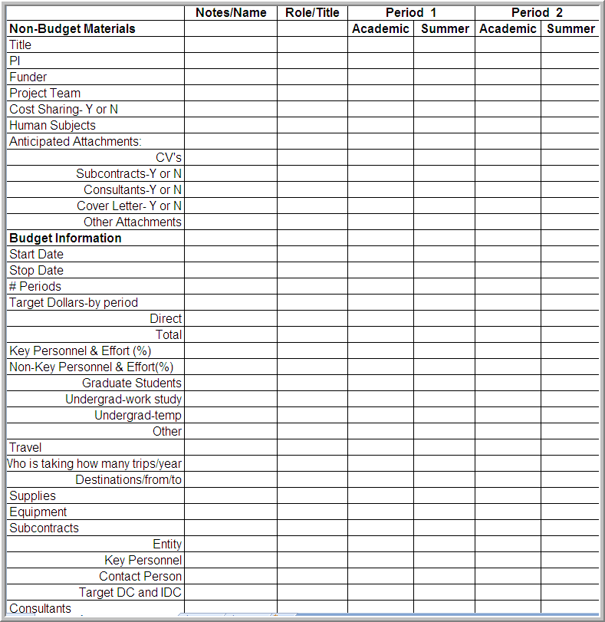
Suggested Checklist

Slide 9
Proposal Budgeting for Administrators
The Departmental Perspective
Budget Basics

Slide 10

Budget Basics
General components of every budget:
Salary
Fringe Benefits
Travel
Other Direct Costs
Consultants
Sub-awards
Equipment
Indirect Costs

Slide 11
Personnel Costs-Salary
Faculty and Research Faculty
Salary requests must be based on actual salary data
  OMB-A21 Part J Section 8.d.
  Salary information at NU can be found in HRIS
Salary requests must be based on appointment type
  9 month appointment
  12 month appointment

Slide 12
Personnel Costs-Salary
Post Doctoral Associates
Salary requests must be based on actual salary data
  HRIS
  NU offer letter
  For TBD post docs, level of compensation set by PI
Some agencies have limits on the compensation of post docs and graduate students*
*must not exceed compensation of others with similar credentials and experience

Slide 13
Fringe Benefits
Use fringe benefit blended rate table provided by OSR
  http://www.research.northwestern.edu/osr/fringe.html
    Table provides rates for regular fringe benefits (faculty, staff, post docs), graduate student fringe benefits, statutory fringe benefits (visiting scholars, temporary employees)
    Determine which rate to use based on type of sponsor
  Fringe benefits should be calculated on all personnel costs except those excluded as detailed on the OSR website

Slide 14
Costs-Graduate Students
Stipend-Monthly stipend determined by PI or Department, minimum set by TGS; must be reasonable.
Fringe Benefits-current rate 1.8%
Tuition
  RAS rate set by TGS annually
  sponsored project must utilize full federal (or non-federal, depending on sponsor) indirect cost rate to be eligible for the RAS
  For any projects that do not use the full indirect cost rate the full tuition rate must be used, or permission from the graduate school to use an RAS equivalent rate must be requested.
  Tuition is not subject to indirect costs in an MTDC base
  For information on current Tuition Rates:
  http://www.research.northwestern.edu/osr/GraduateTuition.html

Slide 15
Other Direct Costs- Determining What’s Allowed
OMB A-21 : Reference for allowability of direct costs
Solicitations: Provide specific guidelines of what will, and will not, be allowed as direct cost on a given program.
  Supplies-lab supplies, consumables for experiments
  Publication Costs-costs of publications, such as posters, journal articles etc., NOT PAPER or TONER
  Non Capital Equipment- NOT COMPUTERS *
  Services-clean room fees, machine shop costs etc.
  Travel-conferences, collaborative meetings
  Sub-awards
  Subject Incentives
*see the NU computer policy, exceptions do exist

Slide 16
Indirect Costs
  Also known as F&A (facilities and administration)
  Use NU rate tables to determine appropriate rate
    http://www.research.northwestern.edu/osr/p_fa2.html
  F&A is calculated on MTDC (modified total direct costs)
    MTDC = Total Direct Costs – any items of cost that are exempt from IDC such as tuition, capital equipment, subcontracts >$25,000

Slide 17
F&A Distribution
  New F&A distribution policies/procedures require confirmation of F&A distribution at proposal stage (OSR-1) and allow for automated assignment of F&A to multiple units (NU Financials/InfoEd)
    http://www.research.northwestern.edu/osr/FA_distribution_guidelines.html

Slide 18
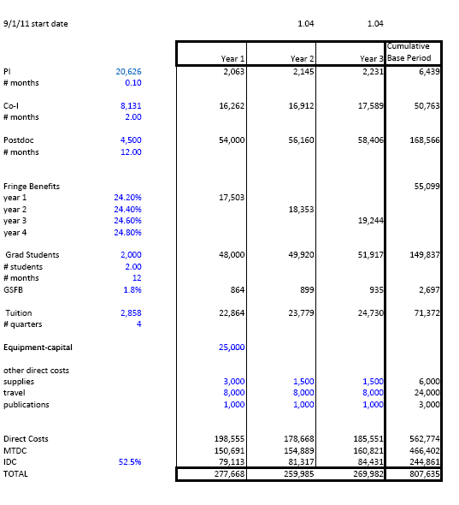
Budget Worksheet
Please note, this is a worksheet, not a budget that would be submitted to a sponsor

Slide 19
Budget Pit Falls
Subcontracts
  Only apply indirect costs to the first $25K (MTDC) per sub
Salary limitations
  NIH stipend levels, post-doc salary, salary cap
  NSF, maximum 2 month salary charged on all NSF funded projects during a fiscal year
  Effort: summer/academic/calendar
Solicitation Limitations
  Travel, particularly foreign travel
  Personnel
  Occasionally, IDC limitations
Irregular Budget Periods
  Common in Department of Defense proposals

Slide 20
Resources
http://mccormick.northwestern.edu/about/offices/research_administration/proposal_preparation.html
OSR-Budget Calculator
http://www.research.northwestern.edu/osr/training.html
OMB A-21
http://www.whitehouse.gov/omb/circulars_a021_2004/
McCormick Research Administration Budget Template

Slide 21
Proposal Budgeting for Administrators
Resources: OSR, Policies, and Funder Updates

Slide 22
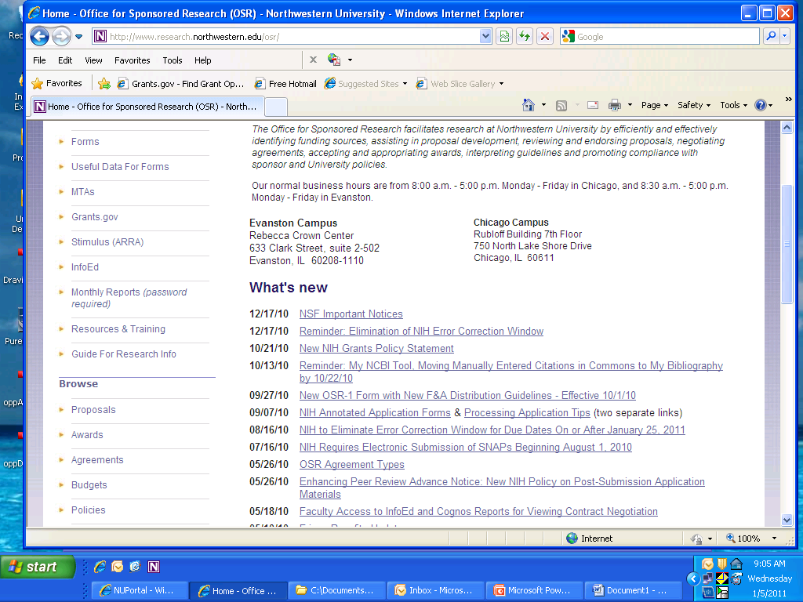
Budget Information from the OSR Website

Slide 23
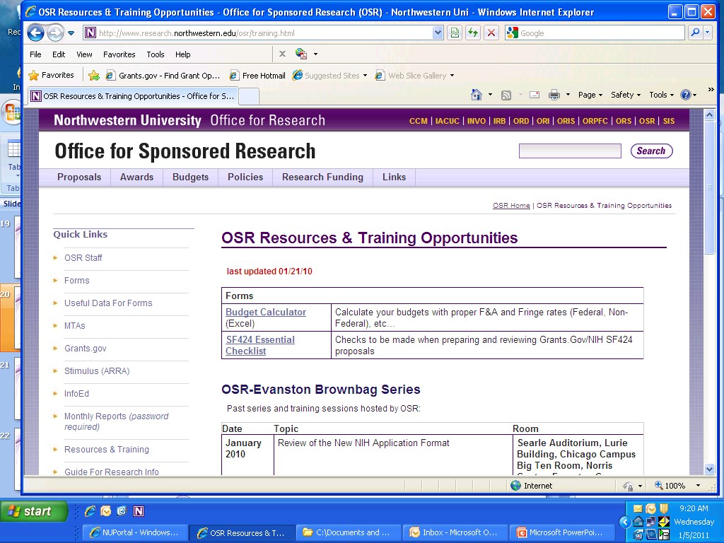
Budget Calculator on OSR Website

Slide 24
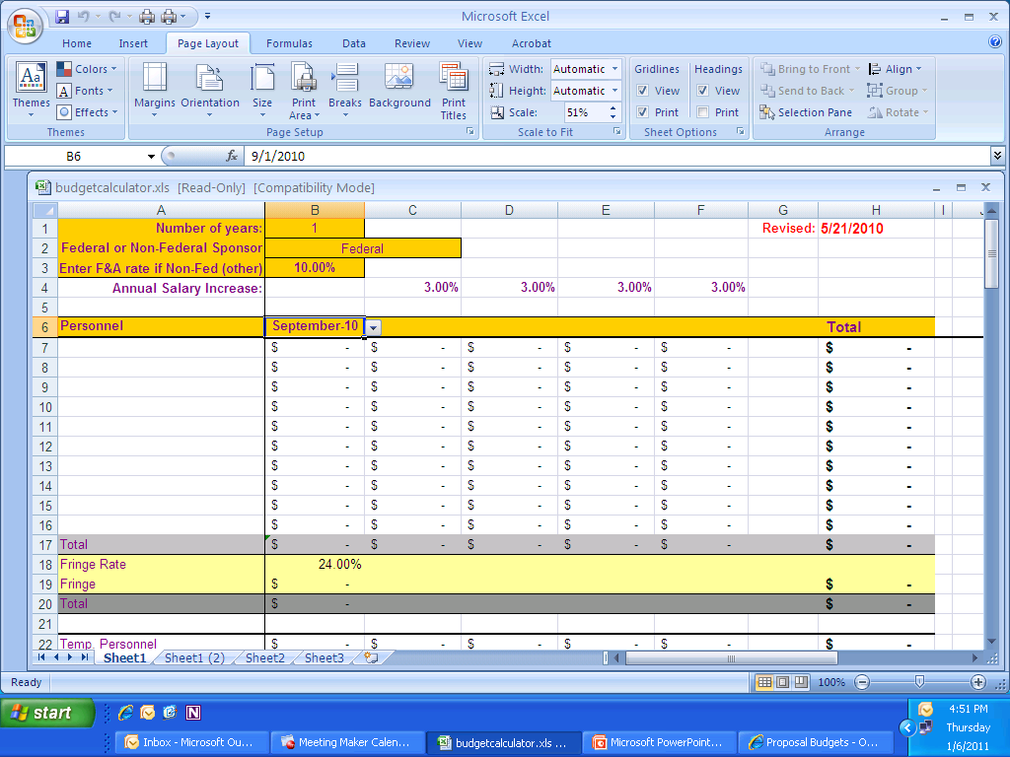
Budget Calculator

Slide 25
OSR Review of the Budget
Review the BAA, Solicitation, PA, FOA, etc. budget component for special considerations regarding the budget.
OSR Grants Assistant reviews the budget using the calculator and indicates in his/her notes if the budget conforms and checks out with HRIS.
We also check the budget justification to make sure it is in tandem with the budget provided and information on the OSR-1 proposal routing form.

Slide 26
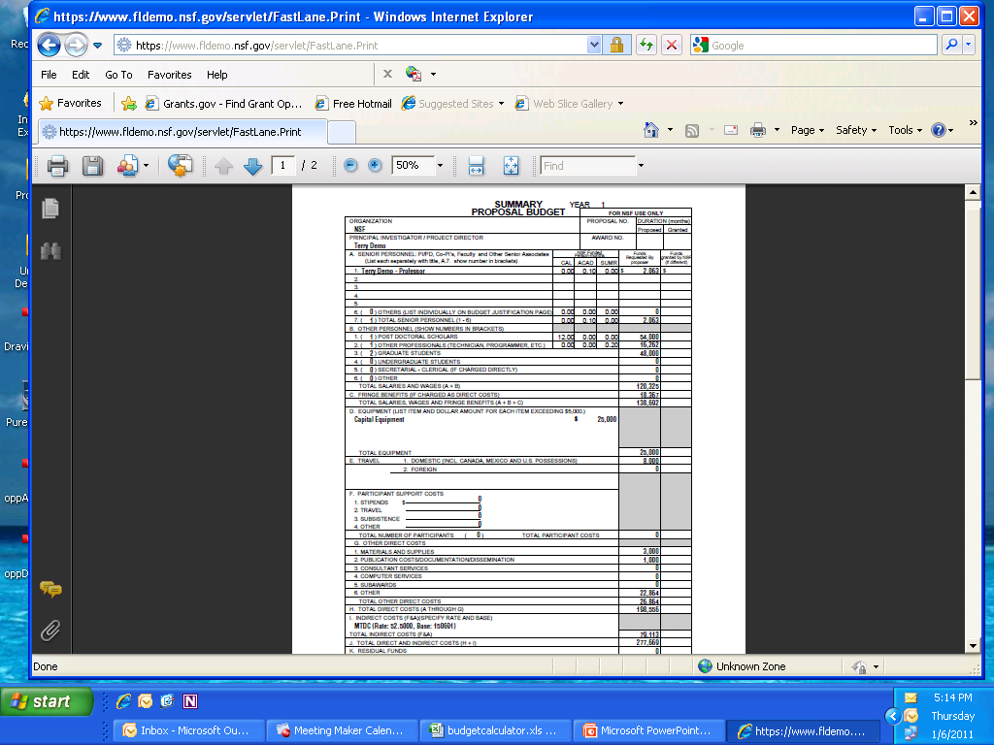
NSF Budget in FastLane

Slide 27
Budget Justification
Personnel
A salary request for 0.10 academic months is made for all three years for Professor McCormick. salary request for 2.0 calendar months is made for all three years for the Co-Investigator, Professor X. A 4% inflationary increase is included in years two and three.
Other personnel
12.0 calendar person months for a post doc is requested in years one through three. The post doc salary request is inflated by 4% each September.
Two Graduate Students (Ph. D. Candidates) are requested for the three year period (12.0 calendar months each). A 4% inflationary increase has been included in years two and three. Compensation is commensurate with Northwestern norms.
Fringe Benefits
Employee benefits have been calculated based on the following DHHS approved rates:
9/1/10-8/31/11: 24.0%
9/1/11-8/31/12: 24.2% (estimated)
9/1/12-8/31/13: 24.4% (estimated)
9/1/13-8/31/14: 24.6% (estimated)
9/1/14-8/31/15: 24.8% (estimated) and thereafter
For Graduate Students:
9/1/10-8/31/11…1.8% and thereafter

Slide 28
Budget Justification continued
Travel
We have budgeted for both national and international conference-scale trips each year for the PI, Co-PI and Graduate Student for the purpose of dissemination of research findings.
Capital Equipment
A high performance server is needed to carry out complex systems simulations. Readily available commercial offerings of servers do not have the speed and capability to carry out the multiple calculations. Indirect charges are not applied to capital equipment.
Other Direct Costs
Materials and Supplies: Support is requested to cover the cost of expendable materials and supplies. This includes costs for a computer in year one, the computer purchase is necessary for the data mining and predictive modeling as proposed and will be used solely for the benefit of this project.
Publication Costs: Funds are requested to cover the costs of study manuscript submission and publication in each year of the project.
Tuition: Total tuition the first year is $2858 per quarter, per student, with a 4% inflationary increase the following years.
F&A
F&A has been calculated based on the following DHHS approved rates:
52.5% MTDC Beginning 9/1/11 – 8/31/12 and thereafter provisional

Slide 29
Relevant Policies
OMB A-21 (cost principles for educational institutions) – reasonable, allowable, allocable http://www.research.northwestern.edu/osr/p_allowability.html
No administrative costs with full F&A unless clearly justified.
Purchase of Personal Computers and Electronic Devices on Sponsored Projects
Computer Space for clusters –one of the following:
    Space identified and discussed with the appropriate Dean's office
    Housed by NUIT in Quest and Vault

Slide 30
Northwestern University Effort Reporting Policy
Basis for estimating effort percentages and calculating salary requests in proposals
For most Northwestern faculty (i.e., those who do not hold NMFF appointments), the effort which relates to and is required by an individual’s Northwestern University (NU) appointment(s), including research, teaching and administration activities.
Expectation for faculty effort in proposals
Faculty are expected to commit some level of effort (>0%) on proposals on which they are listed as principal investigator (PI) or key personnel, with exceptions for certain types of proposals.
Institutional stance on voluntary cost sharing
Northwestern University does not typically cost share on a voluntary basis, consistent with its objective of maximizing sponsor cost reimbursement to support the continued growth of the research enterprise. A voluntary cost sharing commitment should be made only where the competitive forces and perceived institutional benefit of receiving the award are deemed to be sufficiently strong to warrant the commitment.

Slide 31
Institutional Base Salary
  IBS- Annual contracted compensation paid by NU for an employee’s appointment (s), whether that individual’s time is spent on research, instruction or administration.
    For faculty in FSM who hold both NU and NMFF appointments, this includes the effort which relates to and is required by both the NU and NMFF appointments, including research, teaching, administration, and clinical activities.
  IBS excludes
    Incentive compensation
    Additional pay
    VA appointments
    Any income that an individual is permitted to earn outside of contracted duties for Northwestern University.

Slide 32
Academic Base Salary
ABS : Base Salary for proposal submissions and effort reporting
  Researchers with one appointment or all appointments with same contract period
    ABS=Annual Salary
  Researchers with multiple appointments with different contract periods (i.e.9 and 12 month)
    ABS=Aggregate of the 9 month salaries from all appointments
  New panel for ABS in HRIS
    Main Menu --> Workforce Administration --> Job Information --> Review Job Information --> Employment Info
    (NW Employment Info)

Slide 33
NSF New Guide and Requirements
The new NSF Proposal & Award Policies & Procedures Guide(PAPPG) (NSF 11-1) goes into effect for proposals submitted, or due, on or after January 18, 2011.
The significant changes to the PAPPG include:
  1)Required Data Management Plan: Up to two pages, submitted as Supplementary Document
  2) Implementation of National Science Board’s recommendations regarding cost sharing.
  A complete list of significant changes accompanies the PAPPGNSF Important Notice –new requirements on proposals submitted or due on or after January 18, 2011.
FastLane will begin automated compliance checking for the data management plan starting January 15th and proposals (including unsolicited proposals) that do not comply with the requirement will be prevented from submission.

Slide 34
NSF – Specific Changes
INCLUDE: Required Data Management Plan
  Purpose: Describe how the proposal will conform to NSF policy on dissemination and sharing of research results
  Page limit: 2 pages or less
  Location: Upload as supplementary document
  Further information relevant to specific Directorate, Office, Division, Program, or other NSF unit available at : http://www.nsf.gov/bfa/dias/policy/dmp.jsp
    Plans may be no more than a statement that no detailed plan is required, accompanied by clear justification
    Reviewed as part of the intellectual merit and/or broader impacts of the proposal
EXCLUDE: Voluntary Committed Cost Sharing
  Facilities, Equipment, and Other Resources: Include all organizational resources necessary for, and available to a project
    Narrative description
    Must not include any quantifiable financial information

Slide 35
NSF – Specific Changes
Required: Project Outcomes Report for the General Public
  What: PIs will submit a brief summary, prepared specifically for the public, of the nature and outcomes of the project
  When: Within 90 days following grant expiration
  Where: Upload via Research.gov
  For: All awards, funding increments, or supplements issued on or after January 4, 2010

Slide 36
NSF FastLane
Extensive instructions are available through the FastLane website https://www.fastlane.nsf.gov/ (select the “FastLane Help” (top right hand corner)
NSF FastLane demo site: https://www.fldemo.nsf.gov/
For NSF FastLane Login or technical assistance at Northwestern please contact: Michael Green, msgreen@northwestern.edu, 847-491-2749

Slide 37
NIH, AHRQ, and NIOSH to Eliminate Error Correction Window for Due Dates on or after January 25, 2011
It has been NIH’s ultimate goal to define “on-time” submission as having an error-free application (i.e., passes Grants.gov and NIH Commons system-enforced business rules without errors) with a Grants.gov timestamp on/before 5:00 p.m. local time of the applicant organization on the receipt date.
Currently, NIH allows a 2-day window to correct validation errors as long as the original submission was received on time.
Going forward, NIH has announced that the 2-day error correction window for proposal submissions will be eliminated Jan. 25, 2011: An error-free submission must be date-stamped in Grants.gov by 5:00
This means that proposals to NIH can no longer be changed or corrected due to grants.gov or agency validation errors, or PI errors/omissions, after the 5:00 Grants.gov deadline.

Slide 38
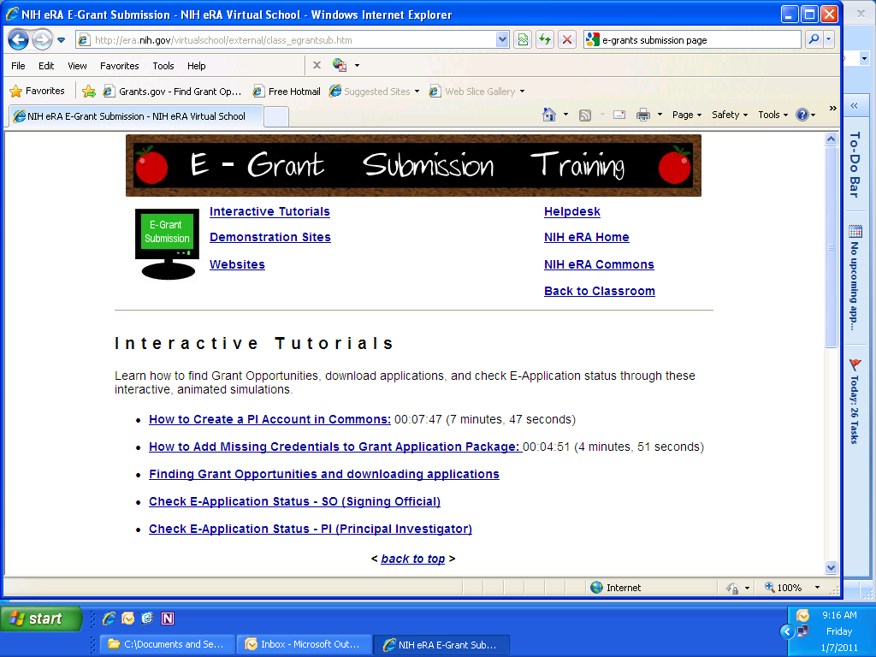
NIH Training Info

Slide 39
General Advice
  Alert PI’s to elimination of NIH error correction window/NSF required Data management plan
  Work closely with PI and OSR on proposal preparation (start early, submit early!)
  Ask relevant questions for budgeting and larger fiscal considerations (F&A, effort commitments)
    Utilize available resources (OSR) for budget process
  Work with OSR to resolve questions/address concerns

Slide 40
Questions?

