Slide 1

NUvention Web 2015 Info Session
10-20-2014
Rich Gordon & Mike Marasco

Slide 2
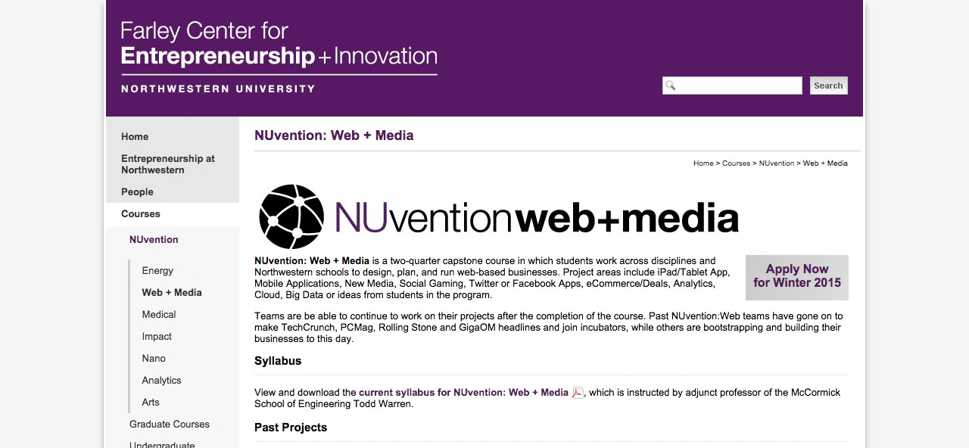
Visit our Web Site for most Current Info

Slide 3
What's Up With The Name Change?
Better reflects the broad scope of class.
What the heck is a media idea?
What’s the difference between a media idea and a web idea?

Slide 4
Why Do This?
Best Interdisciplinary and Experiential learning experience on campus
Best in classroom experience of product and business development process in one class
  You will learn how to translate an idea into a business
Learning occurs:
  By Doing
  From Faculty, Fellow Students and Advisers
This will be a ton of work, but fun.

Slide 5






Why Do This?
Students from NUvention Web have created companies like:
And have sold companies to:

Slide 6
NUvention: A Partnership

Slide 7




How do we compare?

Slide 8
How do we compare?
Similarities
Differences
Success rate
Strong mentorship
National network connectivity
Focus on Customer Development, Lean Start-up, Bootstrapping and Agile
6 months versus versus 3
Not a full time commitment
More regimented
Better learning
No equity grant expected
NU alum network affinity
Strong SW dev focus

Slide 9
Program Details
50-55 Students
  Undergrad/Grad by application only;
  Undergrad preference to June ‘15 graduating students or juniors unable to take in senior year
  Grad preference to June ‘15 graduating student
  Open to all NU Schools
  7-8 teams of 5-7 students
  2-3 students minimum on each team with development experience
Tuesdays 12:30-3:30-taught in new Ford Studio Classroom and Garage Space when opened
Faculty
  Steering Committee
    Core Group that will oversee teams and class
  Subject Matter Experts
    Faculty with specific expertise that student teams may need
  Advisory Board

Slide 10
What We Know
Key skillsets needed in teams
  Best teams had strong project and product management
  Scope pragmatism around what can be done in 2 quarters
  Willingness to engage face-to-face with target users
  Willingness to pivot
Advisory Board
  Can be great mentors
  Teams who engaged adviser got valuable mentorship
Coasting team members really stick out and impact team performance
Teams needed help post-class

Slide 11
Outcomes
By the end of the two quarters students will have:
Developed a business model for a web service or new mobile application
Defined, prototyped and launched an initial product offering
Launched and measured initial market reaction to the web service.
Customers, hopefully paying
Have the basis of a start up company that you can choose to pursue post class

Slide 12
Why an Application Process?
Limited Spots
Need right mix of student experience in each team
Timing
  Apply by 11/3/14 midnight
  Decisions no later than 11/7/114
Wait List
Auditing

Slide 13
Teams of 4-6
Each member has a primary and secondary role
Business
(1-2)
Designer (1)
Hacker/ Developer (2+)
Content Strategist (1)

Slide 14
Application Process: Individual Applications
All students accepted based on individual merits
Questions gauge applicants abilities and interests
Teams networking session after 11/12
EECS Students who have completed 311 data structures are guaranteed acceptance to the program, but still must apply.

Slide 15
Team Applications
NUvention Web is not an opportunity for you to recruit a team. Team decides on opportunity.
Please do NOT apply if you are only willing to work on your idea.

Slide 16
Faculty
EECS
  Chris Riesbeck
  Todd Warren
IEMS/Farley Center
  Mike Marasco
  Steve Olechowski
  Rich Padula
Medill
  Rich Gordon
  Rachel Mersey

Slide 17
More Questions?
Faculty
  Rich Gordon - richgor@northwestern.edu
  Mike Marasco - mmarasco@northwestern.edu
  Caitlin Smith - caitlin.smith@northwestern.edu

Slide 18
Appendix

Slide 19
NUvention Structure
School Deans
Farley Center
NUvention: Web
Chair,
Todd Warren
Advisory Board
Faculty Steering
Committee
Students
Team Advisors

Slide 20
Advisory Board Role
NUvention: Web advisory board members will assist in the following areas:
  Curriculum Oversight – Advising faculty team on the best curriculum for launching Web/software companies
  Networking – Assisting faculty and students to network to optimize curriculum and learning to exceed NUvention Program goals
  Mentoring Students – Direct advising of a student team that is working in an area of your personal interest
  Funding – Assist in obtaining support to defray program costs. The Farley Center provides seed capital.

Slide 21
Reading List
Lean Start-Up, Eric Reis
Running Lean, Ash Mauyra
Do More Faster, David Cohen and Brad Feld
Googled, Ken Auletta
The Four Steps to the Epiphany, Steven Blank
The Entrepreneur’s Guide to Customer Development, Brant Cooper and Patrick Vlaskovits
Business Model Generation, Alexander Osterwalder and Yves Pigneur
Behind the Cloud, Marc Benioff and Carlye Adler

Slide 22
Good Blogs
VentureBeat
Mashable
TechCrunch
CrunchGear
Engadget
Gizmodo
ReadWriteWeb
Steven Blank
  Steveblank.com
Brad Feld-TechStars
  Feld.com
Eric Reis
  Startuplessonslearned.com
Todd Warren
  Toddwinc.com

Slide 23





Where Are We Learning From?

Slide 24
Previous Year’s AB Members and Expertise
Full Name | Expertise | Connection | Current Title
Frank Barbieri | Startup Founder | Chair Connection | SVP Corp Dev and Strategy, YuMe
Viresh Bhatia | Startup Founder | Alumni / Local | Founder, Installshield
Jeffrey Bier | Founder / Venture Capital | Alumni | Investor, Beir & Co.
Bill Bliss | Serial Startup CTO | Alumni | Consultant
Kapil Chaudhary | Venture Capital | Alumni / Local | Managing Director, IA2 Fund
Rick Fink | Venture Capital | Alumni | Managing Director, Miramar Venture Partners
Grant Gochnauer | Startup Founder | Alumni / Local | Co-Founder, Vodori
Gabe Greenbaum | Venture Capital | Alumni / Local | Senior Associate, New World Ventures
Suneel Gupta | VP, Product, Groupon | Alumni | Startup Founder
Josh Hernandez | Startup CEO | Through Student / Local | Founder & EVP, Tap.me
Warren Holtsberg | Venture Capital | Alumni / Local | Managing Principal, MVC Capital
Tim Krauskopf | Serial Startup CTO | Trustee / Local | Principal, Round Lake Designs, LLC
Paul Lee | Venture Capital | Local | Venture Partner, Lightbank
Bret Maxwell | Venture Capital | Alumni / Local | Managing Partner, MK Capital
Matt McCall | Venture Capital | Alumni / Local | Partner, New World Ventures
Kristin McConnell | Startup CEO | Alumni | Founder, Limelife .com
Jon McNeil | CEO | Alumni | CEO, Enservio
Steve Olechowski | Startup Founder | Alumni / Local | Founder, Blinkfire
Bill Pescatello | Venture Capital | Local | Venture Partner, Lightbank
Bob Plaschke | CEO | Alumni | President and CEO, Sonim Technologies, Inc.
Vivek Ragavan | Startup CEO | Alumni | President and CEO, Actelis Networks
Mary Lou Song | Ebay employee #3 | Trustee | Startup CEO
Rob Shurtleff | Venture Capital | Chair Connection | Managing Director, Divergent Ventures
Ben Slivka | Startup CEO | Trustee | Trustee, Wissner-Slivka Foundation
Steve Subar | Startup CEO | Local | President and CEO, OK-Labs
Hon Wong | Startup CEO | Alumni | CEO new startup

Slide 25
Faculty
Core Faculty
  Todd Warren (EECS/Farley), Mike Marasco (Farley), Chris Riesbeck (EECS), Steve Olechowski (Farley), Rich Gordon (Medill)
Team Mentors
  Advisory Board Members

Slide 26
NUvention Web First Quarter
Preclass
Concept Development
Concierge MVP and Customer Validation
Advisor Pitch and Demo
  Define Customer Segments
  Initial Scenario Critique
  Landing Page
  Tool and Environment Up and Running
  Minimum Viable Product
  Value Proposition
  Hello World Application
  Storyboarding and UI
  Depth Customer Research
  Agile Development
  Customer Validation Strategies
  Business Model Canvas Development
  Pitch Development
  Concept Demo
  Initial Development
  Real World Feedback
Product Hypothesis
MVP and Initial Canvas

Slide 27
NUvention Web First Quarter
AB Feedback
Development & Canvas Iterations
Final Pitch, Product, Canvas
  Critique of updated canvas
  Launch Planning
  Iteration Planning
  Understanding the Pivot
  Startup Metrics
  Revenue Models
  Customer Acquisition
  Agile Development
  Continuous Deployment
  Compelling UI
  Building Awareness
  Positioning
  Customer Recruitment
  Successful Launches
  Detailed Canvas
  Practice Pitch
  Financing your startup
  Real World Feedback
Time to Pivot?
Soft Launch

Slide 28
Questions on the Course

Slide 29
Team Composition
Role | # | Description / Principal Activities
Hacker | 2+ | Build the product “Engineering” (Software Development, Mechanical Engineering, Electrical Engineering).
Business | 1-2 | Develop the business model and marketing for the product. Orchestrate initial sales strategy for the product. “Product Management”
Designer | 1-2 | Wireframe the user experience, provide editorial oversight for the content of the site, work with Hackers/Business on structure and flow.
All:
Interview and interact with customers (“Customer Development”)
Present the pitch / Demonstrate the project
Develop website content and product promotional materials
Any:
Project manage the process
Lead the group
Coordinate team meetings

Slide 30
Team Formation Rounds
StartupNU
Preliminary Teams
StartupNU
Initial Concept
Interest area
Interest area
Round 1
Core Team of 3
(hack+biz/design)
Round 2
Expanded Core Team – 4-6
hack, biz, design
Round 3
Complete Team – 4-6
2+ Hack, 1-2 biz, 1-2 design

Slide 31
Team Formation Round 1 – StartupNU Pitches
StartupNU teams tell us (3 minutes):
  What your business concept is
  Who is on your team (names and roles [hacker/designer/business])
  What kinds of team members you are looking for (role, quantity, other qualities)
StartupNU teams in Web:
  Closet
  FutureFit
  HireBar
  Opt-In Revolution
  VitalPatch

Slide 32
Team Mixing / Core Team Formation
Introduce yourself to others at the table
  Name
  School
  Role
  Initial idea / concept area if you have one
Attempt to form a “core” team:
  Minimum 3 people
  At least a hacker and a business person or
  Hacker and a designer
Can defect from interest area to a StartupNU team if your role is something they need
Record in Google Doc

Slide 33
Round 1 Wrap Up: Core Team Report Out
For each team meeting “core” criteria:
  Basic Team Concept, examples:
    “fitness planning mobile application”
    “ecommerce site for home furnishing”
    “online information resource for primary school parents”
  Team Composition
    How many Hackers, Designers, and Business People
    What roles you need
    Any other reason they should join your team

Slide 34
Round 2: Expand core teams or form additional teams
Un-affiliated team members move between tables
Teams Pitch team members they need, team members sell to teams they want to join
A group of Un-affiliated can form a new team (min 3 hack/biz or hack/design)

Slide 35
Round 2 Wrap Up: Team Report Out
For each team meeting “core” criteria:
  Basic Team Concept, examples:
    “fitness planning mobile application”
    “ecommerce site for home furnishing”
    “online information resource for primary school parents”
  Team Composition
    How many Hackers, Designers, and Business People
    What roles you need
    Any other reason they should join your team

Slide 36
Round 3: Expand core teams
Un-affiliated team members move between tables
Teams Pitch team members they need, team members sell to teams they want to join
Work to get to a full team:
  2+ Hackers
  1-2 Business
  1-2 Designers

Slide 37
Round 3 Wrap Up: Team Report Out
What teams are fully formed
Team “core” but not fully formed
  What roles do you need?
New “core” teams:
  Basic Team Concept, examples:
    “fitness planning mobile application”
    “ecommerce site for home furnishing”
    “online information resource for primary school parents”
  Team Composition
    How many Hackers, Designers, and Business People
    What roles you need
    Any other reason they should join your team

Slide 38
Assignments
Right Now
  Record team affiliation in the google docs roster before you leave the room
  If unaffiliated, follow up with Prof. Marasco and Prof. Warren
By Sunday 12-9 Midnight
  Record final team affiliation in google doc roster sheet
  Each Team Creates a name and description in the google doc team sheet
  Un-affiliated students will be assigned a team by the faculty team
  Questions?

