Slide 1
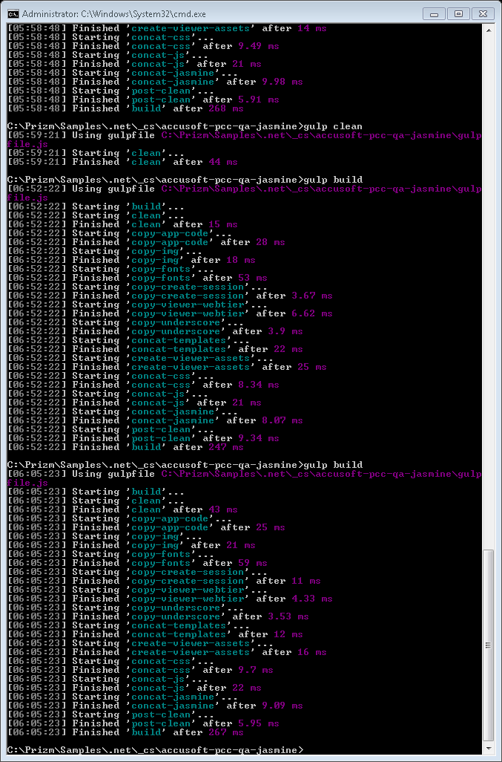
CloudConnect

Slide 2
Machine Relationships
DatabaseByDesign
Internet
Document Server/App
connect.adv
.com (*)
connect2.adv
.com (*)
Client Browser
connect1.adv
.com (*)
Accusoft HQ
GoDaddy
connect.adeptol
.com
Database
Normal
(*) “adv” = “ajaxdocumentviewer”
Failover

Slide 3
Server Functions
Document Server/App
  Deliver original document on demand
  Manually test encrypted URLs
connect.adv.com
  CloudConnect Launcher
connect.adeptol.com
  Session decryption
  Convert to PNG (mobile)
  Convert CAD to swf
  (*) CloudConnect Launcher
  (*) Convert to swf
connect1.adv.com
  Session decryption
  Convert all but CAD to swf
  Cache files
  (*) CloudConnect Launcher
  (*) Convert to PNG (mobile)
connect2.adv.com
  URL decryption
  Session encryption
Database
  Licensing
  Track cached documents
  Logging
(*) Only in failover mode

Slide 4
High-Level Sequence Diagram
Document Server/App
Client Browser
connect.adv
.com
connect2.adv
.com
connect1.adv
.com
connect.adeptol
.com
Provide
source URL
Request
source URL
Encrypt session
Redirect URL
Request URL
Request document
PCC Viewer
Converted
document

Slide 5
Encrypted Source URL Sequence Diagram
Document Server/App
Client Browser
connect.adv
.com
connect2.adv
.com
Optionally test
encrypted source
URL
Provide encrypted
source URL
Request encrypted
source URL
Decrypt source URL
Encrypt session
…

