Slide 1
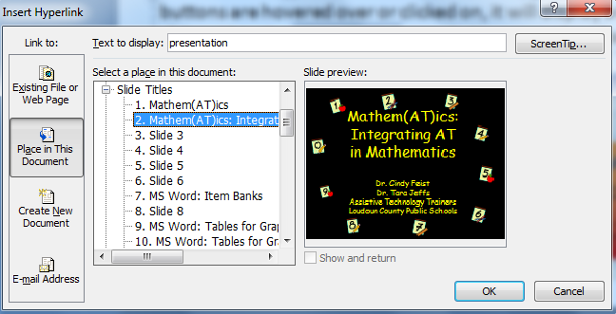

PowerPoint: Hyperlinking
Slides can be hyperlinked so that when text, graphics, or action buttons are hovered over or clicked on, it will display another slide within the presentation, a website, or another document.

Slide 2
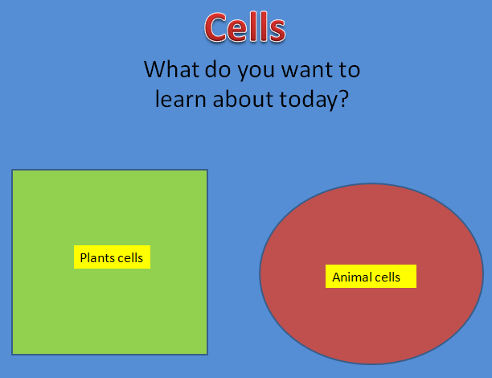
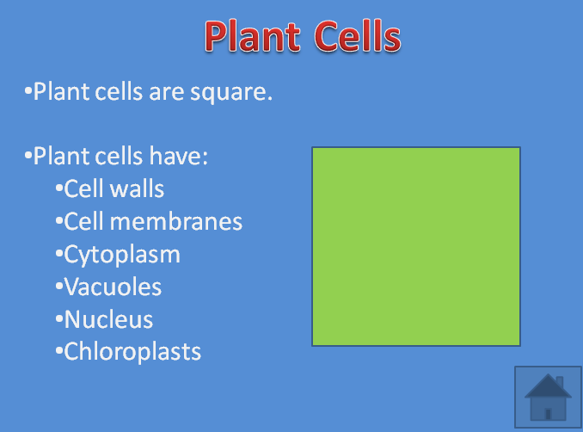
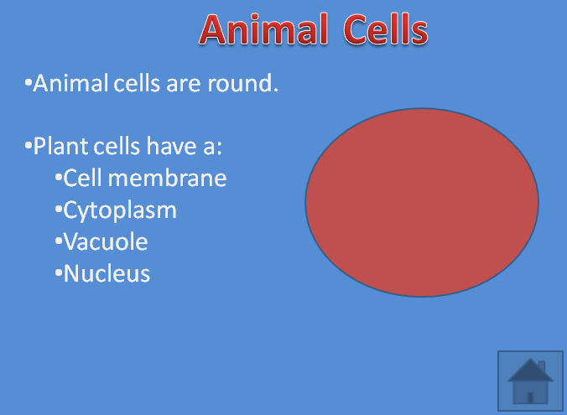
PowerPoint: Hyperlinking
Example of Interactive Learning Menu

Slide 3
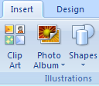

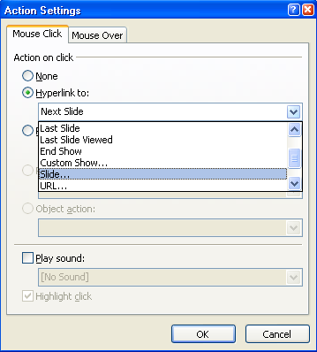
How To Create An Action Button
Action buttons can link to any slide.
On the Insert tab, in the Illustrations group, select the Shapes button.
In the menu that appears, select an Action Button. Click and drag to create the button on the slide.
In the dialog box that appears, select Hyperlink to, and from the drop-down menu, select the slide to hyperlink to.
To play a sound, select the Play sound check box, and then select the sound that you want to play from the drop-down menu.
Select OK. When the presentation is in Slide Show view mode, the action buttons will be active.

Slide 4

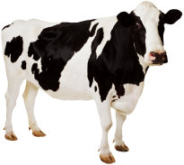
Cells
What do you want to learn about today?
Click on the cells.
Plant cells
Animal cells

Slide 5
Plant Cells
Plant cells are square.
Plant cells have:
  Cell walls
  Cell membranes
  Cytoplasm
  Vacuoles
  Nucleus
  Chloroplast

Slide 6

Good Job!
You’re a Science Whiz!
This slide show was created by the Loudoun County Assistive Technology Team. For more information on hyperlinking slides in PowerPoint, refer to the document Hyperlinking in PowerPoint.

Slide 7
Animal Cells
Animal cells are round.
Animal cells have a:
  Cell membrane
  Cytoplasm
  Vacuole
  Nucleus
Animal cells do not have:
  Chloroplasm
  Cell walls

