Slide 1
A Short Math Quiz
This short quiz has been written to model the use of action buttons in PowerPoint.
When you are brave
enough to begin the
quiz, click on this
button!
The questions, and hints for wrong answers, in this short quiz were taken
from a free Brainchild practice test. This quiz was obtained from
http://itech.pjc.edu/html/ppt_resources/3question_quiz_workshop.ppt
and revised by the LCPS Assistive Technology Team.

Slide 2

Jack’s truck can haul 2 ½ tons of gravel. How much does the load weigh?
6000 pounds
5000 pounds
4000 pounds

Slide 3
Think about this …
Think about how many pounds are in a ton before trying again.
Return

Slide 4
Excellent!
You remembered that there are 2000 pounds in one ton.
Click on the button below to go to the next question.
Next

Slide 5
The Summer Olympics are held in years that are divisible by 4. Which of the following represent years that the Summer Olympics were held?
A.
1936, 1948, 1976, 1988
1952, 1960, 1974, 1992
1928, 1954, 1976, 2000
B.
C.

Slide 6
Think about this …
Since 4 goes evenly into 100, you only need to look at the last two digits to see if a number is divisible by 4.
Return

Slide 7
Excellent!
Since 1900 is evenly divisible by 4, you only had to look at the last two digits on each number.
Click on the button below to go to the next question.
Next

Slide 8
Look at the shapes below.
Which shape is a square?
Click on the square.

Slide 9


Correct!
You found the square. A square has four sides.
Click on the button below to go to the next slide.

Slide 10
Think about this…
A square has four sides.
Return to the quiz and find the square.

Slide 11
Excellent!
This short quiz is over.
If you want to return to the beginning of this quiz, click on the button below.
When you are ready to add your own question
to this quiz, click the smiley face!

Slide 12
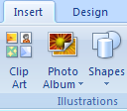

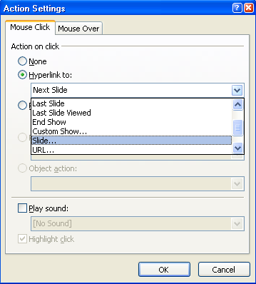
How to create an action button
On the Insert tab, in the Illustrations group, select the Shapes button.
In the menu that appears, select an Action Button. Click and drag to create the button on the slide.
In the dialog box that appears, select Hyperlink to, and from the drop-down menu, select the slide to hyperlink to.
To play a sound, select the Play sound check box, and then select the sound that you want to play from the drop-down menu.
Select OK. When the presentation is in Slide Show view mode, the action buttons will be active.

Slide 13
Question slide
  Press the escape button to edit the slides in Normal mode.
  Write a question on this slide.
  Add two answers (one correct and one incorrect).
  After completing the Incorrect and Correct answer slides (14 and 15), do the following:
  Add an action button next to each question, hyperlinking each one to either the Correct answer slide 14 or the Incorrect answer slide 15).

Slide 14
Correct answer slide
  Write a comment such as That’s right! and any other information.
  Add an action button with a sound effect hyperlinked to You did it! slide 16.

Slide 15
Incorrect/think about it answer slide
  Write a comment such as Try again! and any information.
  Add an action button and hyperlink it to return to Question slide 13.
  Return to Question slide 13 and hyperlink the answers to the Answer slides.

Slide 16

You did it!

