Slide 1

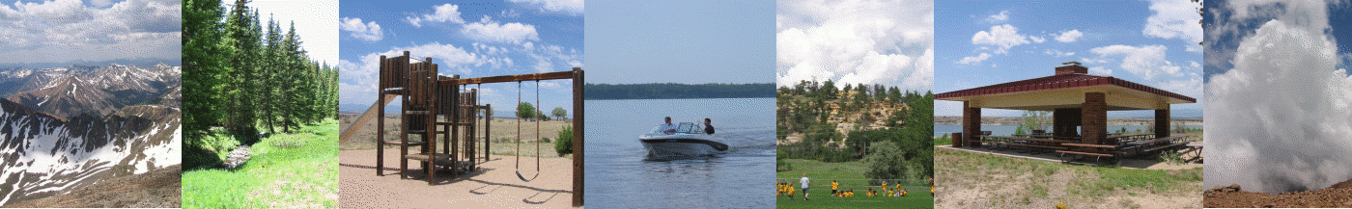

Leon the Lion's
Lightning Safety Game
Guide Leon through the following activities by alerting him whether he is Safe or Not Safe during Lightning.
Review Safety Rules

Slide 2

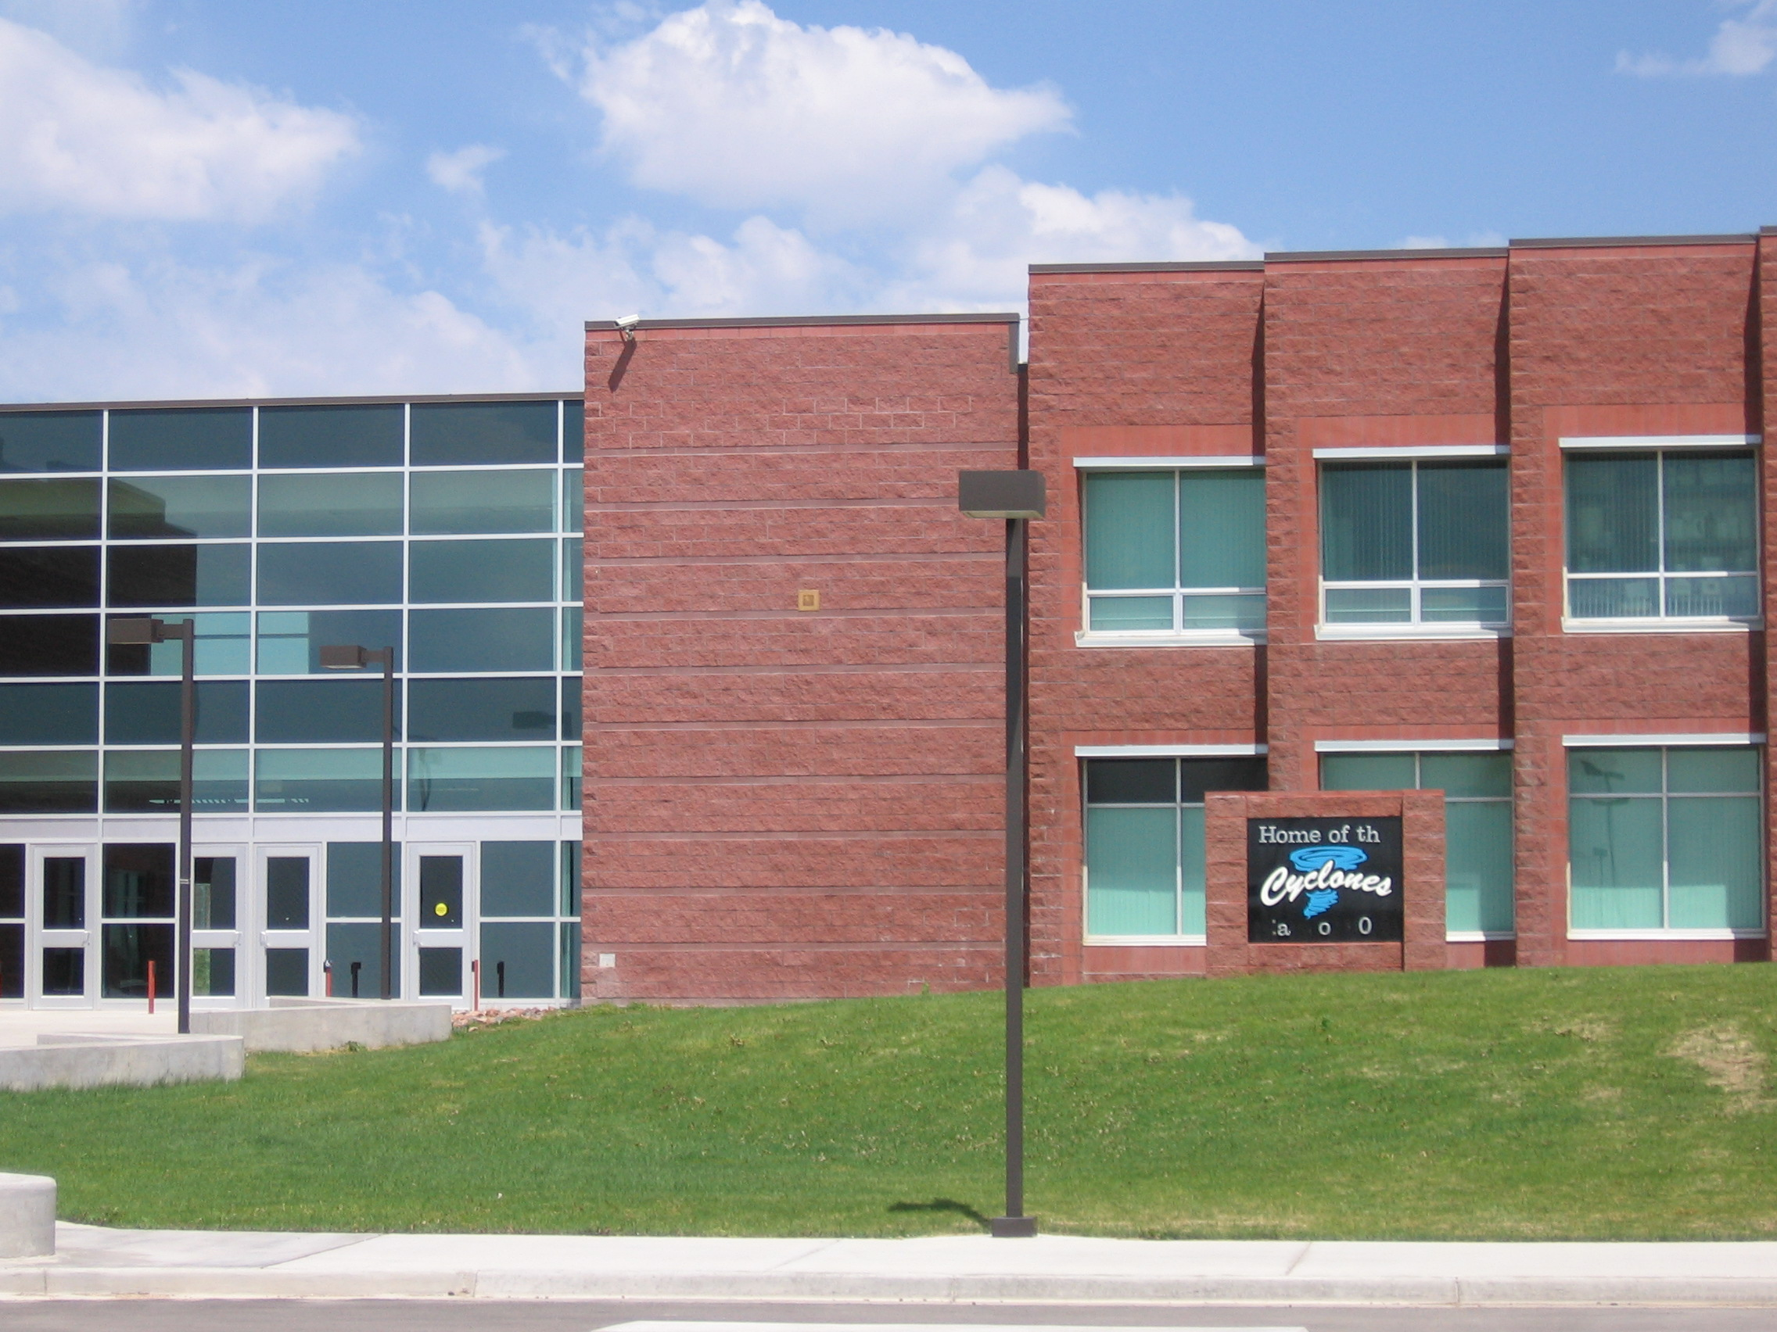
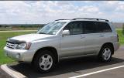
Leon’s Lightning Safety Rules
When thunderstorms are in the area, No Place Outside is Safe!
Go inside a large permanent building, like a house or school
  Stay away from plumbing or electrical appliances.
  Don’t use corded telephones, except in emergencies.
A hard topped metal vehicle is also safe
  Convertibles, motorcycles and bicycles are NOT safe!
Use the 30-30 Rule
  If you hear thunder within 30 seconds of seeing lightning, Go Indoors!
  Stay indoors for 30 minutes after the last rumble of thunder.
  When Thunder Roars, Go Indoors!
Start Game
Visit the NOAA Lightning Safety website for more information

Slide 3
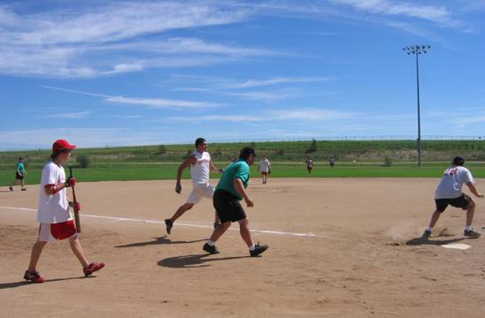
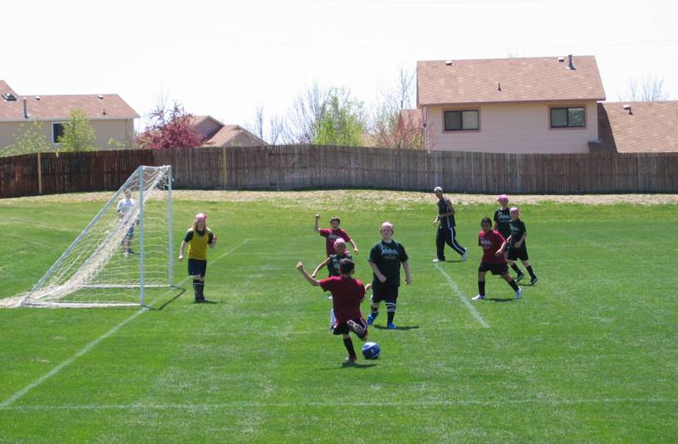


#1 of 17
Safe
or
Not Safe
(Select one)

Slide 4


Not Safe
Correct: Lightning tends to strike tall isolated objects like these players in the open field.
CONTINUE

Slide 5

Not Safe
Incorrect: Lightning tends to strike tall isolated objects like these players in the open field.
CONTINUE

Slide 6
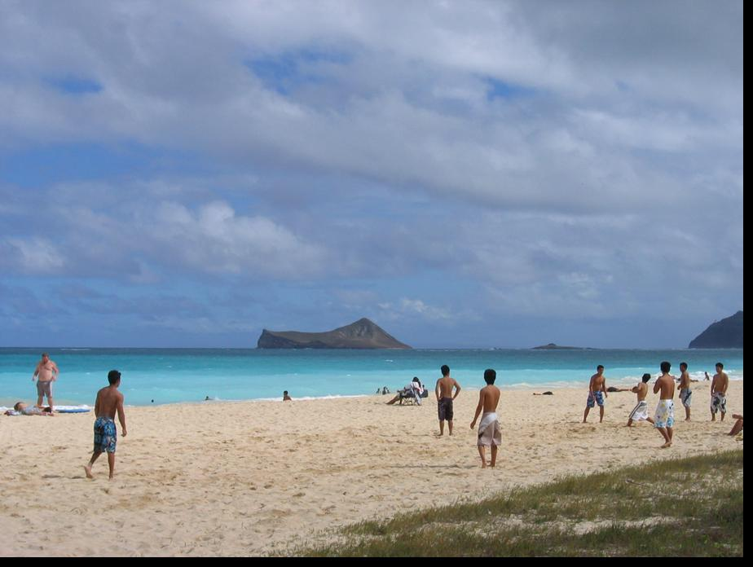
#2 of 17
Safe
or
Not Safe
(Select one)

Slide 7
Not Safe
Correct: Lightning tends to strike tall objects like these people on the flat beach or water surface. No place outside is safe!
CONTINUE

Slide 8
Not Safe
Incorrect: Lightning tends to strike tall objects like these people on the flat beach or water surface. No place outside is safe!
CONTINUE

Slide 9
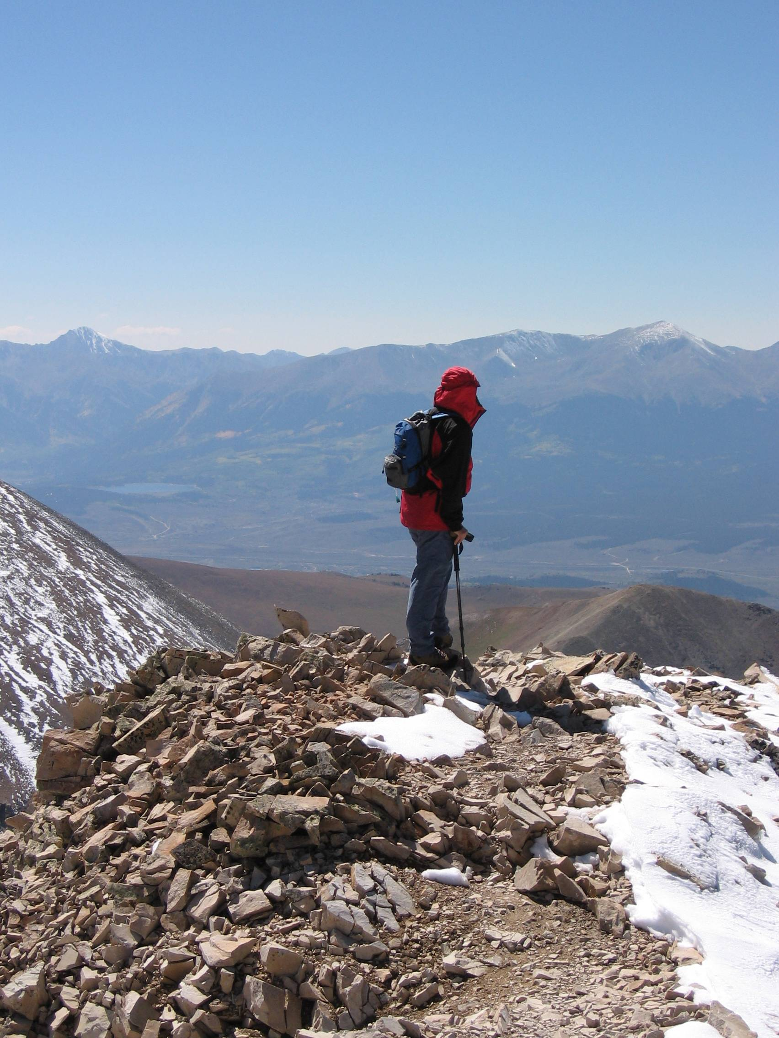
#3 of 17
Safe
or
Not Safe
(Select one)

Slide 10
Not Safe
Correct: Lightning tends to strike tall isolated objects like mountains. Get off mountains before lightning begins!
CONTINUE

Slide 11
Not Safe
Incorrect: Lightning tends to strike tall isolated objects like mountains. Get off mountains before lightning begins!
CONTINUE

Slide 12
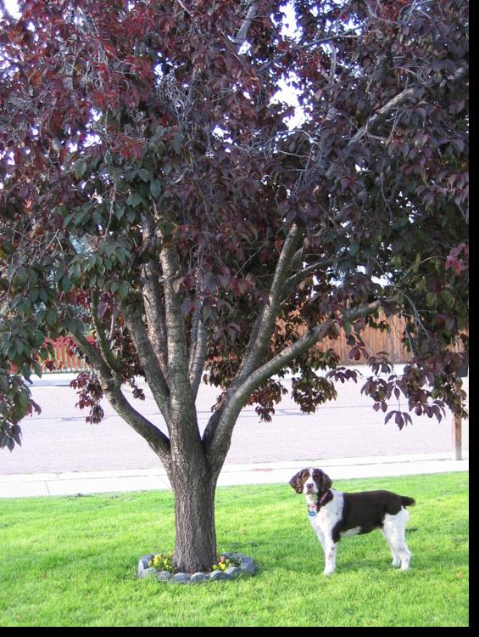
#4 of 17
Safe
or
Not Safe
(Select one)

Slide 13
Not Safe
Correct: Lightning tends to strike tall isolated objects like trees. Stay away from trees!
CONTINUE

Slide 14
Not Safe
Incorrect: Lightning tends to strike tall isolated objects like trees. Stay away from trees!
CONTINUE

Slide 15
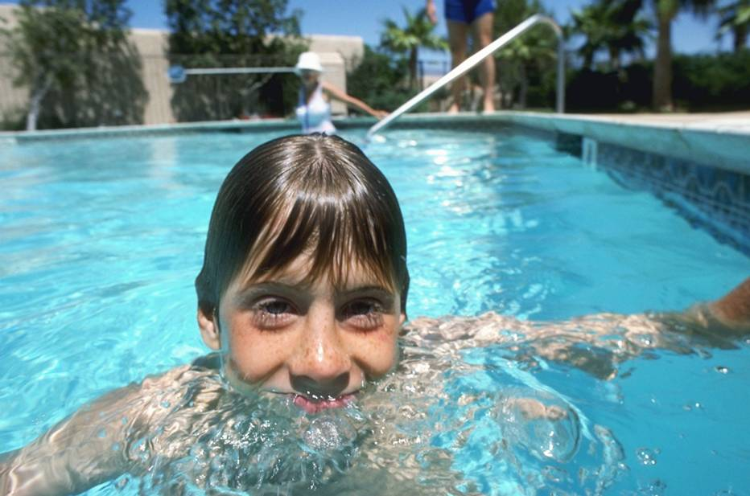
#5 of 17
Safe
or
Not Safe
(Select one)

Slide 16
Not Safe
Correct: No Place Outside is Safe! Even a nearby lightning strike can travel through underground water pipes or wiring, into the pool, and electrocute you.
CONTINUE

Slide 17
Not Safe
Incorrect: No place outside is safe! Even a nearby lightning strike can travel through underground water pipes and wiring, into the pool, and electrocute you.
CONTINUE

Slide 18
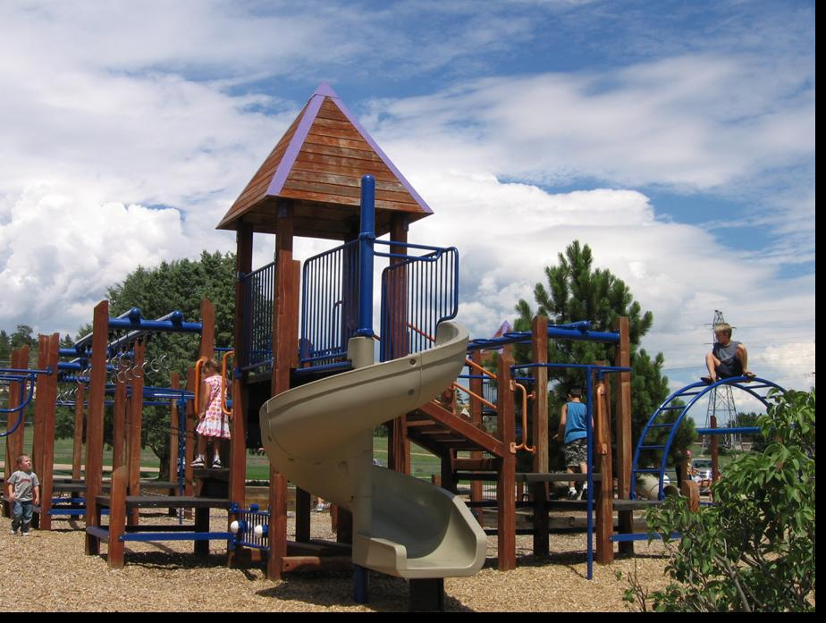
#6 of 17
Safe
or
Not Safe
(Select one)

Slide 19
Not Safe
Correct: Lightning tends to strike isolated tall objects. Remember, no place outside is safe.
CONTINUE

Slide 20
Not Safe
Incorrect: Lightning tends to strike isolated tall objects. Remember, no place outside is safe.
CONTINUE

Slide 21
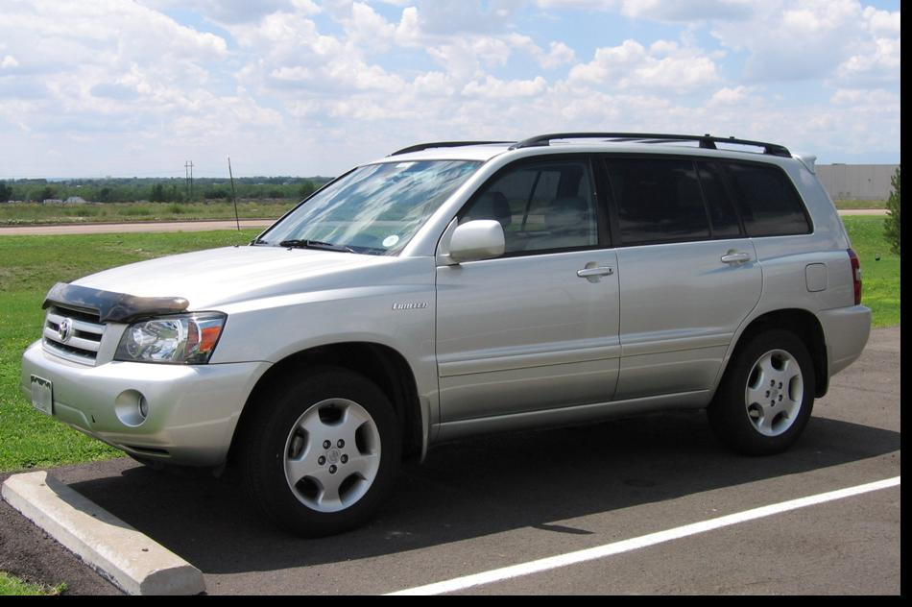
#7 of 17
Safe
or
Not Safe
(Select one)

Slide 22
Safe
Correct: The metal shell of vehicle will transfer electric current safely around you. Roll up windows and don’t touch any metal parts of the car.
CONTINUE

Slide 23
Oops! Wrong Answer
Safe
Incorrect: Metal shell of vehicle will transfer electric current safely around you. Roll up windows and don’t touch any metal of the car.
CONTINUE

Slide 24
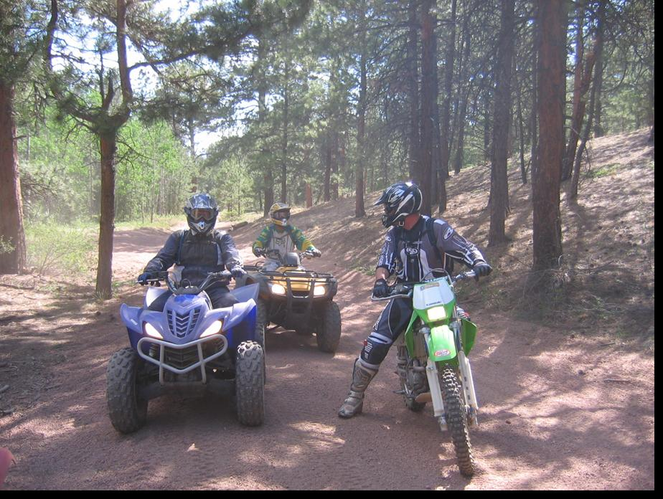
#8 of 17
Safe
or
Not Safe
(Select one)

Slide 25
Not Safe
Correct: These vehicles do not have a fully enclosed metal shell to transfer electric current safely around you!
CONTINUE

Slide 26
Not Safe
Incorrect: These vehicles do not have a fully enclosed metal shell to transfer electric current safely around you!
CONTINUE

Slide 27
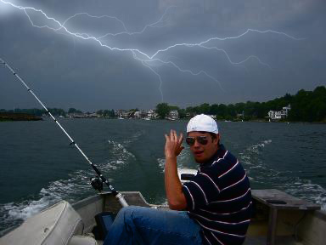
#9 of 17
Safe
or
Not Safe
(Select one)

Slide 28
Not Safe
Correct: Lightning tends to strike tall objects like this boater on the flat water surface. No place outside is safe!
CONTINUE

Slide 29
Not Safe
Incorrect: Lightning tends to strike tall objects like this boater on the flat water surface. No place outside is safe!
CONTINUE

Slide 30
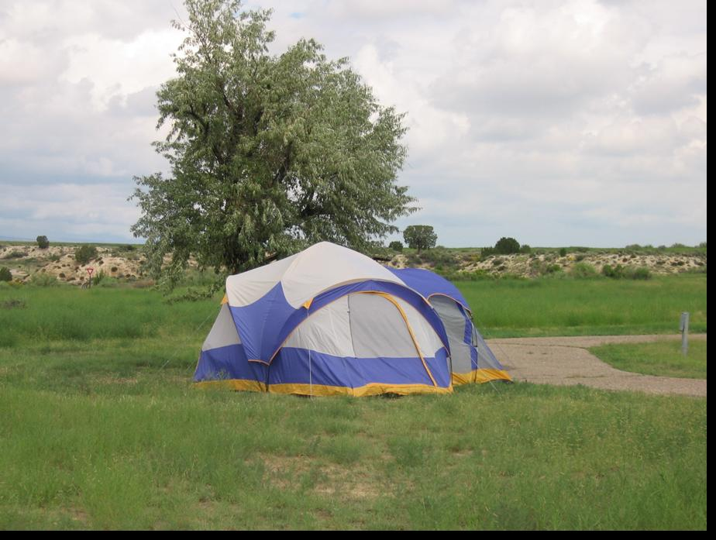
#10 of 17
Safe
or
Not Safe
(Select one)

Slide 31
Not Safe
Correct: Lightning can easily penetrate through a tent. It doesn’t matter how big the tent is or what the poles are made of.
CONTINUE

Slide 32
Not Safe
Incorrect: Lightning can easily penetrate through a tent. It doesn’t matter how big the tent is or what the poles are made of.
CONTINUE

Slide 33
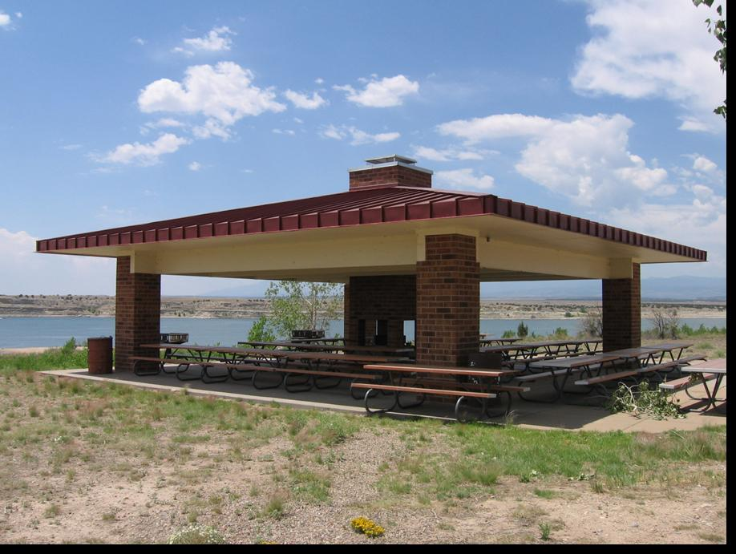
#11 of 17
Safe
or
Not Safe
(Select one)

Slide 34
Not Safe
Correct: Most small shelters offer little or no protection from lightning.
CONTINUE

Slide 35
Not Safe
Incorrect: Most small shelters offer little or no protection from lightning.
CONTINUE

Slide 36
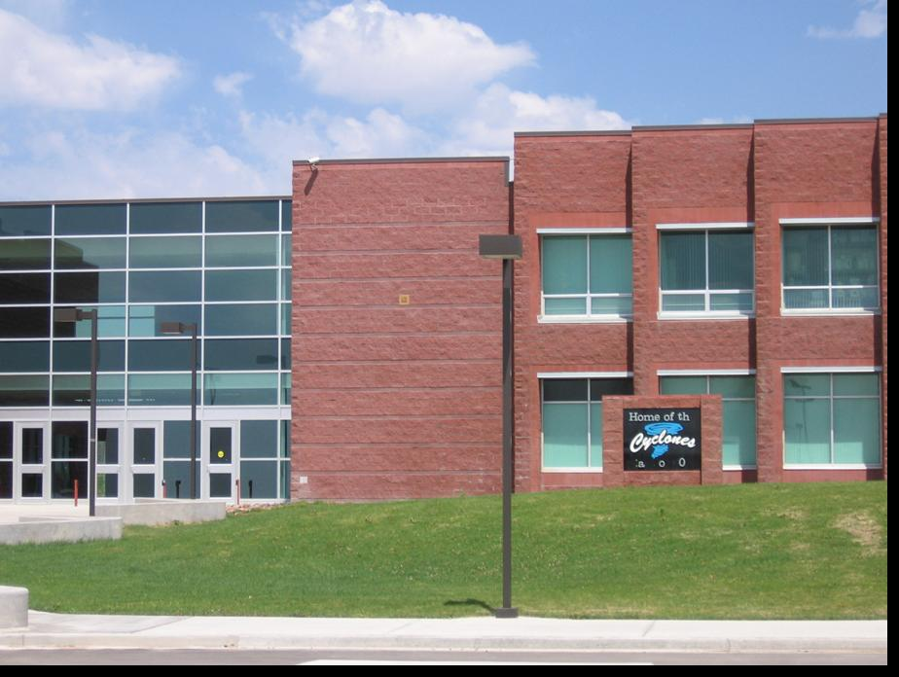
#12 of 17
Safe
or
Not Safe
(Select one)

Slide 37
Safe
Correct: Most large permanent buildings are safe.
CONTINUE

Slide 38
Oops! Wrong Answer
Safe
Incorrect: Most large permanent buildings are safe.
CONTINUE

Slide 39
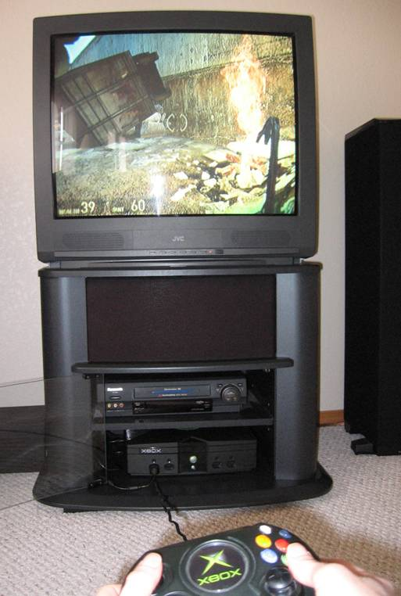
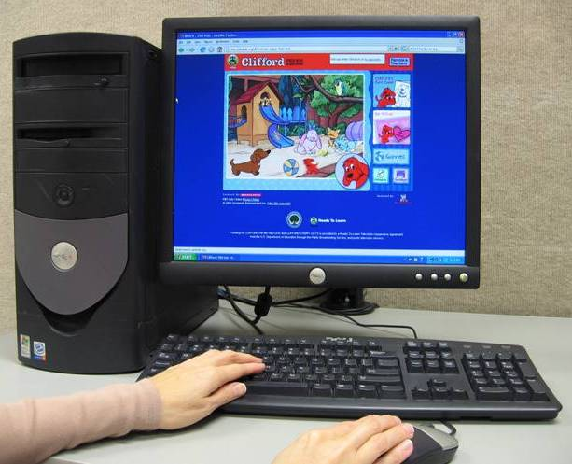
#13 of 17
Safe
or
Not Safe
(Select one)

Slide 40
Not Safe
Correct: Lightning can travel through the wiring in the building, into the computer and electrocute you.
CONTINUE

Slide 41
Not Safe
Incorrect: Lightning can travel through the wiring in the building, into the computer and electrocute you.
CONTINUE

Slide 42
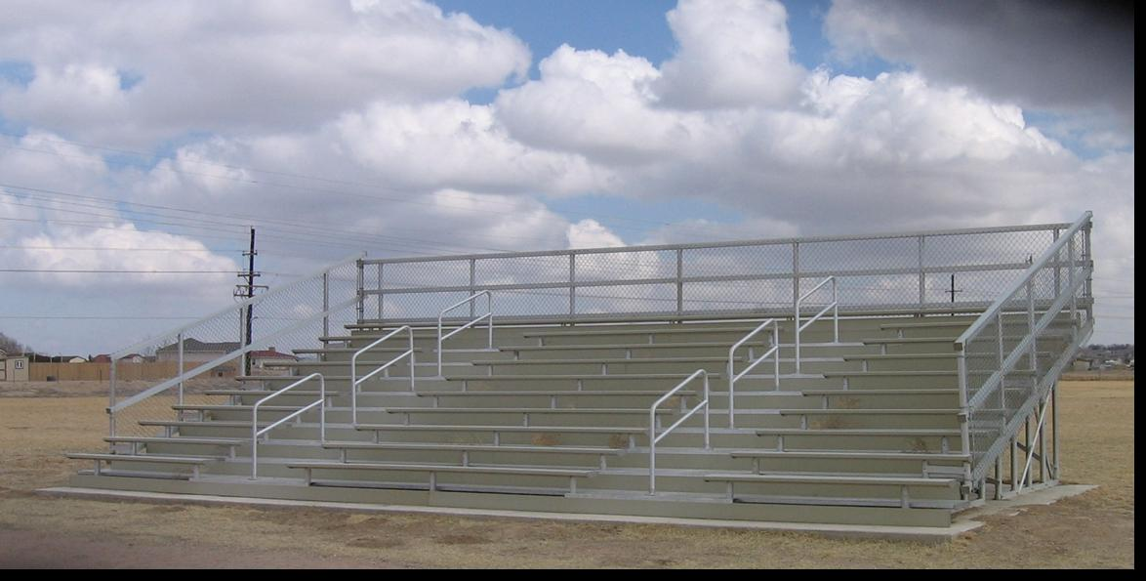
#14 of 17
Safe
or
Not Safe
(Select one)

Slide 43
Not Safe
Correct: Lightning tends to strike tall isolated objects. While metal does not attract lightning, long metal bleachers and fences can conduct electricity long distances.
CONTINUE

Slide 44
Not Safe
Incorrect: Lightning tends to strike tall isolated objects. While metal does not attract lightning, long metal bleachers and fences can conduct electricity long distances.
CONTINUE

Slide 45
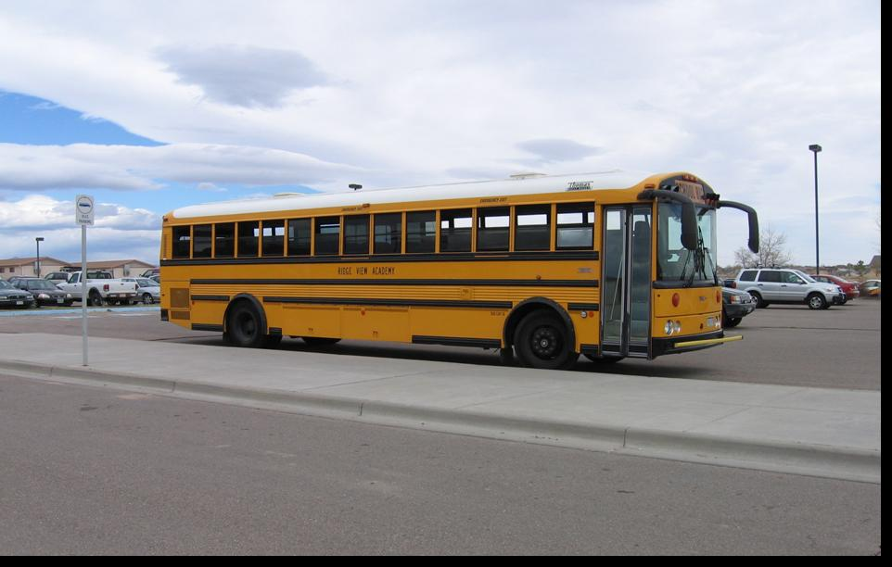
#15 of 17
Safe
or
Not Safe
(Select one)

Slide 46
Safe
Correct: The metal shell of a vehicle will transfer electric current safely around you. Roll up windows and don’t touch any metal.
CONTINUE

Slide 47
Oops! Wrong Answer
Safe
Incorrect: The metal shell of a vehicle will transfer electric current safely around you. Roll up windows and don’t touch any metal.
CONTINUE

Slide 48
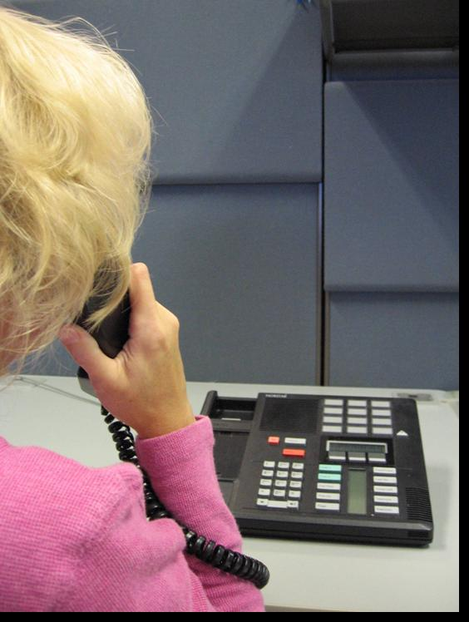
#16 of 17
Safe
or
Not Safe
(Select one)

Slide 49
Not Safe
Correct: Lightning can travel through the wiring in the building into the telephone and electrocute you! Do not use corded telephones except in emergencies.
CONTINUE

Slide 50
Not Safe
Incorrect: Lightning can travel through the wiring in the building into the telephone and electrocute you! Do not use corded telephones except in emergencies.
CONTINUE

Slide 51
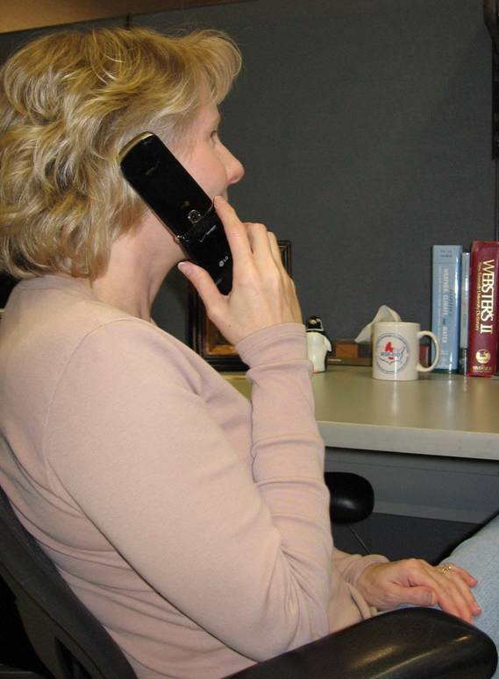
#17 of 17
Cell Phone
Safe
or
Not Safe
(Select one)

Slide 52
Safe
Correct: Cell phones are safe since there is no cord connecting the phone to the wiring in the building.
CONTINUE

Slide 53
Oops! Wrong Answer
Safe
Incorrect: Cell phones are safe since there is no cord connecting the phone to the wiring in the building.
CONTINUE

Slide 54
Congratulations
Remember, When Thunder ROARS Go Indoors
For more information, visit the NOAA Lightning Safety Website www.lightningsafety.noaa.gov
EXIT

