Slide 1

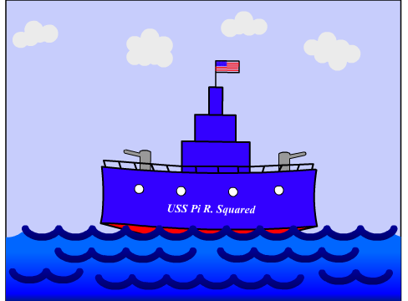
Story
Directions
The Ultimate PowerPoint Game
Hidden Game Board
Visible Game Board
Let’s Play
Preparation
Copyright Notice
A Homemade PowerPoint Game
by
Sarah Grabowski
University of Georgia
Credits

Slide 2
Report to Your Battle Stations…
It was a quiet day on the USS Pi R. Squared. The water was calm and the sky was blue. All of a sudden a fire was heard from the not so far distance. Instantly, the Captain’s voice came over the loudspeaker.
  “Red alert! All hands on deck! Everyone report to their battle stations. We are under attack! I repeat, everyone report to their battle stations.”
Home Page
Story: 1 of 1

Slide 3

BattleGraph Directions
Each team will hide their 4 battleships in their HIDDEN Mathematical Ocean by writing the correct number of points for each battleship with its corresponding letter
All ships must be either horizontal or vertical
Ships may not overlap
Draw a rectangle around the correct number of points for each battleship
Home Page
Directions: 1 of 5

Slide 4
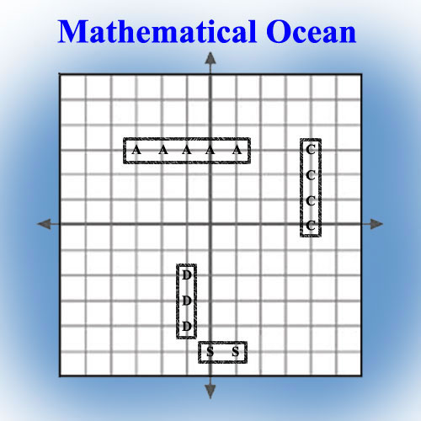
BattleGraph Example
Keep this board HIDDEN
from the other team!
This is the INSIDE board.
Home Page
Directions: 2 of 5

Slide 5
ATTACKERS & DEFENDERS
Teams will take turns being the ATTACKERS and the DEFENDERS
The ATTACKERS will select a place to attack by giving an ordered pair of numbers to the DEFENDERS
The ATTACKERS will then write the ordered pair in the box to the side and circle that point on their VISIBLE Mathematical Ocean
The DEFENDERS will find the coordinate on their HIDDEN Mathematical Ocean and circle it
The DEFENDERS will say if the attack was a HIT (ATTACKERS fill-in circle) or a MISS (ATTACKERS leave circle empty)
Teams will then switch roles
Home Page
Directions: 3 of 5

Slide 6
Winning BattleGraph
If the coordinate is not written in the box on the side, the attack is automatically a MISS
If the coordinate is not in the Mathematical Ocean, the attack is automatically a MISS
If the ATTACKERS sink one of your battleships, you must tell tell them. Otherwise you will LOSE one turn.
The ATTACKERS will connect the points once the entire ship is SUNK.
To WIN the game you must sink all of the the other team’s battleships before they sink all of yours
Home Page
Directions: 4 of 5

Slide 7
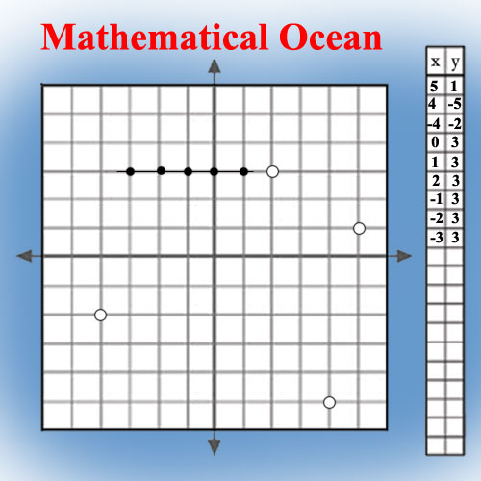
BattleGraph Example
Keep this board VISIBLE!
This is the OUTSIDE board.
Use this board to ATTACK.
Home Page
Directions: 5 of 5

Slide 8
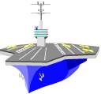



Get Ready to
Hide Your Battleships
Aircraft Carrier
(5 A points)
Cruiser
(4 C points)
Destroyer
(3 D points)
Submarine
(2 S points)
on the HIDDEN Mathematical Ocean
Home Page
Let’s Play: 1 of 1

Slide 9
Teacher Preparation
Welcome…
…and thanks for choosing BattleGraph as a way to teach your students about graphing on a coordinate plane. I hope that you will enjoy using this lesson as much as I have.
If necessary, feel free to change anything to better accommodate your classroom environment or teaching style. Be sure to follow the copyright instructions on slide 16 and then give yourself credit on slides 1 & 17.
The next few slides are designed to help you, the teacher, implement this lesson.
Have fun!
Home Page
Preparation: 1 of 7

Slide 10
Educational Objectives
Audience
  Pre-Algebra and Algebra students
Mathematical Objectives
  Students will be able to graph points on a coordinate plane
  Students will be able to read points from a coordinate plane
  Students will be able to explain terminology associated with graphing on a coordinate plane
Home Page
Preparation: 2 of 7

Slide 11
BattleGraph Materials
To successfully implement this lesson, the following must be prepared prior to class:
PowerPoint Slides
  Slides 1 – 8 are designed to be used during this lesson
  Be familiar with these slides and the directions that go with them
  Teacher instructions for slides 1 – 8 are located in slides 12 – 15
Game Boards
  Print out slide 18, the HIDDEN Mathematical Ocean
  Print out slide 19, the VISIBLE Mathematical Ocean on the back of slide 18
  Fold the paper in half, so that slide 18 is hidden inside and slide 19 is directly on top of slide 18 but outside
  Each student will need a game board that includes slides 18 and 19
Home Page
Preparation: 3 of 7

Slide 12
Teacher Preparation
Title Page SLIDE 1
  During this slide, put students into groups of 2
  Pass out game boards – one to each student
  Each student will also need a writing utensil
The Story SLIDE 2
  This slide creates the atmosphere for the game
  Allow students time to read the story or have a volunteer read the story to the class
Home Page
Preparation: 4 of 7

Slide 13
Teacher Preparation
Student Directions SLIDE 3
  This slide explains to the students how to set up their HIDDEN game board and how to hide their battleships
  Each student will hide 4 battleships (1 Aircraft Carrier, 1 Cruiser, 1 Destroyer, and 1 Submarine)
  Students will use the first letter of the battleship’s name to denote its location and then draw a rectangle around the entire battleship
HIDDEN Mathematical Ocean Example SLIDE 4
  This slide is an example of a completed HIDDEN Mathematical Ocean
  Point out the correct placement and notation of the battleships
Home Page
Preparation: 5 of 7

Slide 14
Teacher Preparation
ATTACKERS & DEFENDERS SLIDE 5
  This slide explains to the students how the game is played
  Be sure that students understand the rules before game play
Winning BattleGraph SLIDE 6
  This slide explains to the students the penalties of not following the instructions
  This slide also explains how the game is won
VISIBLE Mathematical Ocean Example SLIDE 7
  This slide is an example of a completed VISIBLE Mathematical Ocean
  Point out the correct placement of ordered pairs in the box to the side
  Point out the difference between empty and filled-in circles
  Remind students to connect the points once the entire ship has been HIT
Home Page
Preparation: 6 of 7

Slide 15
Teacher Preparation
Hide Your Battleships SLIDE 8
  This slide is for when the game actually starts
  Remind students they each must hide 4 battleships on their HIDDEN Mathematical Ocean:
    1 Aircraft Carrier (5 A’s)
    1 Cruiser (4 C’s)
    1 Destroyer (3 D’s)
    1 Submarine (2 S’s)
  Tell students the player whose first name comes first in the alphabet will ATTACK first in each group
  Game can be played again, but NEW game boards for each student will be needed
Home Page
Preparation: 7 of 7

Slide 16
Copyright Notice
Copyright 2003 Sarah Grabowski
Permission to copy this game at no cost is granted to all teachers and students of non-profit schools.
Permission is also granted to all teachers and students of non-profit schools to make revisions to this game for their own purposes, on the condition that this copyright page and the credits page remain part of the game. Teachers and students who adapt the game should add their names and affiliations to the credits page without deleting any names already there.
Home Page
Copyright: 1 of 1

Slide 17
Credits
All teachers and students at non-profit schools can use, revise, or adapt this game at will at no cost on the condition that all prior designers are cited.
Originally designed by Sarah Grabowski, University of Georgia, July 9, 2003 with the title “BattleGraph”.
Home Page
Credits: 1 of 1

Slide 18
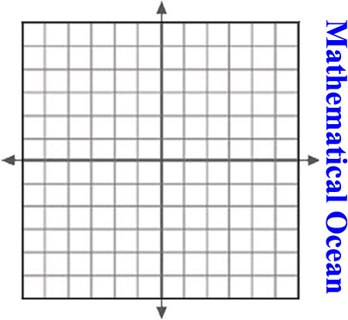
Battleships
  1 Aircraft Carrier
  (AAAAA)
  1 Cruiser
  (CCCC)
  1 Destroyer
  (DDD)
  1 Submarine
  (SS)
Use this board to HIDE your battleships.
Keep this board HIDDEN
from the other team!
This is the INSIDE board.
Home Page

Slide 19
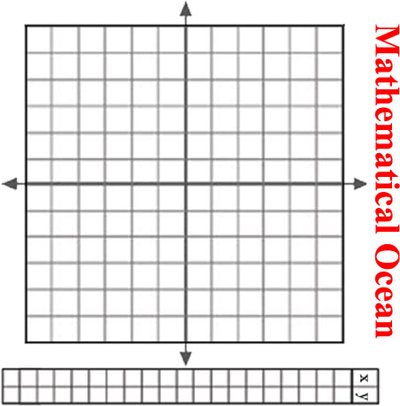
Use this board to ATTACK.
Keep this board VISIBLE!
This is the OUTSIDE board.
Home Page

