Slide 1
The Capitol
Districts
Random
Characters
Disasters & more
1
6
11
21
16
7
12
17
22
2
3
8
13
18
23
4
9
14
19
24
5
10
15
20
25

Slide 2
THE QUESTION IS…….
What nickname is given to Katniss after her debut in the opening ceremony?

Slide 3
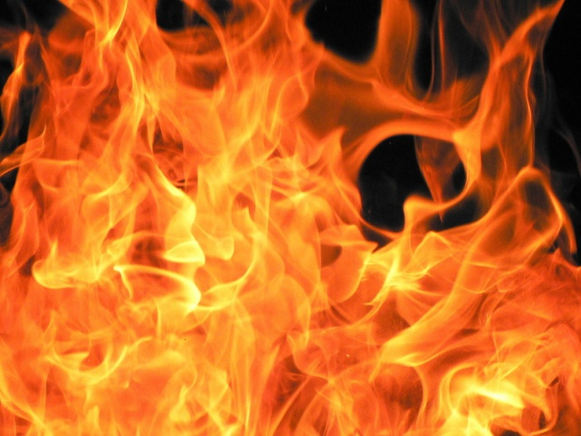
THE ANSWER IS……………….
Girl on Fire

Slide 4
THE QUESTION IS…….
How did Foxface die?

Slide 5

THE ANSWER IS……………….
She ate poison berries.

Slide 6
THE QUESTION IS…….
What is Prim’s goat’s name?

Slide 7

THE ANSWER IS……………….
Lady

Slide 8
THE QUESTION IS…….
How did Katniss’s father die?

Slide 9

THE ANSWER IS……………….
In a coal mining accident.

Slide 10
THE QUESTION IS…….
Who’s place did Katniss take at the reaping?

Slide 11

THE ANSWER IS……………….
Prim

Slide 12
THE QUESTION IS…….
Who is the President of Panem?

Slide 13

THE ANSWER IS……………….
President Snow

Slide 14
THE QUESTION IS…….
Who is Katniss’s head stylist?

Slide 15
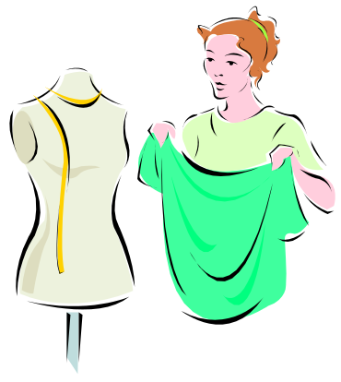
THE ANSWER IS……………….
Cinna

Slide 16
THE QUESTION IS…….
What are the names of Katniss’s other stylists?

Slide 17

THE ANSWER IS……………….
Octavia, Flavius & Venia

Slide 18
THE QUESTION IS…….
What is President Snow’s calling card?

Slide 19

THE ANSWER IS……………….
A white rose.

Slide 20
THE QUESTION IS…….
What is the name of the mentor provided to Katniss & Peeta?

Slide 21

THE ANSWER IS……………….
Haymitch

Slide 22
THE QUESTION IS…….
What district is Peeta & Katniss from?

Slide 23
THE ANSWER IS……………….
District 12

Slide 24
THE QUESTION IS…….
What District is Glimmer from?

Slide 25
THE ANSWER IS……………….
District 1

Slide 26

THE QUESTION IS…….
What District is Foxface from?

Slide 27
THE ANSWER IS……………….
District 5

Slide 28
THE QUESTION IS…….
What is the main export item for District 4?

Slide 29

THE ANSWER IS……………….
Fish!

Slide 30
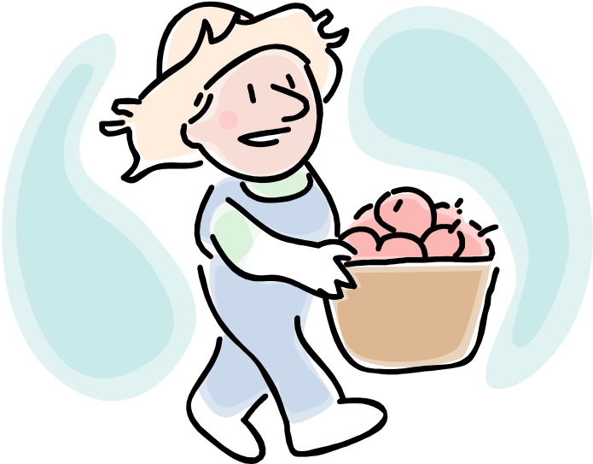
THE QUESTION IS…….
What district produces produce like apples?

Slide 31
THE ANSWER IS……………….
District 11

Slide 32

THE QUESTION IS…….
What is the name of the mutant killer wasps?

Slide 33
THE ANSWER IS……………….
Tracker Jackers

Slide 34
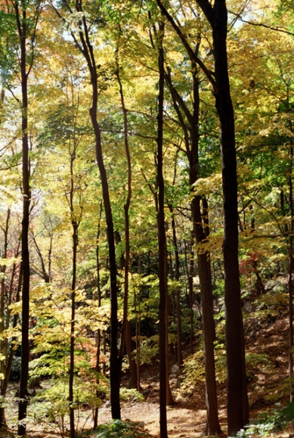
THE QUESTION IS…….
What rained down on Katniss in the forest?

Slide 35

THE ANSWER IS……………….
Giant Fireballs!

Slide 36
THE QUESTION IS…….
Before the Hunger Games, what did Peeta make in the business owned by his parents?

Slide 37

THE ANSWER IS……………….
Cakes

Slide 38
THE QUESTION IS…….
What weapon was Katniss most skilled to use?

Slide 39

THE ANSWER IS……………….
A bow and arrow.

Slide 40

THE QUESTION IS…….
What bird was on Katniss’s pin?

Slide 41
THE ANSWER IS……………….
Mockingjay

Slide 42

THE QUESTION IS…….
What is the name of Katniss’s hunting buddy?

Slide 43
THE ANSWER IS……………….
Gale

Slide 44
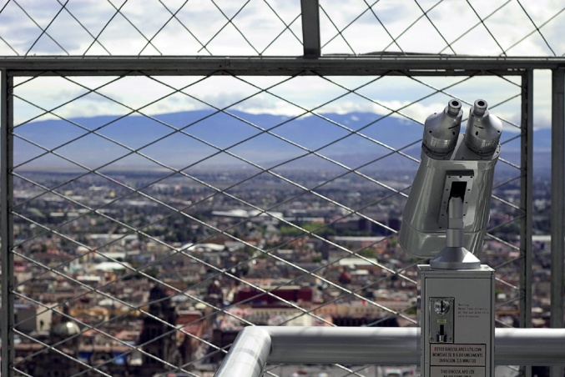
THE QUESTION IS…….
In what section of District 12 does Katniss live?

Slide 45
THE ANSWER IS……………….
The Seam

Slide 46

THE QUESTION IS…….
Why does Katniss not want to have her own children one day?

Slide 47
THE ANSWER IS……………….
She doesn’t want to seem them hurt by The Capitol’s ways.

Slide 48
THE QUESTION IS…….
Katniss thought Rue had a strange resemblance to….

Slide 49
THE ANSWER IS……………….
Prim

Slide 50
THE QUESTION IS…….
Who is the author of The Hunger Games?

Slide 51
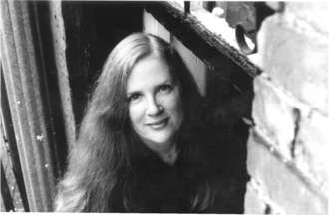
THE ANSWER IS……………….
Suzanne Collins

