Slide 1
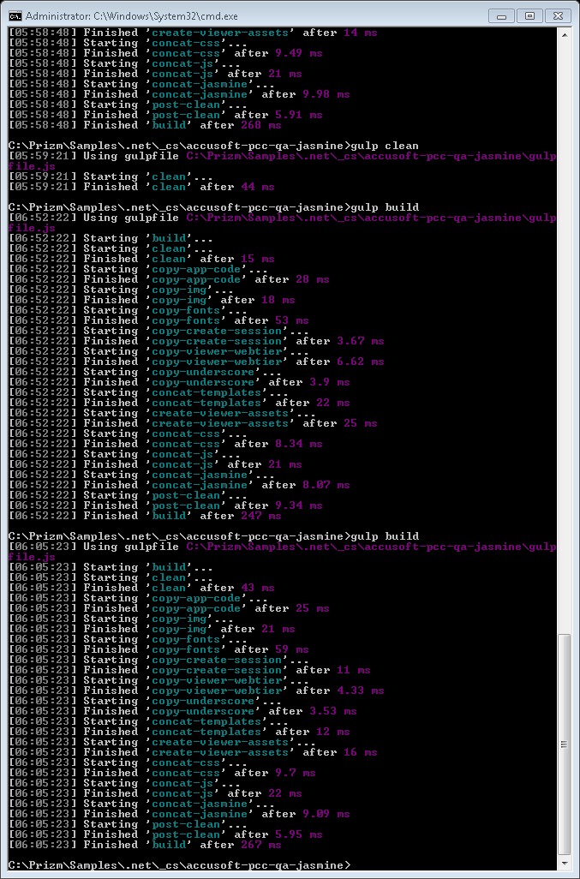
CloudConnect

Slide 2
Machine Relationships
DatabaseByDesign
Internet
Document Server/App
connect.adv
.com (*)
connect2.adv
.com (*)
Client Browser
connect1.adv
.com (*)
Accusoft HQ
GoDaddy
connect.adeptol
.com
Database
Normal
(*) “adv” = “ajaxdocumentviewer”
Failover

Slide 3
Server Functions
Document Server/App
Deliver original document on demand
Manually test encrypted URLs
connect.adv.com
CloudConnect Launcher
connect.adeptol.com
Session decryption
Convert to PNG (mobile)
Convert CAD to swf
(*) CloudConnect Launcher
(*) Convert to swf
connect1.adv.com
Session decryption
Convert all but CAD to swf
Cache files
(*) CloudConnect Launcher
(*) Convert to PNG (mobile)
connect2.adv.com
URL decryption
Session encryption
Database
Licensing
Track cached documents
Logging
(*) Only in failover mode

Slide 4
High-Level Sequence Diagram
Document Server/App
Client Browser
connect.adv
.com
connect2.adv
.com
connect1.adv
.com
connect.adeptol
.com
Provide
source URL
Request
source URL
Encrypt session
Redirect URL
Request URL
Request document
PCC Viewer
Converted
document

Slide 5
Encrypted Source URL Sequence Diagram
Document Server/App
Client Browser
connect.adv
.com
connect2.adv
.com
Optionally test
encrypted source
URL
Provide encrypted
source URL
Request encrypted
source URL
Decrypt source URL
Encrypt session
…

