Slide 1
First page 1

Slide 2
Page #2
Go to page #3 |  |  |  | Last page google

Slide 3
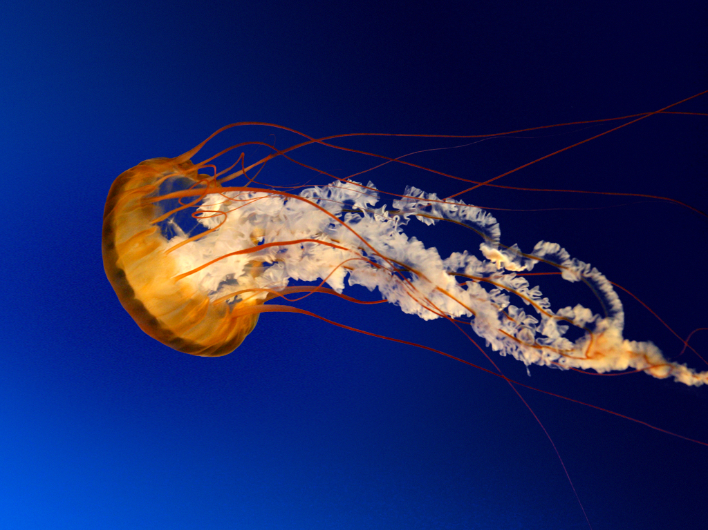
Page #3

Slide 4
Page #4
Go to #2
Go to prev slide
Go to next slide

Slide 5
Last page
Go to first page
Go to first page
Go to first page

