Slide 1
Virginia Regional Market Analysis and Outlook utilizing the Internet as an Interactive Delivery System
MIKE ROBERTS
COMMODITY MARKETING EXTENSION AGENT, VIRGINIA
FARM BUSINESS MANAGEMENT EXTENSION AGENT, SOUTHEAST VIRGINIA
Prince George County Extension Office
P.O. Box 68, 6450 Administration Drive
Prince George, VA 23875
804-733-2686; 804-733-2676 fax; 804-720-1993 cell
mrob@vt.edu

Slide 2
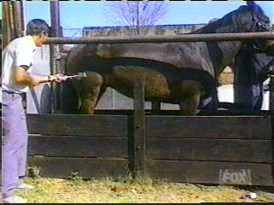
Change is inevitable…..
Except from a vending machine.
Depends upon your perspective whether it’s good or not.

Slide 3
Outline
Project Need
Project Beginnings
Project Summary
Project Steps
Project Funding
Project Results
Project Potential Partners

Slide 4
Project Need
The phasing out of the USDA peanut and tobacco price support programs
Increasing agricultural input costs - especially energy costs
Producers, educators, and agricultural community influencers in Virginia scrambling for ways to increase profits at the farmgate
Disincentivize the growing of more houses by VA, MD, NC, TN, and WV producers

Slide 5
Project Need
Changing extension audiences and delivery tools/methods
  From the very beginning the delivery system was designed to maximize presenter/participant interaction, as well as closely mimic the actual “in-person” presenter experience.
Decreasing number of specialists & field faculty
Expanded role of field extension faculty
  Changing teaching/research & extension requirements
  Increased pressure to raise own programmatic funds
Decreasing land grant budgets:
  Program development & delivery
  Travel dollars
Agricultural Marketing more important now than ever before
  Declining returns
  Increasing costs
  Changing risk management environment (production, management & mktg.)
  Increased importance of risk management education & outlook information
  More diversified agricultural products, marketing avenues, and non-traditional income generators.

Slide 6
Project Beginnings
Patterned after the Southern Region Outlook meeting in Atlanta, GA
Thought it would be a good idea if we could do something similar on a regional basis for extension audiences.
The ‘05/’06 project was a pilot, funded with $1,000.00 from Fm Credit
The Southern Region Risk Management Education Center (SRRMEC) provided $40,000 for ‘06/’07 project & $50,000.00 the ‘07/’08 project.
The ‘06/’07 project is complete; the ’07/’08 project is in the follow up stage; and the ‘08/’09 project full proposal has been submitted.
Project Budgets: Year 1 $1,000.00 / Year 2 $40,000.00 / Year 3 $50,000.00

Slide 7


Project Beginnings
Project funding sponsor:
This material is based upon work supported by USDA/CSREES under Award Number 2004-49200-03123 & 2004-49200-03126
Project Budget

Slide 8
Project Summary
Partners:
  Extension educators from Eleven land grant Universities
  Federal Reserve Bank of Richmond
  Virginia Department of Transportation
  Virginia Farm Bureau
  Virginia Farm Credit &local lending institutions
  Agribusiness input suppliers, and agricultural processors
Engage participants in several comprehensive economic outlook seminars.

Slide 9
Project Summary
Utilized the internet
Advanced interactive video & audio technology tools
Interactive presentations & discussions
Price risk management information
Presentations allowed participants to make sound price risk and marketing decisions or
Share information

Slide 10
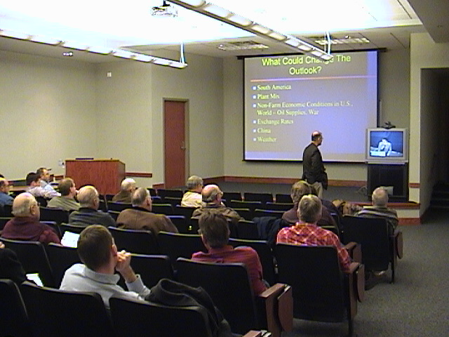
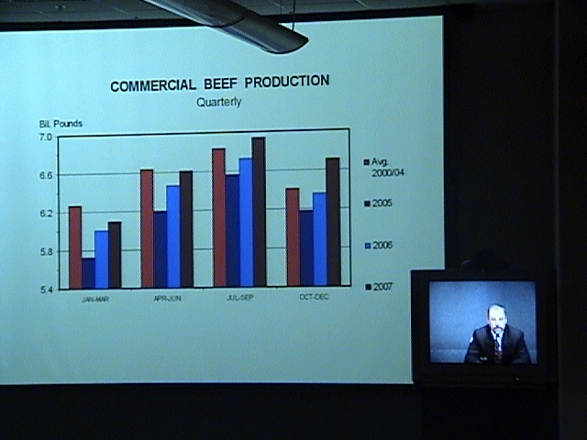
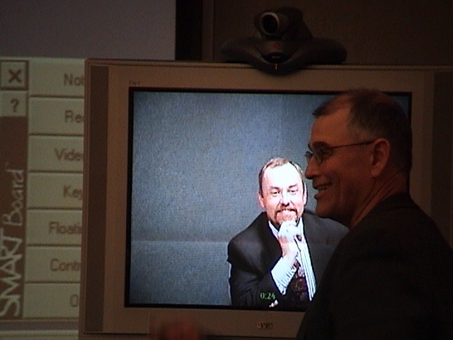
Project Summary

Slide 11
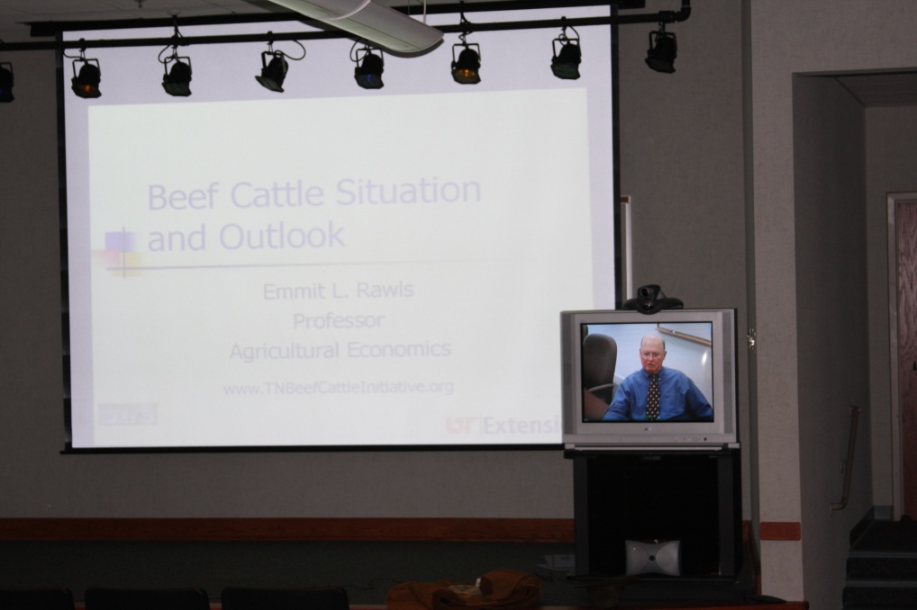
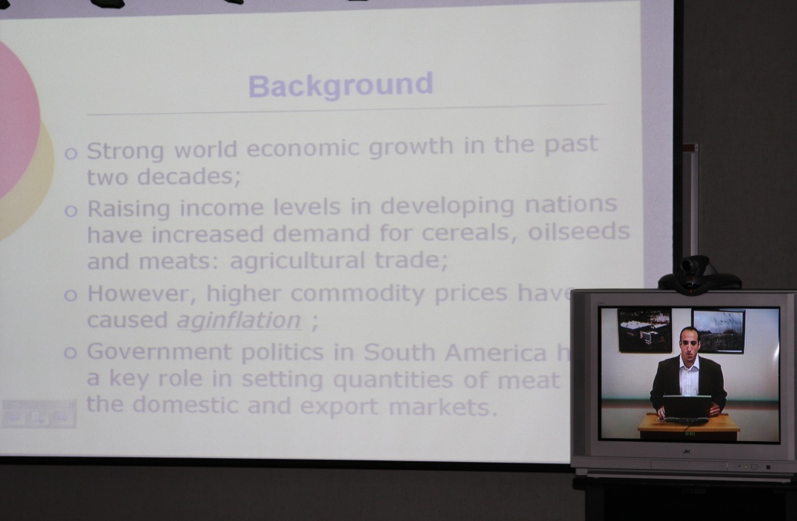
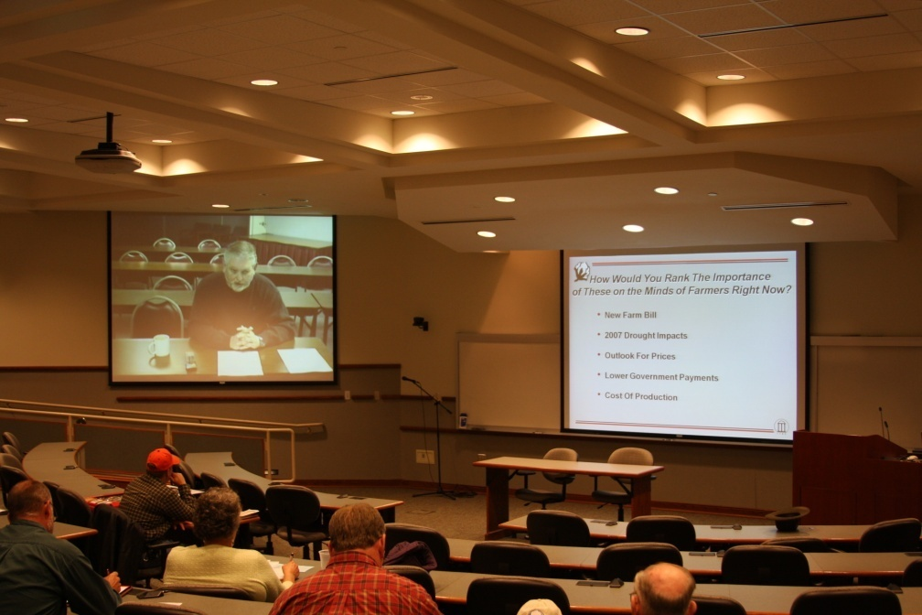
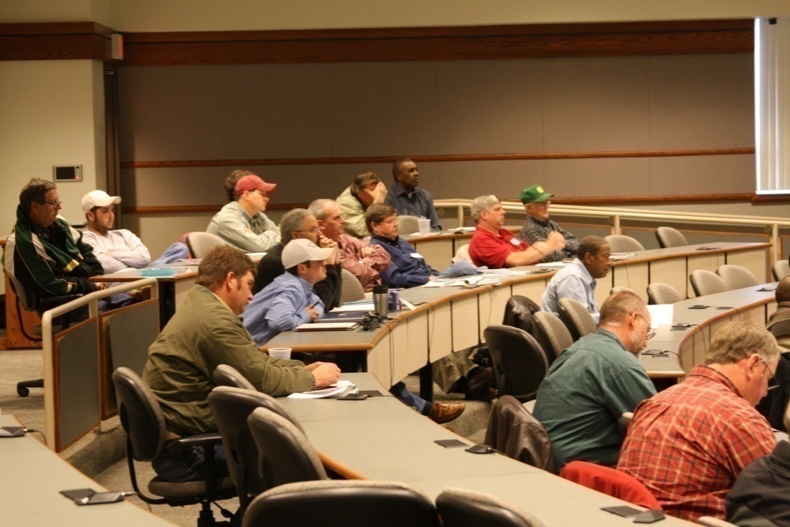
Project Summary

Slide 12
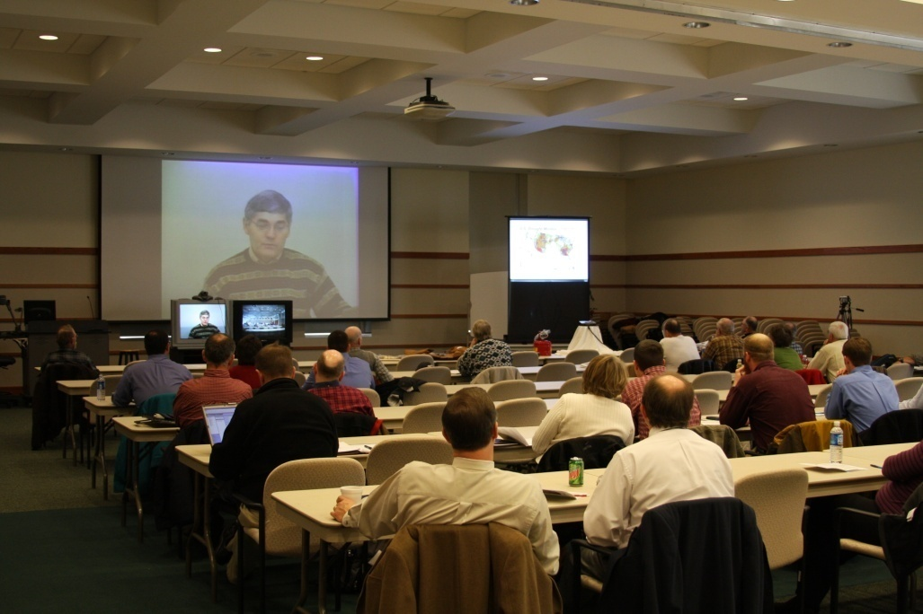
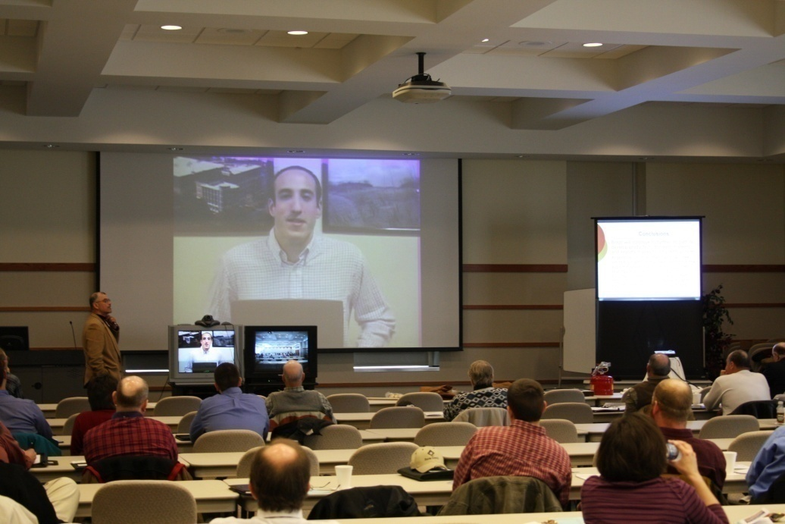
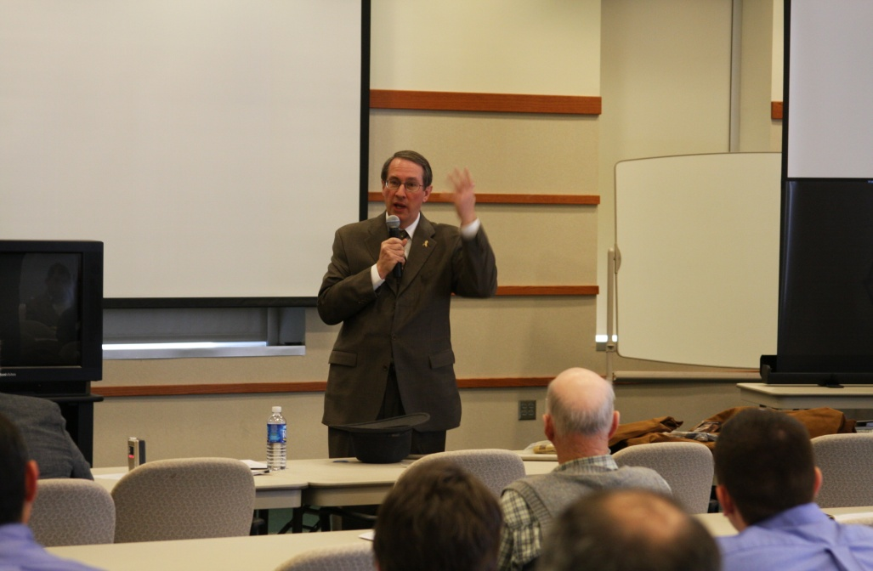
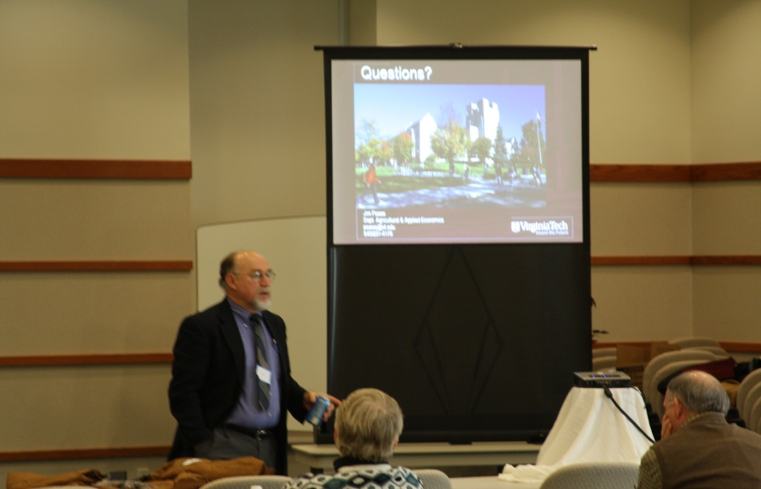
Project Summary

Slide 13
Project Summary
All three Projects used Internet based Polycom or Tandberg Units for program delivery.
The program was developed via survey from pilot project.
Meetings were held during the winter months.
Presenters were recruited all during the summer months.
Seminar sites were identified and reserved early.
IT personnel were trained via conference calls.
A web site was developed to market the seminars, allow web based registration, post presenter bios, and meeting proceedings.
  Walk up registration was accepted as well
Seminar marketing was also done via brochure mailings, news releases and direct phone calls to potential participants.

Slide 14
Project Beginnings
Project Brochure
  Email Brochure / Handout Brochure
Project Agenda:
  Agendas varied slightly
Project Presenters:
  Speaker Biographies

Slide 15
Project Beginnings
Project Website :
  VA Tech in house – Continuing Education
  Marketing
  Registration
  Name Tags & other registration logistics
  Meeting presentations postings
  Pre and Post Seminar Surveying
  Cost @ $10.00/head (estimated registrations) – in this case 300 participants was the goal. Cost = $3,000.00.
  If ‘08/’09 project funded a new website will be developed and hosted by Virginia Tech’s Ag. Econ. Department and different meeting format
  ‘08/’09 no registration cost
  This website will consist of three components: 1) Information section, 2) Outreach segment for pod casts and presentations in adobe presenter, and 3) Feedback section

Slide 16
Project Summary
Participant Targets:
  Multi-State Participants.
    Extension Agents, Producers, Processors, Lenders, Vendors, Decision Makers, and any other Ag. Influencer that could be identified.
Project collaborators :
  Specialists from other land grant institutions
  Govt. Agencies such as VDACS & Federal Reserve
  Farm Bureau & Farm Credit
  Ag. Processors – Cotton Gin, Large Grain dealer
  Brokerages and Exchanges – CME, CBOT, DTN, & AGE

Slide 17
Project Summary
Project Goals:
  Reach participants in four geographic regions of Virginia, as well as localities bordering Virginia.
  Small farmers and lifestyle farmers were especially targeted to attend via mailings, phone calls, and through VSU Small Farmer Program
  Virginia Farm Bureau and Virginia Farm Credit used corporate newsletters to encourage seminar attendance.
  At this time, Distance learning technology (email, website with presentations, and telephone conferencing to local Ext. Units) is being used to reach sequential learners unable to participate in the original meetings.
  Participant goals:
    600 producer, 100 extension educators, and up to 200 community influencers (agricultural suppliers, processors, lenders) would attend meetings.
    Sequential learners +500.

Slide 18
Project Summary
Producer Learning Objectives:
  Understand the current local, regional, and world market outlook for relative commodity group
  Understand where to find more marketing resources
  Be able to anticipate market movement and make profitable decisions
  Learn about the futures market and other risk management tools and how to use them to increase farmgate profits.
Extension Agent Learning Objectives:
  Acquire a broader, up-to-date knowledge of commodity market outlook
  Enable them to pass along information learned in the seminars to non-attending clients
  Gain a broader knowledge of risk management tools and current market strategies

Slide 19
Project Summary
Ag. Influencer Objectives:
  Learn most up-to-date economic and market outlook
  Use that information to maximize customer service to clients
  Be better equipped to help clients maximize profits
  Familiarize them with Outlook project mission, vision, and potential for future projects
  Enlist them as collaborators in order to reach more participants in future project years
Project development Objectives:
  Show that this type of project would leverage already limited human and fiscal extension program delivery resources
  Demonstrate the need for this type of program to the delineated program participants, collaborators, potential funders, and extension administration
  Show that this type of educational program could be developed and expanded in future years with success

Slide 20
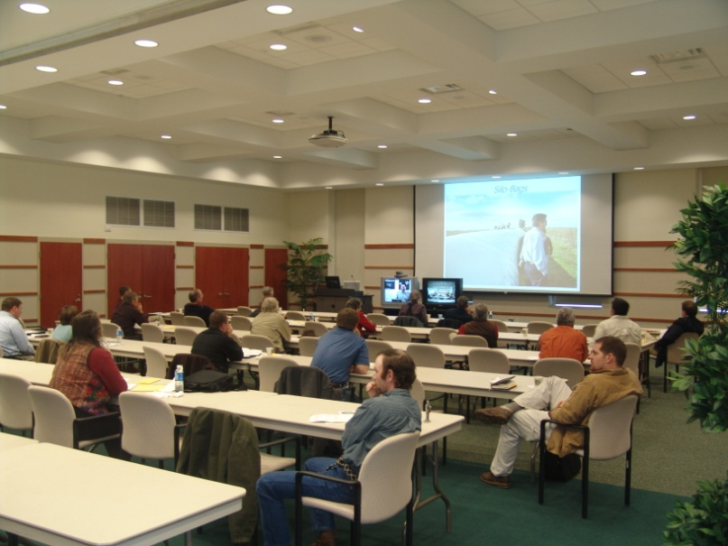
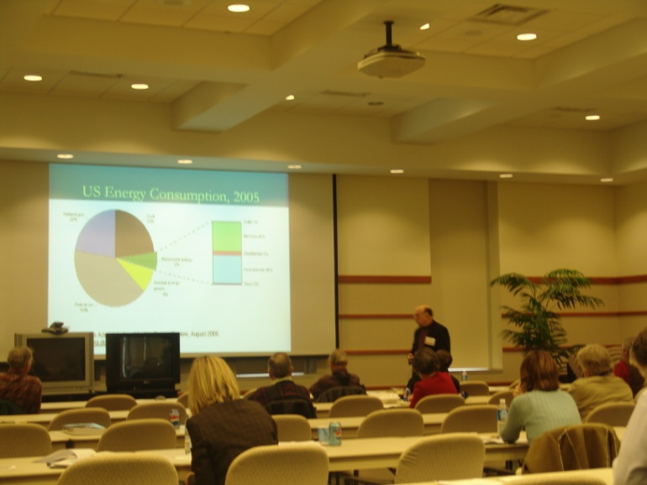
Project Results
Participant Targets:
  All expected groups targeted participated in one or more meetings
    Extension Agents, Producers, Processors, Lenders, Vendors, Decision Makers, and any other Ag. Influencer that could be identified.
    Pilot meeting showed a clear need for a good “on-site/remote” speaker mix.

Slide 21
Project Results
Project collaborators :
  24 Specialists from other land grant institutions have given remote presentations. Some specialists, as well as local extension agents from Virginia Tech gave on-site presentations.
  Federal Reserve of Richmond, VA – The chief economist gave video presentations from Richmond for each meeting utilizing the secure Federal Treasury network and multiple bridge points
  15 local extension agents gave reports
  4 Ag. Industry representative gave a report

Slide 22
Project Results
Project collaborators (cont.):
  Farm Bureau & Farm Credit – promoted events via newsletters & word-of-mouth and sponsored programs with different door prizes
  Ag. Processors – Cotton Gin, Large Grain dealers
    Promoted events somewhat through word-of-mouth
    Attended mostly
    An unexpected outcome was that 100% of the ag. Influencer group verbally stated:
      A) They would promote future meetings, starting earlier and almost requiring clients participation … and
      B) Would financially support next year’s meetings (they liked the door prizes)
  Brokerages and Exchanges – CME, CBOT, DTN, & AGE – provided data & market outlook data and analysis tools

Slide 23
Project Results
Project Goals met:
  Held meetings in four geographic regions of Virginia, reaching all targeted participants
  Small farmers and lifestyle farmers represented about 19% of total participants.
  It was hoped that:
    600 producer participants, 1000 extension educators, and up to 200 community influencers (agricultural suppliers, processors, lenders) would attend meetings.
    The number of sequential learners would be over 500.
  Reached 467 producers, 143 extension educators, 256 agricultural influencers. Processors and lenders represented about 81% of ag. Influencer group.
  1,103 sequential learner (67 did not attend the meetings) consultation contacts have been made to date.
  411 meeting participants have been contacted at least once post meeting.
    Telephone, Letter, Personal visit, VT internet survey tool

Slide 24
Project Results
Producer Learner results (467):
  97% of participants said they had a better-to-much-better understanding of the current local, regional, and world market outlook for their relative commodity group or business interest
  100% said they where better able to find more marketing resources
  81% said they would be better able to anticipate market movement and make profitable decisions
  91% said they gained a better understanding of how to use the futures market and other risk management tools.

Slide 25
Project Results
Producer Learner results (467):
  Follow up survey’s indicate that marketing and management decisions made after the seminars increased farmgate profits an aggregate $1,427,616.50.
    $585,016.00 increased revenue … $842,600.50 reduced input cost
  Note: Several presentations have been downloaded from the official meeting website and there has been no measurement of those impacts.
  Program savings utilizing remote speakers and technology $68,405.00.
“The unique aspect of this part of the program was that the out-of state speakers were not there in person but connected live from their various locations from Mississippi to Missouri. The live feed presented both their image and their presentations and they were able to answer questions from the audience. I was impressed by the use of technology in conducting this seminar –we were able to include experts from different states without the travel and time commitment it would have taken for them to participate in person.” Mark McCann, VCE Director

Slide 26
Project Summary
Extension Agent Learner results (143):
  89% acquired more up-to-date knowledge of commodity market outlook
  76% said they were more comfortable passing along marketing and outlook information learned in the seminars to clients.
  93% said they gained a broader knowledge of risk management tools and current market strategies
  34% said they would help support another project next year via a more active role in advertising and encouraging clientele to attend.
Ag. Influencer results (256):
  97% Learn most up-to-date economic and market outlook
  99% said information presented in seminars would allow them to better serve their clients and help them maximize profits
  100% fully endorsed the current Outlook project and expressed a willingness to participate more pro-actively in future projects
  100% stated they would do everything to enlist producer-participant buy-in short of actually requiring a client to attend in order for them to do business with them! This was totally unexpected!

Slide 27
Project Summary
Project development Outcomes:
  Both the pilot project in ‘05/’06, the fully funded projects in ‘06/’07 & ‘07/’08 have proven that this type of project is easily doable and leverages limited human and fiscal resources for program delivery.
Unexpected Outcomes:
  When one on-site presenter became ill the day before his presentation, this same video conferencing technology was brought to bear in such a way that he was able to make his presentation from his campus office thereby saving the expert presentation for the audience.
  Due to technology difficulties (on the remote end) new technology was found that will enable local county meetings to be held on an ongoing basis.
  Ag. Influencers have become a strong advocate of the project

Slide 28
Project Summary
Project development Objectives:
  Survey and follow-up results show a very clear need and benefit for this type of program not only to the targeted participants but to potential administrative, funding, and future collaborative partners.
  Additionally, surveys indicated in areas where livestock are raised that participants would like a quarterly update using this type of technology. Farm Credit and Farm Bureau have offered to collaborate in doing these quarterly meetings.
  The success of both the expected and the unexpected outcomes of this educational program delivery method clearly show that this type of educational program and delivery method can be exploited for future development and expanded in future years with even more success.
  This kind of technology can be used regardless of program area.

Slide 29
Lessons Learned
Things to do again:
  Mix of on site & remote presenters
  Web site
  Outlook subjects and speakers
  Involve same participant targets
  Organize meetings so participants can come and go for only the parts they are interested in
  Start planning immediately after last meeting
  Get full support of fellow Extension agents

Slide 30
Lessons Learned
Things to do differently:
  Organize SIMULTANEOUS, county meetings
  Involve Ag processors more in getting producer clientele to meetings
  Hold meetings in third to last week of January
  Begin quarterly outlook updates in different regions while expanding the project with other collaborative partners (other extension offices, etc.)
  Seek collaborative funding or resource matching to expand the project for the 2009/2010 year.
  Do not charge for registration so we can ….
  Collaborate with “big draw” speakers, such as political figures at the annual event
  Provide sequential learning and something participants can’t get anywhere else

Slide 31
Virginia Regional Market Analysis and Outlook utilizing the Internet as an Interactive Delivery System
Questions / Comments?
Prince George County Extension Office
P.O. Box 68, 6450 Administration Drive
Prince George, VA 23875
804-733-2686; 804-733-2676 fax; 804-720-1993 cell
mrob@vt.edu
MIKE ROBERTS
COMMODITY MARKETING EXTENSION AGENT, VIRGINIA
FARM BUSINESS MANAGEMENT EXTENSION AGENT, SOUTHEAST VIRGINIA

