Slide 1
Project KickStart
Product Requirements Document
Presenter Name
#/#/200#
Note: this project plan was exported from Project KickStart directly to PowerPoint.
Project KickStart is an easy-to-use project management software for small and medium sized business projects. A Free Trial is available at www.ProjectKickStart.com
Quick Links
(Links are clickable only in slideshow mode, hit F5)
1. Download Free Trial
2. Buy Project KickStart
3. Project KickStart Product Page
4. Project KickStart Tour
5. Project KickStart Templates
6. Contact Project KickStart (800) 678-7008
www.ProjectKickStart.com
Notes:
Quick Links:
1. Download Free Trial, copy and paste URL: http://www.projectkickstart.com/downloads/download_free_trial.cfm?s=ppt_prd
2. Buy Project KickStart, http://projectkickstart.com/sales/index.cfm
3. Project KickStart Product Page, http://projectkickstart.com/products/project_kickstart4.cfm
4. Project KickStart Tour, http://projectkickstart.com/products/PKS_intro.cfm
5. Project KickStart Templates, http://projectkickstart.com/downloads/prxdownload.cfm
6. Contact Project KickStart (800) 678-7008, http://projectkickstart.com/contact/index.cfm

Slide 2
Agenda
Project Phases
Project Schedule
Total Cost
Tasks in Phases
Gantt Chart

Slide 3
Project Phases
Revision History
Approval History
Purpose of this document
Introduction
Purpose and Strategy
Goals - Key Benefits
Positioning
Target Market

Slide 4
Project Phases (Page 2)
Product Overview
Features and Functionality
Competitive Matrix
Constraints and Dependencies
Service Provisioning and Maintenance
Requirements
Future Plans

Slide 5
Project Schedule
Project Start:9/19/2007
Project End:10/11/2007

Slide 6
1. Revision History
Document PRD revisions

Slide 7
2. Approval History
What people will need to approve PRD?
What dates should the approvals be due back on?

Slide 8
3. Purpose of this document
Document the purpose of the Product Requirements Document
Communicate the purpose of the PRD to stakeholders

Slide 9
4. Introduction
Describes nature of product/service release as well as deployment details and communication

Slide 10
5. Purpose and Strategy
Why is the product important?
Who are the target customers for this product/feature?
Are there any schedule requirements with regard to releases?
What is the proposed strategy for the product from a product-marketing standpoint?
What is the proposed implementation strategy: what modules/products will this feature interact with?

Slide 11
6. Goals - Key Benefits
What problem is this product attempting to remedy?
What key benefits will this product bring to any existing product suites?
What functionality will this provide that will address an issue or improve the customer experience?
Include a section if this product/feature is a direct result of customer/user feedback or recommendation.

Slide 12
7. Positioning
This section should describe the product positioning in terms of its competitors and features.

Slide 13
9. Product Overview
Describes what it is, what it does, how it works.

Slide 14
10. Features and Functionality
Describe the features and functionality and associated benefits.

Slide 15
11. Competitive Matrix
The competitive matrix should clearly specify the landscape for this new service/feature.
Consider including competitor functionality matrix.

Slide 16
12. Constraints and Dependencies
This section should detail any known or potential risks such as: resource constraints (Engineering or otherwise) or other implications of implementing feature.

Slide 17
13. Service Provisioning and Maintenance
Describes how the service will be provisioned and maintained.

Slide 18
14. Requirements
Functional Requirements
External Interface Requirements
Performance Requirements
Security Requirements
Usability Requirements
Test Requirements
Billing Requirements
Pricing Requirements

Slide 19
14. Requirements (Page 2)
Reporting Requirements
Distribution and Marketing Requirements
Documentation & Training Requirements
Support Requirements
Installation & Maintenance Requirements
Environmental Requirements

Slide 20
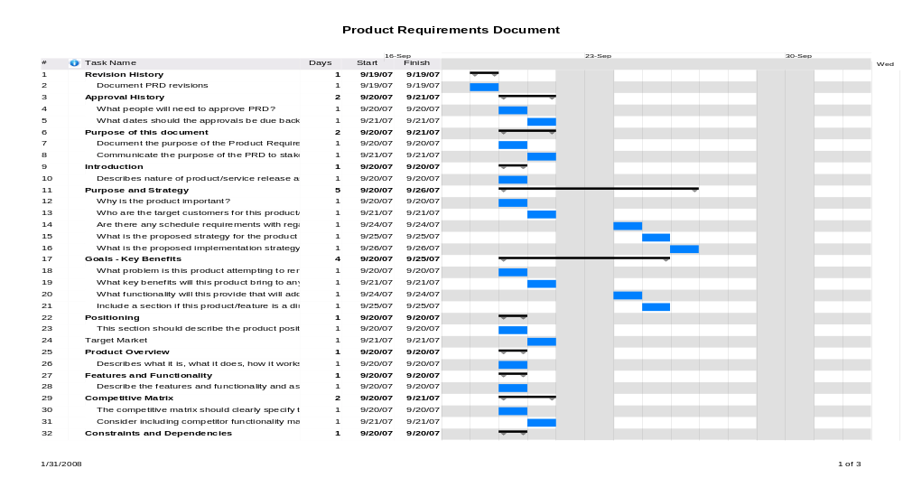
Gantt Chart

Slide 21
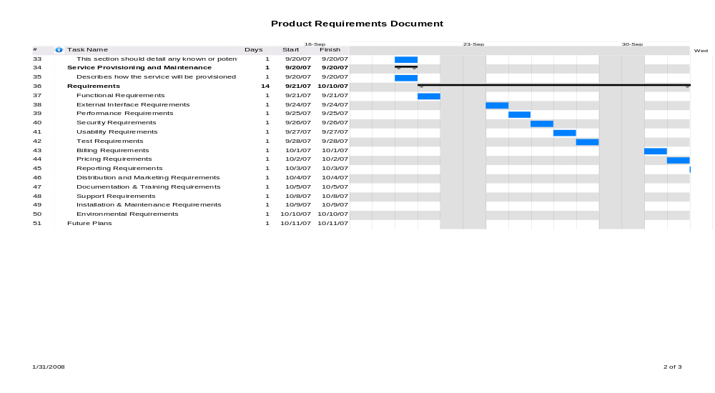
Gantt Chart

Slide 22
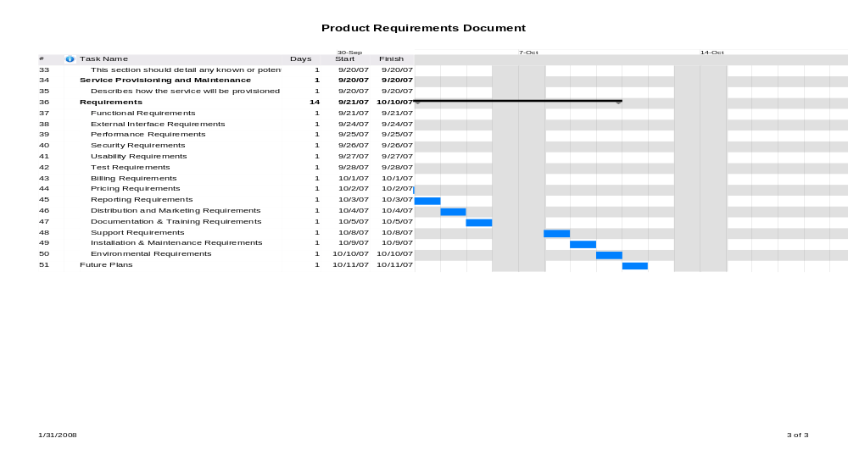
Gantt Chart

Slide 23
Questions?
For additional information on Project KickStart’s
easy-to-use project management software, please visit:
www.ProjectKickStart.com
Sales: (800) 678-7008
Quick Links
(Links are clickable only in slideshow mode, hit F5)
1. Download Free Trial
2. Buy Project KickStart
3. Project KickStart Product Page
4. Project KickStart Tour
5. Project KickStart Templates
6. Contact Project KickStart (800) 678-7008
www.ProjectKickStart.com
Notes:
Quick Links:
1. Download Free Trial, copy and paste URL: http://www.projectkickstart.com/downloads/download_free_trial.cfm?s=ppt_prd
2. Buy Project KickStart, http://projectkickstart.com/sales/index.cfm
3. Project KickStart Product Page, http://projectkickstart.com/products/project_kickstart4.cfm
4. Project KickStart Tour, http://projectkickstart.com/products/PKS_intro.cfm
5. Project KickStart Templates, http://projectkickstart.com/downloads/prxdownload.cfm
6. Contact Project KickStart (800) 678-7008, http://projectkickstart.com/contact/index.cfm

