Slide 1
FINANCIAL MARKETS ANALYTICS
Dynamic Asset
Allocation
ARTEM KHOMYTSKYI
University of Milano-Bicocca
Variant B
Prof. G. Forte
14 July 2026
Classical Markowitz · Michaud Resampling
Ledoit-Wolf · Hierarchical Risk Parity
ORAL PRESENTATION
Financial Markets Analytics | Variant B — Dynamic Asset Allocation
01
Notes:
Good morning. I am Artem Khomytskyi, and this is my Financial Markets Analytics project for Variant B: Dynamic Asset Allocation. The presentation compares classical Markowitz optimization, Ledoit-Wolf covariance shrinkage, Michaud resampling, and Hierarchical Risk Parity. The purpose today is not to repeat the written report. I will focus on the design choices behind the experiment, how the walk-forward backtest avoids look-ahead bias, and what the realized results mean economically. The core message is that sophisticated methods can add value, but only when the estimation problem, constraints, transaction costs, and evaluation period are handled consistently.

Slide 2
RESEARCH QUESTION
Can sophistication beat simple allocation rules?
Do optimized portfolios improve realized risk-adjusted performance after estimation error, turnover, and costs?
01
02
03
Performance
Robustness
Implementability
Return · volatility
Sharpe · drawdown
Sampling error
Covariance stability
Concentration · turnover
Transaction costs
Benchmarks matter: added complexity must earn its place out of sample.
Financial Markets Analytics | Variant B — Dynamic Asset Allocation
02
Notes:
The research question is deliberately practical: can an optimized multi-asset allocation outperform simple rules out of sample after implementation frictions? Dynamic allocation is relevant because expected returns, volatilities, and correlations change through time. But optimization can also magnify estimation error, so complexity is not automatically an advantage. I evaluate three dimensions. First, realized performance: return, volatility, Sharpe, and drawdown. Second, robustness: sensitivity to covariance estimation and resampling. Third, implementability: concentration, turnover, constraints, and transaction costs. Equal Weight and 60/40 provide transparent reference portfolios that require no forecasts, making it possible to judge whether added complexity is justified.

Slide 3
INVESTMENT UNIVERSE
23 ETFs preserve crisis history without backfilling
CORE UNIVERSE
WHY ETFs?
23
liquid, diversified market exposures
Broad exposure without stock-selection noise
Transparent economic roles across asset classes
9
5
3
3
2
Tradable instruments with interpretable weights
Equities 9
Commodities 3
Government bonds 5
Real estate 2
WHY 23?
Credit 3
Cash 1
Retain the 2008 crisis while excluding four late-inception ETFs:
IGOV · VGSH · VNQI · BKLN
Same assets for every final strategy
Financial Markets Analytics | Variant B — Dynamic Asset Allocation
03
Notes:
The core universe contains 23 ETFs across six economic sleeves. ETFs are preferable to individual securities because they provide diversified, liquid, and interpretable market exposures without turning the project into a stock-selection exercise. Nine equity ETFs cover size and geography. Five government-bond ETFs provide duration and inflation sensitivity. Credit, commodities, real estate, and cash add distinct risk drivers. The configured universe originally contained 27 ETFs, but four late-inception funds—IGOV, VGSH, VNQI, and BKLN—were excluded from the core panel. That choice preserves the 2008 crisis while maintaining a complete cross-section. No pre-inception prices were manufactured, and every strategy uses the same 23 assets.

Slide 4
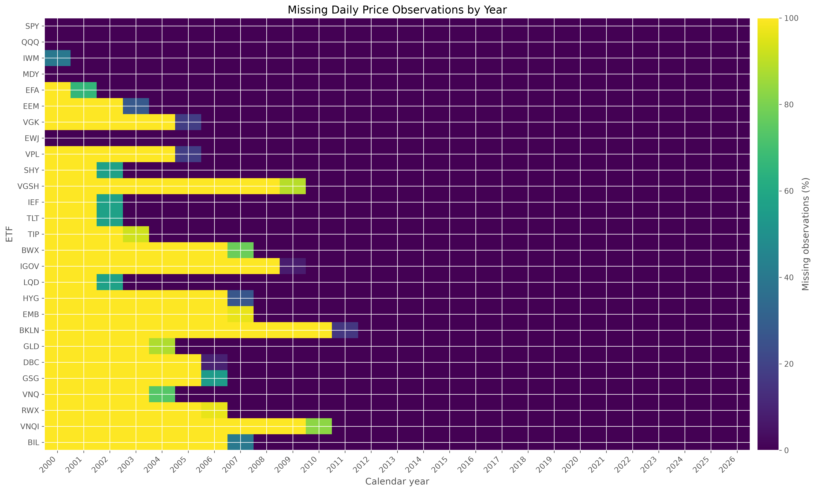
DATA AND CLEANING
Structural missingness defines the analytical sample
DATA
Yahoo Finance adjusted ETF prices
Daily observations → month-end prices
January 2008 → May 2026 core panel
CLEANING RULE
No interpolation
No backfilling
No synthetic prices
Missing blocks are pre-inception history—not zero returns.
Source: outputs/figures/missing_values_heatmap.png
Financial Markets Analytics | Variant B — Dynamic Asset Allocation
04
Notes:
Prices come from Yahoo Finance through yfinance and use adjusted ETF histories, so distributions and corporate actions are reflected in the price series. The raw daily observations were resampled to calendar month-end. Before calculating returns, I inspected inception dates, observation counts, annual missingness, and the availability matrix shown here. The missing values form clear pre-inception blocks rather than intermittent gaps. This matters because backfilling those blocks would create synthetic history and look artificially precise. The clean core panel begins in January 2008 and ends in May 2026; the incomplete June 2026 month is excluded. Yahoo Finance is appropriate for a reproducible academic study, although it is not an institutional total-return database.

Slide 5
METHODOLOGY OVERVIEW
The portfolio is rebuilt using only available information
01
02
03
04
Raw adjusted
prices
Monthly simple
returns
60-month rolling
window
Estimate +
allocate
07
06
05
Next-month
holding period
5 bps
transaction cost
Drift-aware
turnover
Repeat monthly · identical calendar for benchmarks and optimized portfolios
Financial Markets Analytics | Variant B — Dynamic Asset Allocation
05
Notes:
This diagram summarizes the complete walk-forward cycle. Frozen adjusted prices are converted to monthly simple returns. At each decision date, the model takes only the preceding 60 monthly returns. It estimates expected returns and a covariance matrix, applies the chosen allocation rule, measures turnover against drifted holdings, charges five basis points per unit of one-way turnover, and then holds the portfolio for the next realized month. The process repeats monthly. The critical feature is the order: the return earned after the decision never enters the estimation window that produced the weight. Benchmarks and optimized strategies follow the same calendar and cost convention, so differences are attributable to allocation rules rather than timing.

Slide 6
WHY THIS ROLLING WINDOW?
60 months balances stability with adaptability
12
60
120
months
months
months
Too reactive
Chosen balance
Too slow
Noisy means and
correlations
Five years of data
with regime adaptation
Stable estimates,
but stale regimes
← ADAPTABILITY INCREASES
STABILITY INCREASES →
Financial Markets Analytics | Variant B — Dynamic Asset Allocation
06
Notes:
The 60-month window is a bias-variance trade-off. With only 12 monthly observations, mean estimates and correlations are extremely noisy relative to a 23-asset universe; the optimizer would react strongly to transitory movements. A 120-month window offers more statistical stability, but it adapts slowly and blends very different market regimes. Five years supplies enough observations to estimate a reasonably conditioned covariance structure while still allowing the model to respond to changes in volatility and correlation. It is not claimed to be uniquely optimal. It is a transparent, defensible design choice that was fixed before comparing final results, and alternative windows belong in robustness analysis rather than ex-post selection.

Slide 7
CLASSICAL OPTIMIZATION
Constraints make Markowitz implementable
IMPLEMENTATION CONSTRAINTS
THREE OBJECTIVES
Σ weights = 1
Fully invested
Minimum Variance
min wᵀ Σ w
0% ≤ wᵢ ≤ 25%
Long-only + concentration cap
Maximum Sharpe
No leverage
Comparable and investable
max (wᵀμ − rᶠ) / √(wᵀΣw)
Monthly
Matches data frequency
Target Volatility
5 bps
Penalizes unstable turnover
max wᵀμ subject to σ ≤ 10%
Why 25%? Limit estimation-driven concentration without forcing equal weights.
Financial Markets Analytics | Variant B — Dynamic Asset Allocation
07
Notes:
Classical Markowitz optimization combines an objective with explicit implementation constraints. Minimum Variance minimizes portfolio variance. Maximum Sharpe seeks the best estimated excess return per unit of risk. Target Volatility maximizes expected return subject to a ten percent annual volatility ceiling. Every optimized portfolio is fully invested, long-only, and unleveraged, with each ETF capped at 25 percent. The cap prevents a single noisy estimate from producing an economically implausible one-asset solution, while still allowing meaningful active tilts. Monthly rebalancing matches the frequency of the data and avoids false daily precision. Five basis points is a simple one-way trading-cost proxy: modest for liquid ETFs, but sufficient to penalize unstable high-turnover rules.

Slide 8
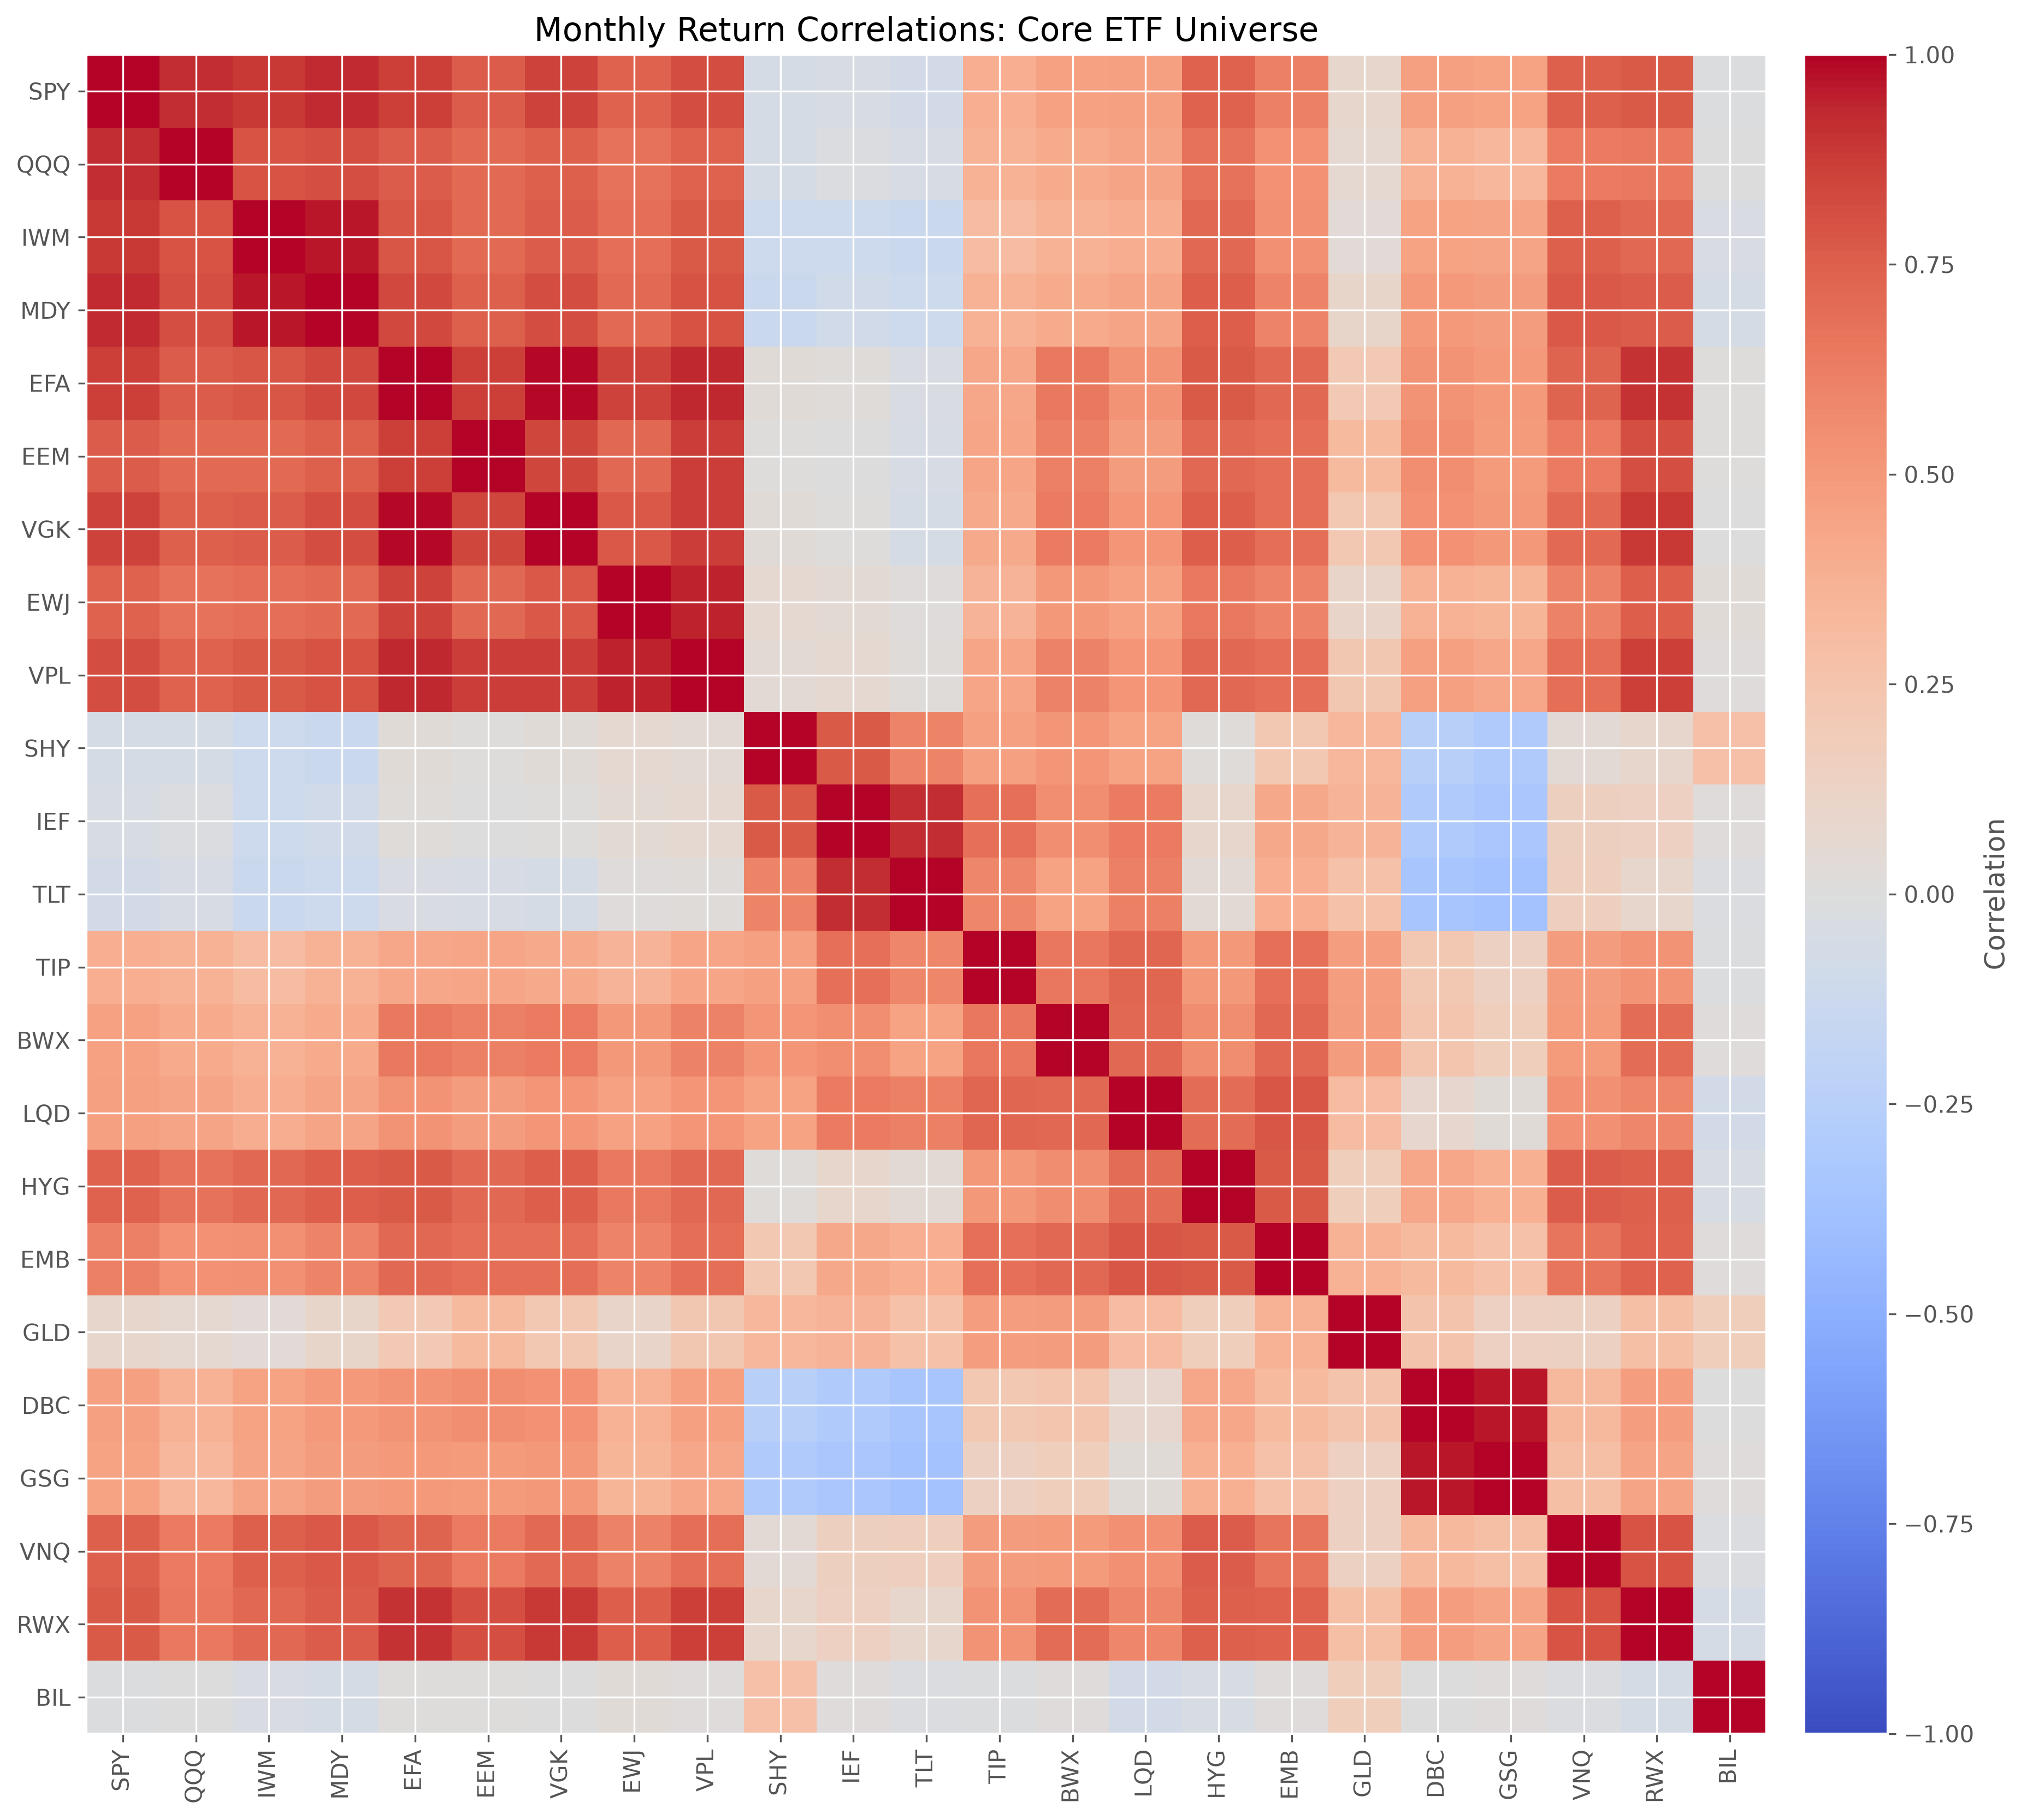
LEDOIT-WOLF COVARIANCE
Shrinkage stabilizes the risk model before optimization
Sample covariance
Direct historical estimate
Noisy off-diagonal terms
Poor conditioning can amplify weight changes
Σᴸᵂ = δF + (1 − δ)S
structured target + sample matrix
Small bias → lower estimation variance → better conditioning
23 assets × 60 observations
Financial Markets Analytics | Variant B — Dynamic Asset Allocation
08
Notes:
The sample covariance matrix is the direct historical estimate, but with 23 assets and only 60 observations it can be noisy and poorly conditioned. Optimization is especially sensitive because small covariance errors can cause large weight changes. Ledoit-Wolf shrinkage addresses this by combining the sample covariance matrix with a structured target. The shrinkage intensity trades a small amount of bias for a larger reduction in estimation variance. Economically, this produces a more stable risk model before any optimization objective is applied. I report both sample and Ledoit-Wolf variants because shrinkage should be tested, not assumed to dominate. In the realized results it improved the strongest Maximum Sharpe specification, although gains were not uniform across every objective.

Slide 9
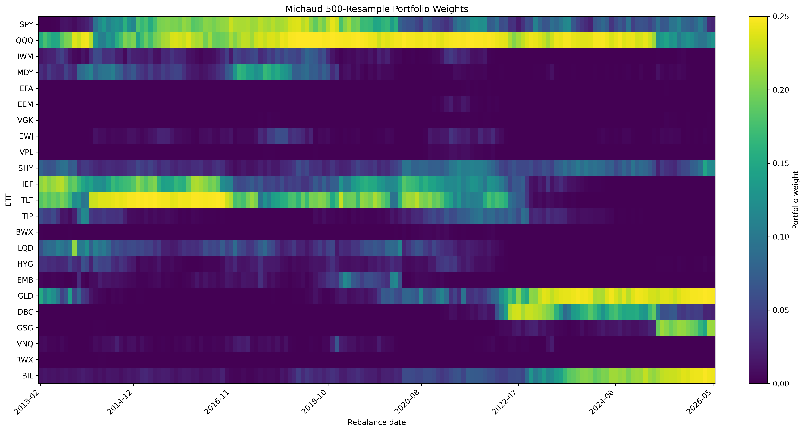
RESAMPLED EFFICIENT FRONTIER
Michaud averages portfolios across plausible inputs
01
02
03
04
Estimate μ and Σ
Simulate M universes
Optimize each
Average weights
AVERAGE THE DECISIONS
w̄ = (1/M) Σₘ wₘ
100 · 250 · 500 nested resamples
Why? Reduce dependence on one noisy efficient-frontier estimate.
Frozen output: Michaud 500 rolling allocation
Financial Markets Analytics | Variant B — Dynamic Asset Allocation
09
Notes:
Michaud resampling targets the instability of a single estimated efficient frontier. At each rebalance, I estimate expected returns and a Ledoit-Wolf covariance matrix from the trailing window. I then simulate many plausible capital-market assumptions, solve the same constrained Maximum Sharpe problem for each simulated universe, and average the resulting portfolio weights. The 100, 250, and 500-resample variants use nested common random draws, so differences primarily reflect convergence rather than unrelated Monte Carlo noise. Averaging portfolios does not eliminate estimation error, and it relies on a multivariate-normal simulation assumption. Its practical benefit is moderation: the final allocation is less dependent on one noisy set of inputs and can reduce concentration or turnover.

Slide 10
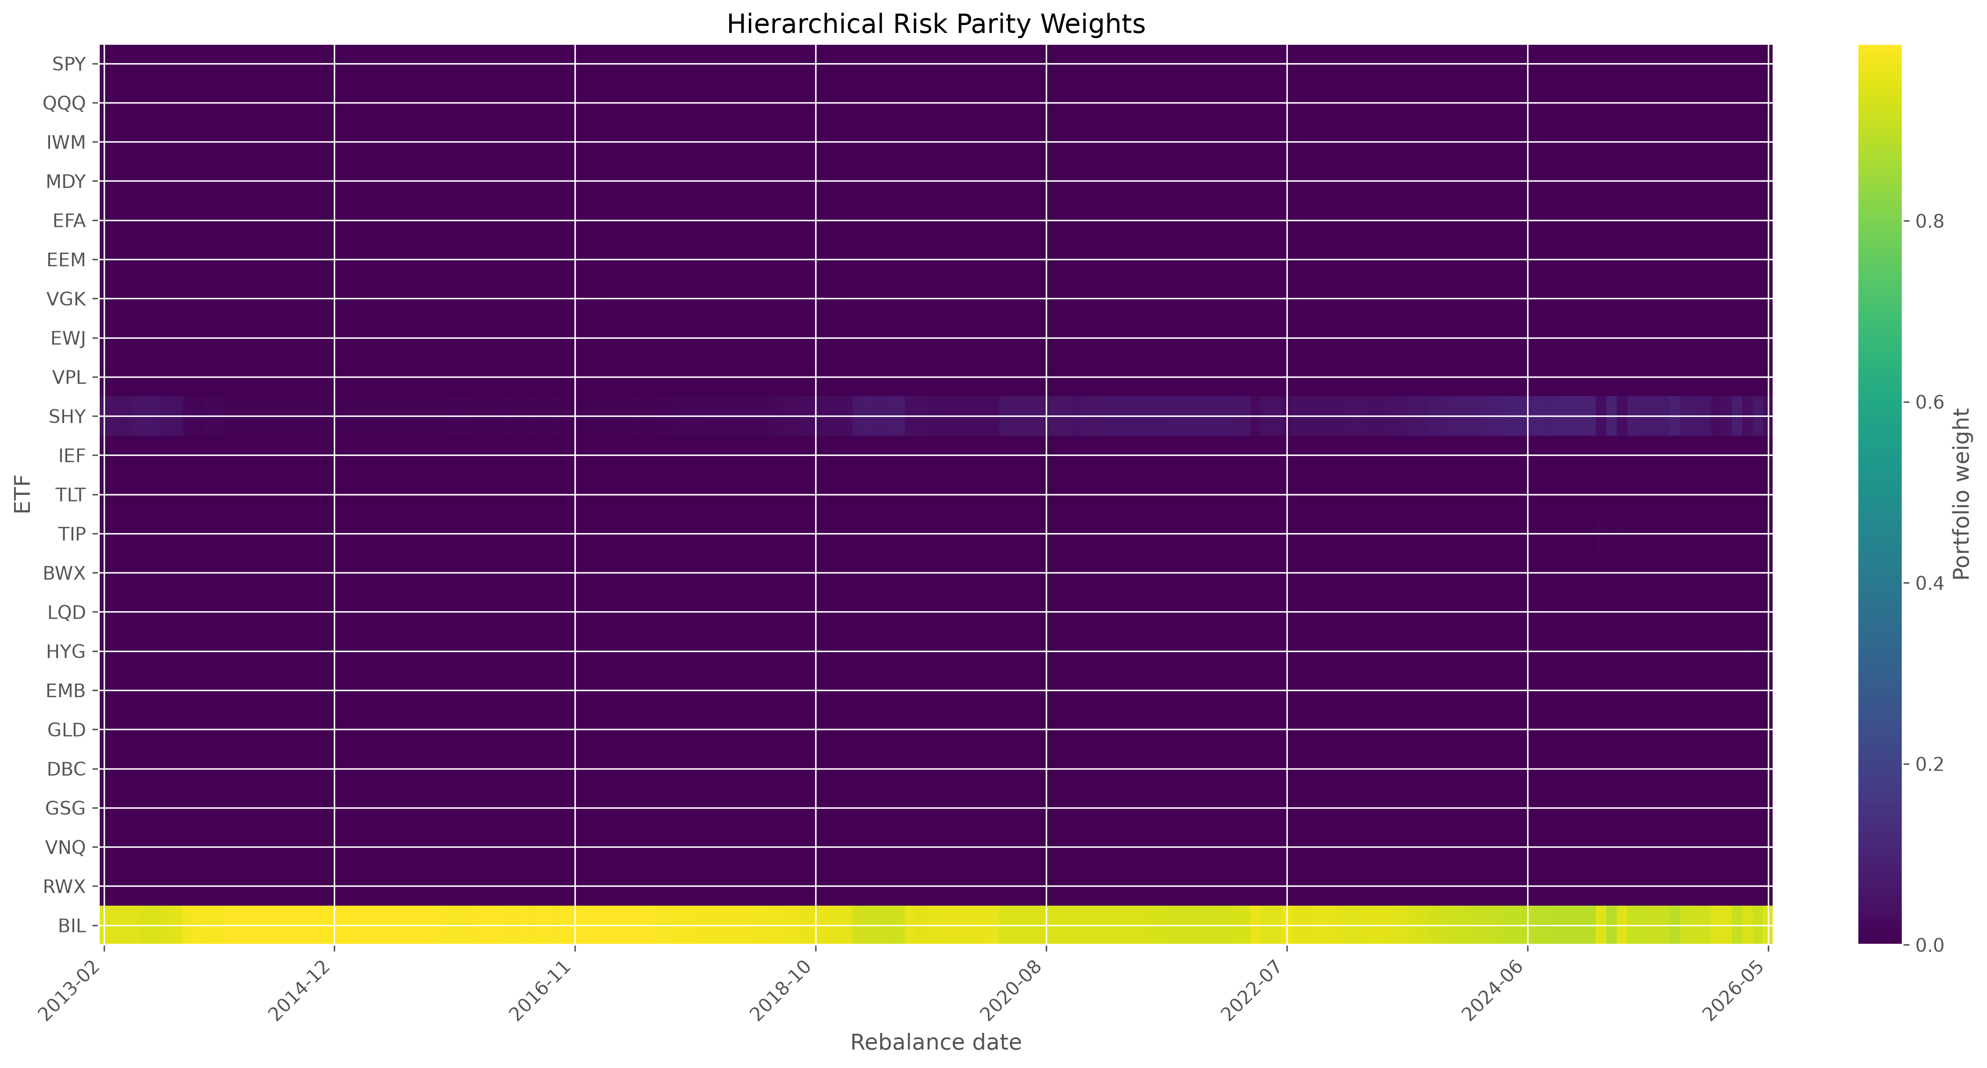
HIERARCHICAL RISK PARITY
HRP removes inversion—but not concentration risk
All ETFs
Growth
Defensive
Real assets
Correlation distance
→ clustering
→ recursive bisection
Frozen HRP weights
Empirical result: near-zero-volatility BIL dominated the unconstrained recursive allocation.
NO COVARIANCE INVERSION
Financial Markets Analytics | Variant B — Dynamic Asset Allocation
10
Notes:
HRP was included as a modern robustness extension. It converts correlations to distances, clusters similar assets, quasi-diagonalizes the hierarchy, and allocates recursively across branches. It therefore avoids direct covariance-matrix inversion and does not require expected-return forecasts. That is attractive when covariance estimates are unstable. However, avoiding inversion does not guarantee diversified capital weights. In this sample, BIL has exceptionally low variance, so unconstrained HRP allocated nearly all capital to the cash-like ETF. The heatmap makes that concentration visible. HRP consequently had very low turnover and drawdown, but weak excess return and the lowest effective diversification. This is an empirical outcome of the cash-inclusive specification, not a coding failure.

Slide 11
WALK-FORWARD BACKTEST
Every reported return is genuinely out of sample
60 monthly observations
historical returns only
t
t+1
t−60
t−1
estimate +
set weights
realized
return
No look-ahead bias
The return earned after the decision never enters its own estimation window.
COMMON FINAL PERIOD
31 Mar 2013
31 May 2026
159 identical months
SAME UNIVERSE · SAME DATES · SAME COSTS
Financial Markets Analytics | Variant B — Dynamic Asset Allocation
11
Notes:
The backtest is strictly walk-forward. For a decision associated with date t, estimates end at t minus one. The new weights are then applied to the following realized month, and transaction costs are deducted using drift-aware turnover. Core monthly returns begin in February 2008. Sixty prior observations first become available for the February 2013 decision, and the conservative implementation lag means the first comparable realized return is March 2013. That is why every final strategy is evaluated from March 2013 through May 2026—159 identical months. Using a common universe, common dates, common cost convention, and common risk-free rate prevents one strategy from gaining an advantage through a more favorable sample.

Slide 12
FINAL RESULTS
No single strategy wins every objective
Strategy
Return
Volatility
Sharpe
Max DD
Turnover
Eff. assets
Equal Weight
6.1%
9.1%
0.476
-19.1%
13.2%
23.00
60/40
7.0%
9.8%
0.540
-23.3%
12.5%
13.89
Min Variance Sample
2.2%
2.8%
0.096
-8.0%
26.1%
4.71
Min Variance Ledoit-Wolf
2.3%
2.9%
0.114
-9.1%
23.5%
5.35
Max Sharpe Sample
9.2%
7.9%
0.909
-20.7%
99.1%
4.50
Max Sharpe Ledoit-Wolf
9.9%
8.5%
0.922
-22.0%
88.1%
4.77
Target Volatility Sample
11.3%
11.5%
0.822
-22.6%
103.9%
4.50
Target Volatility Ledoit-Wolf
11.4%
11.6%
0.818
-22.3%
98.7%
4.52
Michaud 100
9.2%
8.0%
0.903
-20.5%
91.5%
6.23
Michaud 250
9.2%
8.0%
0.899
-20.5%
81.5%
6.24
Michaud 500
9.2%
8.0%
0.900
-20.5%
78.0%
6.25
HRP
1.6%
0.6%
-0.670
-0.3%
7.5%
1.09
BEST SHARPE
HIGHEST RETURN
LOWEST TURNOVER
MOST DIVERSIFIED
Max Sharpe LW 0.922
Target Vol LW 11.38%
HRP 7.49%
Equal Weight 23.00
Financial Markets Analytics | Variant B — Dynamic Asset Allocation
12
Notes:
The full comparison shows that no strategy wins every objective. Maximum Sharpe with Ledoit-Wolf covariance has the best Sharpe ratio at 0.922. Target Volatility with Ledoit-Wolf has the highest annualized geometric return at 11.38 percent and the highest terminal wealth. HRP has the lowest turnover and smallest drawdown, but its 4.66 Calmar ratio is mechanical because the drawdown denominator is extremely small; its Sharpe ratio is negative. Equal Weight has the highest effective number of assets by construction. Among optimized strategies, Michaud 500 is the most diversified. The table therefore supports a multi-dimensional interpretation rather than a single league table.

Slide 13
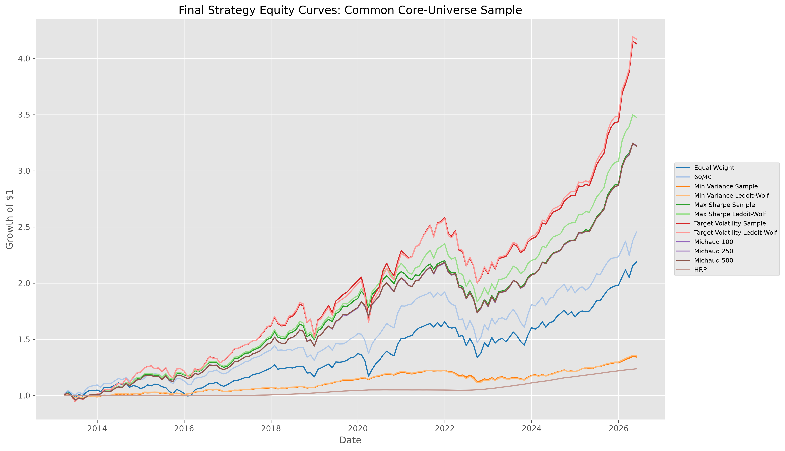
CUMULATIVE PERFORMANCE
Terminal wealth reflects different amounts of risk
READ THE PATH
1
Target Volatility finishes highest by accepting more risk.
2
Maximum Sharpe and Michaud deliver the strongest risk-adjusted middle path.
3
HRP behaves like cash after concentrating in BIL.
Highest wealth ≠ universal best
Source: outputs/figures/final_equity_curves.png
Financial Markets Analytics | Variant B — Dynamic Asset Allocation
13
Notes:
The cumulative-wealth chart shows the main economic trade-off. Target Volatility portfolios finish with the highest wealth because they accept more realized volatility. Maximum Sharpe and Michaud follow a similar middle path and deliver strong risk-adjusted outcomes. Equal Weight and 60/40 are credible benchmarks but do not dominate the optimized leaders. Minimum Variance protects capital by taking little risk, which also limits compounding. HRP behaves almost like cash because of its BIL concentration. The chart is not evidence that the highest terminal line is universally best: an investor must decide how much volatility, turnover, and model dependence are acceptable. This is why the final assessment combines wealth with risk and implementation diagnostics.

Slide 14
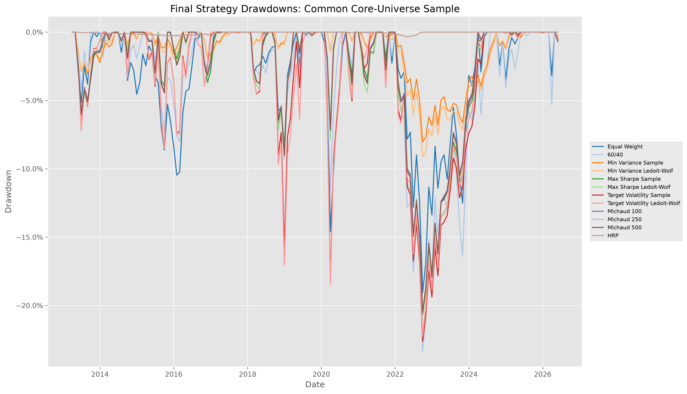
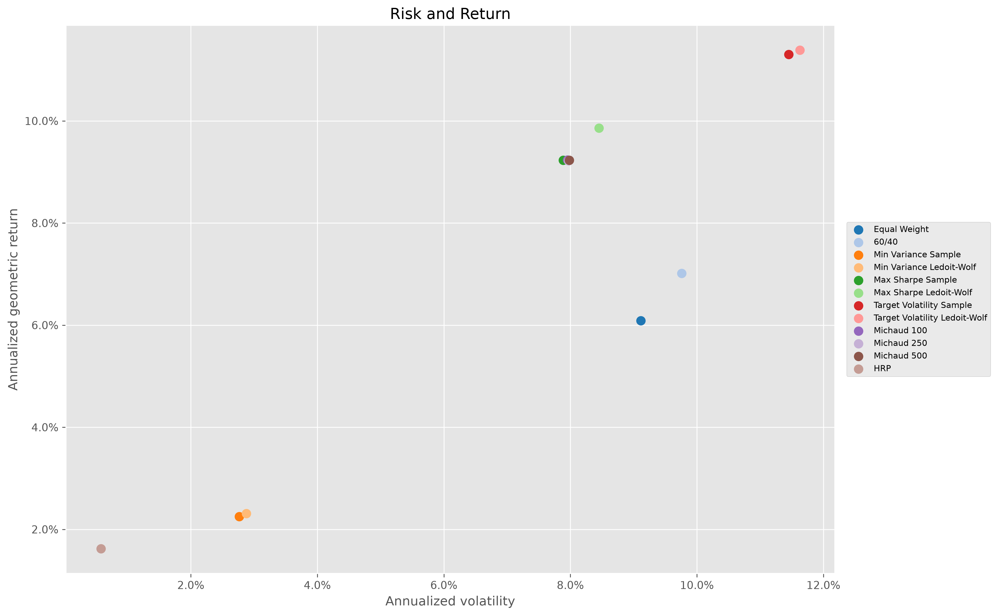
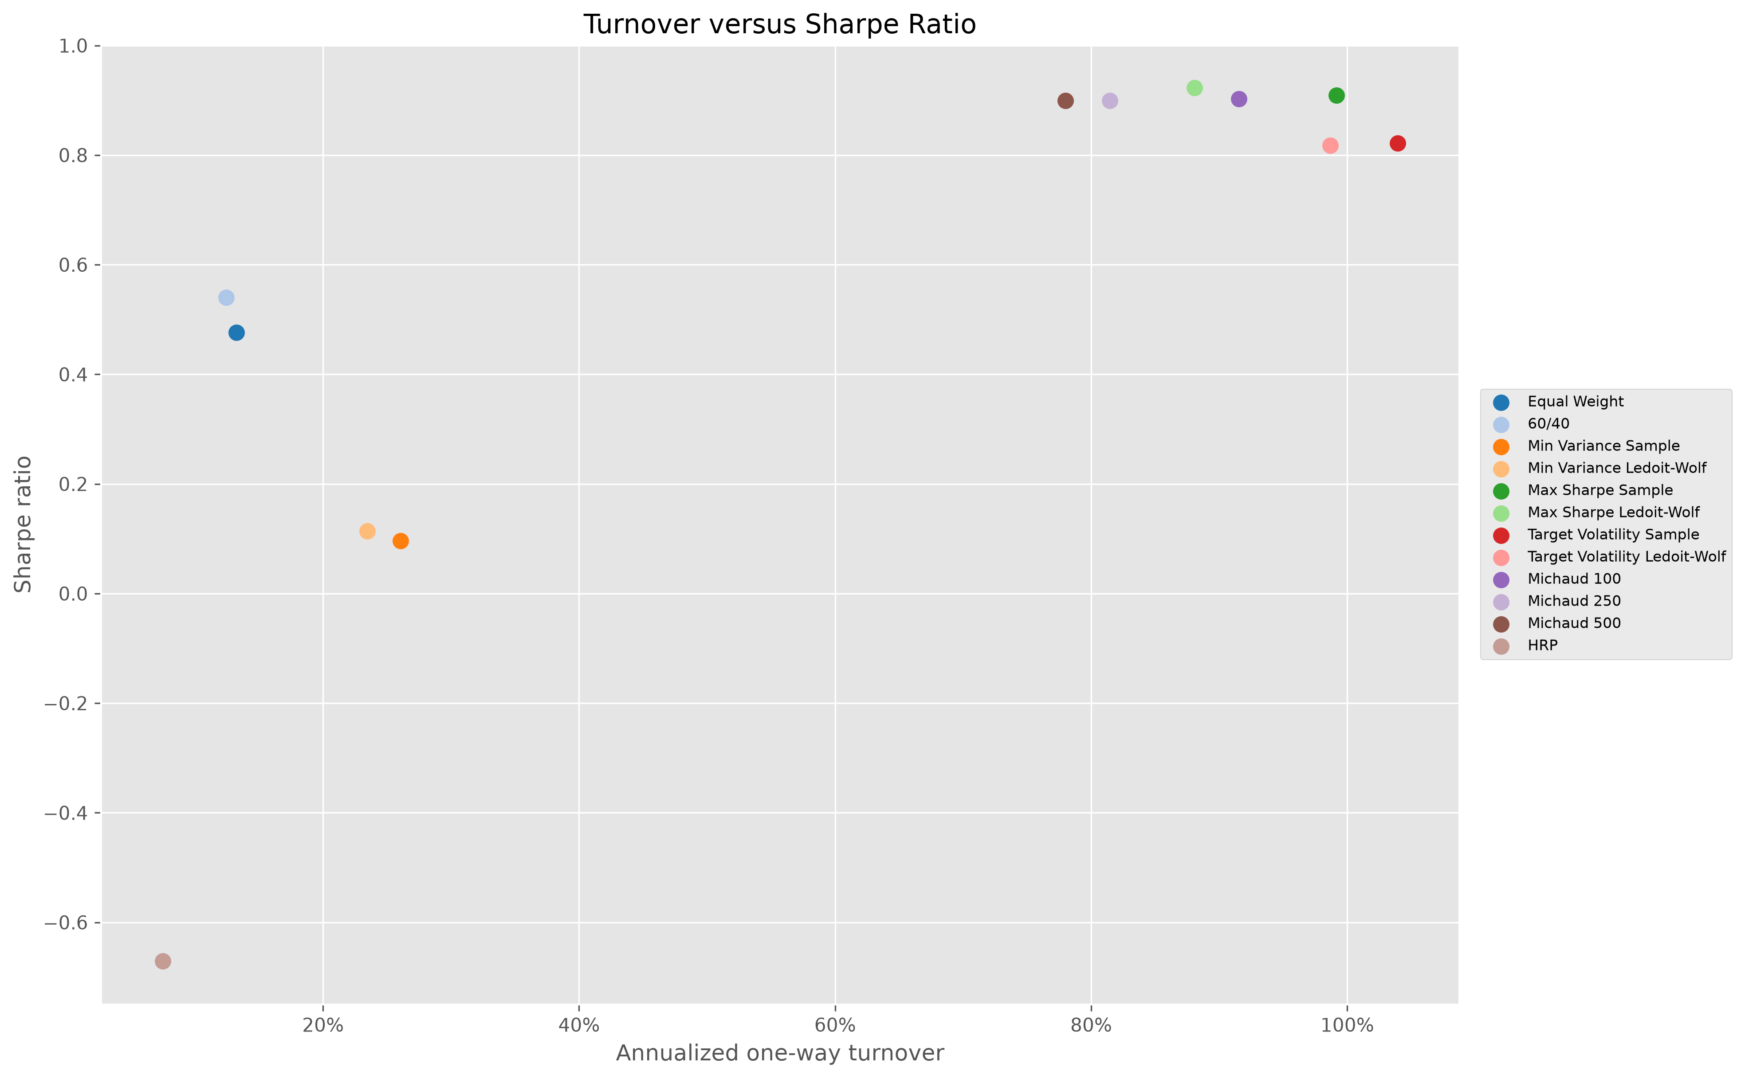
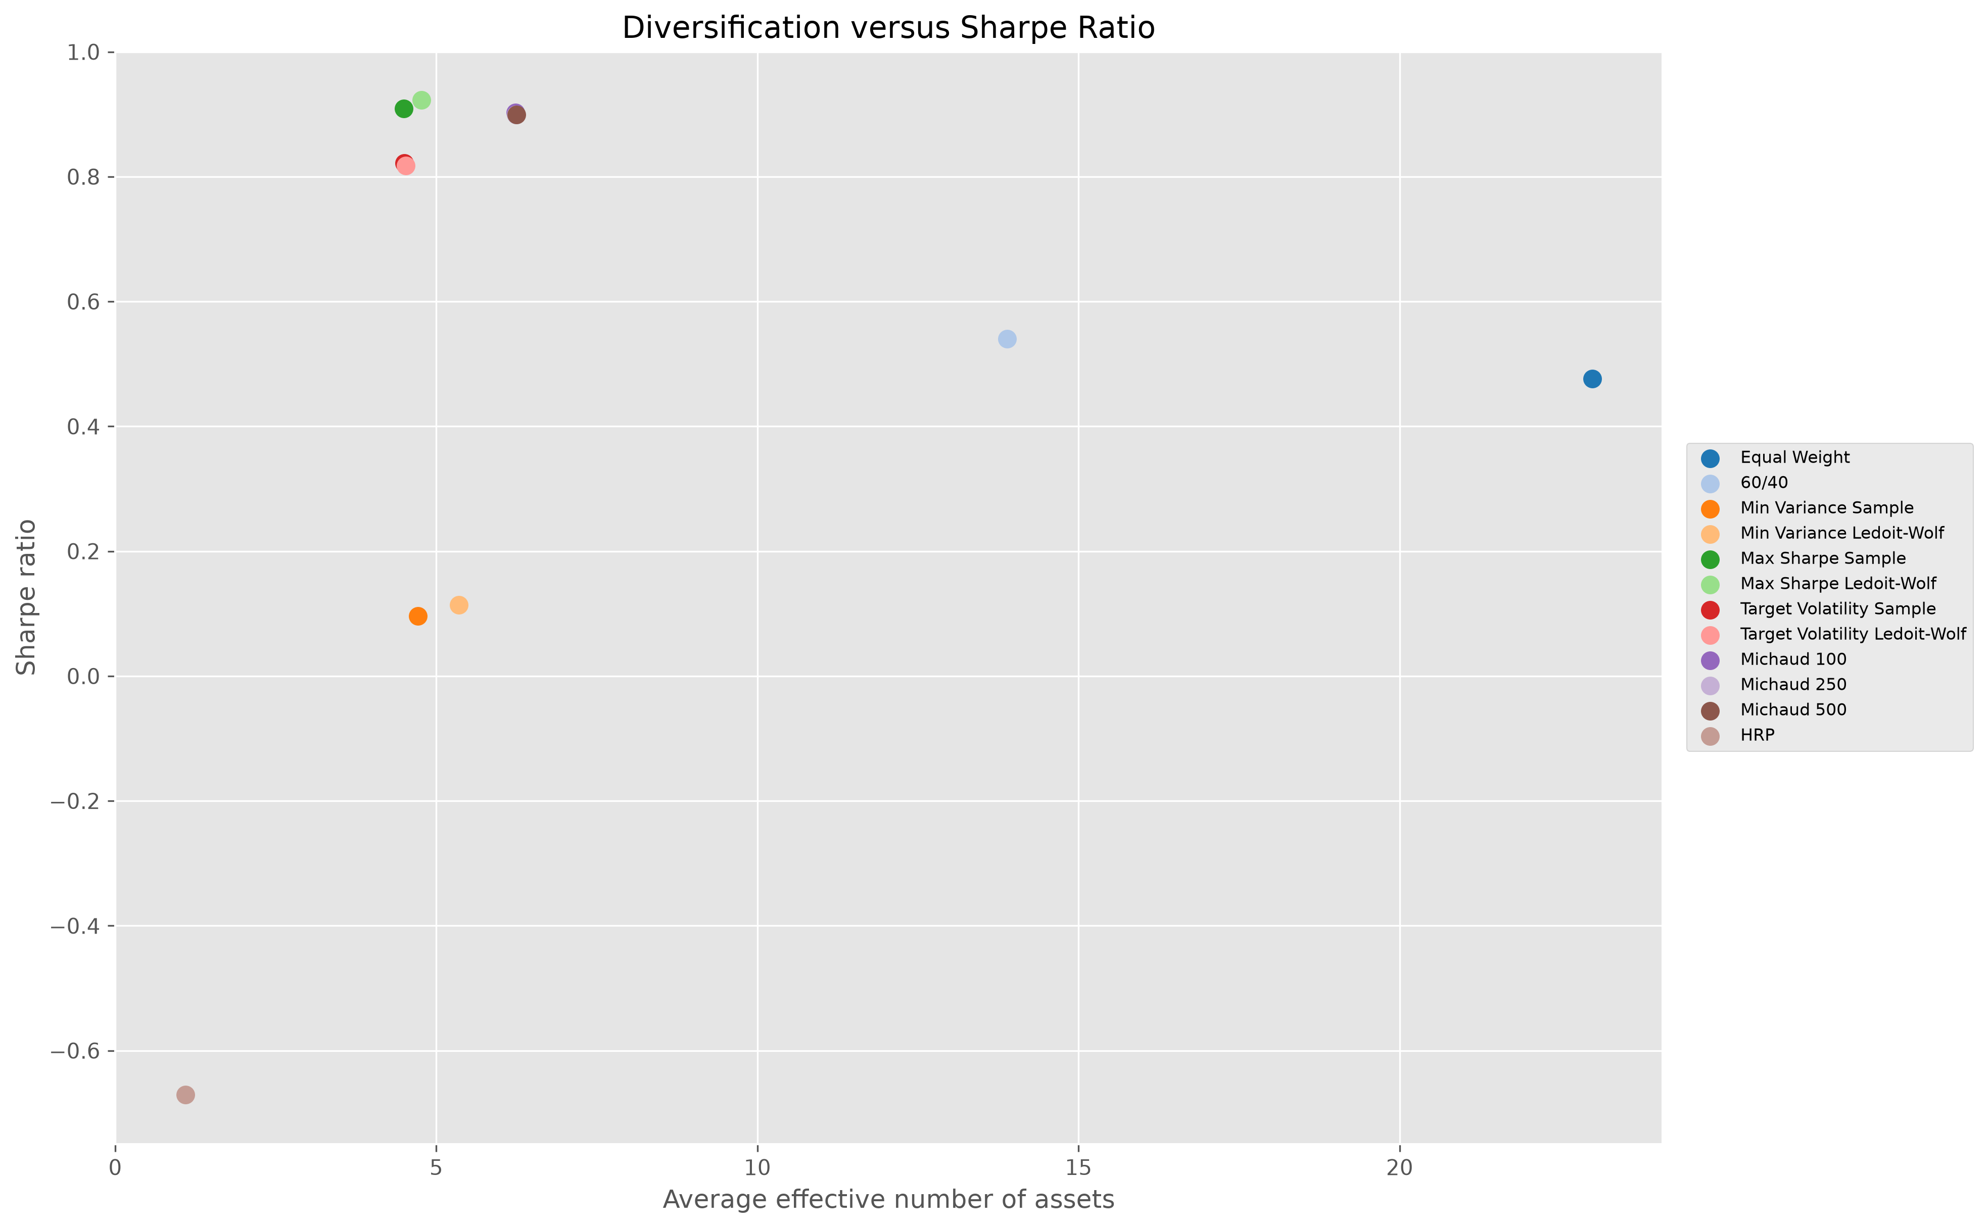
RISK COMPARISON
Risk, turnover, and diversification tell different stories
DRAWDOWNS
RISK–RETURN
TURNOVER–SHARPE
DIVERSIFICATION–SHARPE
Financial Markets Analytics | Variant B — Dynamic Asset Allocation
14
Notes:
These four panels explain why ranking by one metric is incomplete. Drawdowns show the path of losses and the defensive character of Minimum Variance and HRP. The risk-return scatter reveals that Target Volatility earns more return by accepting more volatility, while Maximum Sharpe Ledoit-Wolf offers the strongest realized return-to-risk balance. Turnover versus Sharpe shows the implementation cost of more reactive portfolios. Diversification versus Sharpe highlights that Equal Weight spreads capital most broadly, while Michaud 500 improves diversification among optimized methods. HRP sits at the extreme low-diversification end despite its clustering logic. Together, the panels separate portfolio risk, trading intensity, and concentration—three different concepts that a single Sharpe ratio cannot capture.

Slide 15
INTERPRETATION
Robustness mattered as much as optimization
Maximum Sharpe + Ledoit-Wolf
Best realized Sharpe
The return signal added value after the covariance input was stabilized.
Target Volatility
Highest terminal wealth
The gain came with more volatility—not a free improvement.
Michaud 500
Best optimized diversification
A small Sharpe sacrifice bought lower turnover and broader weights.
HRP
Defensive collapse into BIL
No inversion did not prevent extreme concentration in a cash-like asset.
Method × estimator × universe design determines the realized portfolio.
Financial Markets Analytics | Variant B — Dynamic Asset Allocation
15
Notes:
Four interpretations matter. First, Maximum Sharpe Ledoit-Wolf won because the return signal was strong enough to add value and shrinkage stabilized the covariance input. Second, Ledoit-Wolf improved conditioning, but it did not mechanically improve every strategy; Target Volatility sample and shrinkage Sharpe ratios are close. Third, Michaud is interesting not because it beats the best Sharpe, but because the 500-resample portfolio gives up only a small amount of Sharpe while improving turnover and effective diversification relative to Maximum Sharpe Ledoit-Wolf. Fourth, HRP failed as a return-seeking allocation because unconstrained recursive risk allocation collapsed toward BIL. Its defensive outcome demonstrates that method design and universe composition remain inseparable.

Slide 16
LIMITATIONS
The evidence is informative—not definitive
01
Fixed ETF universe
04
Constant transaction costs
Selection and survivorship bias remain possible.
No time-varying spreads, impact, or liquidity effects.
02
Yahoo Finance
05
Taxes and investor frictions
Reproducible, but not an institutional total-return source.
Taxes, implementation constraints, and mandates are omitted.
03
One realized history
06
Distribution assumptions
Small ranking differences lack formal structural proof.
Michaud normality may understate tails and regime shifts.
Interpret the results as comparative evidence—not universal dominance.
Financial Markets Analytics | Variant B — Dynamic Asset Allocation
16
Notes:
The conclusions must be read with six limitations. The ETF universe is fixed ex post, so selection and survivorship bias are possible. Yahoo Finance is reproducible but not an institutional total-return source. The sample is one realized market path, which limits statistical claims about small performance differences. Trading costs are constant and omit bid-ask variation, market impact, and taxes. The two percent risk-free rate is also constant. Finally, Michaud simulations assume multivariate normality, while real markets exhibit fat tails, changing regimes, and nonlinear dependence. These limitations do not invalidate the experiment; they define the scope of what can be claimed. The results are comparative evidence, not proof of universal dominance.

Slide 17
FUTURE WORK
Robustness checks should challenge the design choices
Black-Litterman
Regime models
Alternative windows
Constrained HRP
Implementation
01
02
03
04
05
Structured priors
and investor views
Time-varying
risk structure
36 / 60 / 120
and quarterly
No cash · caps ·
asset-class floors
Dynamic costs +
extended universe
Principle
Pre-specify robustness tests—do not search ex post for the best-looking result.
Financial Markets Analytics | Variant B — Dynamic Asset Allocation
17
Notes:
Future work should test the assumptions most likely to change the conclusions. Black-Litterman could combine equilibrium returns with structured views instead of relying entirely on historical means. Regime-switching or time-varying covariance models could respond more explicitly to changing market states. Alternative estimation windows and quarterly rebalancing would test the stability-versus-responsiveness trade-off. HRP should be rerun without cash, with maximum weights, or with minimum asset-class allocations. Transaction costs should vary by asset and market regime. Finally, the extended 27-ETF universe can be evaluated over its later common sample. These are robustness checks, not opportunities to select whichever specification produces the best ex-post result.

Slide 18
CONCLUSION
Complexity helped only when paired with discipline
01
Walk-forward design
Same universe, dates, costs, and next-month timing
02
Best Sharpe
Maximum Sharpe Ledoit-Wolf · 0.922
03
Highest wealth
Target Volatility Ledoit-Wolf · more risk
04
Best robustness trade-off
Michaud 500 · broader weights and lower turnover
Robust portfolio design is more than choosing an optimizer.
Financial Markets Analytics | Variant B — Dynamic Asset Allocation
18
Notes:
I conclude with four points. A disciplined walk-forward design matters more than apparent in-sample optimality. Ledoit-Wolf Maximum Sharpe delivered the best realized Sharpe ratio, showing that optimization and shrinkage can work together. Target Volatility Ledoit-Wolf produced the highest terminal wealth, but by accepting greater risk. Michaud 500 offered the most attractive robustness trade-off among optimized methods by improving diversification and turnover with only a modest Sharpe sacrifice. HRP demonstrated that a modern method can still produce an undesirable allocation when cash is included without constraints. Overall, complexity added value only when paired with consistent samples, realistic constraints, transaction costs, and careful interpretation.

