Slide 1
FINANCIAL MARKETS ANALYTICS
Dynamic Asset
Allocation
ARTEM KHOMYTSKYI
University of Milano-Bicocca
Variant B
Prof. G. Forte
14 July 2026
Classical Markowitz | Michaud Resampling
Ledoit-Wolf | Hierarchical Risk Parity
DETAILED ORAL DEFENSE
Financial Markets Analytics | Variant B - Dynamic Asset Allocation
01
Notes:
Main explanation:
Good morning. I am Artem Khomytskyi, and this is my Financial Markets Analytics project for Variant B: Dynamic Asset Allocation. The project compares classical Markowitz portfolios, Ledoit-Wolf covariance shrinkage, Michaud resampling, and Hierarchical Risk Parity. I will emphasize the decisions behind the experiment, the walk-forward timing, and the practical meaning of the results. The central message is that sophisticated methods can add value, but only when the universe, sample, constraints, costs, and information timing are controlled consistently.
Transition:
Next, I turn to: The assignment required dynamic allocation and out-of-sample evidence.
Likely question:
What is the single contribution of the project?
Answer:
A controlled out-of-sample comparison that separates optimizer choice from estimation, implementation, and sample-design effects.

Slide 2
PROJECT OVERVIEW
REQUIRED VS ADDED
The assignment required dynamic allocation and out-of-sample evidence
REQUIRED CORE
OUR ADDITIONS
Dynamic multi-asset allocation
Ledoit-Wolf covariance shrinkage
Classical Markowitz optimization
Target Volatility portfolio
Michaud-style resampling
Hierarchical Risk Parity extension
Walk-forward out-of-sample comparison
Drift-aware turnover and costs
Benchmarks, graphs, and risk metrics
Concentration and diversification diagnostics
Variant B: allocation across asset classes through time - not stock selection.
Financial Markets Analytics | Variant B - Dynamic Asset Allocation
02
Notes:
Main explanation:
Variant B required a dynamic multi-asset allocation study rather than a static in-sample optimization. Classical Markowitz, Michaud-style resampling, periodic out-of-sample rebalancing, benchmarks, graphs, and risk metrics were the required core. I added Ledoit-Wolf shrinkage, Target Volatility, HRP, and detailed turnover and concentration diagnostics. These additions do not replace the assignment requirements; they help explain why the required methods behave differently once estimation and implementation are taken seriously.
Transition:
Next, I turn to: Sophistication must beat transparent rules after costs.
Likely question:
Which parts were required and which were original?
Answer:
Markowitz, Michaud, and the dynamic out-of-sample comparison were required. Ledoit-Wolf, Target Volatility, HRP, and expanded implementation diagnostics were additions.

Slide 3
RESEARCH QUESTION
Sophistication must beat transparent rules after costs
Can optimized portfolios improve realized risk-adjusted performance?
01
02
03
04
05
Markowitz
Ledoit-Wolf
Michaud
HRP
Implementation
Does it beat Equal Weight and 60/40?
Does covariance shrinkage improve stability?
Does resampling reduce instability?
Does hierarchy offer a robust alternative?
Do gains survive turnover and 5-bps costs?
No strategy receives a more favorable universe, sample, date, or cost convention.
Financial Markets Analytics | Variant B - Dynamic Asset Allocation
03
Notes:
Main explanation:
The research question is practical: can optimized portfolios improve realized risk-adjusted performance after estimation error, turnover, and transaction costs? I break the question into five tests. Does Markowitz beat Equal Weight and 60/40? Does Ledoit-Wolf stabilize the covariance input? Does Michaud moderate instability? Does HRP provide a structurally different robust alternative? And do any improvements survive the same cost convention? This framing prevents a model from being judged only by an attractive in-sample frontier.
Transition:
Next, I turn to: One controlled pipeline separates model choice from sample choice.
Likely question:
Why not ask only which strategy has the highest return?
Answer:
Because return alone ignores volatility, drawdown, trading intensity, concentration, and model dependence.

Slide 4
COMPLETE PROJECT MAP
CONTROLLED DESIGN
One controlled pipeline separates model choice from sample choice
01
02
03
04
Data
Sample policy
Returns
Estimators
Adjusted ETF prices
Core and extended panels
Monthly simple returns
Means and covariance
08
07
06
05
Evaluation
Costs
Walk-forward
Strategies
Common 159 months
Drift-aware 5 bps
Prior data only
Required + extensions
Required methods and extensions differ only at the strategy stage.
Financial Markets Analytics | Variant B - Dynamic Asset Allocation
04
Notes:
Main explanation:
The project follows one fixed chain: data acquisition, explicit sample policy, monthly returns, rolling estimation, allocation, next-month implementation, transaction costs, and common-period evaluation. Required methods and extensions enter at the strategy stage, while every other stage remains identical. This structure is important because unequal dates, assets, or costs could create a ranking that reflects sample selection rather than portfolio design. The pipeline is therefore part of the research contribution, not just software organization.
Transition:
Next, I turn to: ETFs keep the experiment about allocation, not stock selection.
Likely question:
What is the most important control in the pipeline?
Answer:
Every final strategy uses the same 23 ETFs, the same 159 realized months, the same next-month timing, and the same 5-bps cost convention.

Slide 5
DATA AND UNIVERSE
WHY ETFs?
ETFs keep the experiment about allocation, not stock selection
INDIVIDUAL STOCKS
MULTI-ASSET ETFs
Firm-specific events dominate outcomes
Broad, diversified market exposures
Stock-selection noise obscures allocation skill
Reduced firm-specific risk
Economic interpretation is more difficult
Liquid and reproducible instruments
Cross-asset roles are not represented
Each weight has a clear asset-class role
One instrument can represent one interpretable source of portfolio risk.
Financial Markets Analytics | Variant B - Dynamic Asset Allocation
05
Notes:
Main explanation:
The assignment concerns allocation across economic sources of risk and return. Individual stocks would introduce firm-specific events, stock-selection skill, and harder economic interpretation. ETFs instead provide diversified market exposures, reduce idiosyncratic noise, and let each weight represent an understandable asset-class role. They are also liquid, reproducible instruments. This makes the covariance structure genuinely multi-asset and keeps the comparison aligned with Variant B rather than turning it into an equity-selection exercise.
Transition:
Next, I turn to: The initial 27-ETF universe was broad but still interpretable.
Likely question:
Why not use the supplied stock datasets?
Answer:
They are appropriate for equity selection, but they do not provide the cross-asset opportunity set required for flexible multi-asset allocation.

Slide 6
INITIAL INVESTMENT UNIVERSE
27 CONFIGURED ETFs
The initial 27-ETF universe was broad but still interpretable
27
instruments across six economic sleeves
WHY THIS BREADTH?
Growth and geographic equity exposure
9
7
4
3
3
Duration, credit, and inflation sensitivity
Real assets and cash-like defense
Equities: 9
Government bonds: 7
Credit: 4
Commodities: 3
Within the recommended 15-30 range
Real estate: 3
Cash: 1
Fixed before strategy performance was compared
Broad enough for allocation; small enough to explain.
Financial Markets Analytics | Variant B - Dynamic Asset Allocation
06
Notes:
Main explanation:
The configured universe contains 27 ETFs across six asset classes, which lies within the assignment's recommended range of 15 to 30 instruments. The design deliberately includes several growth exposures, multiple government-bond durations, credit risk, inflation-sensitive assets, listed real estate, and cash. Breadth gives the optimizer meaningful cross-sectional choice, while 27 instruments remain manageable enough to document and interpret. The universe was fixed before strategy comparison rather than selected from ex-post winners.
Transition:
Next, I turn to: Each ticker has a distinct economic role.
Likely question:
Why exactly 27 ETFs?
Answer:
It provided regional and asset-class breadth without making the economic role of each instrument opaque or the optimization unnecessarily large.

Slide 7
WHY THESE SPECIFIC ETFS?
ROLE-BASED SELECTION
Each ticker has a distinct economic role
Asset class
ETF examples
Economic purpose
US equities
SPY / QQQ / IWM / MDY
Size and style exposure
International equities
EFA / EEM / VGK / EWJ / VPL
Developed and emerging growth
Government bonds
SHY / IEF / TLT / TIP / BWX
Duration, inflation, global defense
Credit
LQD / HYG / EMB / BKLN
Investment-grade to floating-rate risk
Commodities
GLD / DBC / GSG
Gold and broad real-asset exposure
Real estate
VNQ / RWX / VNQI
US and international listed property
Cash
BIL
Short Treasury-bill exposure
Selection criterion: economic role + liquidity + availability + interpretability - not ex-post performance.
Financial Markets Analytics | Variant B - Dynamic Asset Allocation
07
Notes:
Main explanation:
The ticker list was chosen for coverage rather than historical performance ranking. US and international equity ETFs capture size, style, and geography. Government bonds span short, intermediate, long, inflation-linked, and international duration. Credit ETFs distinguish investment-grade, high-yield, emerging-market, and bank-loan risk. Gold, broad commodities, listed real estate, and BIL add inflation, real-asset, and cash-like exposures. Liquidity, data availability, and interpretability were considered together.
Transition:
Next, I turn to: The research universe stayed at 27; the core experiment used 23.
Likely question:
Were the ETFs selected because they performed well?
Answer:
No. Selection was based on economic function, liquidity, history, and interpretability, not an ex-post return ranking.

Slide 8
EXPLICIT SAMPLE POLICY
NO SILENT DELETION
The research universe stayed at 27; the core experiment used 23
27
FOUR LATE-INCEPTION ETFs
Initial research universe
IGOV | VGSH | VNQI | BKLN
No January 2008 history
CORE EXPERIMENT
EXTENDED PANEL
23 ETFs
27 ETFs
from January 2008
from March 2011
No backfilling. No synthetic history. Final optimization uses the core 23 only.
Financial Markets Analytics | Variant B - Dynamic Asset Allocation
08
Notes:
Main explanation:
Four ETFs - IGOV, VGSH, VNQI, and BKLN - did not have January 2008 history. They were not erased from the research universe. They were excluded only from the main fixed-universe experiment so the core panel could begin in 2008 without synthetic prices. The resulting core panel has 23 ETFs. A separate extended descriptive panel retains all 27 ETFs from March 2011. The final optimized comparison is explicitly the 23-ETF core experiment.
Transition:
Next, I turn to: Preserving 2008 adds a severe stress regime to the evidence.
Likely question:
Why not backfill the four late-inception ETFs?
Answer:
Backfilling would manufacture investable history and contaminate the out-of-sample design with data that did not exist.

Slide 9
WHY THE CORE SAMPLE STARTS IN 2008
SAMPLE DESIGN
Preserving 2008 adds a severe stress regime to the evidence
2008-09
2009-19
2020
2021-22
2022-26
Global crisis
Recovery + low rates
COVID shock
Inflation shift
Rapid tightening
A 2011 start would remove the Global Financial Crisis
Stress coverage was prioritized over four extra ETFs
The core choice was fixed before strategy results
This is not automatic missing-data deletion
Availability determined the universe - not ex-post performance.
Financial Markets Analytics | Variant B - Dynamic Asset Allocation
09
Notes:
Main explanation:
Starting the main panel in 2008 preserves the Global Financial Crisis, one of the most important cross-asset stress episodes in the sample. A 2011 start would increase breadth but remove that regime. The core sample then spans recovery, the low-rate period, the COVID shock, inflation, and rapid monetary tightening. This is a pre-specified sample-design decision, not an automatic deletion rule and not a choice made after seeing strategy performance.
Transition:
Next, I turn to: Adjusted prices support reproducible ETF total-return approximations.
Likely question:
Does excluding four ETFs create bias?
Answer:
It creates a narrower opportunity set, but it avoids synthetic history and is applied identically to every final strategy. The limitation is disclosed.

Slide 10
DATA SOURCE AND PRICE TYPE
YAHOO FINANCE
Adjusted prices support reproducible ETF return histories
WHAT THE PIPELINE USES
IMPORTANT LIMITATION
Yahoo Finance accessed through yfinance
Accessible and reproducible
Daily adjusted ETF price histories
but not equivalent to
Adjustments reflect distributions and corporate actions
Bloomberg, FactSet, or an institutional total-return database
Daily data converted to calendar month-end prices
Frozen downloaded files retained for reproducibility
A new live download may differ if the provider revises adjusted history.
Submitted results use the included frozen raw and processed artifacts.
Financial Markets Analytics | Variant B - Dynamic Asset Allocation
10
Notes:
Main explanation:
The project downloads daily adjusted ETF price histories from Yahoo Finance through yfinance. Adjusted prices incorporate splits and distributions, so percentage changes approximate pre-tax total returns. Daily observations are converted to calendar month-end prices, and the downloaded files are frozen in the repository for reproducibility. Yahoo Finance is accessible and appropriate for an academic project, but it is not equivalent to Bloomberg, FactSet, or an institutional total-return database. A future live download could differ if the provider revises history.
Transition:
Next, I turn to: Structural pre-inception gaps were never treated as zero returns.
Likely question:
Why use adjusted rather than raw close prices?
Answer:
Adjusted prices incorporate distributions and corporate actions, which are necessary for meaningful return measurement.

Slide 11
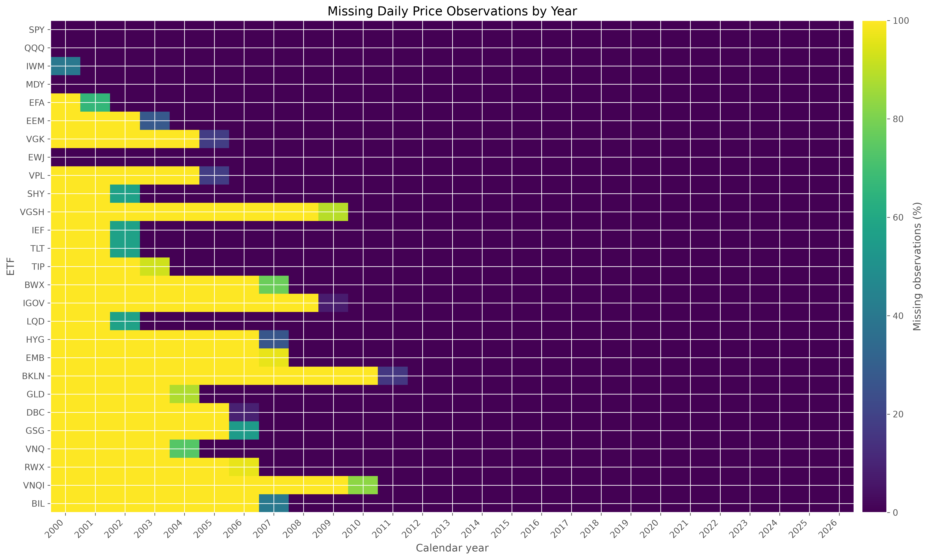
DATA QUALITY AND CLEANING
NO SYNTHETIC DATA
Structural pre-inception gaps were never treated as zero returns
OBSERVED PATTERN
Missing cells are mainly pre-inception history
No within-lifetime missing observations
CLEANING RULES
No interpolation
No backfilling
No zero-return substitution
Incomplete June 2026 removed
Unavailable history is not a zero price and not a zero return.
Source: frozen data-quality output
Financial Markets Analytics | Variant B - Dynamic Asset Allocation
11
Notes:
Main explanation:
The missingness heatmap shows blocks of unavailable history before ETF inception, not random gaps within each fund's observed lifetime. The cleaning policy therefore forbids interpolation, backfilling, synthetic prices, and zero-return substitution. A pre-inception missing price means the ETF did not yet provide an observable investable history. The incomplete June 2026 observation was also removed, leaving May 2026 as the clean sample end. These rules protect the economic meaning of the return panel.
Transition:
Next, I turn to: Simple monthly returns drive portfolio wealth.
Likely question:
Were any ETFs silently removed during cleaning?
Answer:
No. The four core exclusions are explicit in the sample policy, and complete panels must pass a zero-missing-value validation.

Slide 12
RETURNS ENGINE
RETURN DEFINITIONS
Simple monthly returns drive portfolio wealth
SIMPLE MONTHLY RETURN
WHY SIMPLE RETURNS?
r(t) = P(t) / P(t-1) - 1
Portfolio return is the weighted sum of asset simple returns
They compound directly into investor wealth
Month-end adjusted prices
LOG RETURNS
GEOMETRIC RETURN
SHARPE INPUT
Retained for diagnostics; not used for final portfolio wealth
Reported performance reflects realized compounding
Uses annualized arithmetic mean excess return
Geometric return and the arithmetic mean used in Sharpe are different quantities.
Financial Markets Analytics | Variant B - Dynamic Asset Allocation
12
Notes:
Main explanation:
Monthly simple returns are calculated from consecutive month-end adjusted prices as current price divided by prior price minus one. Simple returns are used because a portfolio return is the weighted sum of constituent simple returns. Log returns were retained for diagnostics, but they do not drive final portfolio wealth. Reported annualized return is geometric, which reflects compounding. The Sharpe ratio instead uses the annualized arithmetic mean of monthly excess returns, so it cannot be reconstructed directly from the geometric-return column.
Transition:
Next, I turn to: Monthly data balance responsiveness with implementability.
Likely question:
Why report geometric return but use arithmetic return in Sharpe?
Answer:
Geometric return describes compounded investor wealth; Sharpe is conventionally based on mean excess return divided by volatility.

Slide 13
WHY THIS FREQUENCY?
MONTHLY REBALANCING
Monthly data balance responsiveness with implementability
MONTHLY
DAILY
ANNUAL
Chosen balance
Too reactive
Too slow
Matches assignment
More noise
Few observations
Practical cadence
Unnecessary turnover
Poor adaptability
Enough history
Unstable covariance
Delayed response
Costs remain visible
Quarterly rebalancing remains a future robustness test, not part of the frozen comparison.
Financial Markets Analytics | Variant B - Dynamic Asset Allocation
13
Notes:
Main explanation:
Daily optimization would add noise, unstable covariance estimates, and excessive trading without matching the policy-allocation purpose. Annual data would provide too few observations and adapt too slowly. Monthly frequency matches the assignment, supplies a workable estimation history, and represents a practical institutional rebalancing cadence. It also aligns the return measurement, estimation window, decision calendar, and transaction-cost calculation in one coherent time scale.
Transition:
Next, I turn to: A 60-month window balances estimation noise and regime adaptation.
Likely question:
Why not rebalance quarterly to reduce turnover?
Answer:
Quarterly rebalancing is a useful robustness test, but it answers a different design question and was not used for the frozen final comparison.

Slide 14
WHY THIS ESTIMATION WINDOW?
PROJECT-SPECIFIC CHOICE
A 60-month window balances estimation noise and regime adaptation
12
60
120
months
months
months
Too reactive
Chosen balance
Too slow
Only 12 observations
for 23 assets
Five years of data
with regime response
More stable, but stale
and delays the backtest
<- ADAPTABILITY INCREASES
STABILITY INCREASES ->
A transparent compromise - not claimed to be universally optimal.
Financial Markets Analytics | Variant B - Dynamic Asset Allocation
14
Notes:
Main explanation:
Twelve monthly observations are far too few for stable expected returns and a 23-asset covariance matrix. A 120-month window would improve stability but react slowly and postpone the first out-of-sample result. Sixty months provides five years of history, enough observations for a usable risk estimate while retaining some response to changing regimes. It is a transparent project-specific compromise, not a claim that five years is universally optimal.
Transition:
Next, I turn to: The realized return never enters its own estimation window.
Likely question:
Was the 60-month window selected because it produced the best result?
Answer:
No. It was fixed as a methodological compromise before interpreting the final strategy ranking.

Slide 15
WALK-FORWARD TIMING
NO LOOK-AHEAD
The realized return never enters its own estimation window
t-60 through t-1
At t
At t
At t+1
Use 60 completed monthly returns
Estimate mean and covariance
Calculate target weights
Earn the next realized return
Decision information
Future outcome
INFORMATION BOUNDARY
The estimator ends strictly before the weight date
The new portfolio is held during the following month
The return earned after the decision cannot help create that decision.
Financial Markets Analytics | Variant B - Dynamic Asset Allocation
15
Notes:
Main explanation:
At a decision date t, the model uses monthly returns from t minus 60 through t minus 1. It estimates expected returns and covariance, calculates target weights at t, and applies those weights to the realized return at t plus 1. This is a conservative one-month implementation lag. The key point is causal ordering: the return earned after the decision is absent from the information set that created the decision.
Transition:
Next, I turn to: The first common realized month is March 2013.
Likely question:
How do you know the backtest avoids look-ahead bias?
Answer:
The estimation helper explicitly ends before the weight date, and tests verify that future observations do not alter contemporaneous weights.

Slide 16
WHY THE FINAL PERIOD STARTS HERE
159 REALIZED MONTHS
The first common realized month is March 2013
31 Jan 2008
Feb 2008
Feb 2013
31 Mar 2013
31 May 2026
Core price panel begins
First monthly return
60th completed return and first weight date
First out-of-sample realized portfolio return
Final complete month
31 March 2013 -> 31 May 2026
159 identical realized months for every final strategy
February 2013 is a decision date; March 2013 is the first month that earns return.
Financial Markets Analytics | Variant B - Dynamic Asset Allocation
16
Notes:
Main explanation:
Core prices begin at the end of January 2008, so the first monthly return is February 2008. Sixty complete monthly returns are required before a decision can be formed. The first saved weights are therefore estimated at the end of February 2013, and the one-month implementation lag produces the first realized portfolio return in March 2013. The comparison ends in May 2026, giving 159 identical realized months for every final strategy.
Transition:
Next, I turn to: Turnover is measured from drifted holdings to the new target.
Likely question:
Why not report performance from February 2013?
Answer:
February is the first decision date after 60 observations; March is the first month in which those weights earn a realized return.

Slide 17
MONTHLY REBALANCING MECHANICS
DRIFT-AWARE TURNOVER
Turnover is measured from drifted holdings to the new target
STARTING TARGET
AFTER MARKET DRIFT
NEW TARGET
SPY
20%
SPY
23%
SPY
25%
TLT
20%
TLT
18%
TLT
17%
Trade only the differences
SPY: +2 percentage points | TLT: -1 percentage point
Target-to-target changes alone would ignore the return-driven drift between rebalances.
Financial Markets Analytics | Variant B - Dynamic Asset Allocation
17
Notes:
Main explanation:
Portfolio weights move during each holding month because assets earn different returns. At the next rebalance, the strategy trades from those drifted holdings to the newly calculated target. Turnover is therefore not simply the difference between two target vectors. The small example shows that only required changes are traded. This drift-aware convention makes the cost estimate and implementation burden more realistic than assuming the portfolio magically remains at its prior target.
Transition:
Next, I turn to: Five basis points are charged only on the traded fraction.
Likely question:
Is turnover one-way or two-way?
Answer:
It is one-way turnover: one half of the absolute weight changes from drifted holdings to the new target.

Slide 18
TRANSACTION-COST MECHANICS
ONE-WAY COST
Five basis points are charged only on the traded fraction
FORMULA
NUMERICAL EXAMPLE
cost = turnover x 0.0005
10% one-way turnover
x 0.05% trading cost
5 bps = 0.05%
= 0.005% of portfolio value
WHAT IS CHARGED
WHAT IS NOT MODELED
Only the traded wealth fraction
Taxes and market impact
Every ongoing rebalance
Time-varying spreads or liquidity
Same rule for every final strategy
Brokerage minimum fees
Initial establishment is excluded from turnover averages.
Financial Markets Analytics | Variant B - Dynamic Asset Allocation
18
Notes:
Main explanation:
The one-way transaction-cost rate is 5 basis points, or 0.05 percent. It is multiplied by the fraction of portfolio wealth traded at the rebalance. If one-way turnover is 10 percent, the cost is 10 percent times 0.05 percent, equal to 0.005 percent of portfolio value. The full portfolio is not charged every month. Initial establishment is excluded from average turnover so the statistic describes ongoing rebalancing rather than the unavoidable first investment.
Transition:
Next, I turn to: Five basis points provide a modest, consistent implementation penalty.
Likely question:
What costs are omitted?
Answer:
Taxes, time-varying bid-ask spreads, market impact, liquidity variation, and brokerage minimums are outside the project model.

Slide 19
WHY THIS COST ASSUMPTION?
COMPARABILITY ASSUMPTION
Five basis points provide a modest, consistent implementation penalty
01
02
03
04
Liquid ETF proxy
Implementation penalty
Constant across strategies
Transparent simplification
A modest trading-cost assumption for accessible funds
High-turnover rules do not trade for free
Trading intensity is penalized consistently
Easy to reproduce and audit
Not a universal market estimate: costs vary by ETF, trade size, and market regime.
Future check: time-varying, asset-specific transaction costs.
Financial Markets Analytics | Variant B - Dynamic Asset Allocation
19
Notes:
Main explanation:
The 5-bps assumption is intentionally simple. It represents modest trading costs for liquid ETFs and prevents high-turnover strategies from receiving a free implementation advantage. Keeping the rate constant makes strategy differences comparable across time and assets. It should not be interpreted as an exact historical execution estimate for every ETF and every market regime. More detailed cost models are an important extension, but they would add assumptions beyond the assignment's scope.
Transition:
Next, I turn to: Complexity has value only relative to credible simple benchmarks.
Likely question:
Would a higher cost assumption change the ranking?
Answer:
Potentially, especially for Maximum Sharpe and Target Volatility. That sensitivity was not part of the frozen final experiment and should be tested separately.

Slide 20
BENCHMARK PORTFOLIOS
TRANSPARENT BASELINES
Complexity has value only relative to credible simple benchmarks
EQUAL WEIGHT
60/40
No forecasts
Traditional balanced allocation
Maximum capital-weight breadth
Growth plus defensive sleeves
Complete core opportunity set
No optimizer or covariance estimate
Easy to explain and reproduce
Familiar implementation standard
A complex model must improve on rules that have no estimation error.
Financial Markets Analytics | Variant B - Dynamic Asset Allocation
20
Notes:
Main explanation:
Equal Weight and 60/40 establish transparent performance floors. Equal Weight requires no forecasts and spreads capital across the complete core opportunity set. The 60/40 portfolio is a familiar balanced allocation combining growth and defensive sleeves. Neither benchmark estimates expected returns or covariance. Their low complexity, interpretability, and relatively low turnover make them hard standards: an optimized model should improve outcomes after costs, not merely produce a mathematically sophisticated allocation.
Transition:
Next, I turn to: Equal Weight assigns 1/23 to every core ETF.
Likely question:
Why include two benchmarks rather than one?
Answer:
They test different notions of simplicity: broad 1/N diversification and a traditional equity-government-bond policy mix.

Slide 21
HOW THE BENCHMARK IS CONSTRUCTED
1/N BENCHMARK
Equal Weight assigns 1/23 to every core ETF
IMPLEMENTATION
TARGET WEIGHT
Every core ETF receives identical target capital
1 / 23
Monthly drift-aware rebalancing
approximately 4.35%
per ETF
Same realized dates and 5-bps cost convention
No expected-return or covariance estimation
23 effective assets
by construction
Equal capital does not mean equal risk contribution
A broad capital allocation benchmark - not a risk-parity portfolio.
Financial Markets Analytics | Variant B - Dynamic Asset Allocation
21
Notes:
Main explanation:
The Equal Weight benchmark assigns approximately 4.35 percent to each of the 23 core ETFs and rebalances monthly under the same cost convention and realized dates as optimized strategies. It uses no expected-return or covariance estimates. Its effective number of assets is exactly 23 by construction, but equal capital weights do not imply equal risk contributions because asset volatilities and correlations differ. It is therefore a mechanical diversification benchmark, not a risk-parity portfolio.
Transition:
Next, I turn to: The 60/40 benchmark uses only equity and government-bond sleeves.
Likely question:
Why does Equal Weight have the highest effective asset count?
Answer:
Because the effective number equals the inverse of weight concentration, and all 23 capital weights are identical.

Slide 22
HOW THE BENCHMARK IS CONSTRUCTED
TRADITIONAL BALANCED MIX
The 60/40 benchmark uses only equity and government-bond sleeves
WHY USE IT?
60% EQUITIES
40% BONDS
Familiar policy portfolio
Clear growth-defense split
9 equity ETFs
5 government-bond ETFs
No forecast or optimizer
60% / 9 = 6.67% each
40% / 5 = 8.00% each
Same monthly costs and dates
Zero benchmark weight
Credit | Commodities | Real estate | Cash
Limitation: it does not use the complete opportunity set.
Financial Markets Analytics | Variant B - Dynamic Asset Allocation
22
Notes:
Main explanation:
The 60/40 benchmark allocates 60 percent equally across nine equity ETFs and 40 percent equally across the five government-bond ETFs available in the core universe. Credit, commodities, real estate, and BIL receive zero benchmark weight. It is rebalanced monthly with the same timing and transaction-cost convention. The benchmark is familiar and interpretable, but it does not exploit the complete 23-ETF opportunity set, which is an intentional feature of the comparison.
Transition:
Next, I turn to: Markowitz converts forecasts, covariance, and constraints into weights.
Likely question:
Why not allocate the 40 percent across all fixed income ETFs?
Answer:
The benchmark follows the conventional equity-government-bond definition; credit is excluded because it carries materially different economic risk.

Slide 23
CLASSICAL MEAN-VARIANCE OPTIMIZATION
INPUTS -> DECISION
Markowitz converts forecasts, covariance, and constraints into weights
EXPECTED RETURNS
COVARIANCE
CONSTRAINTS
OUTPUT
mu
Sigma
C
w*
Reward estimate
Risk and co-movement
Investability rules
Portfolio weights
Minimum Variance
Maximum Sharpe
Target Volatility
Minimize risk
Maximize excess return per risk
Maximize return under a risk ceiling
The framework is disciplined; the inputs remain estimated and noisy.
Financial Markets Analytics | Variant B - Dynamic Asset Allocation
23
Notes:
Main explanation:
Classical mean-variance optimization takes expected returns, a covariance matrix, and investment constraints as inputs. It then chooses portfolio weights according to a specific objective. Minimum Variance focuses only on risk. Maximum Sharpe trades expected excess return against risk. Target Volatility maximizes expected return within a risk ceiling. The framework is powerful because it makes diversification explicit, but it is also vulnerable because the inputs are estimates rather than known parameters.
Transition:
Next, I turn to: Minimum Variance buys stability, not high expected return.
Likely question:
What is the main weakness of Markowitz in practice?
Answer:
Optimization can amplify small errors in expected returns and covariance into large, unstable portfolio weights.

Slide 24
MARKOWITZ OBJECTIVE 1
DEFENSIVE OBJECTIVE
Minimum Variance buys stability, not high expected return
EXPECTED BEHAVIOR
OBJECTIVE
Favors low-volatility, low-correlation assets
minimize
Can concentrate in cash and short bonds
w' Sigma w
Suitable for capital preservation
Uses covariance + constraints
PROJECT RESULT
Does not use expected returns
2.25-2.31%
2.77-2.88%
0.096-0.114
Annualized return
Volatility
Sharpe
Low Sharpe: realized return stayed close to the 2% reference rate.
Financial Markets Analytics | Variant B - Dynamic Asset Allocation
24
Notes:
Main explanation:
Minimum Variance minimizes portfolio variance using covariance and constraints; expected returns do not enter the objective. In a universe containing BIL and short-duration bonds, it naturally favors defensive exposures. The sample and Ledoit-Wolf versions earned roughly 2.25 to 2.31 percent annually with volatility near 2.8 percent. Drawdowns were small relative to risk-bearing strategies, but Sharpe ratios were weak because realized return remained close to the constant 2 percent reference rate.
Transition:
Next, I turn to: Maximum Sharpe achieved the best realized risk-adjusted result.
Likely question:
Why call the low return a feature rather than a failure?
Answer:
The strategy solved its stated objective: reduce variance. It was not designed to maximize return or Sharpe.

Slide 25
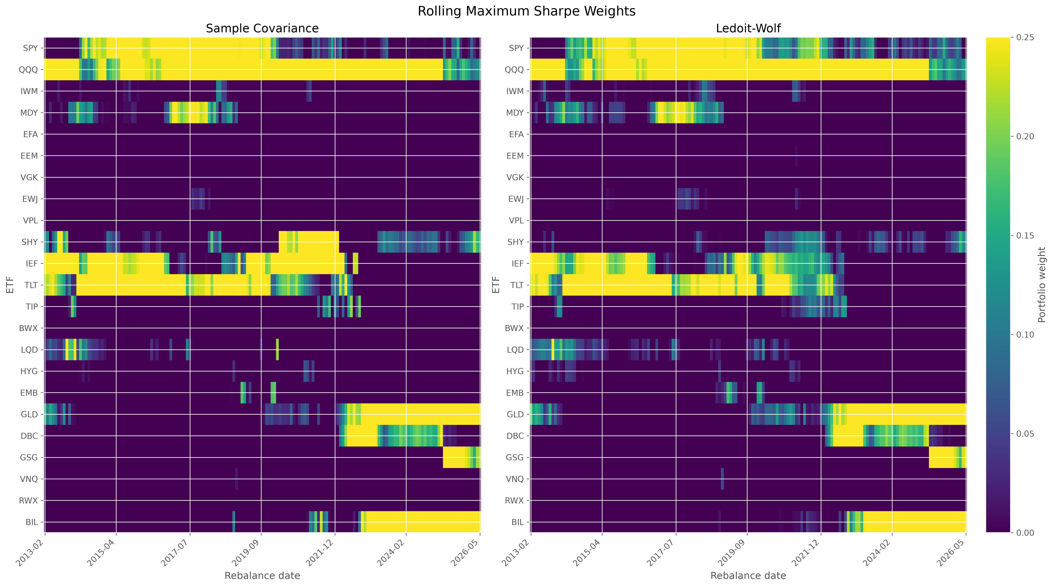
MARKOWITZ OBJECTIVE 2
BEST SHARPE: 0.922
Maximum Sharpe achieved the best realized risk-adjusted result
OBJECTIVE
maximize expected excess return
per unit of portfolio risk
Uses mu + Sigma + 2% risk-free rate
Noisy expected returns
Saved rolling weights show concentration and time variation.
Concentrated weights
9.86%
8.45%
88.06%
High rebalancing demand
Annualized return
Volatility
Annualized turnover
Ledoit-Wolf delivered the highest realized Sharpe.
Financial Markets Analytics | Variant B - Dynamic Asset Allocation
25
Notes:
Main explanation:
Maximum Sharpe uses expected returns, covariance, and a 2 percent annual risk-free reference to seek the greatest estimated excess return per unit of volatility. That dependence on expected returns makes it especially sensitive to estimation noise and turnover. In the realized comparison, the Ledoit-Wolf version produced the highest Sharpe ratio, 0.922, with 9.86 percent annualized geometric return and 8.45 percent volatility. The trade-off was concentration and 88.06 percent annualized turnover.
Transition:
Next, I turn to: Target Volatility reached the highest wealth by accepting more risk.
Likely question:
Why can Maximum Sharpe weights change sharply?
Answer:
Small changes in noisy mean estimates can materially change which assets appear to offer the best excess return per unit of risk.

Slide 26
MARKOWITZ OBJECTIVE 3
10% EX-ANTE TARGET
Target Volatility reached the highest wealth by accepting more risk
WHY 10%?
OBJECTIVE
Comparable to balanced portfolios
maximize expected return
Allows meaningful risky-asset participation
subject to
Prevents unconstrained risk escalation
estimated annual volatility <= 10%
REALIZED RESULT - LEDOIT-WOLF
Moderate project-specific ceiling
11.38%
11.63%
4.17
Annualized return
Realized volatility
Final wealth
An ex-ante 10% constraint cannot guarantee 10% realized future volatility.
Financial Markets Analytics | Variant B - Dynamic Asset Allocation
26
Notes:
Main explanation:
Target Volatility maximizes expected return subject to an annual volatility ceiling of 10 percent in the estimated optimization problem. Ten percent was chosen as a moderate, balanced-portfolio-like project target that permits risky-asset participation without unconstrained risk escalation. The Ledoit-Wolf version delivered the highest realized annualized return, 11.38 percent, and final wealth, 4.17. Realized volatility was 11.63 percent because an ex-ante constraint cannot guarantee the future realized outcome.
Transition:
Next, I turn to: Constraints turn mathematical optima into interpretable portfolios.
Likely question:
Why did realized volatility exceed the 10 percent target?
Answer:
The constraint applies to estimated forward risk at each rebalance; realized markets can differ from the estimate.

Slide 27
WHY THESE IMPLEMENTATION RULES?
MARKOWITZ + MICHAUD
Constraints turn mathematical optima into interpretable portfolios
Weights sum to 1
Fully invested
Minimum weight 0%
Long only; no short selling
Maximum weight 25%
Limits estimation-driven corner solutions
No leverage
Comparable, investable risk
WHY NOT TIGHTER?
A much lower cap forces quasi-equal weighting.
WHY NOT UNCAPPED?
No cap allows noisy estimates to dominate.
Financial Markets Analytics | Variant B - Dynamic Asset Allocation
27
Notes:
Main explanation:
Every Markowitz and Michaud portfolio is fully invested, long-only, and unleveraged. Individual ETF weights lie between 0 and 25 percent. The lower bound avoids short-sale and financing assumptions. No leverage prevents performance from being increased mechanically by scaling risk. The 25 percent cap limits corner solutions caused by estimation error while retaining meaningful conviction. A much tighter cap would force allocations toward quasi-equal weighting; no cap would allow a single noisy estimate to dominate.
Transition:
Next, I turn to: A 23-asset sample covariance is noisy with only 60 observations.
Likely question:
Why was HRP not subject to the same 25 percent cap?
Answer:
The HRP extension used the standard unconstrained PyPortfolioOpt HRP allocation to reveal its native interaction with the cash-inclusive universe.

Slide 28
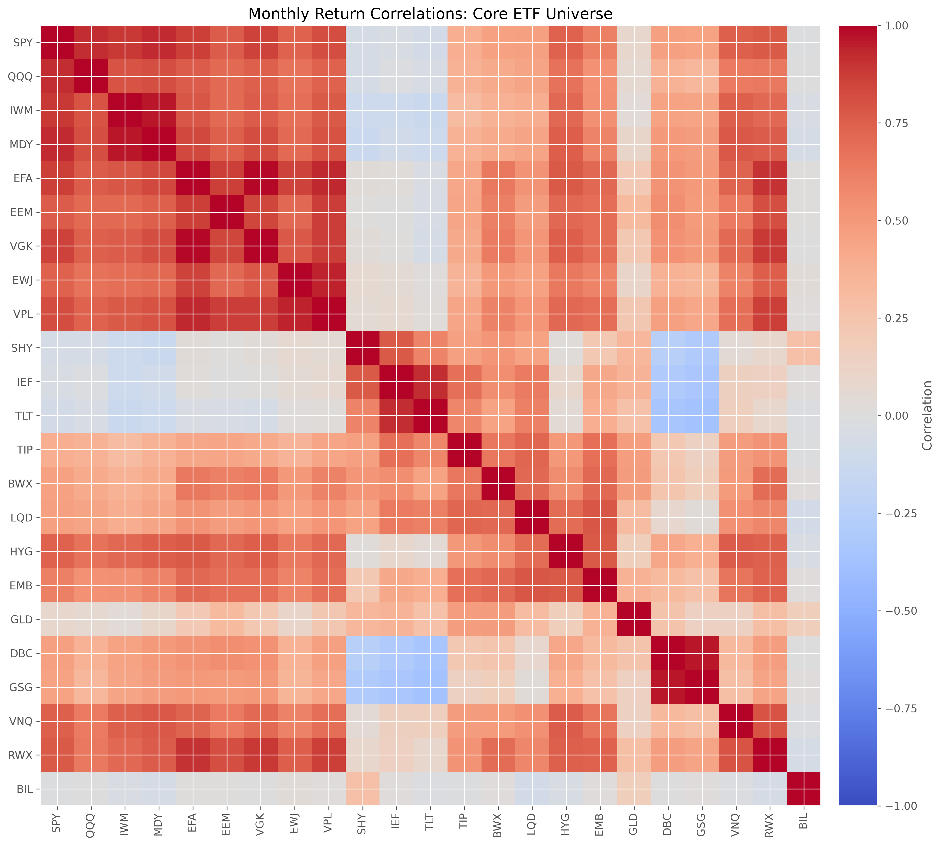
COVARIANCE ESTIMATION PROBLEM
23 x 23 FROM 60 MONTHS
A 23-asset sample covariance is noisy with only 60 observations
WHY IT MATTERS
Variances and correlations contain sampling noise
Optimization amplifies small input errors
Poor conditioning creates unstable weights
Equity clustering limits naive diversification
The sample estimator is valid - but high-variance in a short window.
Frozen core-universe correlation output
Financial Markets Analytics | Variant B - Dynamic Asset Allocation
28
Notes:
Main explanation:
Each rolling window estimates a 23 by 23 covariance matrix from 60 monthly observations. Sampling noise affects variances and correlations, and optimization can amplify small errors into unstable weights. Numerical conditioning matters because the objective depends on the covariance structure. The heatmap also shows why a single average correlation is insufficient: equities cluster strongly, while bonds, commodities, and cash provide different relationships. A more stable covariance estimator may therefore improve portfolio implementation.
Transition:
Next, I turn to: Ledoit-Wolf trades a little bias for much lower estimation variance.
Likely question:
Is the sample covariance matrix invalid?
Answer:
No. It is a consistent historical estimator, but it can have high estimation variance in a short, high-dimensional window.

Slide 29
COVARIANCE SHRINKAGE
ESTIMATOR - NOT OBJECTIVE
Ledoit-Wolf trades a little bias for much lower estimation variance
LEDOIT-WOLF
SAMPLE
COVARIANCE
STRUCTURED
TARGET
+
Weighted
combination
Detailed but noisy
Stable but simplified
Data-driven shrinkage intensity
Small bias
Lower estimation variance
Better conditioning
More stable risk input
The Markowitz objective stays unchanged; only the covariance input is stabilized.
Financial Markets Analytics | Variant B - Dynamic Asset Allocation
29
Notes:
Main explanation:
Ledoit-Wolf shrinkage combines the noisy sample covariance matrix with a more structured target. The shrinkage intensity is estimated from the data rather than chosen arbitrarily. Moving slightly toward the target introduces bias, but it can reduce estimation variance and improve numerical conditioning by more. This is an input estimator, not a new portfolio objective. Minimum Variance, Maximum Sharpe, and Target Volatility remain the same strategies; only the covariance matrix supplied to them changes.
Transition:
Next, I turn to: Shrinkage improved the strongest Markowitz implementation.
Likely question:
What exactly is being shrunk?
Answer:
The sample covariance matrix is moved toward a structured covariance target using a data-driven shrinkage intensity.

Slide 30
WHAT CHANGED IN THE RESULTS?
SAMPLE VS LEDOIT-WOLF
Shrinkage improved the strongest Markowitz implementation
Strategy
Sharpe
Annualized turnover
Effective assets
Min Variance
0.096 -> 0.114
26.06% -> 23.46%
4.71 -> 5.35
Max Sharpe
0.909 -> 0.922
99.14% -> 88.06%
4.50 -> 4.77
Target Volatility
0.822 -> 0.818
103.94% -> 98.66%
4.50 -> 4.52
MAXIMUM SHARPE
MINIMUM VARIANCE
TARGET VOLATILITY
Higher Sharpe, lower turnover, slightly broader weights
Small Sharpe improvement and meaningful turnover reduction
Lower turnover, but no Sharpe improvement
Useful here - not proof of universal dominance.
Financial Markets Analytics | Variant B - Dynamic Asset Allocation
30
Notes:
Main explanation:
The empirical benefit of Ledoit-Wolf is clearest for Maximum Sharpe. Relative to sample covariance, Sharpe rose from 0.909 to 0.922, annualized turnover fell from 99.14 to 88.06 percent, and effective assets increased from 4.50 to 4.77. Minimum Variance also became somewhat broader and lower-turnover. Target Volatility turnover fell, but its Sharpe changed little. The correct conclusion is sample-specific: shrinkage improved stability and implementation here, not that it must dominate in every period or universe.
Transition:
Next, I turn to: Michaud was required because one estimated frontier is fragile.
Likely question:
Did Ledoit-Wolf improve every metric?
Answer:
No. The gains were strongest for Maximum Sharpe and more modest or mixed for the other objectives.

Slide 31
RESAMPLED EFFICIENT FRONTIER
MARKOWITZ ENIGMA
Michaud was required because one estimated frontier is fragile
01
02
03
04
INPUTS LOOK PRECISE
BUT ARE UNCERTAIN
OPTIMIZER AMPLIFIES
WEIGHTS BECOME FRAGILE
Estimated means and covariance
Sampling error remains
Favors extreme estimates
Concentration and turnover
Michaud response
Average optimized portfolios across plausible capital-market assumptions.
An extension of Markowitz - not an unrelated strategy.
Resampling moderates dependence on one noisy efficient frontier.
Financial Markets Analytics | Variant B - Dynamic Asset Allocation
31
Notes:
Main explanation:
Michaud resampling addresses the Markowitz optimization enigma. Optimized weights can look precise even though expected returns and covariance are estimated imprecisely. A single noisy input estimate produces a single potentially unstable portfolio. Michaud remains an extension of Markowitz: it repeatedly solves the same constrained mean-variance problem, but it acknowledges uncertainty by averaging decisions across plausible capital-market assumptions.
Transition:
Next, I turn to: Michaud averages optimized decisions across plausible inputs.
Likely question:
Does Michaud remove estimation error?
Answer:
No. It reduces dependence on one estimated input set; uncertainty and distributional assumptions remain.

Slide 32
HOW THE METHOD WORKS
SIX-STEP CYCLE
Michaud averages decisions across plausible inputs
01
02
03
04
05
06
Estimate
Simulate
Optimize
Repeat
Average
Hold
mu and Sigma from prior 60 months
one plausible market assumption set
constrained Maximum Sharpe
M independent scenarios
component weights across solutions
averaged portfolio next month
Final weight for asset i
w(i) = average of w(i,1) ... w(i,M)
The future return is never part of the simulation or estimation window.
Average portfolio decisions - not future outcomes.
Financial Markets Analytics | Variant B - Dynamic Asset Allocation
32
Notes:
Main explanation:
At each rebalance, the method first estimates annualized means and a Ledoit-Wolf covariance matrix from the prior 60 months. It then simulates one plausible mean vector and covariance matrix, solves the constrained Maximum Sharpe problem, and repeats this process M times. The resulting weights are averaged component by component and held during the next month. The benefit comes from averaging portfolio decisions, not from averaging realized future returns.
Transition:
Next, I turn to: The code resampled capital-market assumptions, not historical rows.
Likely question:
Why solve Maximum Sharpe inside each resample?
Answer:
The project uses Michaud specifically as a robust extension of the expected-return-sensitive Maximum Sharpe portfolio.

Slide 33
VERIFIED MICHAUD IMPLEMENTATION
NORMAL SAMPLING THEORY
The code resampled capital-market assumptions, not historical rows
WHAT WAS SIMULATED
WHAT IT WAS NOT
Expected-return vectors from their sampling distribution
Not a simple bootstrap of historical rows
Covariance realizations consistent with Sigma and sample size
Not a simulation of future realized returns
One constrained Maximum Sharpe solution per scenario
Not an unconstrained efficient frontier
Same long-only, no-leverage, 25% cap rules
Not a claim that returns are perfectly normal
Reproducibility
Random seed 42 + deterministic seed sequences at each rebalance
Financial Markets Analytics | Variant B - Dynamic Asset Allocation
33
Notes:
Main explanation:
The verified implementation simulates expected-return vectors from their estimated multivariate-normal sampling distribution and generates covariance realizations from centered multivariate-normal draws consistent with the estimated covariance and sample size. It is therefore not a simple bootstrap of historical months. Every simulated scenario uses the same long-only, fully invested, unleveraged, 25-percent-cap constraints. Seed 42 and deterministic seed sequences make the weight histories reproducible. The normality framework is a modeling approximation, not a claim of perfect distributional realism.
Transition:
Next, I turn to: Three resample counts show when Monte Carlo results stabilize.
Likely question:
Was the historical return matrix resampled row by row?
Answer:
No. The implementation resampled mean and covariance assumptions under normal sampling theory.

Slide 34
WHY 100, 250, AND 500?
CONVERGENCE CHECK
Three resample counts reveal Monte Carlo convergence
500
100
250
resamples
resamples
resamples
Primary
Fastest
Intermediate
Results largely stabilized
More Monte Carlo variation
Convergence checkpoint
91.53% turnover
81.45% turnover
78.00% turnover
The marginal changes became small; more simulation would add cost, not a new conclusion.
Financial Markets Analytics | Variant B - Dynamic Asset Allocation
34
Notes:
Main explanation:
The project evaluates 100, 250, and 500 resamples. One hundred is faster but more exposed to Monte Carlo variation. Two hundred fifty is an intermediate convergence check. Five hundred provides greater numerical stability at a higher computational cost. Results changed only slightly as the count increased, while turnover declined. The 500-resample variant is emphasized because the output had stabilized and it achieved the lowest turnover among the tested Michaud counts.
Transition:
Next, I turn to: Michaud sacrificed little Sharpe and improved implementation.
Likely question:
Why stop at 500 rather than simulate thousands?
Answer:
The marginal changes were already small, so more simulation would add computation without materially changing the project conclusion.

Slide 35
MAXIMUM SHARPE VS MICHAUD 500
FOCUSED COMPARISON
Michaud sacrificed little Sharpe and improved implementation
Metric
Max Sharpe Ledoit-Wolf
Michaud 500
Interpretation
Return
9.86%
9.23%
Small return sacrifice
Volatility
8.45%
7.98%
Slightly lower realized risk
Sharpe
0.922
0.900
Near-leading risk-adjusted result
Turnover
88.06%
78.00%
Lower implementation burden
Effective assets
4.77
6.25
Broader optimized allocation
Michaud did not beat Markowitz on every metric; it improved robustness and diversification.
Financial Markets Analytics | Variant B - Dynamic Asset Allocation
35
Notes:
Main explanation:
Maximum Sharpe Ledoit-Wolf earned 9.86 percent with 8.45 percent volatility, Sharpe 0.922, 88.06 percent turnover, and 4.77 effective assets. Michaud 500 earned 9.23 percent with 7.98 percent volatility, Sharpe 0.900, 78.00 percent turnover, and 6.25 effective assets. Michaud did not beat Markowitz on every metric. Its contribution is a more diversified and lower-turnover implementation while preserving most of the realized risk-adjusted performance.
Transition:
Next, I turn to: HRP provides a structurally different robustness test.
Likely question:
Which strategy is preferable in practice?
Answer:
Maximum Sharpe leads on Sharpe; Michaud 500 offers the stronger robustness, concentration, and turnover compromise.

Slide 36
ORIGINAL MODERN EXTENSION
OPTIONAL EXTENSION
HRP provides a structurally different robustness test
WHY HRP?
WHY NOT BLACK-LITTERMAN?
Avoids direct covariance inversion
Requires explicit investor views
Uses no expected-return forecast
Requires confidence levels for those views
Clusters related assets hierarchically
No defensible objective view set was available
Provides a non-Markowitz comparison
Invented views would add untestable subjectivity
Tests method-universe interaction
Reserved for future work
HRP was added to challenge the design - not to guarantee a better result.
Financial Markets Analytics | Variant B - Dynamic Asset Allocation
36
Notes:
Main explanation:
HRP was an optional original extension. Unlike Markowitz, it does not forecast expected returns and avoids direct covariance-matrix inversion. It uses correlation-based hierarchy and recursive allocation, offering a useful comparison with mean-variance optimization. HRP was chosen instead of Black-Litterman because Black-Litterman requires defensible investor views and confidence levels. No objective view set was available, so implementing it would have introduced subjective assumptions that could not be validated.
Transition:
Next, I turn to: HRP allocates through a hierarchy rather than an efficient frontier.
Likely question:
Why not include both HRP and Black-Litterman?
Answer:
The project prioritized one interpretable extension; HRP required no invented investor views and exposed a different form of model risk.

Slide 37
HOW HRP WORKS
SIX-STEP HIERARCHY
HRP allocates through a hierarchy rather than an efficient frontier
01
02
03
04
05
06
Distance
Cluster
Reorder
Split
Allocate
Continue
Convert correlations to distances
Group similar assets
Place related assets together
Divide hierarchy recursively
Weight clusters by variance
Reach individual ETF weights
IT AVOIDS
IT DOES NOT GUARANTEE
Expected returns and direct covariance inversion
Balanced capital weights or equal risk contributions
Hierarchy changes the allocation logic - it does not remove dependence on the universe.
Financial Markets Analytics | Variant B - Dynamic Asset Allocation
37
Notes:
Main explanation:
HRP converts correlations into distances, clusters similar assets, reorders them according to the hierarchy, and recursively splits capital between branches according to cluster variance. The procedure continues until individual ETF weights are obtained. It avoids direct inversion and does not use expected returns. However, hierarchical risk allocation does not guarantee equal capital weights or equal risk contributions, and it remains sensitive to the universe, distance definition, and unconstrained variance structure.
Transition:
Next, I turn to: Unconstrained HRP collapsed toward the cash-like BIL ETF.
Likely question:
Is HRP the same as equal risk contribution?
Answer:
No. HRP allocates recursively through clusters; it is not a direct equal-risk-contribution optimization.

Slide 38
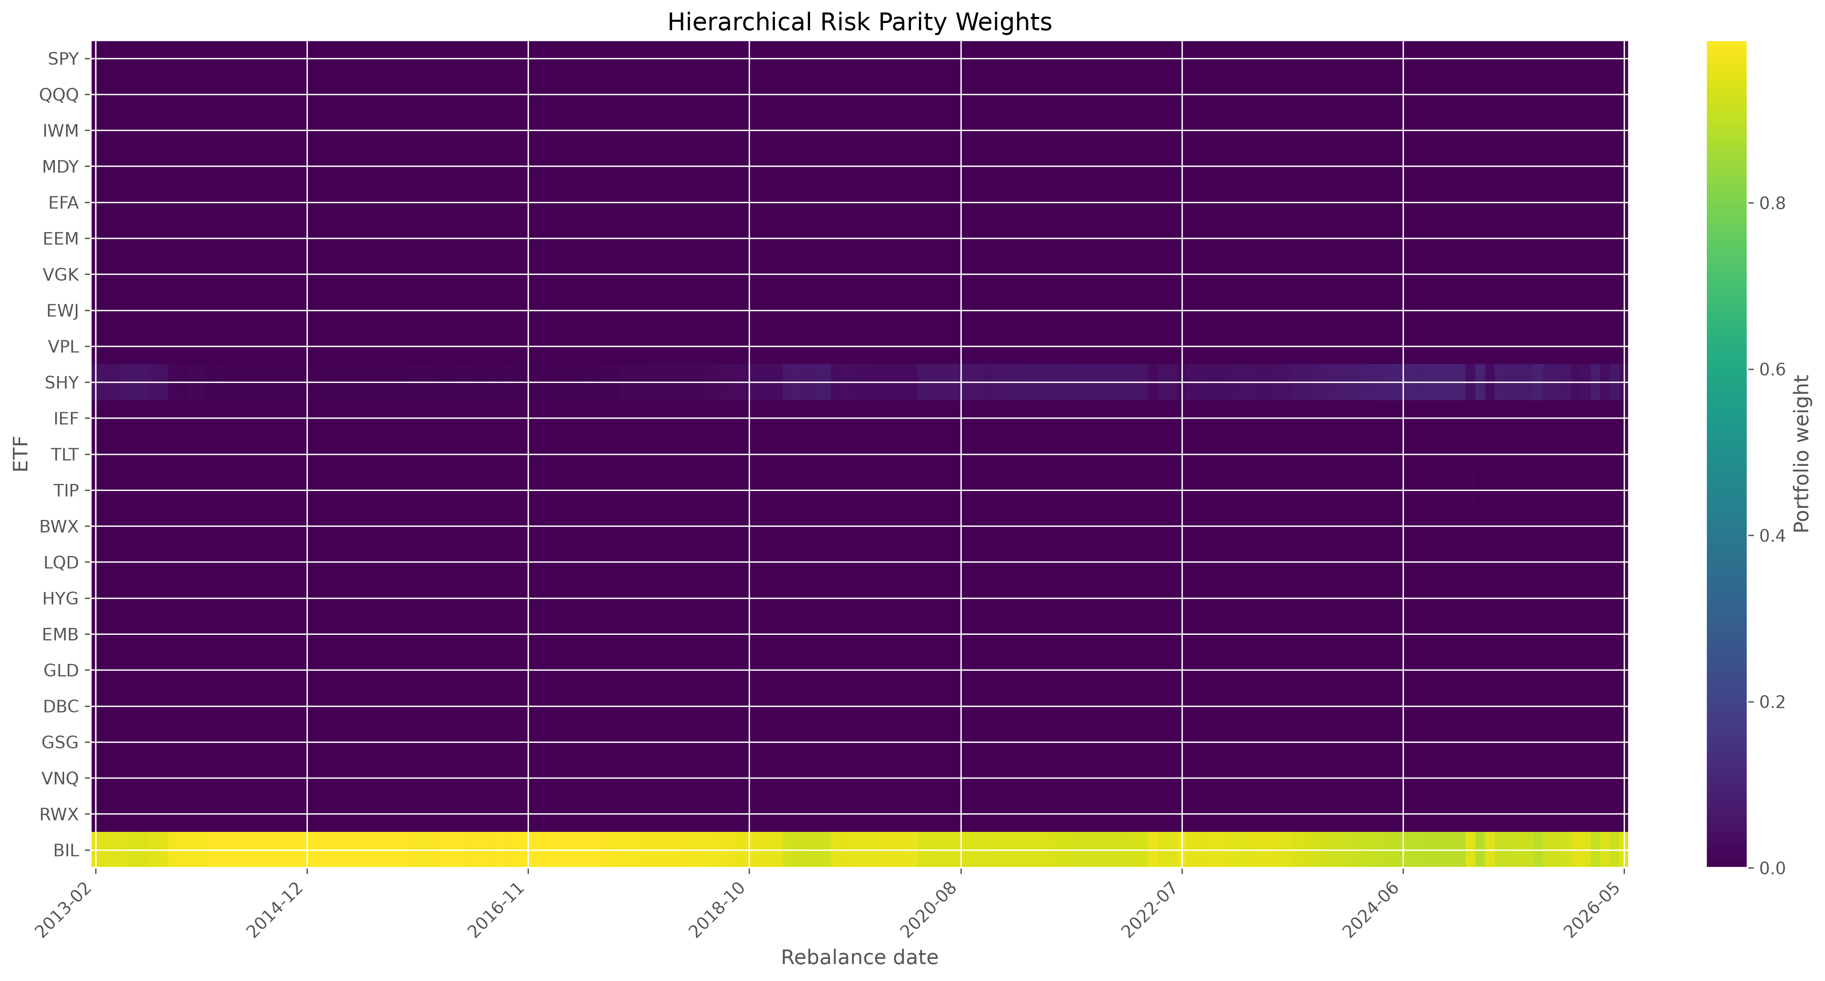
WHY THE EXTENSION CONCENTRATED
METHOD-UNIVERSE INTERACTION
Unconstrained HRP collapsed toward the cash-like BIL ETF
CAUSAL CHAIN
BIL has extremely low realized volatility
Recursive variance allocation strongly favors it
HRP has no Markowitz-style 25% cap
Average BIL weight reaches 95.60%
Effective assets fall to about 1.09
Empirical finding - not a coding failure.
Saved HRP weights
Financial Markets Analytics | Variant B - Dynamic Asset Allocation
38
Notes:
Main explanation:
BIL is a short Treasury-bill ETF with extremely low realized volatility. The unconstrained recursive variance allocation strongly favored that low-variance branch, and HRP did not inherit the Markowitz 25 percent cap. The saved weights averaged 95.60 percent in BIL, and effective assets fell to about 1.09. The heatmap confirms persistent concentration. This is not a coding failure; it is an empirical method-universe interaction created by applying unconstrained HRP to a cash-inclusive opportunity set.
Transition:
Next, I turn to: HRP minimized drawdown but failed as a return-seeking allocation.
Likely question:
Would HRP behave differently without BIL?
Answer:
Very likely, but that is an untested robustness extension and cannot be claimed from the frozen results.

Slide 39
HOW TO INTERPRET THE EXTENSION
DEFENSIVE COLLAPSE
HRP minimized drawdown but failed as a return-seeking allocation
1.62%
0.58%
-0.670
POSITIVE
Annualized return
Volatility
Sharpe
Very low volatility
Tiny drawdown
-0.35%
7.49%
1.09
Low turnover
Max drawdown
Annualized turnover
Effective assets
NEGATIVE
Return below 2% reference
Extreme concentration
Little economic diversification
High Calmar is mechanical: the drawdown denominator is extremely small.
Financial Markets Analytics | Variant B - Dynamic Asset Allocation
39
Notes:
Main explanation:
HRP earned 1.62 percent annually with only 0.58 percent volatility, a negative Sharpe of minus 0.670, maximum drawdown near minus 0.35 percent, turnover of 7.49 percent, and 1.09 effective assets. Its tiny volatility, drawdown, and turnover are positive if the objective is near-cash capital preservation. But return fell below the constant 2 percent reference, and economic diversification was extremely weak. The high Calmar ratio is mechanical because its drawdown denominator is exceptionally small.
Transition:
Next, I turn to: Performance metrics reveal different objectives, not one universal winner.
Likely question:
Did HRP win because it had the smallest drawdown?
Answer:
Only under a narrow capital-preservation objective. It performed worst on Sharpe and collapsed into a cash-dominated portfolio.

Slide 40
FINAL COMPARISON - PERFORMANCE
COMMON 159 MONTHS
Performance metrics reveal different objectives, not one universal winner
Strategy
Return
Volatility
Sharpe
Max drawdown
Equal Weight
6.09%
9.11%
0.476
-19.07%
60/40
7.01%
9.76%
0.540
-23.32%
Min Variance Ledoit-Wolf
2.31%
2.88%
0.114
-9.11%
Max Sharpe Ledoit-Wolf
9.86%
8.45%
0.922
-22.02%
Target Volatility Ledoit-Wolf
11.38%
11.63%
0.818
-22.27%
Michaud 500
9.23%
7.98%
0.900
-20.51%
HRP
1.62%
0.58%
-0.670
-0.35%
Target Volatility leads return; Maximum Sharpe leads risk-adjusted performance.
Financial Markets Analytics | Variant B - Dynamic Asset Allocation
40
Notes:
Main explanation:
This focused table compares seven representative strategies on the common period. Target Volatility Ledoit-Wolf leads return but also carries the highest volatility among the selected strategies. Maximum Sharpe Ledoit-Wolf leads realized Sharpe. Minimum Variance and HRP are defensive, but their returns are low. Equal Weight and 60/40 remain credible simple references. The table intentionally separates performance from implementation so that turnover and concentration do not disappear behind a single headline ranking.
Transition:
Next, I turn to: Implementation metrics change how the performance ranking is judged.
Likely question:
Why show only seven strategies here?
Answer:
They represent the main benchmark, Markowitz, Michaud, and HRP conclusions without crowding the classroom slide; the complete table remains in the report and CSV.

Slide 41
FINAL COMPARISON - TURNOVER AND CONCENTRATION
CAPITAL-WEIGHT DIAGNOSTICS
Implementation metrics change how the performance ranking is judged
Strategy
Turnover
Effective assets
HHI
Interpretation
Equal Weight
13.23%
23.00
4.35%
Broadest by construction
60/40
12.45%
13.89
7.20%
Simple sleeve allocation
Min Variance Ledoit-Wolf
23.46%
5.35
18.76%
Low-risk defensive mix
Max Sharpe Ledoit-Wolf
88.06%
4.77
21.26%
Higher turnover and concentration
Target Volatility Ledoit-Wolf
98.66%
4.52
22.19%
Highest selected turnover
Michaud 500
78.00%
6.25
16.29%
Broadest optimized allocation
HRP
7.49%
1.09
91.72%
Low turnover because cash dominated
Michaud 500 improves optimized breadth; HRP's low turnover is economically misleading.
Financial Markets Analytics | Variant B - Dynamic Asset Allocation
41
Notes:
Main explanation:
Equal Weight has 23 effective assets by construction, while 60/40 has 13.89. Among optimized strategies, Michaud 500 is the broadest at 6.25 effective assets. Maximum Sharpe Ledoit-Wolf has higher turnover and more concentration than Michaud. HRP has the lowest turnover, but that advantage comes from maintaining an economically undesirable near-cash concentration. Effective assets measure capital-weight concentration, not full economic risk diversification, so the statistic must be interpreted with portfolio context.
Transition:
Next, I turn to: Terminal wealth reflects both skill and the amount of risk accepted.
Likely question:
Is Equal Weight automatically the best diversified portfolio?
Answer:
It has the broadest capital weights, but correlated ETFs can still create concentrated economic risk.

Slide 42
SELECTED STRATEGY EQUITY CURVES
FROZEN RETURN SERIES
Terminal wealth reflects both skill and the amount of risk accepted
READ THE PATH
Target Volatility finishes highest by taking more risk
Max Sharpe and Michaud deliver strong middle paths
Benchmarks remain credible but finish below leaders
HRP behaves like cash after concentrating in BIL
2013
2026
Selected-strategy view; complete 12-strategy chart remains in the report.
Financial Markets Analytics | Variant B - Dynamic Asset Allocation
42
Notes:
Main explanation:
The selected-strategy wealth chart is built only from frozen saved monthly return series over the common 159 months. Target Volatility finishes highest because it accepts more risk. Maximum Sharpe Ledoit-Wolf and Michaud 500 compound strongly with lower volatility than Target Volatility. Equal Weight and 60/40 remain respectable but finish below the leaders. HRP behaves like cash after concentrating in BIL. The chart should therefore be read together with volatility, drawdown, turnover, and concentration rather than as a standalone winner ranking.
Transition:
Next, I turn to: Drawdowns expose the path risk hidden by terminal wealth.
Likely question:
Were any returns recalculated for this slide?
Answer:
No strategy was rerun. The presentation compounds the frozen saved monthly return series only to create a readable selected-strategy view.

Slide 43
SELECTED STRATEGY DRAWDOWNS
LOSS FROM PRIOR PEAK
Drawdowns expose the path risk hidden by terminal wealth
INTERPRETATION
High wealth still includes material stress
Minimum Variance and HRP take less risk
2022 challenged equity-bond diversification
Small drawdown alone does not imply high return
2013
2026
Drawdown is path dependent; volatility is not.
Financial Markets Analytics | Variant B - Dynamic Asset Allocation
43
Notes:
Main explanation:
Drawdown measures the percentage loss from the previous wealth peak. The selected-strategy chart shows that high terminal wealth does not arrive without periods of loss. Maximum Sharpe, Target Volatility, Michaud, and the benchmarks all experience material stress. Minimum Variance and HRP have smaller drawdowns because they take much less risk, but they also compound less. The 2022 multi-asset decline is especially informative because both equities and bonds weakened, challenging conventional diversification.
Transition:
Next, I turn to: Maximum Sharpe offered the best realized return-risk balance.
Likely question:
Why is drawdown different from volatility?
Answer:
Volatility measures overall return dispersion; drawdown measures cumulative loss from a prior peak and is path dependent.

Slide 44
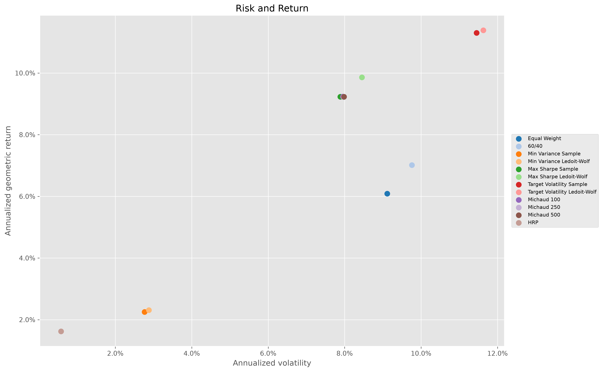
RISK-RETURN TRADE-OFF
RETURN VS VOLATILITY
Maximum Sharpe offered the best realized return-risk balance
HOW TO READ
Upper-left is generally preferred
Target Volatility: more return and more risk
Maximum Sharpe LW: best realized Sharpe
Min Variance and HRP sit near the low-risk corner
Risk preference still determines the relevant choice.
Frozen final risk-return output
Financial Markets Analytics | Variant B - Dynamic Asset Allocation
44
Notes:
Main explanation:
In the risk-return scatter, the preferred direction is generally upward and left: more return with less volatility. Target Volatility lies higher but farther right, reflecting more return and more risk. Maximum Sharpe Ledoit-Wolf combines strong return with lower volatility and therefore leads realized Sharpe. Minimum Variance lies near the low-risk, low-return corner, while HRP sits close to cash. The figure illustrates that every objective occupies a different part of the risk-return plane.
Transition:
Next, I turn to: Higher Sharpe generally required more trading.
Likely question:
Does the upper-left rule always identify the best portfolio?
Answer:
It is a useful visual heuristic, but investor preferences, drawdown, turnover, and concentration also matter.

Slide 45
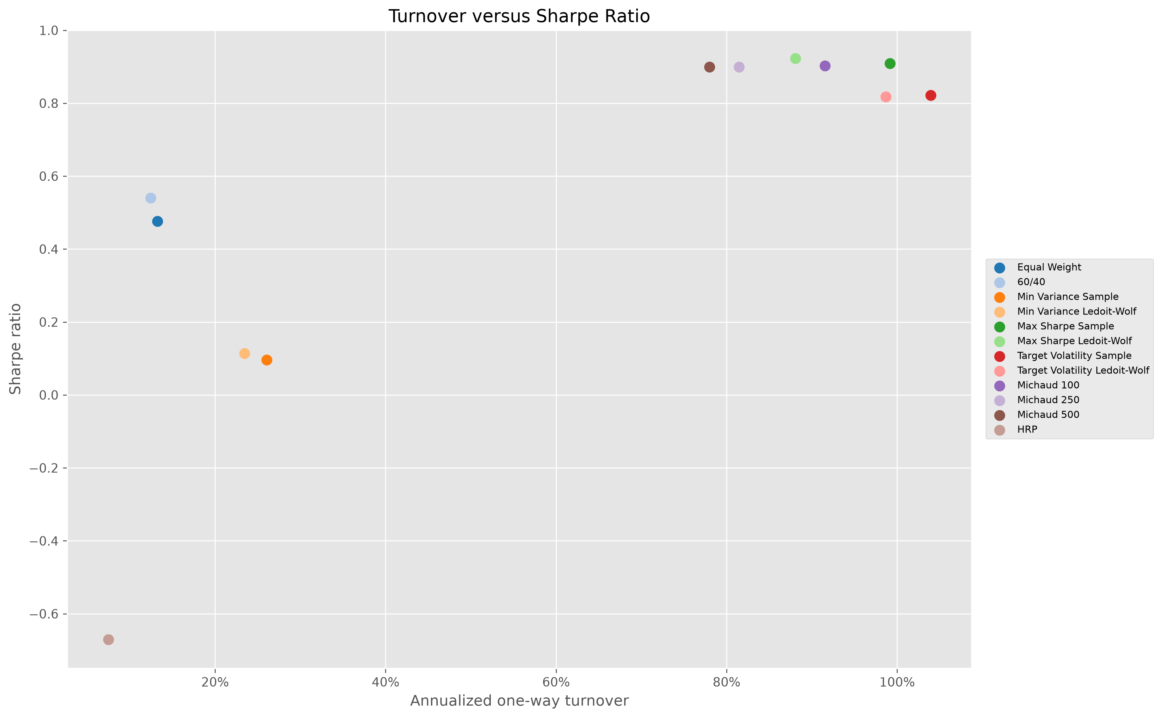
TURNOVER-SHARPE TRADE-OFF
IMPLEMENTATION FRONTIER
Higher Sharpe generally required more trading
TRADE-OFF
Maximum Sharpe led Sharpe but traded heavily
Michaud kept near-leading Sharpe with less turnover
Benchmarks were easier to implement
HRP was stable only because cash dominated
Returns are already net of the common 5-bps cost rule.
Frozen final turnover-Sharpe output
Financial Markets Analytics | Variant B - Dynamic Asset Allocation
45
Notes:
Main explanation:
The turnover-Sharpe plot shows an implementation frontier. Maximum Sharpe Ledoit-Wolf achieved the highest Sharpe but traded heavily. Michaud 500 retained a near-leading Sharpe with lower turnover, which supports the robustness interpretation. Equal Weight and 60/40 were easier to implement. HRP had the lowest turnover for the wrong economic reason: its BIL-dominated weights changed little. Turnover is not automatically bad, but it creates cost, operational, and estimation-risk exposure.
Transition:
Next, I turn to: Michaud broadened optimized portfolios without losing much Sharpe.
Likely question:
Are the reported returns already net of transaction costs?
Answer:
Yes. The frozen strategy returns use the common 5-bps drift-aware cost convention.

Slide 46
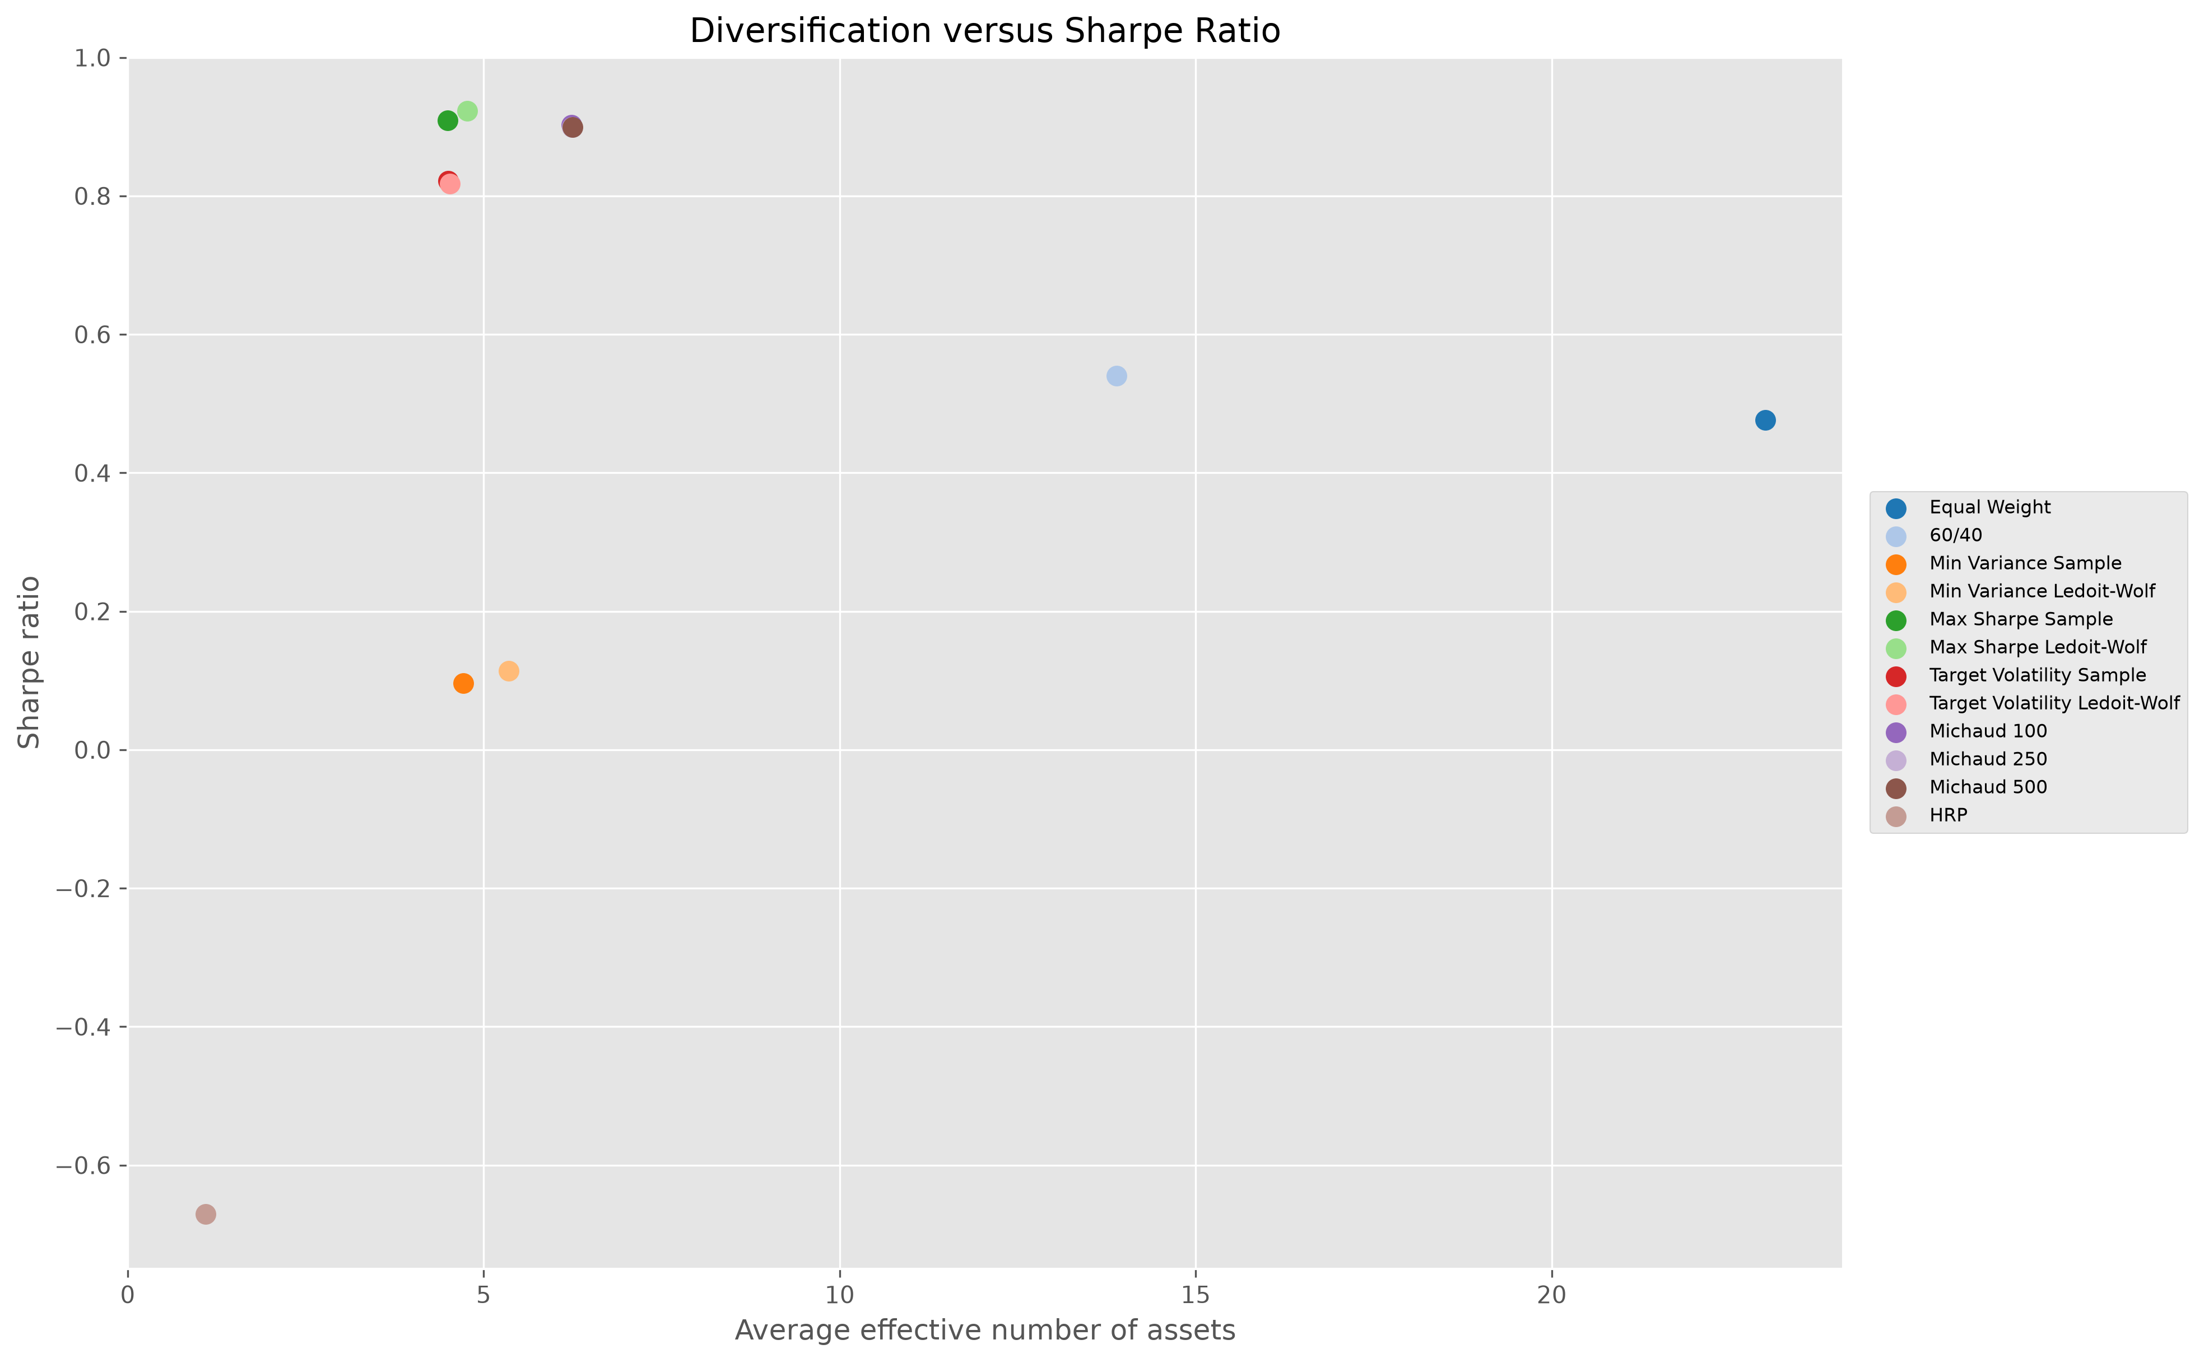
DIVERSIFICATION-SHARPE TRADE-OFF
EFFECTIVE ASSETS
Michaud broadened optimized portfolios without losing much Sharpe
KEY POINTS
Equal Weight: 23 by construction
Michaud 500: broadest optimized mix
Classical optimized portfolios stay concentrated
HRP is least diversified despite its label
Position count is not effective diversification.
Frozen final diversification-Sharpe output
Financial Markets Analytics | Variant B - Dynamic Asset Allocation
46
Notes:
Main explanation:
The diversification-Sharpe plot separates mechanical breadth from optimized robustness. Equal Weight has 23 effective assets by construction. Classical optimized portfolios are far more concentrated. Michaud increases effective assets to about 6.25 while retaining Sharpe near 0.90, making it the broadest optimized specification. HRP is least diversified despite its risk-parity label because the unconstrained allocation concentrated in BIL. The number of nonzero positions is not enough; effective diversification depends on how evenly capital is distributed.
Transition:
Next, I turn to: The winning strategy depends on the investor's objective.
Likely question:
Why use effective assets rather than position count?
Answer:
A portfolio can hold many tiny positions and still be dominated by one asset; the inverse Herfindahl measure captures that concentration.

Slide 47
WHICH STRATEGY WON?
MULTI-DIMENSIONAL ANSWER
The winning strategy depends on the investor's objective
BEST SHARPE
HIGHEST WEALTH
BEST ROBUSTNESS COMPROMISE
Max Sharpe Ledoit-Wolf
Target Volatility Ledoit-Wolf
Michaud 500
0.922
4.17
6.25 effective assets
LOWEST OPTIMIZED RISK
LOWEST TURNOVER
SIMPLEST IMPLEMENTATION
Min Variance Ledoit-Wolf
HRP
Equal Weight / 60/40
2.88% volatility
7.49% - cash dominated
No estimated inputs
No single strategy dominates return, risk, turnover, concentration, and simplicity.
Financial Markets Analytics | Variant B - Dynamic Asset Allocation
47
Notes:
Main explanation:
Maximum Sharpe Ledoit-Wolf wins on realized Sharpe. Target Volatility Ledoit-Wolf wins on return, terminal wealth, and the strongest meaningful Calmar ratio. Michaud 500 offers the best optimized diversification-turnover compromise. Minimum Variance delivers the lowest meaningful optimized risk. HRP has the lowest turnover and drawdown, but only because it collapsed into BIL. Equal Weight and 60/40 remain the simplest implementations. The project therefore rejects a one-dimensional definition of success.
Transition:
Next, I turn to: Michaud improved robustness rather than every performance metric.
Likely question:
Which strategy would you recommend?
Answer:
For risk-adjusted performance, Maximum Sharpe Ledoit-Wolf; for a more robust implementation compromise, Michaud 500.

Slide 48
MAIN LESSON - MARKOWITZ VS MICHAUD
AGGRESSION VS MODERATION
Michaud improved robustness rather than every performance metric
MAXIMUM SHARPE LEDOIT-WOLF
MICHAUD 500
Uses one estimated market input
Averages decisions across plausible inputs
Exploits return signals aggressively
Improves allocation breadth
Achieved the best Sharpe: 0.922
Reduces annualized turnover to 78.00%
More concentrated and high-turnover
Sacrifices only 0.022 Sharpe
Resampling moderated the implementation profile; it did not create a universal winner.
Financial Markets Analytics | Variant B - Dynamic Asset Allocation
48
Notes:
Main explanation:
Classical Maximum Sharpe uses one estimated market input and can exploit signals aggressively. In this sample it achieved the best Sharpe, but it remained concentrated and high-turnover. Michaud averages decisions across plausible inputs, broadens allocations, and lowers turnover. It sacrifices only about 0.022 Sharpe relative to Maximum Sharpe Ledoit-Wolf. The lesson is not that resampling dominates optimization; it changes the implementation profile in a favorable way while preserving most of the performance.
Transition:
Next, I turn to: Input estimation mattered almost as much as objective choice.
Likely question:
Did Michaud solve the optimization enigma?
Answer:
It moderated concentration and turnover, but it did not remove estimation risk or produce the highest Sharpe.

Slide 49
WHAT LEDOIT-WOLF TAUGHT US
RISK MODEL MATTERS
Input estimation mattered almost as much as objective choice
NOISY COVARIANCE
SHRINKAGE
BETTER CONDITIONING
REALIZED EFFECT
Unstable correlations and variances
Lower estimation variance
More stable risk model
Lower turnover + broader weights
0.909 -> 0.922
99.14% -> 88.06%
4.50 -> 4.77
Maximum Sharpe
Maximum Sharpe
Maximum Sharpe
Realized Sharpe
Annualized turnover
Effective assets
Ledoit-Wolf stabilizes covariance - not noisy expected returns.
Financial Markets Analytics | Variant B - Dynamic Asset Allocation
49
Notes:
Main explanation:
Ledoit-Wolf shows that an optimizer is only as reliable as the risk model supplied to it. Shrinkage improved covariance conditioning, reduced Maximum Sharpe turnover, and modestly broadened weights while increasing realized Sharpe. These changes occurred without changing the portfolio objective. The result demonstrates that robust estimation can be as important as selecting Minimum Variance, Maximum Sharpe, or Target Volatility. It also cautions against interpreting an optimizer's output as a property of the objective alone.
Transition:
Next, I turn to: HRP shows that avoiding inversion does not eliminate model risk.
Likely question:
Can shrinkage fix noisy expected returns?
Answer:
No. Ledoit-Wolf stabilizes covariance; expected-return estimation remains noisy and especially important for Maximum Sharpe and Target Volatility.

Slide 50
HRP LESSON
NEGATIVE FINDING = EVIDENCE
HRP shows that avoiding inversion does not eliminate model risk
01
02
03
04
Robustness is specific
Universe design matters
Constraints still matter
Labels can mislead
Avoiding covariance inversion solves only one problem
A cash-like ETF can dominate variance allocation
No 25% cap allowed extreme concentration
Risk parity did not imply diversified capital
The BIL concentration is an empirical method-universe interaction - not a coding error.
Future test: constrained HRP, HRP without cash, and asset-class floors.
Financial Markets Analytics | Variant B - Dynamic Asset Allocation
50
Notes:
Main explanation:
HRP successfully avoids direct covariance inversion, but that addresses only one source of instability. The final portfolio still depends on the universe, correlation distance, hierarchy, recursive allocation, and constraints. Including BIL caused a near-cash allocation with little economic diversification. This negative result is valuable because it demonstrates that a method labeled robust can still need economic guardrails. Robustness must be evaluated empirically, not assumed from the algorithm's name.
Transition:
Next, I turn to: Simple benchmarks remain difficult to dismiss.
Likely question:
Was HRP implemented incorrectly because it concentrated?
Answer:
No. The saved weights pass validation; the concentration follows from unconstrained recursive variance allocation with a near-zero-volatility asset.

Slide 51
WHY NAIVE PORTFOLIOS STILL MATTER
LOW MODEL DEPENDENCE
Simple benchmarks remain difficult to dismiss
Transparent
Low complexity
Lower turnover
No estimation error
Reproducible
Rules are immediately understandable
No means, covariance, or solver
Smaller implementation burden
No noisy input forecasts
Easy to rebuild and audit
Optimized leaders improved selected metrics
but required more trading and stronger modeling assumptions
Benchmarks are economic alternatives - not ceremonial rows in a table.
Added complexity must earn its place after costs.
Financial Markets Analytics | Variant B - Dynamic Asset Allocation
51
Notes:
Main explanation:
Equal Weight and 60/40 require no expected-return forecasts, no covariance estimator, no nonlinear optimization, and no resampling design. They are transparent, low-turnover, and easy to communicate. In the common sample, optimized leaders beat them on selected metrics, especially Sharpe and terminal wealth, but at the cost of more trading and stronger modeling assumptions. Benchmarks therefore remain economically credible even when they do not top the final table.
Transition:
Next, I turn to: Data and sample choices limit how broadly the evidence can be generalized.
Likely question:
Why not declare optimization superior because its Sharpe is higher?
Answer:
The gain must be weighed against turnover, concentration, estimation uncertainty, and the fact that only one historical path was observed.

Slide 52
LIMITATIONS - DATA AND SAMPLE
SCOPE OF CLAIMS
Data and sample choices limit how broadly the evidence can be generalized
Fixed ETF universe
Yahoo Finance
One realized path
Possible selection and survivorship bias
Not an institutional total-return source
No repeated independent market histories
Late inception
Extended 27 panel
Four ETFs shorten full-universe history
Not a complete optimized robustness backtest
The ranking is comparative evidence for this design and period - not universal proof.
Financial Markets Analytics | Variant B - Dynamic Asset Allocation
52
Notes:
Main explanation:
The ETF universe is fixed ex post and may contain selection or survivorship bias. Yahoo Finance is reproducible but not institutional-quality total-return data. The backtest observes one realized historical path. Four late-inception ETFs shorten the full-universe history, and the extended 27-ETF panel was not used for a complete optimized robustness backtest. These limitations mean the final ranking is evidence for this design and period, not proof of universal superiority.
Transition:
Next, I turn to: Model assumptions remain simplified and testable.
Likely question:
Does the 23-ETF core universe eliminate survivorship bias?
Answer:
No. It solves the common-history problem, but an ex-post ETF list can still embed selection and survivorship effects.

Slide 53
LIMITATIONS - ESTIMATION AND IMPLEMENTATION
TRANSPARENT ASSUMPTIONS
Model assumptions remain simplified and testable
ESTIMATION
IMPLEMENTATION
Expected returns remain noisy
Constant 5-bps transaction costs
Fixed 60-month estimation window
No taxes or market impact
Constant 2% risk-free reference
No time-varying liquidity model
Michaud normal-sampling assumptions
No formal significance testing
Transparency makes the experiment reproducible; sensitivity analysis tests how dependent the results are.
Financial Markets Analytics | Variant B - Dynamic Asset Allocation
53
Notes:
Main explanation:
Expected returns remain noisy even with five years of data. The window is fixed at 60 months, the risk-free reference is constant at 2 percent, and transaction costs are constant at 5 basis points. Michaud relies on normal sampling assumptions. Taxes, time-varying spreads, market impact, liquidity constraints, and formal statistical significance tests are absent. These choices keep the experiment transparent and reproducible, but they also define the boundary of the claims.
Transition:
Next, I turn to: Future robustness checks should challenge the design, not search for winners.
Likely question:
Which limitation is most important?
Answer:
Mean estimation and the single historical path are especially important because small performance differences may not be statistically or economically persistent.

Slide 54
WHAT WE WOULD TEST NEXT
PRE-SPECIFY SENSITIVITY
Future robustness checks should challenge the design, not search for winners
WINDOWS
REBALANCING
HRP
ASSET CLASSES
36 / 60 / 120 months
Monthly vs quarterly
Cap weights or remove BIL
Floors and maximum sleeves
BLACK-LITTERMAN
REGIMES
COSTS
EXTENDED UNIVERSE
Only with defensible views
Time-varying covariance
Asset- and regime-specific
Full 27-ETF optimization
Principle: define robustness tests before seeing which specification performs best.
Financial Markets Analytics | Variant B - Dynamic Asset Allocation
54
Notes:
Main explanation:
The next tests should vary the assumptions most likely to change conclusions: 36-, 60-, and 120-month windows; quarterly rebalancing; constrained HRP; HRP without BIL; asset-class floors and caps; Black-Litterman with defensible views; regime-dependent covariance; time-varying costs; and full extended-universe optimization. These specifications should be pre-defined. Robustness analysis should reveal sensitivity, not search ex post for whichever combination produces the best Sharpe.
Transition:
Next, I turn to: Robust portfolio design is more than choosing an optimizer.
Likely question:
What would you test first?
Answer:
Constrained HRP or HRP without BIL, because the current extension clearly exposes a method-universe interaction that can be tested directly.

Slide 55
FINAL CONCLUSION
FIVE CONCLUSIONS
Robust portfolio design is more than choosing an optimizer
01
Identical out-of-sample months
Same assets, dates, costs, and next-month timing
02
Best realized Sharpe
Maximum Sharpe Ledoit-Wolf: 0.922
03
Highest terminal wealth
Target Volatility Ledoit-Wolf: more risk
04
Best robustness compromise
Michaud 500: broader weights and lower turnover
05
Most important negative result
HRP still depended on constraints and universe design
Sophistication added value only when paired with estimation discipline and implementation controls.
Financial Markets Analytics | Variant B - Dynamic Asset Allocation
55
Notes:
Main explanation:
Five conclusions resolve the research question. All strategies share identical out-of-sample months. Maximum Sharpe Ledoit-Wolf achieved the best realized Sharpe. Target Volatility Ledoit-Wolf produced the highest wealth by accepting more risk. Michaud improved diversification and turnover with only a small Sharpe sacrifice. HRP demonstrated that robust methods still depend on constraints and universe design. The broader lesson is that estimation, timing, costs, and interpretation determine whether sophistication adds practical value.
Transition:
Next, I turn to: Questions.
Likely question:
Did sophistication beat simple allocation rules?
Answer:
On selected risk-adjusted and wealth metrics, yes; but the gains were not universal and came with greater implementation and modeling demands.

Slide 56
ORAL-DEFENSE MAP
DEFENSE GUIDE
Questions
DATA
DESIGN
METHODS
RESULTS
Why ETFs?
Why 23?
Why preserve 2008?
Why monthly?
Why 60 months?
Why 5 bps?
Why Markowitz?
Why Michaud?
Why Ledoit-Wolf?
Why HRP?
Why did Max Sharpe win?
Why did HRP fail?
Which strategy is practical?
Anchor answer: same universe + same months + same timing + same costs.
Thank you.
Financial Markets Analytics | Variant B - Dynamic Asset Allocation
56
Notes:
Main explanation:
This final slide is a defense map. Questions about data can be answered through the ETF, core-universe, and 2008 sample-policy decisions. Design questions connect to monthly frequency, the 60-month window, next-month implementation, and 5-bps costs. Method questions connect to Markowitz objectives, Ledoit-Wolf, Michaud, and HRP. Result questions should always return to the multi-dimensional comparison: best Sharpe, highest wealth, robustness compromise, and the HRP concentration finding.
Transition:
I will keep this defense map visible and take questions.
Likely question:
Which answer should anchor the defense?
Answer:
The experiment is credible because every final strategy shares the same assets, dates, information timing, and costs; the remaining differences come from the allocation rules.

